Slide 1
SQL QUERIES

Slide 2
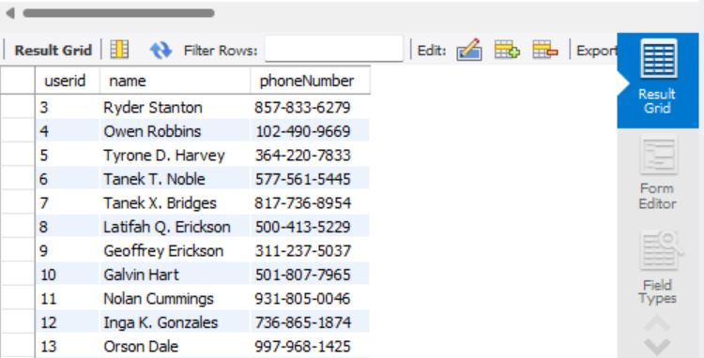
SELECT * FROM users;
This query will return the name of all users in the Users table

Slide 3
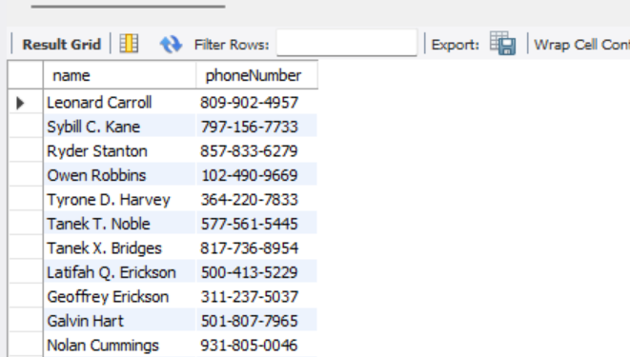
SELECT name, phoneNumber FROM Users;
This query will return the name and phone number of all users in the Users table.

Slide 4
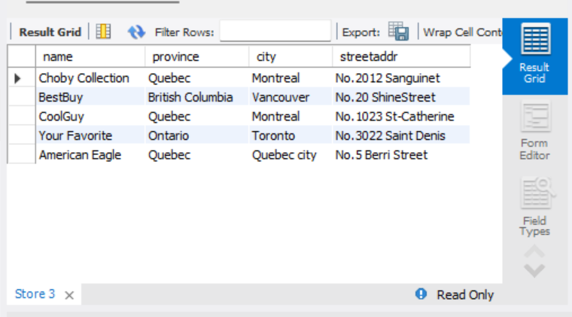
SELECT name, province, city, streetaddr FROM Store;
This query will return the name, province, city, and street address of all stores in the Store table.

Slide 5
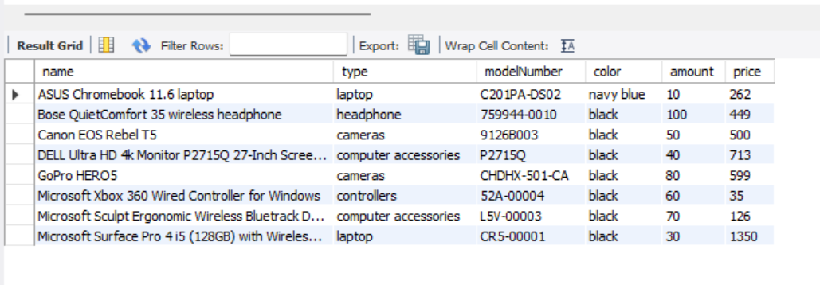
SELECT name, type, modelNumber, color, amount, price FROM Product;
This query will return the name, type, model number, color, amount, and price of all products in the Product table.

Slide 6
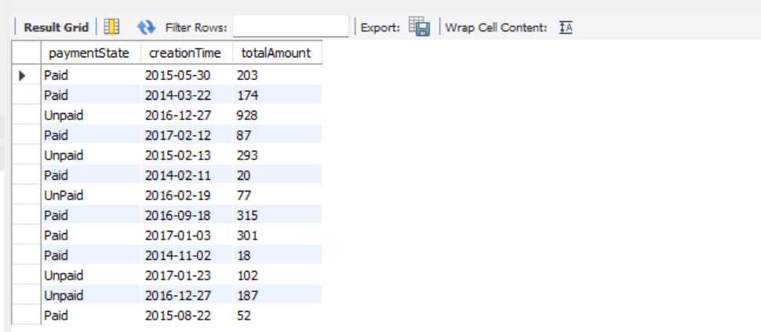
SELECT paymentState, creationTime, totalAmount FROM Orders;
This query will return the payment state, creation time, and total amount of all orders in the Orders table.

Slide 7
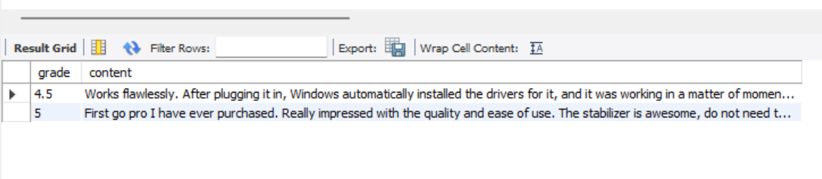
SELECT grade, content FROM Comments WHERE userid = 24;
This query will return the grade and content of all comments made by a specific user with the specified userid in the Comments table.

Slide 8
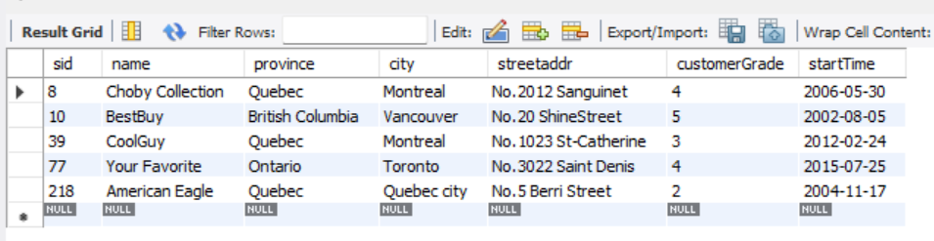
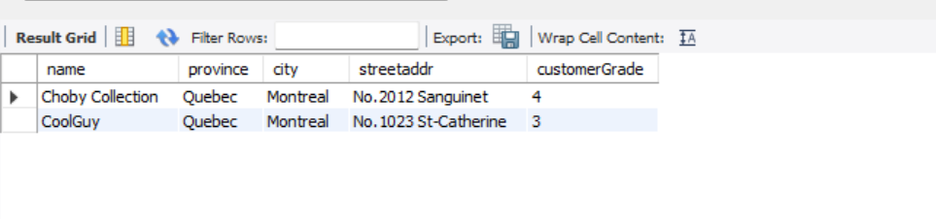
SELECT name, province, city, streetaddr, customerGrade FROM Store WHERE city = 'Montreal';
This query will return the name, province, city, street address, and customer grade of all stores located in a specific city

Slide 9
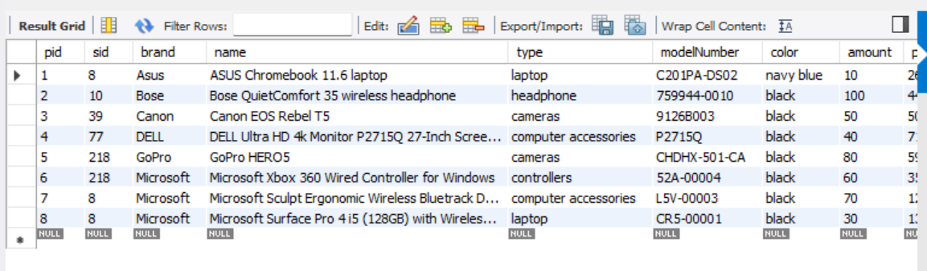
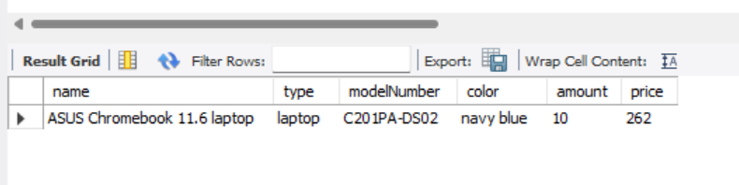
SELECT * FROM Product; SELECT name, type, modelNumber, color, amount, price FROM Product WHERE brand = 'Asus';
This query will return the name, type, model number, color, amount, and price of all products made by a specific brand.

Slide 10
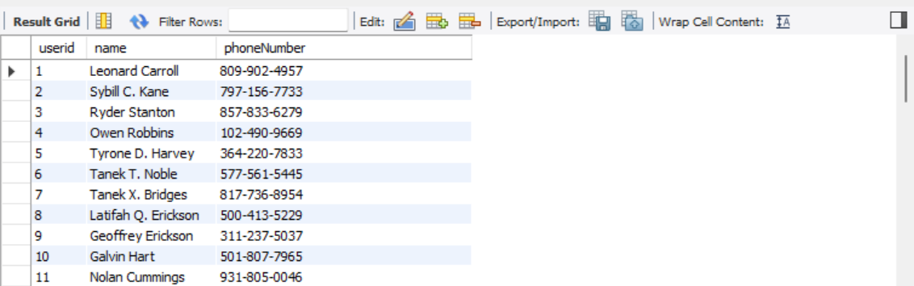
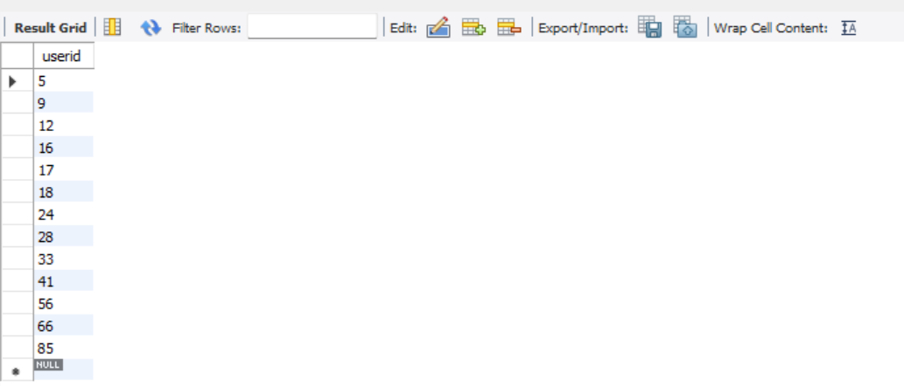
SELECT * FROM Users; SELECT * FROM Buyer;

Slide 11
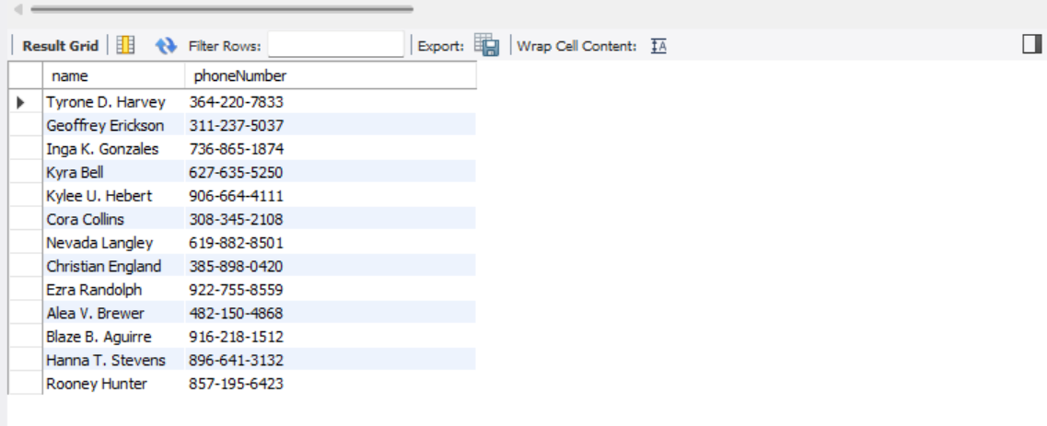
SELECT name, phoneNumber FROM Users JOIN Buyer ON Users.userid = Buyer.userid;
This query will return the name and phone number of all users that are also buyers in the Buyer table.

Slide 12
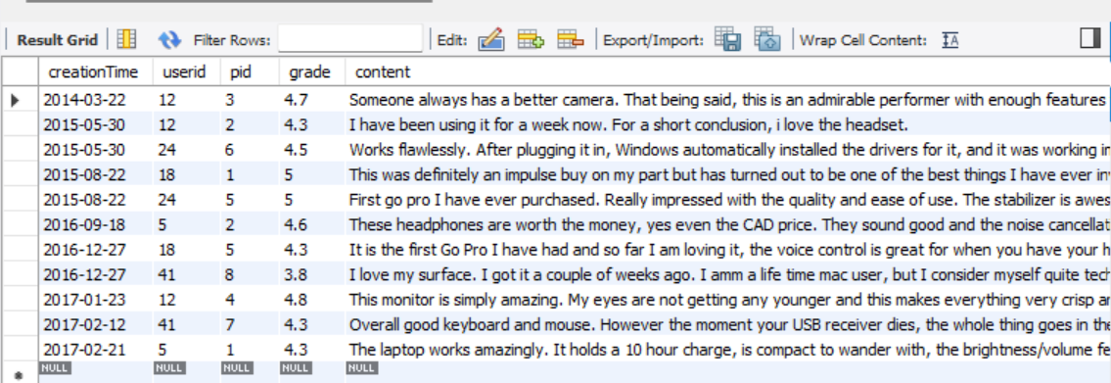
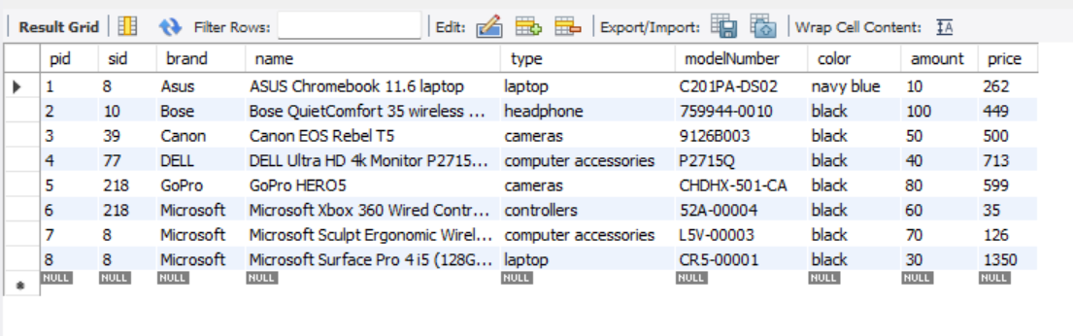
SELECT * FROM Comments;
SELECT * FROM Product;

Slide 13
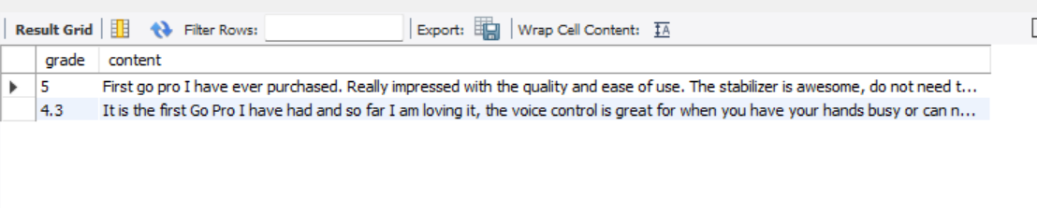
SELECT grade, content FROM Comments JOIN Product ON Comments.pid = Product.pid WHERE Product.name = "GoPro HERO5";
This query will return the grade and content of all comments for a specific product by name.

Slide 14
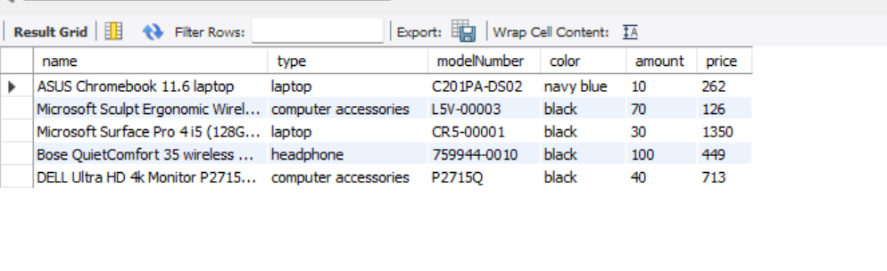
SELECT Product.name, Product.type, Product.modelNumber, Product.color, Product.amount, Product.price FROM Product JOIN Store ON Product.sid = Store.sid WHERE Store.customerGrade > "3";
This query will return the name, type, model number, color, amount, and price of all products sold by stores with a customer grade greater than a specified value.

Slide 15
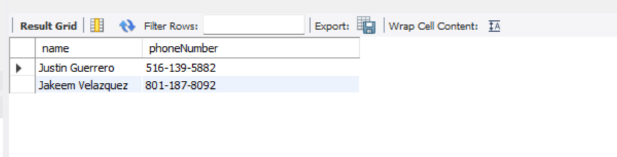
SELECT name, phoneNumber FROM Users WHERE name LIKE 'J%';
This query will return the name and phone number of all users whose name starts with the letter "J". The '%' is used as a wildcard character to match any string of characters.

Slide 16
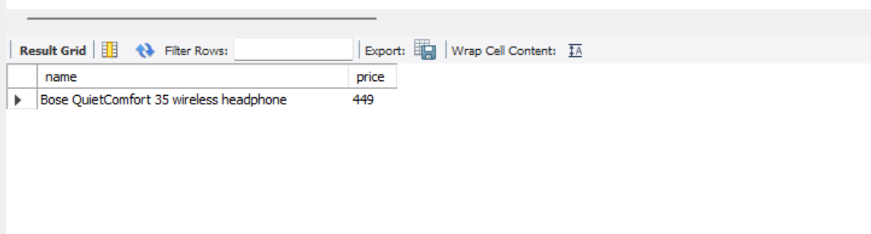
SELECT name, price FROM Product WHERE type LIKE '%Phone';
This query will return the name and price of all products whose type ends with the word "Phone".

Slide 17
SELECT * FROM Store WHERE city LIKE '%city%';
This query will return the name of all stores located in a city that starts with “city"

Slide 18
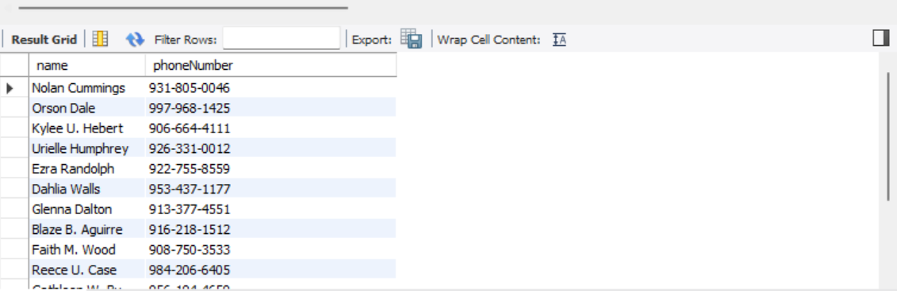
SELECT name, phoneNumber FROM Users WHERE phoneNumber LIKE '9%';
This query will return the name and telephone number of all users whose phone number starts with 9…..

Slide 19
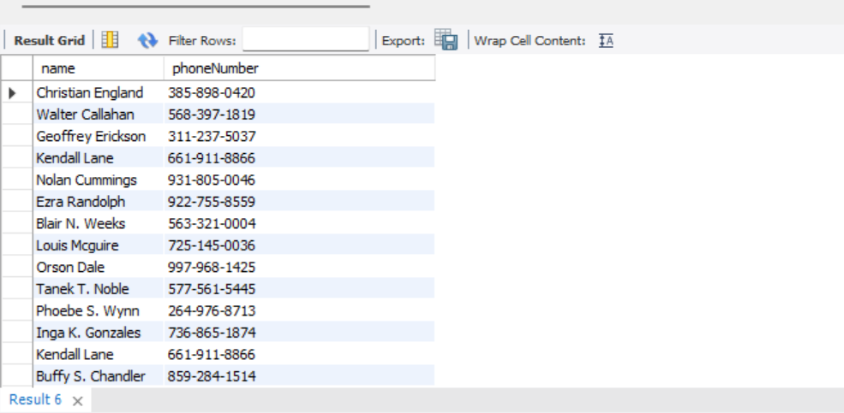
SELECT users.name, users.phoneNumber FROM users JOIN Address ON Users.userid = Address.userid WHERE Address.province = 'Ontario';
This query will return the name and phone number of all users who have an address located in the province of Ontario.

Slide 20
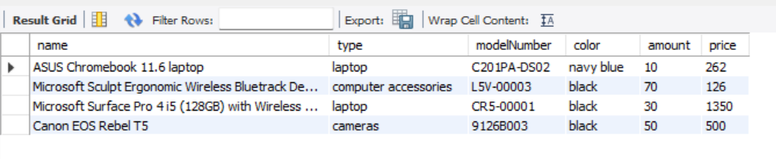
SELECT Product.name, Product.type, Product.modelNumber, Product.color,Product.amount, Product.price FROM Product JOIN Store ON Product.sid = Store.sid WHERE Store.city = 'Montreal' AND Product.price > 100;
This query will return the name, type, model number, color, amount, and price of all products sold by stores located in Montreal, with a price greater than 100.

Slide 21
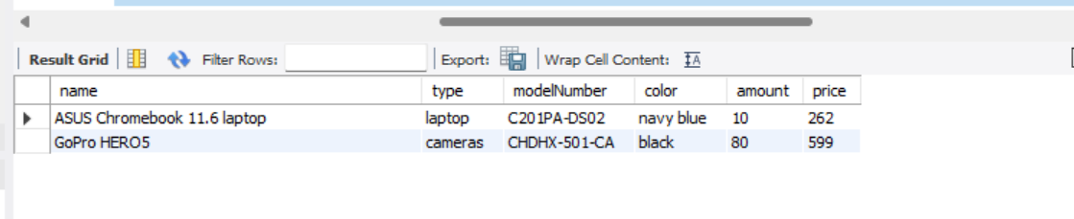
SELECT * from Brand; SELECT Product.name,Product.type,Product.modelNumber,Product.color,Product.amount,Product.price FROM Product JOIN Brand ON Product.brand = Brand.brandName WHERE Brand.brandName = 'Asus' OR Brand.brandName = 'GoPro';
This query will return the name, type, model number, color, amount, and price of all products made by either Asus or GoPro.

Slide 22
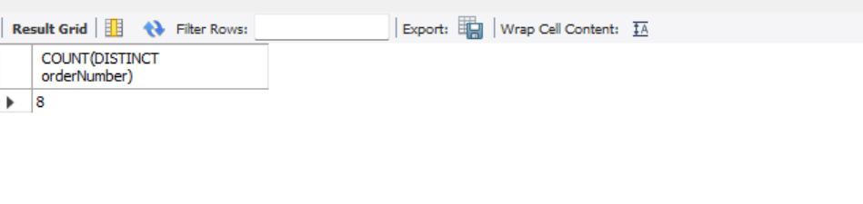
SELECT COUNT(DISTINCT orderNumber) FROM Orders WHERE paymentState = 'paid';
This query will return the count of orders that’s fully paid from the orders table.

Slide 23
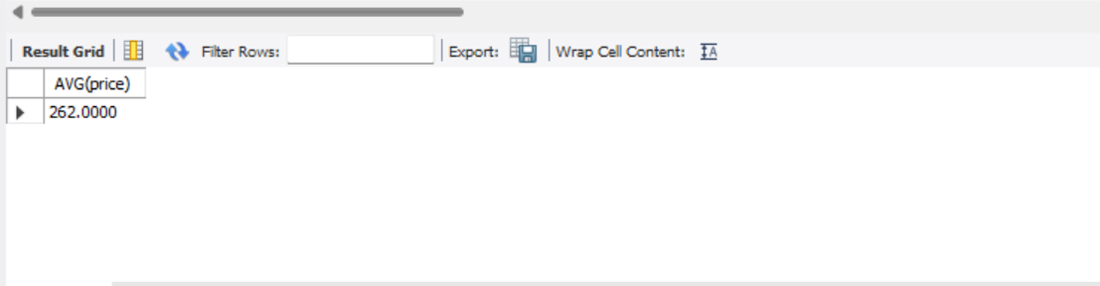
SELECT AVG(price) FROM Product JOIN Brand ON Product.brand = Brand.brandName WHERE Brand.brandName = 'Asus';
This query will return the average price of all products made by Asus brand.

Slide 24
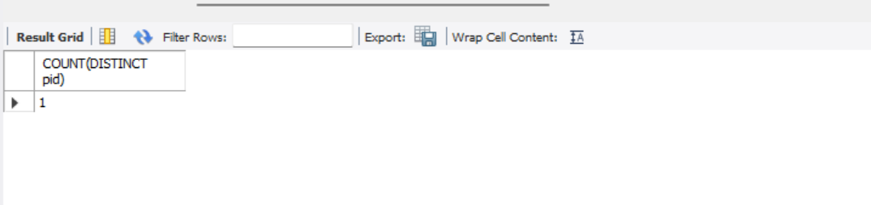
SELECT COUNT(DISTINCT pid) FROM Product JOIN Store ON Product.sid = Store.sid WHERE Store.province = Ontario';
This query will return the number of unique products sold by stores located in the province of Ontario.

