Slide 1
SemTpy
Marzorati Stefano

Slide 2
Funzionalità Implementate
getDatasetsList
getDatasetTables(idDataset)
getTable(idDataset, idTable, reconciliationName = False)
getExtendersList()
getReconciliatorsList()
addTable(idDataset, filePath, tableName)
reconcile(table, columnName, idReconciliator)
updateTable(table)
extendColumn(table, reconciliatedColumnName, idExtender, properties, newColumnsName)

Slide 3

Import Library

Slide 4
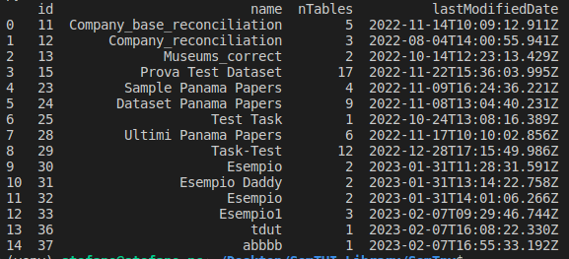
getDatasetList

Slide 5
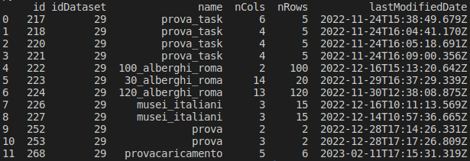
getDatasetTables

Slide 6

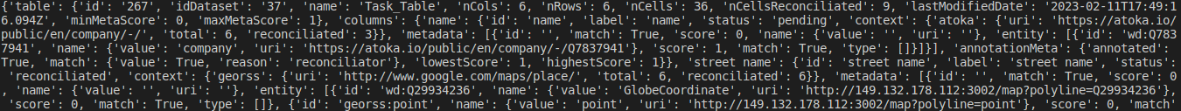

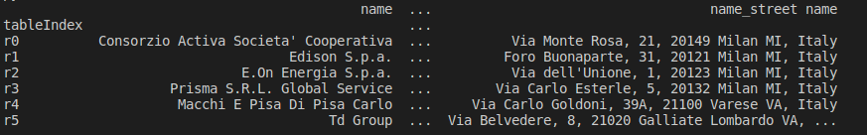

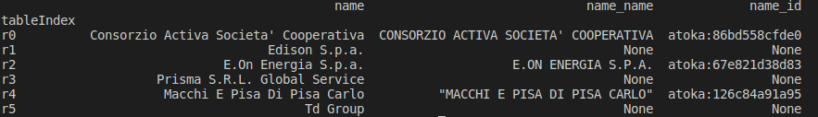
getTable

Slide 7
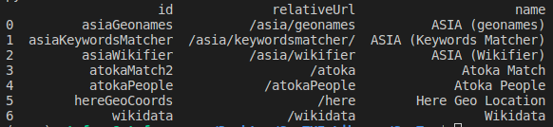
getReconciliatorsList

Slide 8
addTable

Slide 9
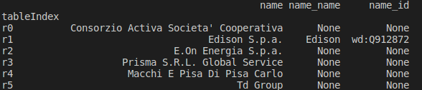
reconcile

Slide 10

extendColumn

