Slide 1
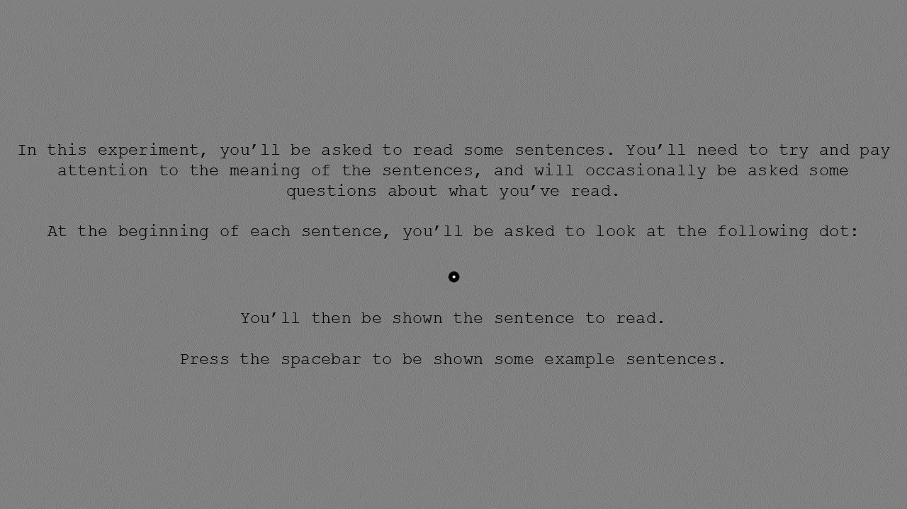

Slide 2

In this experiment, you’ll be given sentences to read. Please simply read these naturally and silently to yourself. Pay attention to the meaning of the sentences, as you’ll occasionally be asked questions about what you’re reading.
At the beginning of each sentence, you’ll be asked to look at the following dot:
You’ll then be shown the sentences to read.
Please press the spacebar to proceed to the eye calibration process.

Slide 3
Next

Slide 4
True
False

