Slide 1
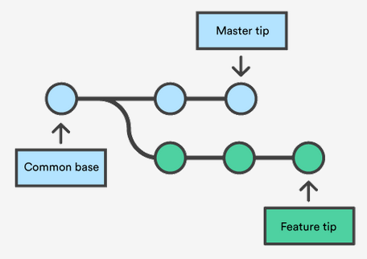
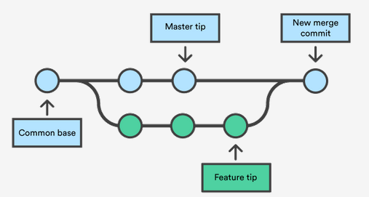
git/GitHub
October 28, 2019
Image source: https://www.atlassian.com/git/tutorials/using-branches/git-merge
Notes:
Presentation time: 30 mins.
Intended audience:
You’ve tried to use git before but aren’t sure where to start OR have gotten confused or intimidated.
You can use basic commands comfortably (add/commit/add/commit/etc) but would like to learn a little more “fancy” functionality.

Slide 2
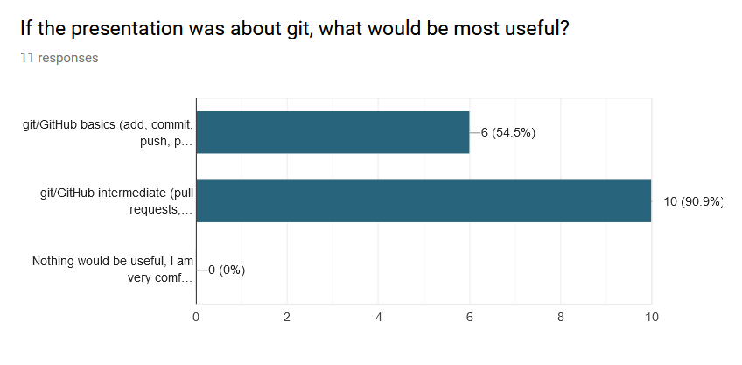
This is a brief overview
First: breeze through basic concepts
Then: discuss some intermediate techniques at a conceptual level
Code examples will look like this:
$ git init
Notes:
Audience survey to determine what content to cover in this 30 min. presentation

Slide 3



First important point:
What is the difference between
and
???
Image sources: https://git-scm.com/ and https://github.com/
Notes:
Discussion:
git: version control software
GitHub: hosting service for git repositories – central storage useful for backup and collaboration (others: BitBucket, local server. Need git to use GitHub, but don’t need GitHub to use git)
git is the software we need to learn. GitHub is a convenient way to interface

Slide 4
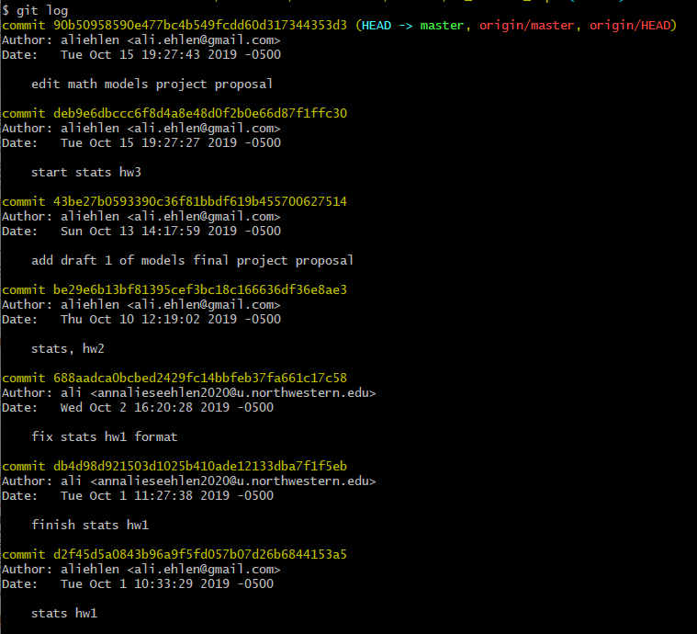
Basic git concepts: version control on your local computer
Useful status commands:
$ git log
$ git status
my_project
.git
a_script.py
another_script.py
subfolder
yet_another_script.py
my_project
a_script.py
another_script.py
subfolder
yet_another_script.py
This is where the magic happens
Edit files and create commits:
<edit your files>
$ git add <files>
$ git commit –m “useful message”
1
2
3
4
(repeat ad nauseum)
Notes:
Usually, we think of a project as a folder with some files and subfolders
Once you change this into a git repository, the project is now files, subfolders, and an additional layer: the history of the project (stored in the .git folder)
Not covering how to create a git repo (there are a few ways to do this, depending on the use case), but here are some other useful commands
That history is stored in the form of snapshots (commits)
These snapshots are labeled with long strings of letters and numbers (SHA1 hashes), but right now, we are going to use 1, 2, 3…
One, then another, etc. Each will have its unique hash and also a useful message to help track history
Log output example: yellow commit hash that actually identified commits + white human-readable commit message
To actually do this: work, git add, git commit, repeat
Difference between adding and committing: adding is gathering the changes that will be committed to the snapshot (git commit actually takes the snapshot)

Slide 5
Basic git concepts: getting your history from your computer to a hosting service
(like GitHub or BitBucket)
repo on your computer
repo on your computer
1
2
3
4
1
2
3
4
5
$ git push
$ git pull
repo on GitHub
repo on GitHub
1
2
3
4
1
2
3
4
5
Notes:
All that is on your local computer
Now say you want to back up to github, or put these on github so they can by accessed by other people or yourself on another computer
There are a few extra steps you need to take when setting this communication up for the first time, but generally the commands are “git push” and “git pull”
Which one should we do first?? Always git pull, so you can deal with any issues on your own computer and make sure everything works before putting changes online

Slide 6
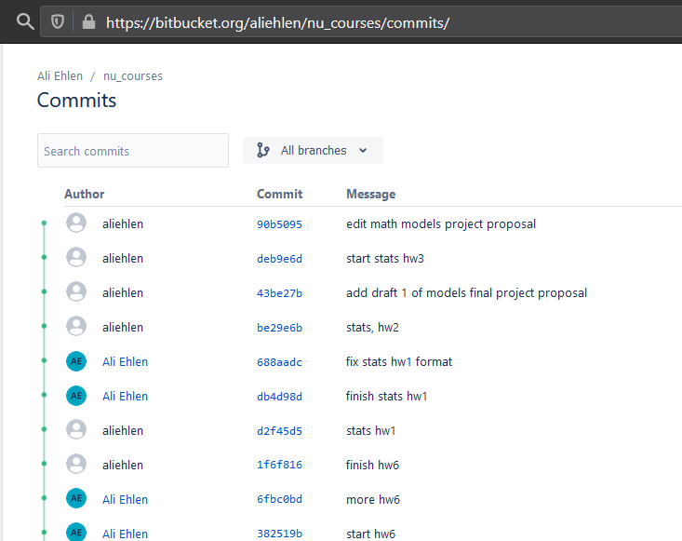
Basic git concepts: getting your history from your computer to a hosting service
(like GitHub or BitBucket)
repo on your computer
repo on your computer
1
2
3
4
1
2
3
4
5
$ git push
$ git pull
repo on GitHub
repo on GitHub
1
2
3
4
1
2
3
4
5
Notes:
Example of what this looks like: same log of commits from local computer, then also what that same commit history looks like on bitbucket

Slide 7
Basic git concepts: branches and forks
switch to branch ‘new-feature’
list all branches in repo
What’s the difference?
$ git branch
$ git checkout new-feature
$ git checkout –b new-feature
BRANCHES are labels
master
master
create branch ‘new-feature’ (if it doesn’t already exist) and switch to it
1
2
3
4
6
5
merge ‘new-feature’ into ‘master’
new-feature
<while on master branch>
$ git merge new-feature
Notes:
What is the difference between a branch and a fork?
Branch: split of history within your repo - branches are labels that point to the latest commit in a particular train of history
There are many ways to use branches well; how to “best” use them is dependent on how they can best enhance your own productivity
Fork: fully separate copy of the repo (useful for open source projects, for example, so you can develop completely independently of the main project repo)

Slide 8
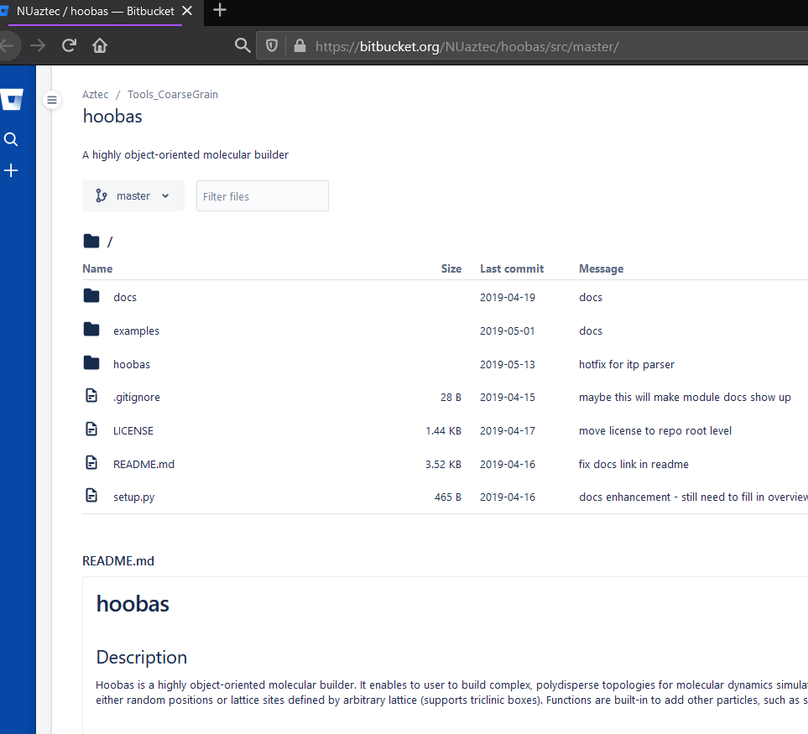
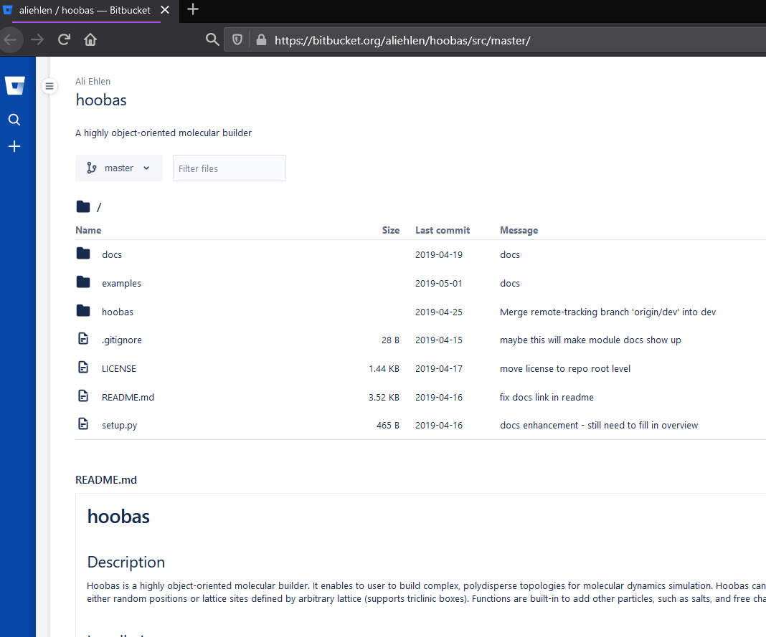
Basic git concepts: branches and forks
FORKS are separate copies of the repo
Notes:
What is the difference between a branch and a fork?
Branch: split of history within your repo - branches are labels that point to the latest commit in a particular train of history
Fork: fully separate copy of the repo (useful for open source projects, for example, so you can develop completely independently of the main project repo)
These are two copies of the same repo (aliehlen forked repo called hooas from NUaztec. Can see that they are basically the same, mostly same commits/files/etc, different owners).

Slide 9
Intermediate topics in merging
Pull requests
How to deal with merge conflicts
Merge vs rebase

Slide 10
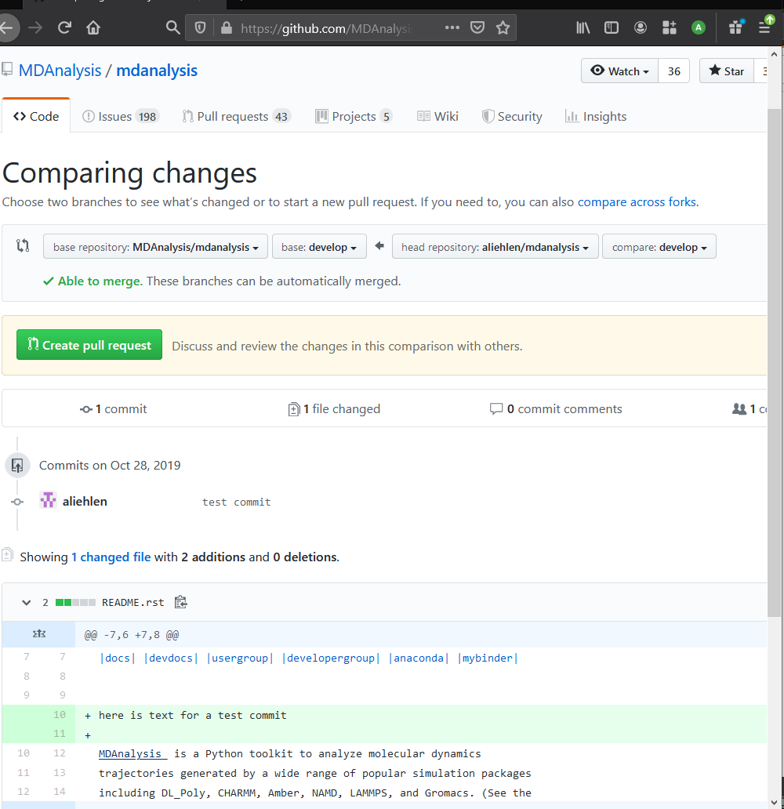
Pull requests
What is a pull request (PR)?
Notes:
Glorified merge – from one branch to another within a repo OR from one branch to another between forks
Mechanism to allows review from others
May be necessary if you don’t have push access

Slide 11
Easy merges
grocery_list.txt:
here is a list
apples
oranges
pears
grapes - 13
grocery_list.txt:
here is a list
apples
oranges
pears
grapes
grocery_list.txt:
here is a list
apples - 5
oranges
pears
grapes - 13
master
master
master
1
2
3
4
6
grocery_list.txt:
here is a list
apples - 5
oranges
pear
grapes
5
$ git checkout master
$ git merge new-feature
Auto-merging grocery_list.txt
Merge made by the ‘recursive’ strategy.
grocery_list.txt | 2 +-
1 file changed, 1 insertion(+), 1 deletion(-)
new-feature
Notes:
git provides a consistent and “easy” way to handle merge conflicts
Example of a straightforward merge: change one file in two locations, git will make all changes (including additions and deletions) in the file. Also applies to changing multiple different files in the same repo.

Slide 12
Merge conflicts
Step 1: Don’t panic!
grocery_list.txt:
here is a list
apples
oranges
<<<<<<< HEAD
pears – really need 10
=======
pears – need 5
>>>>>>> new_feature
grapes
grocery_list.txt:
here is a list
apples
oranges
pears – really need 10
grapes
grocery_list.txt:
here is a list
apples
oranges
pears
grapes
grocery_list.txt:
here is a list
apples
oranges
pears – buy 15
grapes
master
master
master
1
2
3
4
6
!!
$ git checkout master
$ git merge new-feature
Auto-merging grocery_list.txt
CONFLICT (content): Merge conflict in grocery_list.txt
Automatic merge failed: fix conflicts and then commit the result
grocery_list.txt:
here is a list
apples
oranges
pears – need 5
grapes
5
new-feature
$ git add grocery_list.txt
$ git commit –m “resolve pear amnt conflict”
Notes:
git provides a consistent and “easy” way to handle merge conflicts
If two branches change the same line, git will save both versions within that file so that you can go in, manually make the changes you want, and add/commit those changes as a part of the merge process.

Slide 13
Merge vs rebase
$ git checkout master
$ git merge new-feature
master
1
2
3
4
6
master
5
1
2
3
4
new-feature
5
new-feature
master
master
1
2
3
4
6
7
$ git checkout new-feature
$ git rebase master
5
new-feature
$ git merge master
Notes:
Merging: combine two branches as we’ve been talking about, by making a new commit to combine changes in both branches.
However, might end up with a history that’s too complicated and hard to read. In that case, might consider rebasing, which moves all commits into a linear chain. (Would deal with any conflicts in a similar way to a “normal” merge). Pros: cleaner history (if you want it). Cons: have to be a little more careful with when to use it because altering commit history.
Like everything with git, which to use and when is user- and use-case-dependent

Slide 14
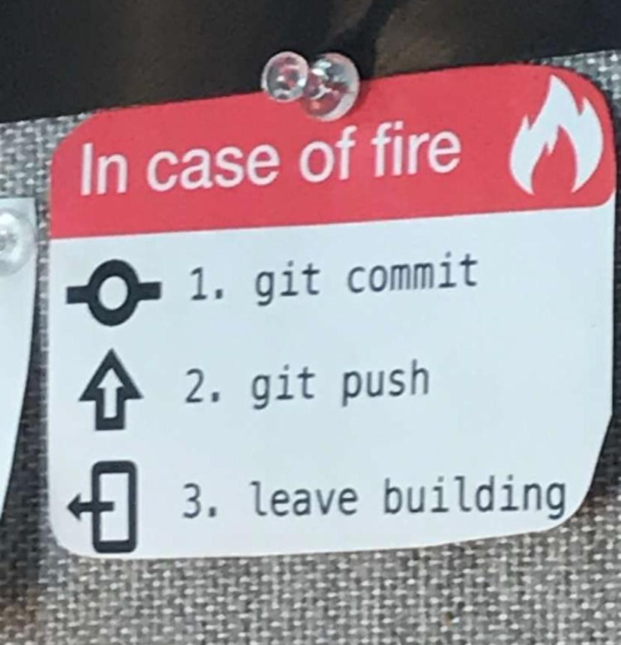
Other resources:
git book
Atlassian tutorials
StackOverflow
Thank you for listening!

