Slide 1



Slide 2


Slide 3
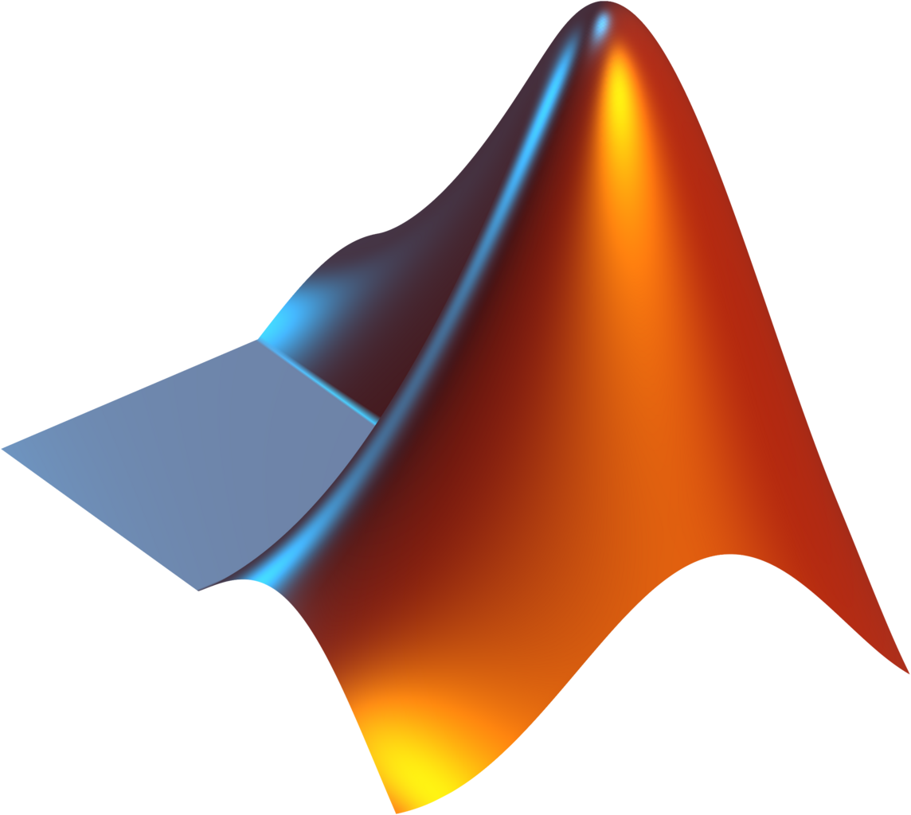

MATLAB
Notes:
MATLAB

Slide 4
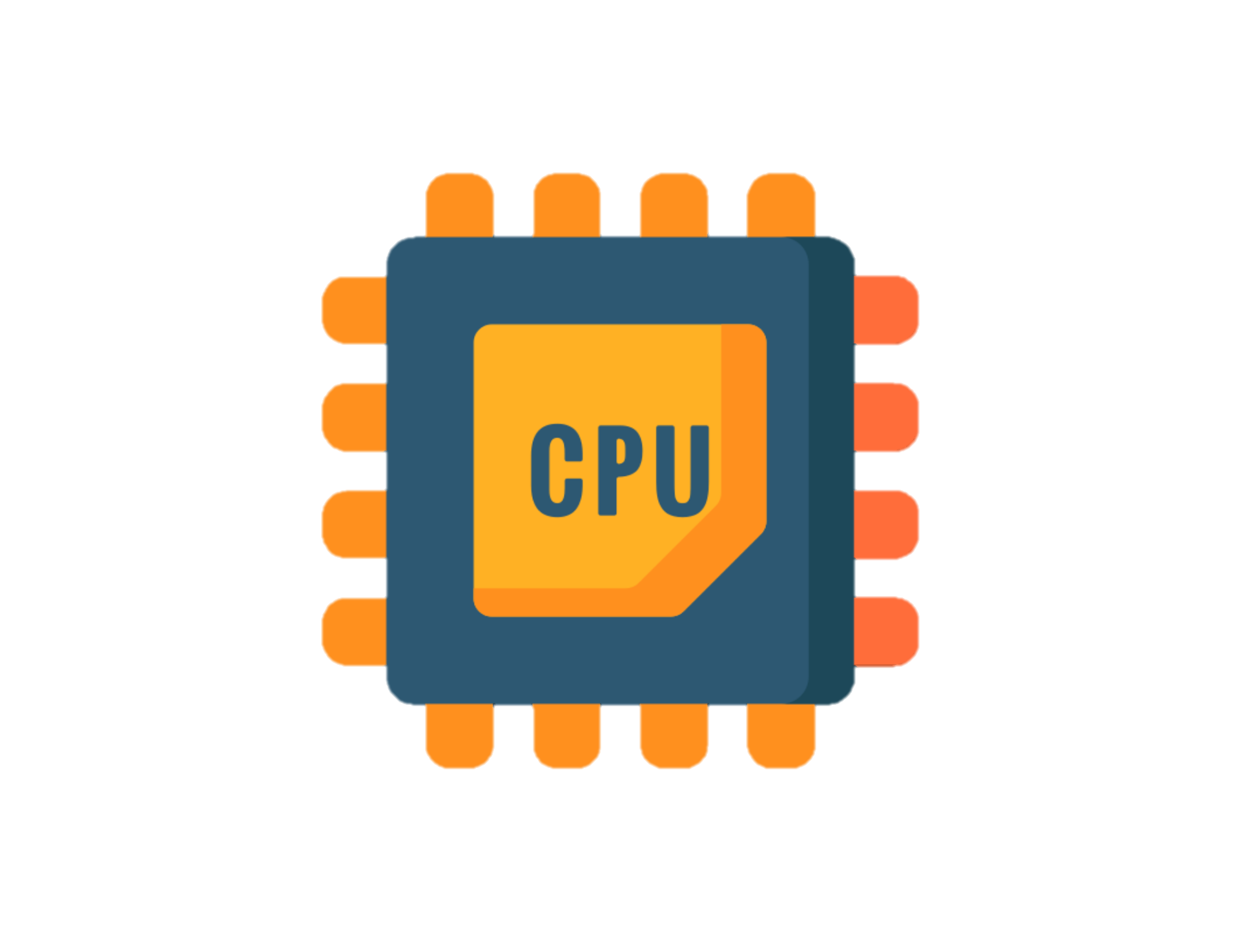

Slide 5


Slide 6


