Slide 1

Team 10:
Ali Ayman Ali
Abdelrahman Ahmed Abdelghaffar
Ali Mohammed Saad

Slide 2
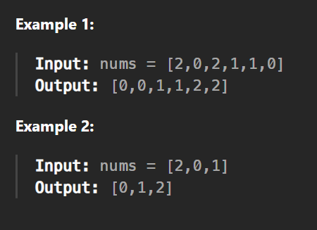
1. Given an array `nums` with n objects colored red, white, or blue, sort them in-place so that objects of the same color are adjacent, with the colors in order red, white, blue.
We will use the integers 0, 1, and 2 to represent the color red, white, and blue respectively.
You must solve this problem without using the library’s sort function.

Slide 3
2
0
2
1
1
0
Low
Mid
High

Slide 4
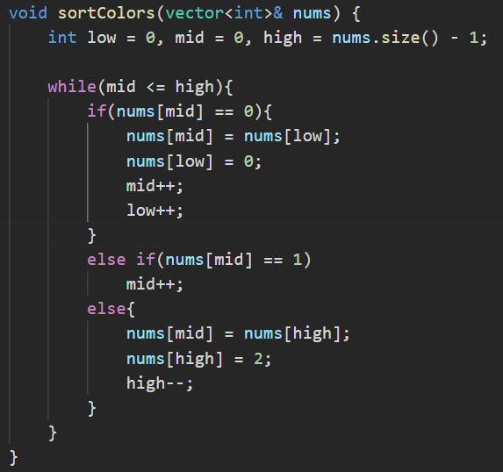

Slide 5
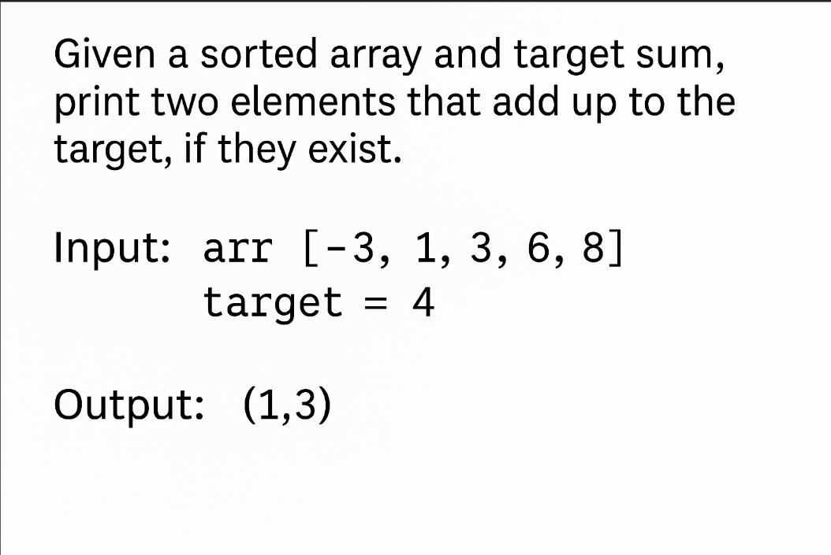
2. Given a sorted Array arr of length N (1 <= N <= 200,000) composed of non-zero integers, you’re given a target T and you’re required to print two integers that exist in the array such that their sum is equal to T, or say that the element doesn’t exsit.

Slide 6
2. Given a sorted Array arr of length N (1 <= N <= 200,000) composed of non-zero integers, you’re given a target T and you’re required to print two integers that exist in the array such that their sum is equal to T, or say that the elements don’t exist.
5
3
-3
4
-3
4
1
4
8
4
6
1
3
7
4
+
6
+
+
+
=
=
=
=
>
<
=
>
-3
1
3
6
8
Low
High

Slide 7
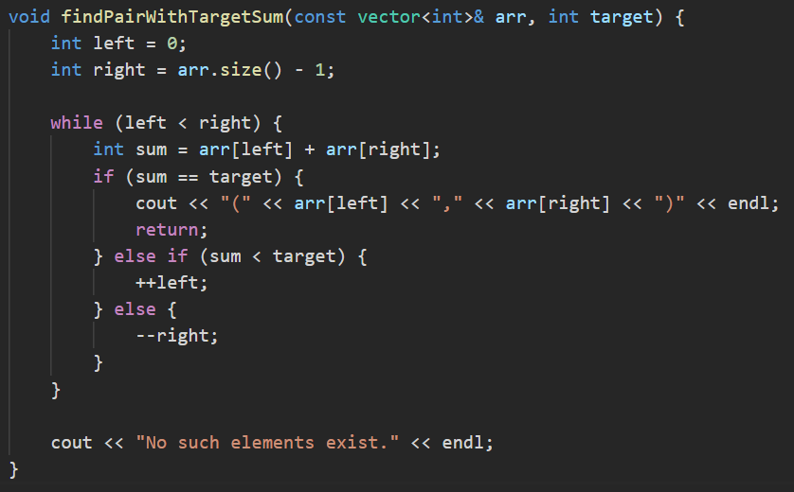

Slide 8
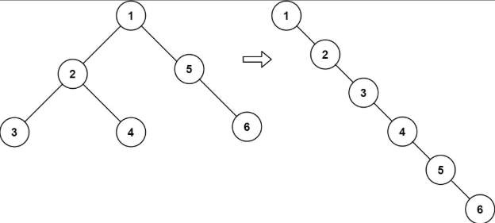
3. Given the root of a binary tree, flatten the tree into a linked list:
The linked list should use the same Tree class and the left child pointer is always null.
The linked list should be in the same order as a pre-order traversal of the binary tree.

Slide 9
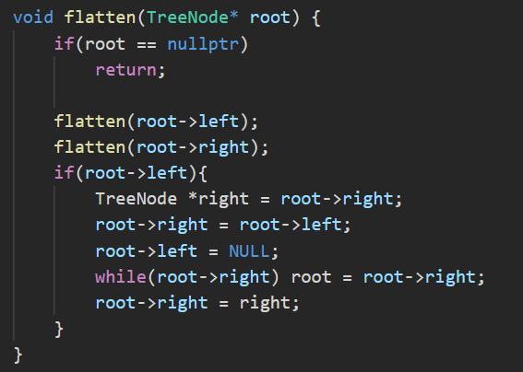

Slide 10
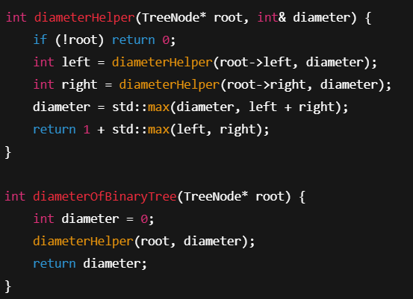
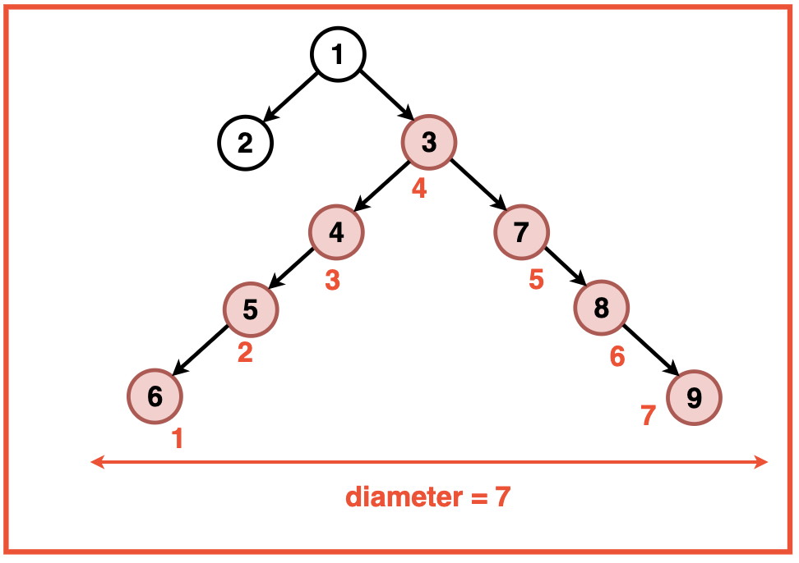
4. Find the longest diameter of a given binary tree. The diameter is the longest path between any two nodes, which might or might not pass through the root

Slide 11
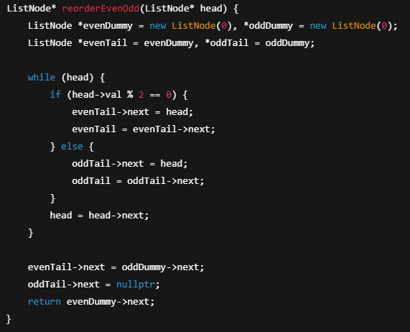
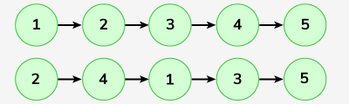
5. Reorder linked list even before odd whilst preserving the initial order of the even and odd numbers

Slide 12
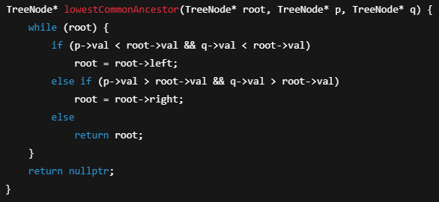
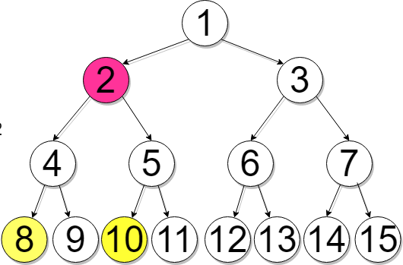
6. Lowest common ancestor (LCA) in a BST

Slide 13
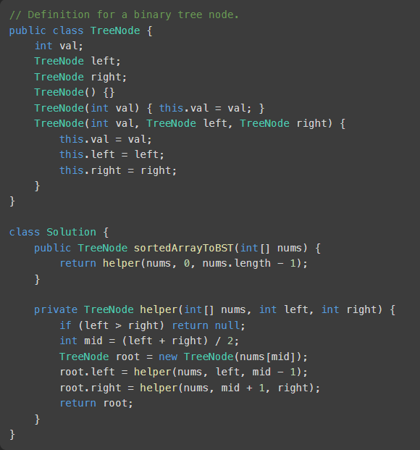
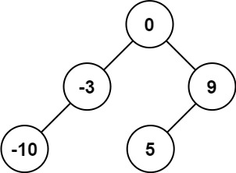
7.Convert Sorted Array to Binary Search Tree
Given an integer array nums where the elements are sorted in ascending order, convert it to a height-balanced binary search tree.
Input: nums = [-10,-3,0,5,9]
Output: [0,-3,9,-10,null,5]

Slide 14
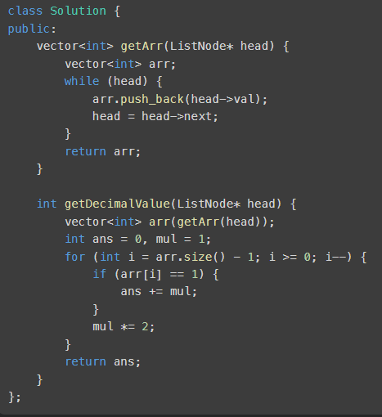
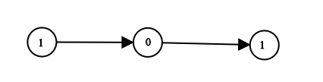
8.Convert Binary Number in a Linked List to Integer
Given two integer arrays nums1 and nums2, return an array of their intersection. Each element in the result must be unique and you may return the result in any order.
Example 2:
Input: head = [1,0,1]
Output: 5
Explanation: (101) in base 2 = (5) in base 10
Example 2:
Input: head = [0]
Output: 0

Slide 15
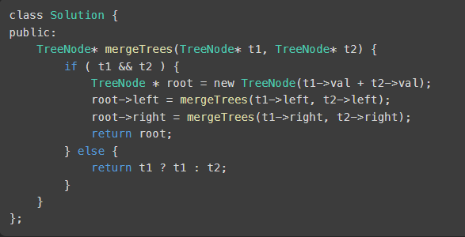
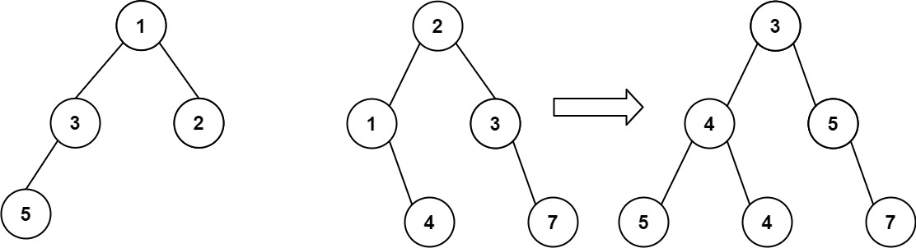
9.Merge Two Binary Trees
You are given two binary trees root1 and root2.
Imagine that when you put one of them to cover the other, some nodes of the two trees are overlapped while the others are not. You need to merge the two trees into a new binary tree. The merge rule is that if two nodes overlap, then sum node values up as the new value of the merged node. Otherwise, the NOT null node will be used as the node of the new tree.
Return the merged tree.
Note: The merging process must start from the root nodes of both trees.
Example 1:
Input: root1 = [1,3,2,5], root2 = [2,1,3,null,4,null,7]
Output: [3,4,5,5,4,null,7]

Slide 16
Thank You
Hope that was beneficial!

