Slide 1


FLEXI

Slide 2
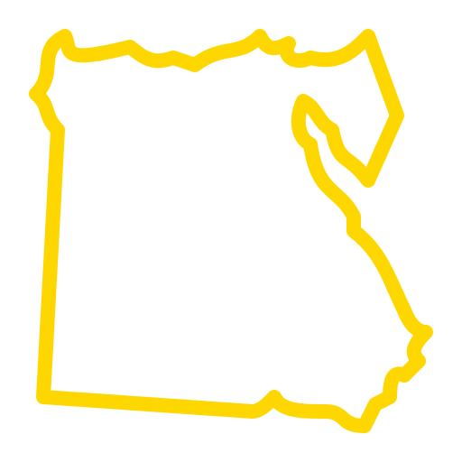

Numbers of physical deformities
cases in 2024:
12M
100M

Slide 3
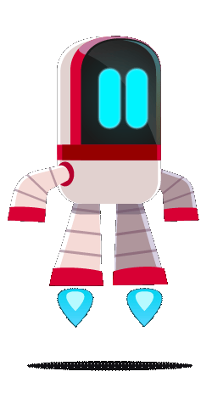
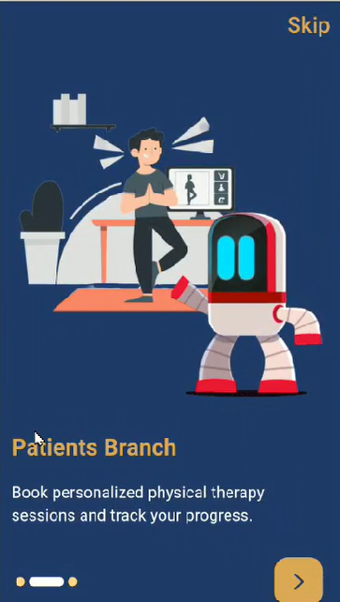
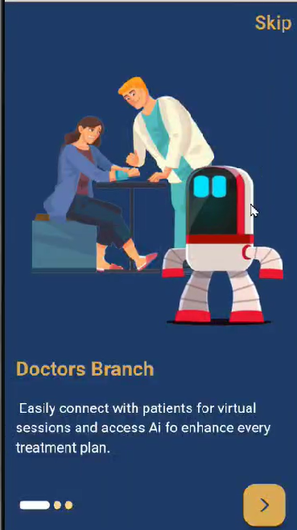

Slide 4
value propositions
making healthcare accessible and personalized
analyzing photos or videos from different angles
combining telemedicine with AI-driven diagnostics

Slide 5

Flexi also incorporates
innovative hardware solutions !

Slide 6
Posture Tracking Device
(nicklace)
A wearable necklace designed to monitor posture,using sensors for real-time analysis.
Gym Equipment
Attachments
An attachable device that count reps, track strength, and predict risks during exercise.

Slide 7
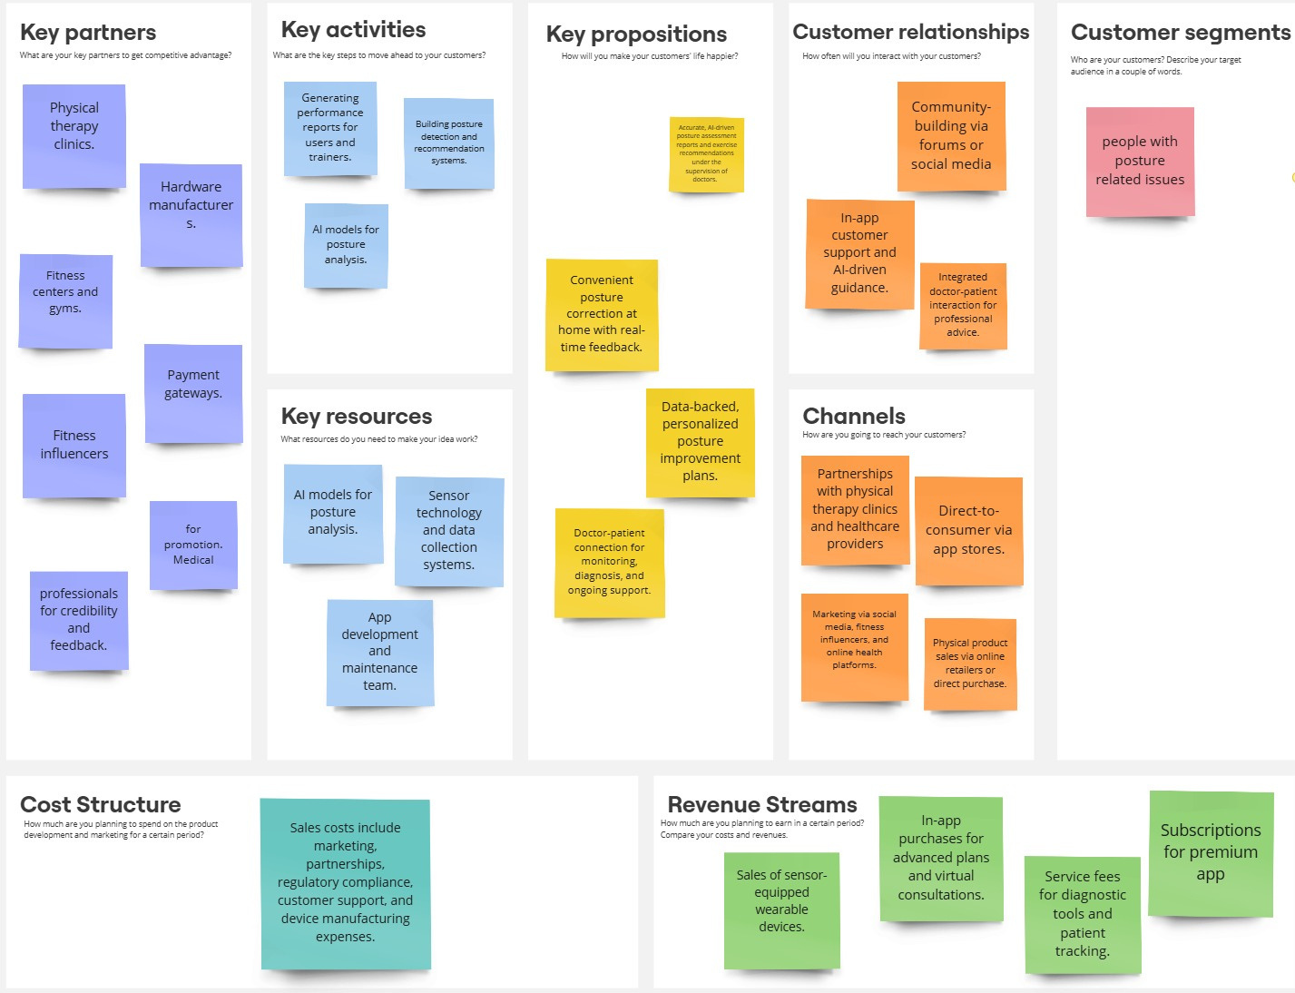

Slide 8


Thank you

