Slide 1

.

Slide 2
Array
.

Slide 3
Problem
I want to give you 4 numbers then you should print it reversed.
Input:
1 2 3 4
Output:
4 3 2 1

Slide 4
Solution
int main() {
int n1, n2, n3, n4;
cin >> n1 >> n2 >> n3 >> n4;
cout << n4 << “ “ << n3
<< “ “ << n2 << “ “ << n1 << endl;
}

Slide 5
Problem
I want to give you N numbers then you should print it reversed.
Input:
17
1 2 3 4 4 3 2 1 9 8 7 6 5 4 5 6 6
Output:
6 6 5 4 5 6 7 8 9 1 2 3 4 4 3 2 1

Slide 6

Solution
help!

Slide 7
Arrays
If i asked you what is the array ? -You can tell
[1] Fixed size sequence of elements.
[2] All elements of the same type.
[3] I can use any number of elements within
the size of the array.

Slide 8
Array Declaration
<dataType> <name> [constantSize]
data Type: is the type of the array { int, char, … }
name: you must give your array a name.
size: when you need to declare an array, the size must be constant.

Slide 9
Types of array declaration
int arr[10]; // array of 10 elements
int arr[10] = {0}; // all elements equal zero
int arr[10] = {1}; // first element is 1, rest 0
int arr[] = {2, 4, 3}; // array of 3 elements

Slide 10
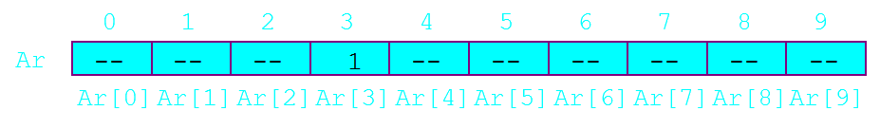
Indexing
int Ar[10];
first index is 0
last index is 9

Slide 11
Filling and Printing an array
int main() {
int arr[100];
int n = 10;
for(int i = 0; i < n; i++)
cin >> arr[i]; // filling
for(int i = 0; i < n; i++)
cout << arr[i] << “ “; // printing
cout << endl;
}

Slide 12
Sorting an array
Given N numbers, print them sorted.
Input:
4
1 3 2 4
Output:
1 2 3 4

Slide 13
Solution
int main() {
int arr[1000], n; cin >> n;
for (int i = 0; i < n; i++) cin >> arr[i];
for (int i = 0; i < n; i++) {
for (int j = i + 1; j < n; j++) {
if(arr[i] > arr[j]) { // swap
int temp = arr[i];
arr[i] = arr[j];
arr[j] = temp;
}
}
}
for(int i = 0; i < n; i++) cout << arr[i] << " ";
}

Slide 14
Example
Given an Array with N numbers, find the maximum number.
Input:
5
3 1 7 3 2
Output:
7
int main() {
int arr[1000], n, mx;
cin >> n;
for (int i = 0; i < n; i++)
cin >> arr[i];
mx = arr[0];
for(int i = 1; i < n; i++)
if(mx < arr[i]) mx = arr[i];
cout << mx << endl;
}

Slide 15
2 - Dimensional Arrays
<dataType> <name> [const-Size][const-Size]
data Type: is the type of the array { int, char, … }
name: you must give your array a name.
size: when you need to declare an array, the size must be constant.

Slide 16
Types of array declaration
int arr[10][5]; // array of 10 arrays of 5 elements
int arr[10][5] = {0}; // all elements equal zero
int arr[][3] = {
{2, 4, 3},
{2, 4, 3},
{2, 4, 3}
}; // array of 3 arrays of 3 elements

Slide 17
Filling and Printing an array
int main() {
int arr[100][100];
int n = 10, m = 5;
for(int i = 0; i < n; i++)
for(int j = 0; j < m; j++)
cin >> arr[i][j]; // filling
for(int i = 0; i < n; i++) {
for(int j = 0; j < m; j++)
cout << arr[i][j] << “ “; // printing
cout << endl;
}
}

Slide 18
C-String
.

Slide 19
Types of array declaration
char str[80]; // string of 79 char.
char str[] = “Farewell! thou art too dear for my possessing.”;
char str[] = { ‘F’, ‘a’, ‘r’, ‘e’, ‘w’, ‘e’, ‘l’, ‘l’, ‘!’};

Slide 20
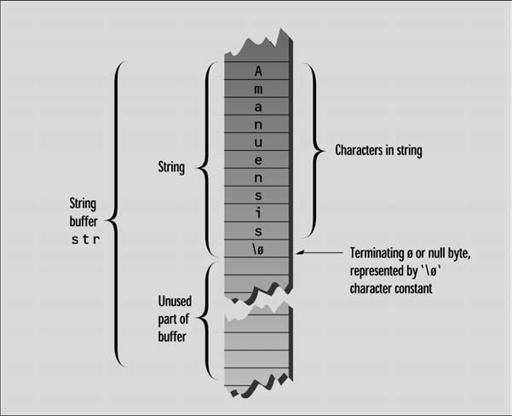
NULL Character

Slide 21
Filling an array of chars
cin >> str; // space or end of line terminator
cin.get(str, MAX_SIZE);
cin.get(str, MAX_SIZE, ‘$’); // terminate with ‘$’

Slide 22
Copying a String
#include <cstring> //for strlen()
int main() { //initialized string
char str1[] = “Oh, Captain, my Captain! our fearful trip is done”;
const int MAX = 80; //size of str2
char str2[MAX]; //empty string
Int n = strlen(str1), j;
for(j=0; j<n; j++)
str2[j] = str1[j]; // from str1 to str2
str2[j] = ‘\0’; //insert NULL at end
cout << str2 << endl; //display str2
return 0;
}

Slide 23
Arrays of Strings
#include <iostream>
using namespace std;
int main() {
const int DAYS = 7; //number of strings in array
const int MAX = 10; //maximum size of each string
//array of strings
char star[DAYS][MAX] = { “Sunday”, “Monday”, “Tuesday”, “Wednesday”, “Thursday”,
“Friday”, “Saturday” };
for(int j=0; j<DAYS; j++) //display every string
cout << star[j] << endl;
return 0;
}

Slide 24
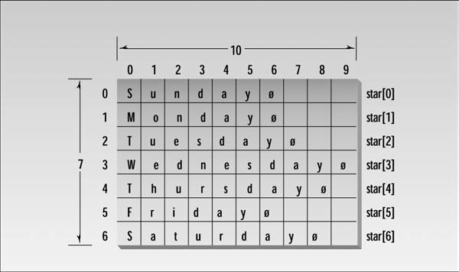

Slide 25
Questions ?
Thank You :)
.

