Slide 1

SEARCHING AND SORTING

Slide 2
Objective
Linear search and binary search algorithms
Several sorting algorithms, including:
selection sort
insertion sort
bubble sort
quick sort
merge sort
Complexity of the search and sort algorithms

Slide 3
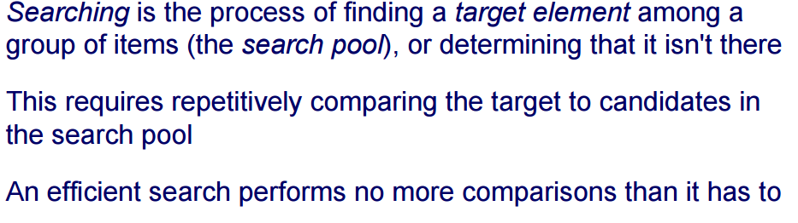
Searching

Slide 4
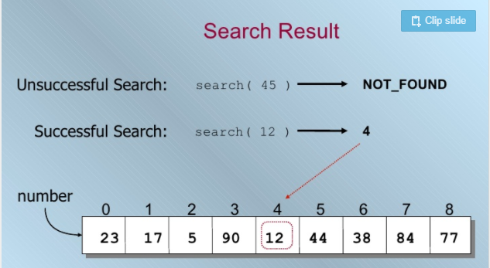

Slide 5
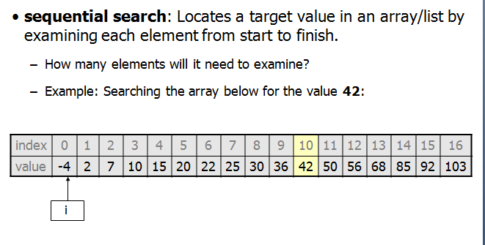

Slide 6
Searching an array of integers
If an array is not sorted, there is no better algorithm than linear search for finding an element in it
static final int NONE = -1; // not a legal index
static int linearSearch(int target, int[] a) { for (int p = 0; p < a.length; p++) { if (target == a[p]) return p; } return NONE; }

Slide 7
Searching an array of Strings
Searching an array of Strings is just like searching an array of integers, except
Instead of int1==int2 we need to use string1.equals(string2)
static final int NONE = -1; // not a legal index
static int linearSearch(String target, String[] a) { for (int p = 0; p < a.length; p++) { if (target.equals(a[p])) return p; } return NONE; }

Slide 8
Searching an array of Objects
Searching an array of Objects is just like searching an array of Strings, provided
The operation equals has been defined appropriately
static final int NONE = -1; // not a legal index
static int linearSearch(Object target, Object[] a) { for (int p = 0; p < a.length; p++) { if (target.equals(a[p])) return p; } return NONE; }

Slide 9
Templates
There is no way, in Java, to write a general linear search method for any data type
We can write a method that works for an array of objects (because Object defines the equals method)
For arbitrary objects, equals is just ==
For your own objects, you may want to override public boolean equals(Object o)
The parameter must be of type Object!
The method we defined for Objects also works fine for Strings (because String overrides equals)
A search method for objects won’t work for primitives
Although an int can be autoboxed to an Integer, an int[] cannot be autoboxed to an Integer[]

Slide 10
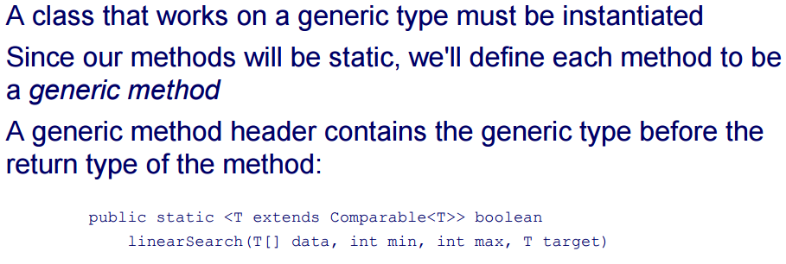
Generic Methods

Slide 11
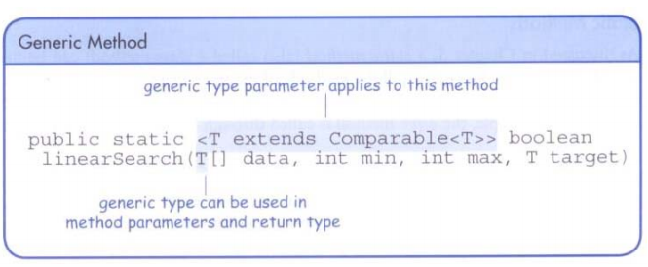
Generic Methods
The generic type can be used in the return type, the parameter list, and the method body

Slide 12
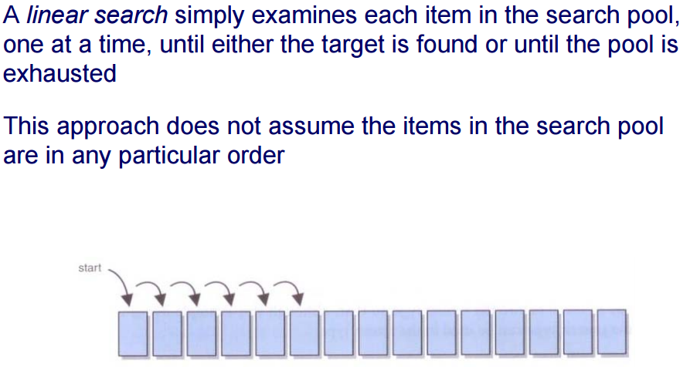
Linear Search

Slide 13
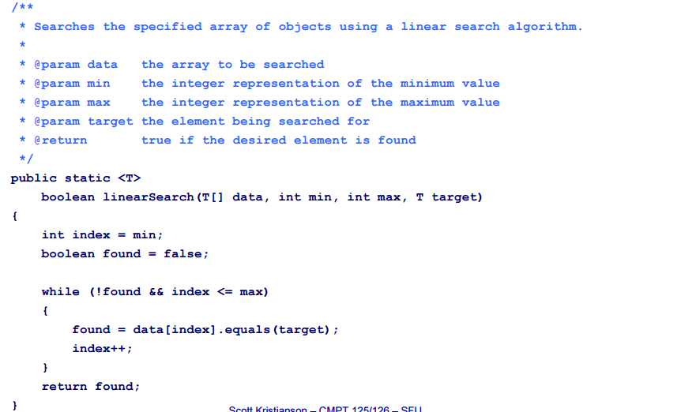
Linear Search

Slide 14
Linear Search or Binary SEarch
Linear search has linear time complexity:
Time n if the item is not found
Time n/2, on average, if the item is found
If the array is sorted, we can write a faster search
How do we look up a name in a phone book, or a word in a dictionary?
Look somewhere in the middle
Compare what’s there with the thing you’re looking for
Decide which half of the remaining entries to look at
Repeat until you find the correct place
This is the binary search algorithm

Slide 15
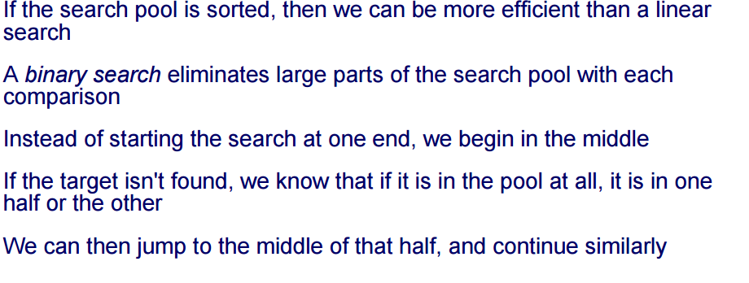
Binary SEarch

Slide 16
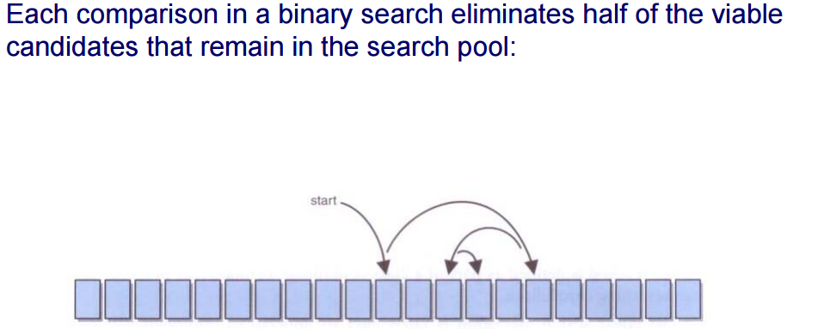
Binary Search

Slide 17
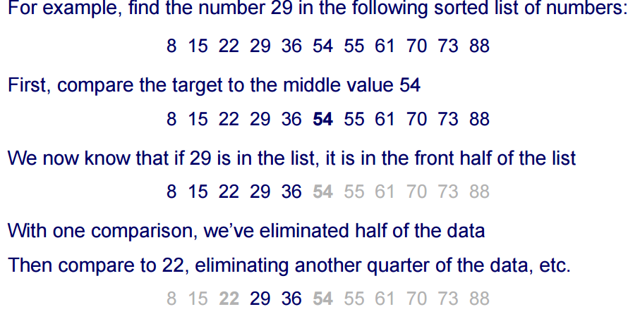
Example

Slide 18
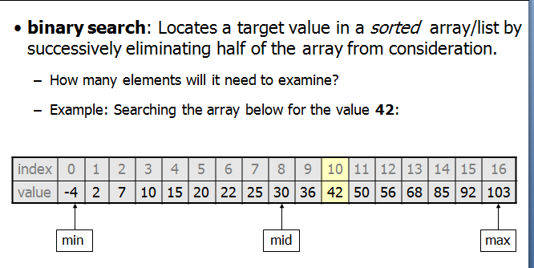

Slide 19
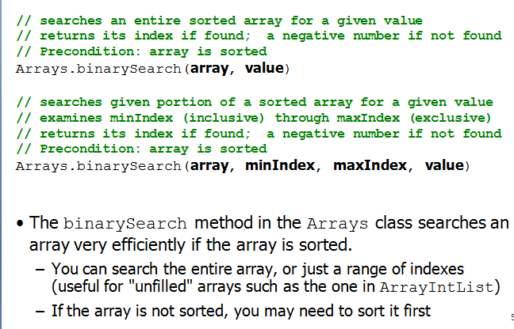
Arrays.BinarySearch()

Slide 20
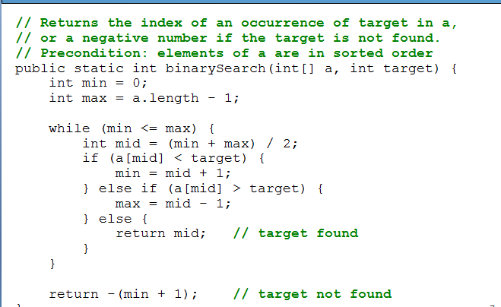
Binary Search Code

Slide 21
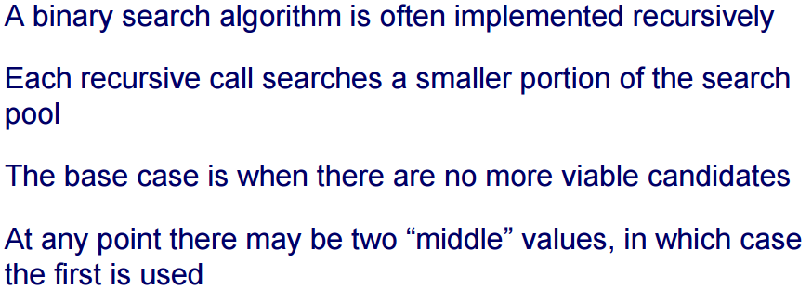
Recursive Binary Search

Slide 22
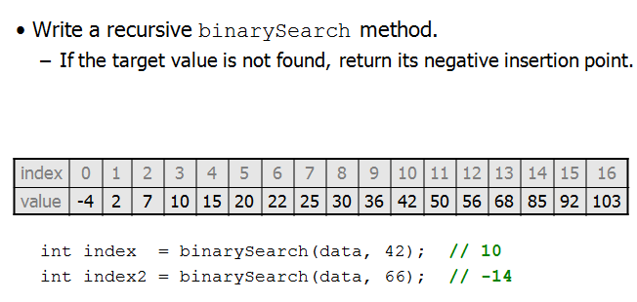

Slide 23
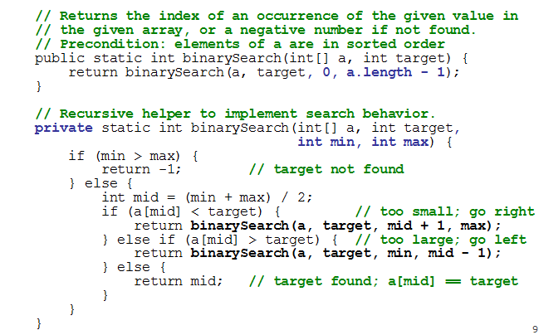

Slide 24
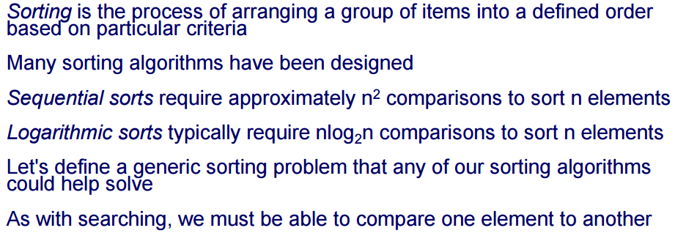
Sorting

Slide 25
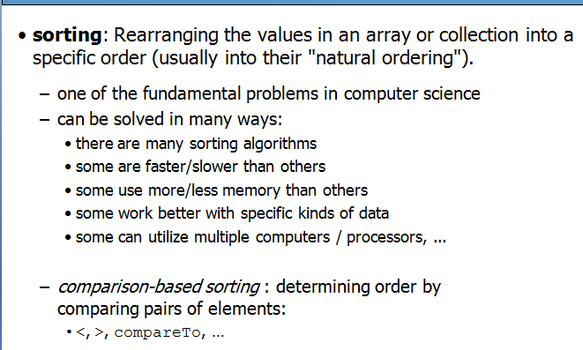
Sorting

Slide 26
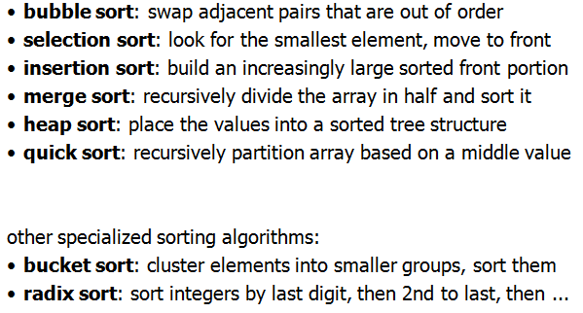
Sorting Algorithms

Slide 27
https://visualgo.net/en/sorting

