Slide 1

LIST

Slide 2
What is a Data Structure?
A data structure is a collection of data organized in some fashion.
A data structure not only stores data, but also supports the operations for manipulating data in the structure.
For example, an array is a data structure that holds a collection of data in sequential order.
You can find the size of the array, store, retrieve, and modify data in the array.
Array is simple and easy to use, but it has two limitations:

Slide 3
Limitations of arrays
Once an array is created, its size cannot be altered.
Array provides inadequate support for inserting, deleting, sorting, and searching operations.

Slide 4
Object-Oriented Data Structure
In object-oriented thinking, a data structure is an object that stores other objects, referred to as data or elements.
So some people refer a data structure as a container object or a collection object
The class for a data structure should use data fields to store data and provide methods to support operations such as insertion and deletion.

Slide 5
Four Classic Data Structures
Four classic dynamic data structures are lists, stacks, queues, and binary trees.
A list is a collection of data stored sequentially. It supports insertion and deletion anywhere in the list.
A stack can be perceived as a special type of the list where insertions and deletions take place only at the one end, referred to as the top of a stack.

Slide 6
Four Classic Data Structures
A queue represents a waiting list, where insertions take place at the back (also referred to as the tail of) of a queue and deletions take place from the front (also referred to as the head of) of a queue.
A binary tree is a data structure to support searching, sorting, inserting, and deleting data efficiently.

Slide 7
3 types of list collection
ORDERED LIST :
whose elements are ordered by some inherent characteristics of the element.
UNORDERED LIST :
whose elements have no inherent order
INDEXED LIST :
whose elements can be referenced using numeric index

Slide 8
Examples
ORDERED LIST
Keep list of people ordered alphabetically by name or
Keep inventory list ordered by part no
Any element added to list has a proper location given its key value
UNORDERED LIST
The elements are placed in particular order but the order is no based on the elements
Elements can be put at front or rear of the list or after a particular index

Slide 9
INDEXED LIST
There is no inherent relationship among the elements that determines their order in the list
Addition of each element can be referenced by particular index that begins at 0 at front of the list
Every time changes occur in the list the index are adjusted to stay in order

Slide 10
Lists
A list is a popular data structure to store data in sequential order. For example, a list of students, a list of available rooms, a list of cities, and a list of books, etc. can be stored using lists. The common operations on a list are usually the following:
· Retrieve an element from this list.
· Insert a new element to this list.
· Delete an element from this list.
· Find how many elements are in this list.
· Find if an element is in this list.
· Find if this list is empty.

Slide 11
LIST interface
A List is an ordered Collection (sometimes called a sequence). Lists may contain duplicate elements.
METHODS | DESCRIPTION
ADD(E element) | Adds an element at the end of the list
add(int index, E element ) | Inserts an element at specified index
get(int index) | Returns the element stored at the specified index
remove(int index) | Removes the element at position index
set(int index, E element) | Replaces the element at specified index
Size() | Returns the number of elements in the list

Slide 12
LIST interface
A List is an ordered Collection (sometimes called a sequence). Lists may contain duplicate elements.
METHODS | DESCRIPTION
removeFirst | Remove the first element form the list
removeLast | Removes the last element from the list
First | Examines the element at the front of the list
Last | Examines the element at the rear of the list
Contains | Determines if list contains a particular element
isEmpty | Determines if the list is empty

Slide 13
Example

Slide 14
ADDING ELEMENTS TO THE LIST
Operation to ordered list
Add : adds an element to list based on its key value
Operation to unordered list
addToFront : adds an element at front of the list
addToRear : adds an element at rear of the list
addAfter : add an element after a particular element already in the list

Slide 15
http://www.cs.armstrong.edu/liang/animation/web/ArrayList.html

Slide 16
Creating a new list
It’s a good practice to declare a list instance with a generic type parameter, for example:
List<Object> listAnything = new ArrayList<Object>();
List<String> listWords = new ArrayList<String>();
List<Integer> listNumbers = new ArrayList<Integer>();
List<String> linkedWords = new LinkedList<String>();
When creating a new ArrayList using the empty constructor, the list is constructed with an initial capacity of ten.
Let’s say, if we know that a list contains around 1000 elements, declare the list as follows:
List<Integer> listNumbers = new ArrayList<>(1000);

Slide 17
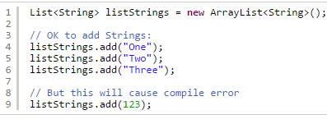


Slide 18
We can also add all elements of an existing collection to the end of the list:
listStrings.addAll(listWords);
Or add the elements to the list at a specified position:
listStrings.addAll(2, listWords);
That inserts all elements of the listWords collection at 3rd position of the listStrings collection.

Slide 19
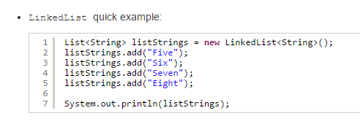
LinkedList: An implementation that stores elements in a doubly-linked list data structure.
It offers constant time for adding and removing elements at the end of the list;
linear time for operations at other positions in the list.
Therefore, we can consider using a LinkedList if fast adding and removing elements at the end of the list is required

Slide 20
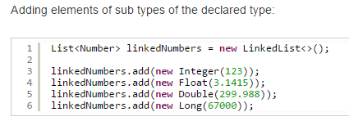

Slide 21
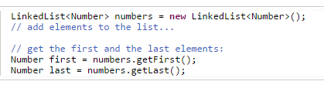
Retrieving elements
get an element at 2nd position in the array list and an element at 4th position in the linked list:
String element = listStrings.get(1);
Number number = linkedNumbers.get(3);
For a LinkedList implementation, we can get the first and the last elements like this:

Slide 22
Updating elements
Use the set(index, element) method to replace the element at the specified index by the specified element. For example:
listStrings.set(2, "Hi")
That replaces the 3rd element in the list by the new String “Hi”.

Slide 23
Removing elements
To remove an element from the list, use the remove(index) or remove(Object) method which removes the element at the specified index or by object reference. For example:
Remove the element at the 3rd position in the list:
listStrings.remove(2);
Remove the String element “Two” in the list:
listStrings.remove("Two")
To remove all elements in the list, use the clear() method:
listStrings.clear();

Slide 24
Iterating over a list
we can use the enhanced for loop to iterate through all elements in the list
for (String element : listStrings) {
System.out.println(element);
}
Or
Iterator<String> iterator = listStrings.iterator();
while (iterator.hasNext()) {
System.out.println(iterator.next());
}

Slide 25
we can use the forEach()method like this:
listStrings.forEach(s -> System.out.println(s));

Slide 26
Searching for an element in a list
boolean contains(Object):
returns true if the list contains the specified element.
int indexOf(Object):
returns the index of the first occurrence of the specified element in the list, or -1 if the element is not found.
int lastIndexOf(Object):
returns the index of the last occurrence of the specified element in the list, or -1 if the element is not found.

Slide 27
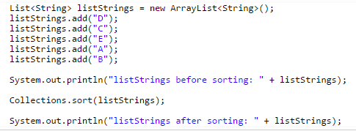
Sorting a list
Collections.sort() static method which sorts the specified list into ascending order, based on the natural ordering of its elements
if we want to sort by descending order, we need to use the Collections.reverse(list)

Slide 28
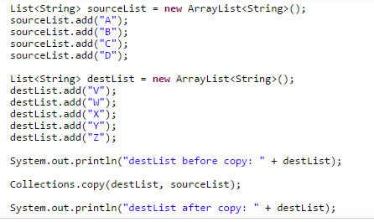

Copying one list into another
Collections.copyList(dest, src) static method allows us to copy all elements from the source list into the destination one

Slide 29
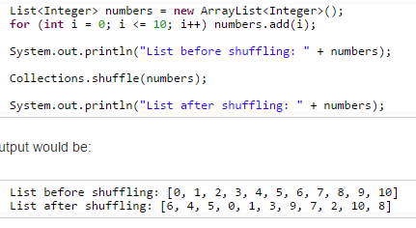
Shuffling elements in a list
To randomly permute elements in a list, use the Collections.shuffle() static method

Slide 30
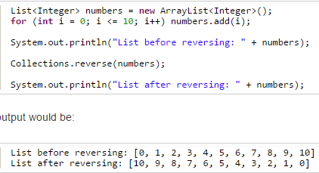
Reversing elements in a list
To reverse order of elements in a list, use the Collections.reverse()

Slide 31
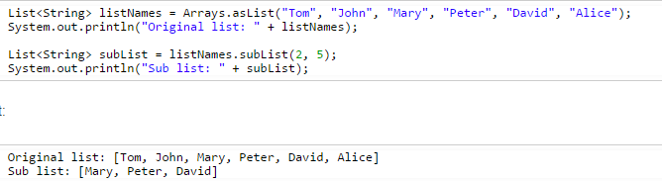
Extracting a portion of a list
subList(fromIndex, toIndex) allows us to get a portion of the list between the specified fromIndex (inclusive) and toIndex (exclusive).

Slide 32
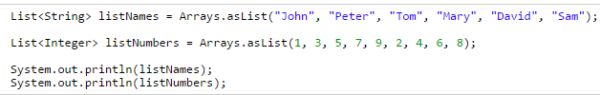

Converting between Lists and arrays
The Arrays.asList(T… a) method converts an array of type T to a list of type T

Slide 33
toArray() method that returns an array of Objects containing all of the elements in the list
String[] words = listWords.toArray();
Integer[] numbers = listNumbers.toArray();

