Slide 1

Recursion

Slide 2
Objective
Learn about recursion definition
Explore the base case and the general case of a recursive definition
Example
Explore how to use recursive methods to implement recursive algorithms

Slide 3
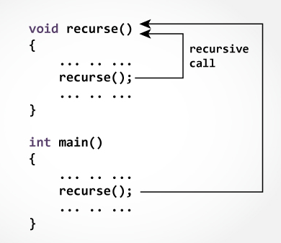
What is recursion?
A method calls itself continuously

Slide 4
Iteration vs. Recursion
Problem: Collect $1,000.00 for charity
Assumption: Everyone is willing to donate $1
Iterative Solution
Visit 1000 people, asking each for $1
Recursive Solution
Visit 10 people and ask them to each raise 1/10th of the amount of money that you have been asked to raise
Collect the money that they give you and combine it into one bag
Give it to the person who asked you to collect the money

Slide 5
What is recursion in programming?
Process of solving a problem
by reducing it to smaller versions of problem itself
Requires
A method
one or more base cases
Case in recursive definition in which the solution is obtained directly
Stops the recursion

Slide 6
General Form of Recursive methods
Solve(Problem)
{
if (a base case)
solve Problem directly; i.e., without recursion
else {
Decompose Problem into one or more similar, strictly smaller subproblems: SP1, SP2, ... , SPN
Recursively call Solve (this method) on each subproblem: Solve(SP1), Solve(SP2),..., Solve(SPN)
Combine the solutions to these subproblems into a solution that solves the original Problem }
}

Slide 7
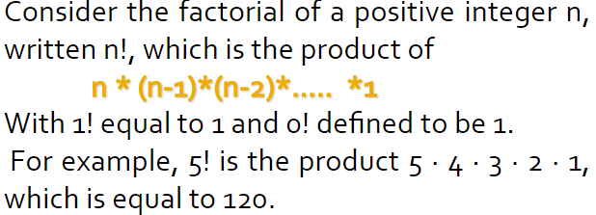
Example Factorial

Slide 8
Iterative Solution
Factorial(8) = 8*7*6*5*4*3*2*1
Factorial(6) = 6*5*4*3*2*1
Factorial(4) = 4*3*2*1
int factorial (int n)
{
int answer = 1;
for (int i=1; i<=n; i++)
answer = answer * i;
return answer;
}

Slide 9
Recursive approach for Factorial
int factorial (int n)
{
if (n == 0) //Base Case (Stop Condition)
return 1;
else {
int subN = n-1; //Decompose
int subFact = factorial(subN); //Solve Subproblem
return n * subFact; //Combine
}
}

Slide 10
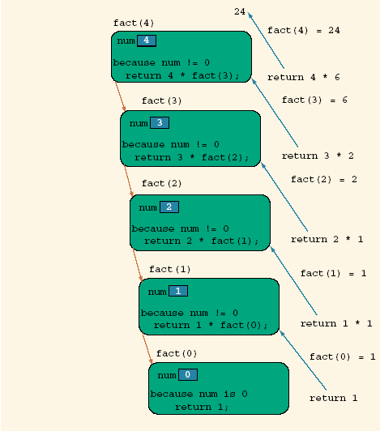
Execution Path for Factorial(4)

Slide 11
Recursive Factorial Method
public static int fact(int num) { if (num = = 0) //base case return 1; else return num * fact(num – 1); //solve subproblem
// and combine }

Slide 12
Recursive Factorial Method
public static int fact(int num) { if (num = = 0) return 1; else return num * fact(num – 1); }
RECURSION
public static int factorial (int n)
{
int answer = 1;
for (int i=1; i<=n; i++)
answer = answer * i;
return answer;
}
ITERATION

Slide 13
Example
public static int mystery(int n) {
if (n < 10) {
return n;
} else {
int a = n / 10;
int b = n % 10;
return b + mystery(a);
}
What is the result of the following call?
mystery(648)

Slide 14
A recursive trace
mystery(648):
int a = 648 / 10; // 64
int b = 648 % 10; // 8
return b + mystery(a); // 8 + mystery(64)
mystery(64):
int a = 64 / 10; // 6
int b = 64 % 10; // 4
return b+ mystery(a); // 4 + mystery(6)
return 6;
10
=8+10
=18
6
=6+4
=10
mystery(6):

Slide 15
Recursion or Iteration?
Two ways to solve particular problem
Iteration
Recursion
Both iteration and recursion use a control statement
Iteration uses a repetition statement
Recursion uses a selection statement

Slide 16
Recursion or Iteration? (Cont’d)
Iteration and recursion both involve a termination test
Iteration terminates when the loop-continuation condition fails
Recursion terminates when a base case is reached
Recursion can be expensive in terms of processor time and memory space, but usually provides a more intuitive solution

Slide 17
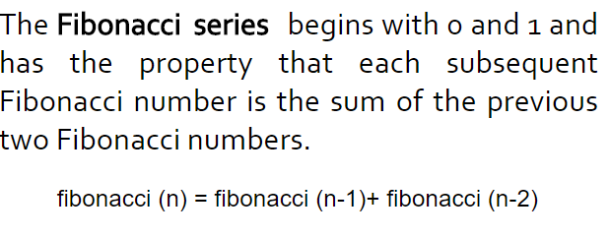
Problem : Fibonacci series
1 1 2 3 5 8 13 21…
Base class : n=0 or n=1
Sub problem : Fibonacci(n-1) + Fibonacci(n-2)

Slide 18
Problem
Write the following method recursively public static String reverse (String s)
Choose an appropriate base case, recursive call (hint: substring method using one parameter),
a way to combine (hint: +)
smaller problems to solve the original problem
reverse("abcd") should return "dcba"

Slide 19
Exercise
Write a recursive method reverseLines that accepts a file Scanner and prints the lines of the file in reverse order.
Example input file: Expected output:
I have eaten the icebox
the plums that were in
that were in the plums
the icebox I have eaten

Slide 20
Reversal pseudocode
Reversing the lines of a file:
Read a line L from the file.
Print the rest of the lines in reverse order.
Print the line L.
public static void reverseLines(Scanner input) {
if (input.hasNextLine()) {
// Read a line
//recursive case
reverseLines(input);
//print a line
System.out.println(line);
}
}

Slide 21
Recursion – Java Animate
What you mean by Recursion?
https://www.youtube.com/watch?v=FyHloXKnPWc
https://www.youtube.com/watch?v=Px8dgjKeh5I

