Slide 1

ITERATORS

Slide 2
Objective
Define an iterator and its use
Iterator & Iterable interface
Implementation of iterators

Slide 3
Iterator
Allows user to acquire and use each element in collection one at a time.
Often, you will want to cycle through the elements in a collection.
For example, you might want to display each element. The easiest way to do this is to employ an iterator, which is an object that implements either the ITERATOR or the LISTITERATOR interface.
Iterator is used for iterating (looping) various collection classes such as HashMap, ArrayList, LinkedList etc.

Slide 4
Iterator
enables you to cycle through a collection, obtaining or removing elements.
ListIterator
extends Iterator to allow bidirectional traversal of a list, and the modification of elements.

Slide 5
The Methods Declared by Iterator
Method | Description
Boolean hasNext() | Returns true if the iteration has more elements
E next() | Returns the next element in the iteration
Void remove() | Removes the last element returned by the iteration from the underlying collection

Slide 6
The Methods Declared by ListIterator
void add(Object obj) | Inserts obj into the list in front of the element that will be returned by the next call to next( ).
boolean hasNext( ) | Returns true if there is a next element. Otherwise, returns false.
boolean hasPrevious( ) | Returns true if there is a previous element. Otherwise, returns false.
Object next( ) | Returns the next element.
Object previous( ) | Returns the previous element
int nextIndex( ) | Returns the index of the next element. If there is not a next element, returns the size of the list.
int previousIndex( ) | Returns the index of the previous element. If there is not a previous element, returns -1.
void remove( ) | Removes the current element from the list.
void set(Object obj) | Assigns obj to the current element

Slide 7
follow these steps
To use an iterator to cycle through the contents of a collection
Obtain an iterator to the start of the collection by calling the collection's iterator( ) method.
Set up a loop that makes a call to hasnext( ). have the loop iterate as long as hasnext( ) returns true.
Within the loop, obtain each element by calling next( ).

Slide 8
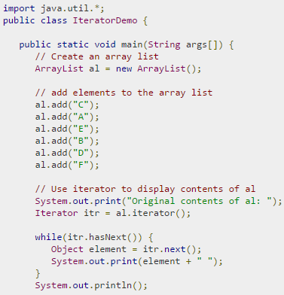
Example

Slide 9
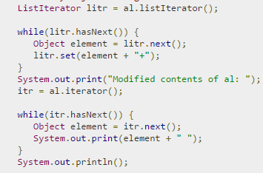

Example

Slide 10
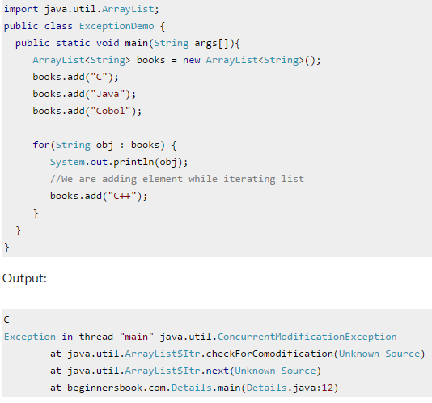
ConcurrentModificationException while using Iterator

Slide 11
We cannot add or remove elements to the collection while using iterator over it.
it is not generally permissible for one thread to modify a Collection while another thread is iterating over it

Slide 12
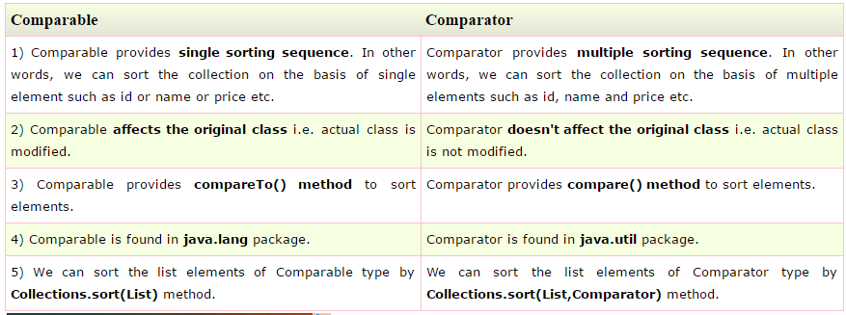
Comparable and Comparator
Comparable and Comparator both are interfaces
Useful for sorting collection of objects

Slide 13
Comparable and Comparator
We can sort the elements of:
String objects
Wrapper class objects
User-defined class objects
String class and Wrapper classes implements the Comparable interface.So if you store the objects of string or wrapper classes, it will be Comparable.

Slide 14
Java Comparable interface
Used to order the objects of user-defined class.
This interface is found in java.Lang package and contains only one method named compareto(object).
It provide single sorting sequence only
I.E. You can sort the elements on based on single data member only.
For example it may be rollno, name, age or anything else.

Slide 15
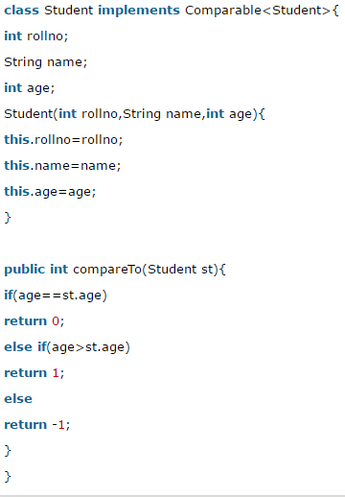
Java Comparable Example

Slide 16
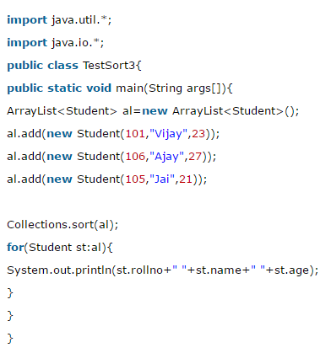
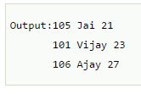

Slide 17
Java Comparator interface
Java comparator interface is used to order the objects of user-defined class.
Contains 2 methods compare(object obj1,object obj2) and equals(object element).
It provides multiple sorting sequence i.E. You can sort the elements on the basis of any data member, for example rollno, name, age or anything else.

Slide 18
Comparator interface
Compare(object o1, object o2)
Method need to be implemented that takes two object argument,
It should be implemented in such a way that
It returns negative int if first argument is less than the second one
Returns zero if they are equal
Returns positive int if first argument is greater than second one.

Slide 19
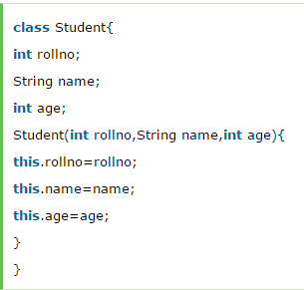
Example
Let's see the example of sorting the elements of List on the basis of age and name

Slide 20
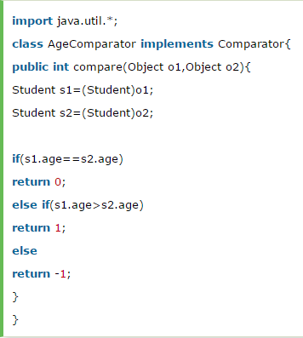
AgeComparator.java

Slide 21
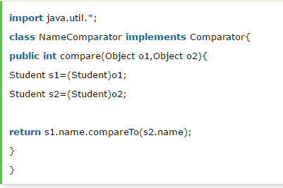
NameComparator.java

Slide 22
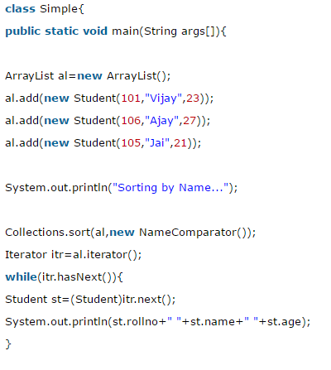
Simple.java

Slide 23
