Slide 1

Generics

Slide 2
Introduction
Prior to the JDK 5.0 release, when you created a Collection, you could put any object in it.
List myList = new ArrayList(10);
myList.add(new Integer(10));
myList.add("Hello, World");
Integer I = myList.get(0); //error
Getting items out of the collection required you to use a casting operation:
Integer myInt = (Integer)myList.get(0)
String str = (String) mylist.get(1);

Slide 3
How Generics useful?
This error comes up only when we are executing the program and not during compile time
If you accidentally cast the wrong type, the program would successfully compile, but an exception would be thrown at runtime.
A generic is a method that is recompiled with different types as the need arises

Slide 4
Generics allows you to specify, at compile-time, the types of objects you want to store in a Collection. Then when you add and get items from the list, the list already knows what types of objects are supposed to be acted on.
So you don't need to cast anything. The "<>" characters are used to designate what type is to be stored. If the wrong type of data is provided, a compile-time exception is thrown.

Slide 5
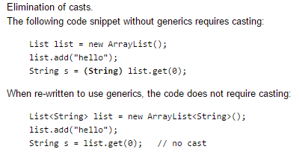
In a nutshell, generics enable types (classes and interfaces) to be parameters when defining classes, interfaces and methods.

Slide 6
Generic Types
It would be nice if we could write a single sort method that could sort the elements in an Integer array, a String array, or an array of any type that supports ordering.
Java Generic methods and generic classes enable programmers to specify, with a single method declaration, a set of related methods, or with a single class declaration, a set of related types, respectively.
A generic type is a generic class or interface that is parameterized over types.

Slide 7
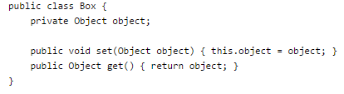
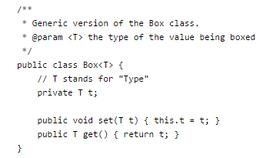
A Generic Version of the Box Class
A type variable can be any non-primitive type you specify:

Slide 8
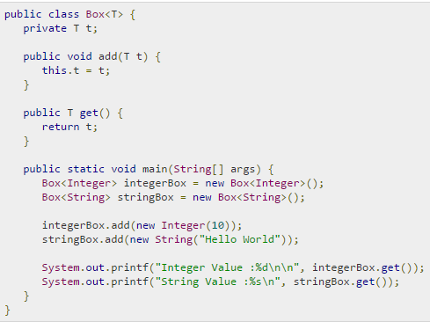

Slide 9
Invoking and Instantiating a Generic Type
Box<Integer> integerBox = new Box<Integer>();
In Java SE 7 and later, you can replace the type arguments required to invoke the constructor of a generic class with an empty set of type arguments (<>)
Box<Integer> integerBox = new Box<>();

Slide 10
Generic Methods
single generic method declaration that can be called with arguments of different types
All generic method declarations have a type parameter section delimited by angle brackets (< and >) that precedes the method's return type ( < E >)

Slide 11
Type Parameters
The type parameters naming conventions are important to learn generics thoroughly. The commonly type parameters are as follows:
T - Type
E - Element
K - Key
N - Number
V - Value

Slide 12
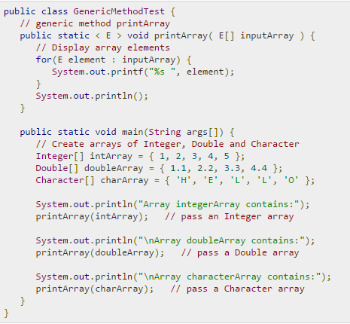

Slide 13
Wildcard in Java Generics
The ? (question mark) symbol represents wildcard element. It means any type.
Upper Bounded Wildcards
Works on List<Integer>, List<Double>, and List<Number>; than use List<? extends Number>
If we write <? extends Number>,
it means any child class of Number e.g. Integer, Float, double etc.

Slide 14
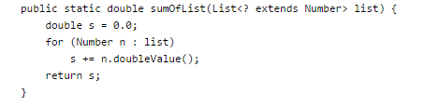


Ex

Slide 15
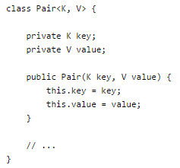

Restrictions on Generics
Cannot Instantiate Generic Types with Primitive Types
Cannot Declare Static Fields
Cannot Overload a Method

Slide 16
Autoboxing and Unboxing
Autoboxing is the automatic conversion that the Java compiler makes between the primitive types and their corresponding object wrapper classes.
For example, converting an int to an Integer, a double to a Double, and so on.
Character ch = 'a';
If the conversion goes the other way, this is called unboxing.

Slide 17
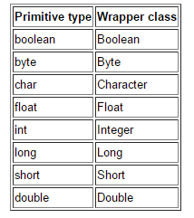
autoboxing
Converting a primitive value (an int, for example) into an object of the corresponding wrapper class (Integer) is called autoboxing

Slide 18

Autoboxing
The Java compiler applies autoboxing when a primitive value is:
Passed as a parameter to a method that expects an object of the corresponding wrapper class.
Assigned to a variable of the corresponding wrapper class.

Slide 19
unboxing
Converting an object of a wrapper type (Integer) to its corresponding primitive (int) value is called unboxing.
The Java compiler applies unboxing when an object of a wrapper class is:
Passed as a parameter to a method that expects a value of the corresponding primitive type.
Assigned to a variable of the corresponding primitive type.

Slide 20
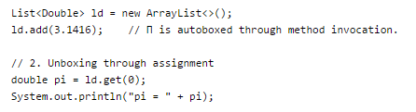

Slide 21
Write a generic method to count the number of elements in a collection that have a specific property (for example, odd integers, prime numbers, palindromes).
Write a generic method to exchange the positions of two different elements in an array.

