Slide 1
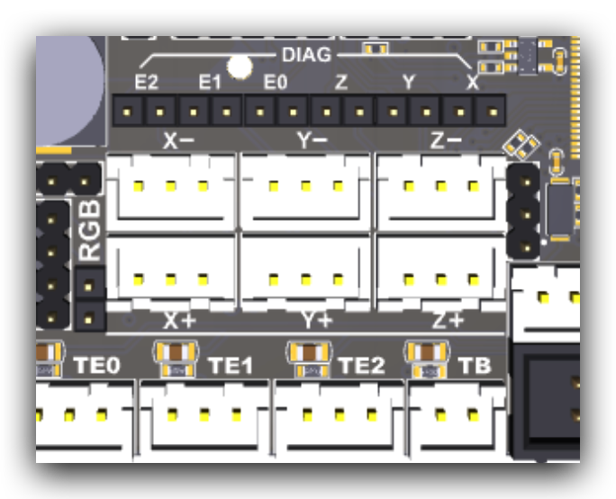
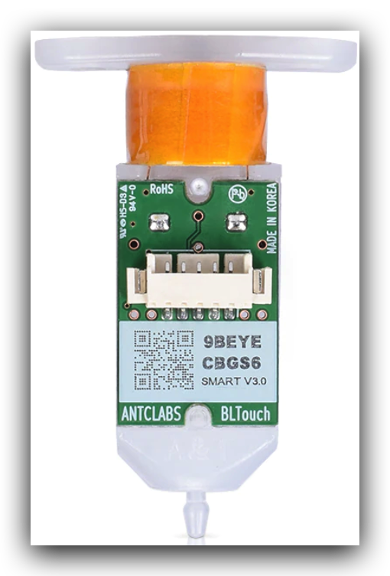
PA0
PA2
+5v
GND
+5v
PWM
GND SGN

Slide 2
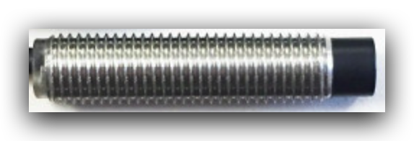
+24v
PA3
+5v
+VCC
GND
SGN Thermistor

