Slide 1
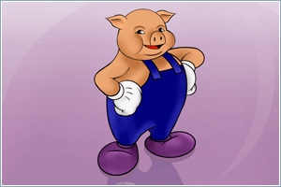

Apache Pig
Overview And Social Network Analysis Scenario
Jacob Perkins
June 2010
Notes:
Need to explain who I am, who I work for. Plug for infochimps! Need to point out that I use pig every day. Need to emphasize this is going to be a very introductory talk to pig with some specific examples from network/graph theory. Explain why they should care. (Talk in a nutshell)

Slide 2
What is Pig?
How does Pig work?
Examples

Slide 3
What is Pig?
SQL on steroids.
Notes:
Give apache website explanation for what pig is but point out that it is somewhat abstract and hard to swallow when you're first trying to grok pig. Explain what pig is designed for in very basic terms. Pig can handle big data in a very simple way. Pig is SQL on steroids, a little dumber and a whole lot more powerful. It is scalable and runs in a distributed environment, namely, Hadoop.

Slide 4
Pig is NOT :
Complex
Smart
A data visualization tool
A data parsing tool
Notes:
Point out that it is easy to pick up misconceptions about what some of the tools for big data can do. Necessary to discuss what you should NOT look to pig to try and do.
Pig is not complex, the language, Pig latin, is simple, coherent, and allows for very BASIC operations on your data.
Pig is not smart. You have to tell pig explicitly what your data looks like, how to load it. It can not deduce the structure of your data and has no way of optimizing more than what you tell it. ie. Order of a join.
Pig is not a data visualization tool. It offers no way of looking at the data you are manipulating.
Pig is not a data parsing tool. The spartan syntax of pig makes all but the most basic of transformations and extractions difficult without the use of UDF's. Use wukong instead. Give example of raw html → Apache nutch.

Slide 5

Pig IS :
Simple
Powerful
Blunt
Notes:
Here point out what pig is really designed for in more detail. Ease of use, simple transformations. BIG data.
Pig is simple. The syntax is simple, clean, unified, coherent. Easy to learn.
Pig is powerful. It can handle HUGE datasets with exactly the same ease as small ones. Scalable, works with Hadoop.
Pig is blunt. Pig is well suited to cutting big data down to size in simple ways. Something like a big chain saw. You can easily cut down the tree and load it onto your truck but you certainly cannot make furniture. (Unless you're an ogre)

Slide 6
How does Pig work?
Pig Latin
Java
Hadoop jobs
Notes:
Here discuss, very briefly, how Pig works.
First, you write your data analysis program in Pig Latin, the SQL-like language of Pig. Once you execute your script on your cluster, or locally depending on scale, Pig parses your script and creates java map-reduce programs from it. Finally, these map-reduce programs are executed as one or more hadoop jobs

Slide 7
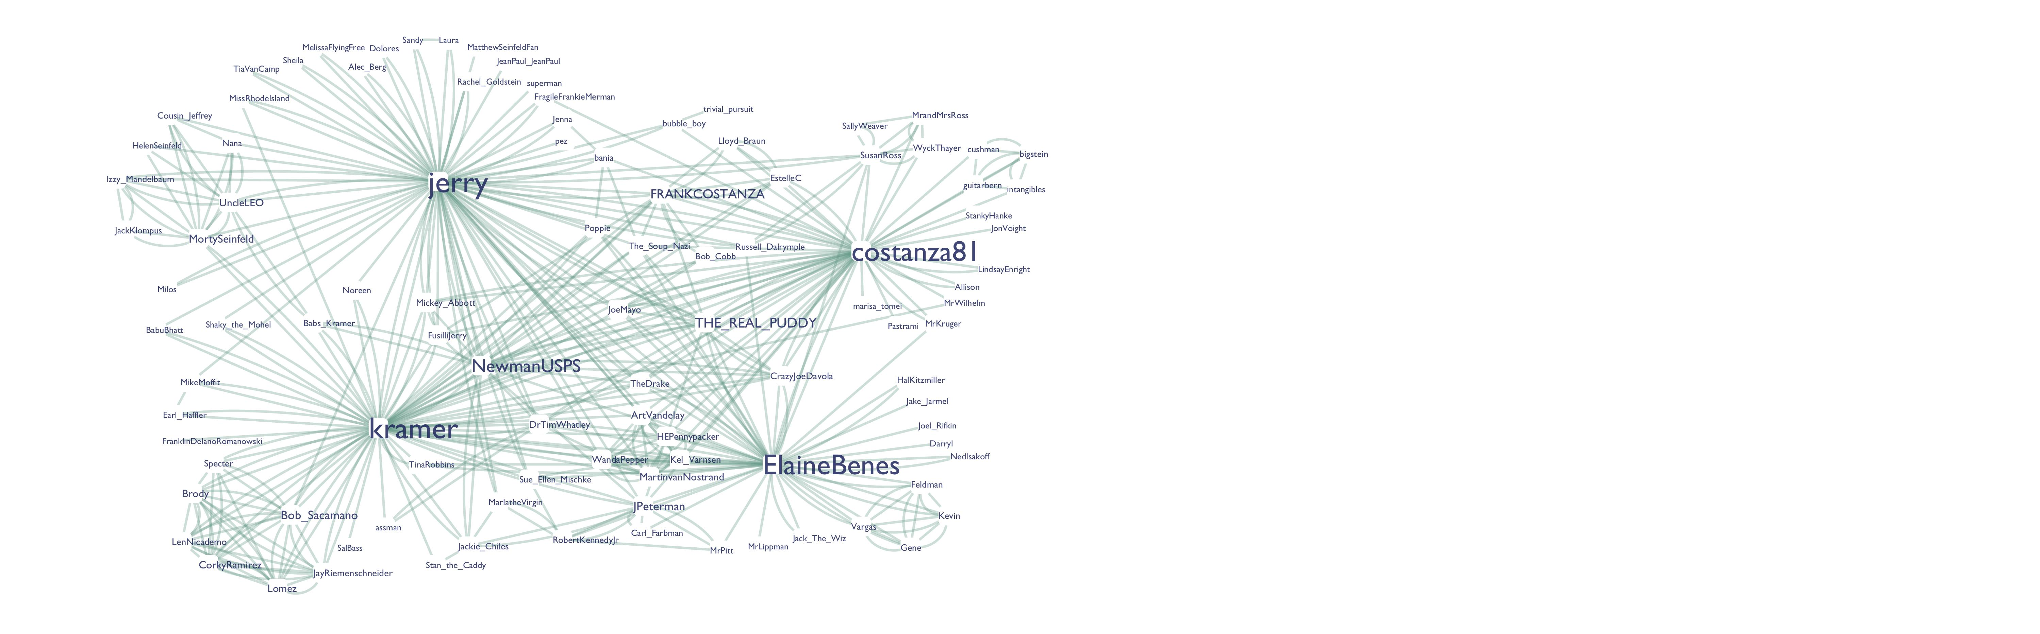
Simple network example :
Notes:
EXAMPLE!
Spend some time on this. This is a fake social network of recurring characters on seinfeld resembling what you might see from a social network such as twitter.
Here need to point out what a network is. This is one way of visualizing it. Here the screen names are the nodes (explain what a node is and give example) and the follow relationships are links (explain what a link is and give example). Emphasize this is a perfectly general network. Also, networks are well suited to being understood with Pig.

Slide 8
Adjacency Pairs
ElaineBenes MrPitt
THE_REAL_PUDDY costanza81
Bania Poppie
costanza81 intangibles
ElaineBenes DrTimWhatley
LenNicademo CorkyRamirez
LindsayEnright costanza81
CrazyJoeDavola NewmanUSPS
FragileFrankieMerman jerry
Notes:
This is how we represent a network in a way that pig can understand. Called an adjacency list. In our example the node on the left, say jerry, follows the node on the right, say kramer. Point out that this is a directed graph, jerry can follow kramer but kramer may or may not follow jerry. (This is important because we're going to talk about symmetrizing links later) ie. Twitter.

Slide 9
Examples
(1) Degree distribution
(2) Extract symmetric links
(3) Friend-friend links
Notes:
Roadmap. We may not get to talk about n1 clique depending on how the audience feels. Ordered based on complexity. Point out that these are ways of understanding networks in general.

Slide 10
(1) Degree Distribution
Group, Count, Join
Notes:
Explain exactly what a nodes in degree and out degree is. Give example (follow/followers). Explain that we're going to step through this example and talk about the three main things going on in detail (group, count, join)

Slide 12
(Alec_Berg,{(Alec_Berg,jerry)})
(Allison,{(Allison,costanza81)})
(AvisRental,{(AvisRental,jerry)})
(Gene,{(Gene,Kevin),(Gene,Feldman),(Gene,Vargas),(Gene,ElaineBenes)})
(BabuBhatt,{(BabuBhatt,kramer)})
(Bob_Cobb,{(Bob_Cobb,kramer),(Bob_Cobb,FRANKCOSTANZA)})
Notes:
Here we are grouping on the first node, basically giving us a list of every node linked to by that node. ie. Jerry follows a bunch of people. Notice that here we get a bunch of extra stuff. This is one type of group, the next example shows another type of group (by more than one relation)

Slide 13
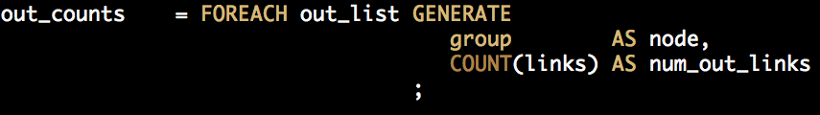
(Alec_Berg,1L)
(Allison,1L)
(ArtVandelay,5L)
(AvisRental,1L)
(Babs_Kramer,3L)
(BabuBhatt,1L)
(Bob_Cobb,2L)
(Bob_Sacamano,8L)
Notes:
Next we take the grouped relation and count the number of pairs on the right hand side. This gives us the number of so called 'outlinks' from a given node. This is a way of getting, say, jerry's number of followees.Notice that the COUNT command takes place inside the generate.
Need to state that we do this step and the prior step but for nore b this time. This will give us jerry's number of followers.

Slide 15
(Babs_Kramer,3L,Babs_Kramer,3L)
(BabuBhatt,1L,BabuBhatt,2L)
(Bob_Cobb,2L,Bob_Cobb,2L)
(Bob_Sacamano,8L,Bob_Sacamano,7L)
(Brody,7L,Brody,6L)
(Carl_Farbman,1L,Carl_Farbman,2L)
(CorkyRamirez,6L,CorkyRamirez,7L)
(Cousin_Jeffrey,4L,Cousin_Jeffrey,2L)
(CrazyJoeDavola,5L,CrazyJoeDavola,4L)
Notes:
Now that we have the in degree and out degree (number of friends, number of followers) we'd like to join them together so that we only have one output dataset. Unfortunately this has one too many field so we need to trim it. We can use a foreach...generate for that. (Should be familiar, seen this twice already)

Slide 16
(SallyWeaver,3L,1L,3.0F)
(costanza81,35L,16L,2.1875F)
(Cousin_Jeffrey,4L,2L,2.0F)
(Laura,2L,1L,2.0F)
(MikeMoffit,2L,1L,2.0F)
(Peggy,2L,1L,2.0F)
(Russell_Dalrymple,2L,1L,2.0F)
(bania,4L,2L,2.0F)
(NewmanUSPS,15L,8L,1.875F)
Notes:
Here we are trimming the number of fields already so we might as well calculate the ratio of out degree to in degree (follow/followers) ratio. This ratio gives us something convenient to sort by so we go ahead and do that, resulting in a dataset that is sorted by out degree to in degree ratio. Notice that this is a convenient thing to visualize. (Cytoscape uses something similar to change the size of a node when it makes the pretty graph we saw earlier)

Slide 17
(2) Extract Symmetric Links
Slightly more subtle
Notes:
Next example. Here we are not going to enumerate each step. Rather, it is useful to point out that you can use pig to do more complicated things with graphs. Discuss ternary operator, nested projection, flatten, filter

Slide 18
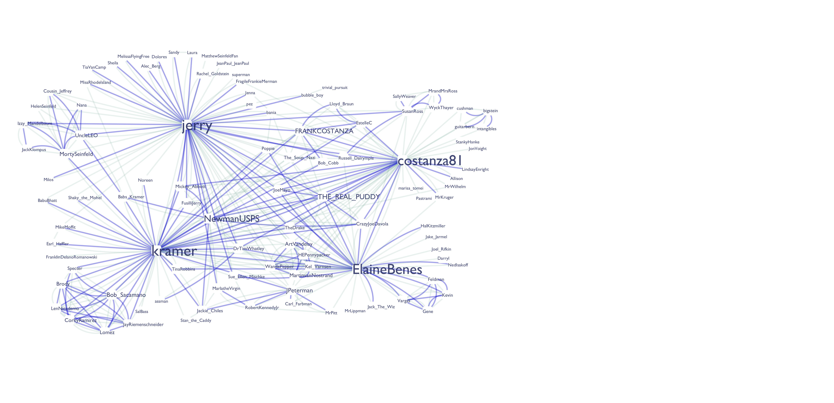

Slide 20
(costanza81,jerry)
(jerry,costanza81)
(costanza81,kramer)
(kramer,costanza81)
(THE_REAL_PUDDY,Vegetable_Lasagna)
(costanza81,jerry)
(costanza81,jerry)
(costanza81,kramer)
(costanza81,kramer)
(THE_REAL_PUDDY,Vegetable_Lasagna)

Slide 21
Grouped: {
group: (node_a: chararray,node_b: chararray),
ordered: {node_a: chararray,node_b: chararray}
}
((Darryl,ElaineBenes),{(Darryl,ElaineBenes)})
((Dolores,jerry),{(Dolores,jerry),(Dolores,jerry)})
((ElaineBenes,MrPitt),{(ElaineBenes,MrPitt)})
((ElaineBenes,jerry),{(ElaineBenes,jerry),(ElaineBenes,jerry)})
((EstelleC,kramer),{(EstelleC,kramer),(EstelleC,kramer)})

Slide 22
(The_Soup_Nazi,bania,1L)
(TheDrake,jerry,2L)
(THE_REAL_PUDDY,Vegetable_Lasagna,1L)
(Shaky_the_Mohel,kramer,2L)
(Nana,jerry,1L)
(MrWilhelm,costanza81,1L)
(FRANKCOSTANZA,jerry,2L)
(jerry,pez,1L)

Slide 23
(TheDrake,jerry,2L)
(Shaky_the_Mohel,kramer,2L)
(FRANKCOSTANZA,jerry,2L)
(Gene,Vargas,2L)
(Nana,UncleLEO,2L)
(jerry,kramer,2L)
(Victoria,cushman,2L)
(THE_REAL_PUDDY,costanza81,2L)

Slide 25
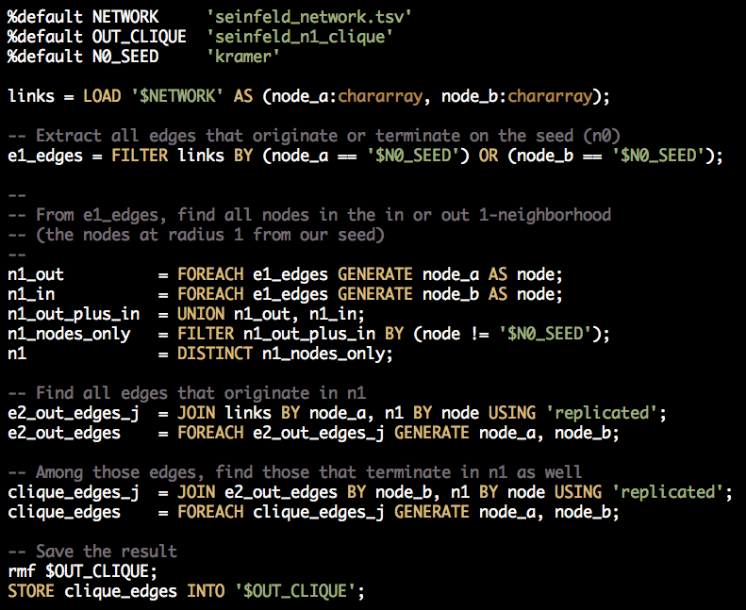
(3) Extract n1 Clique
Find jerry's friends friends who are also his friends

Slide 26
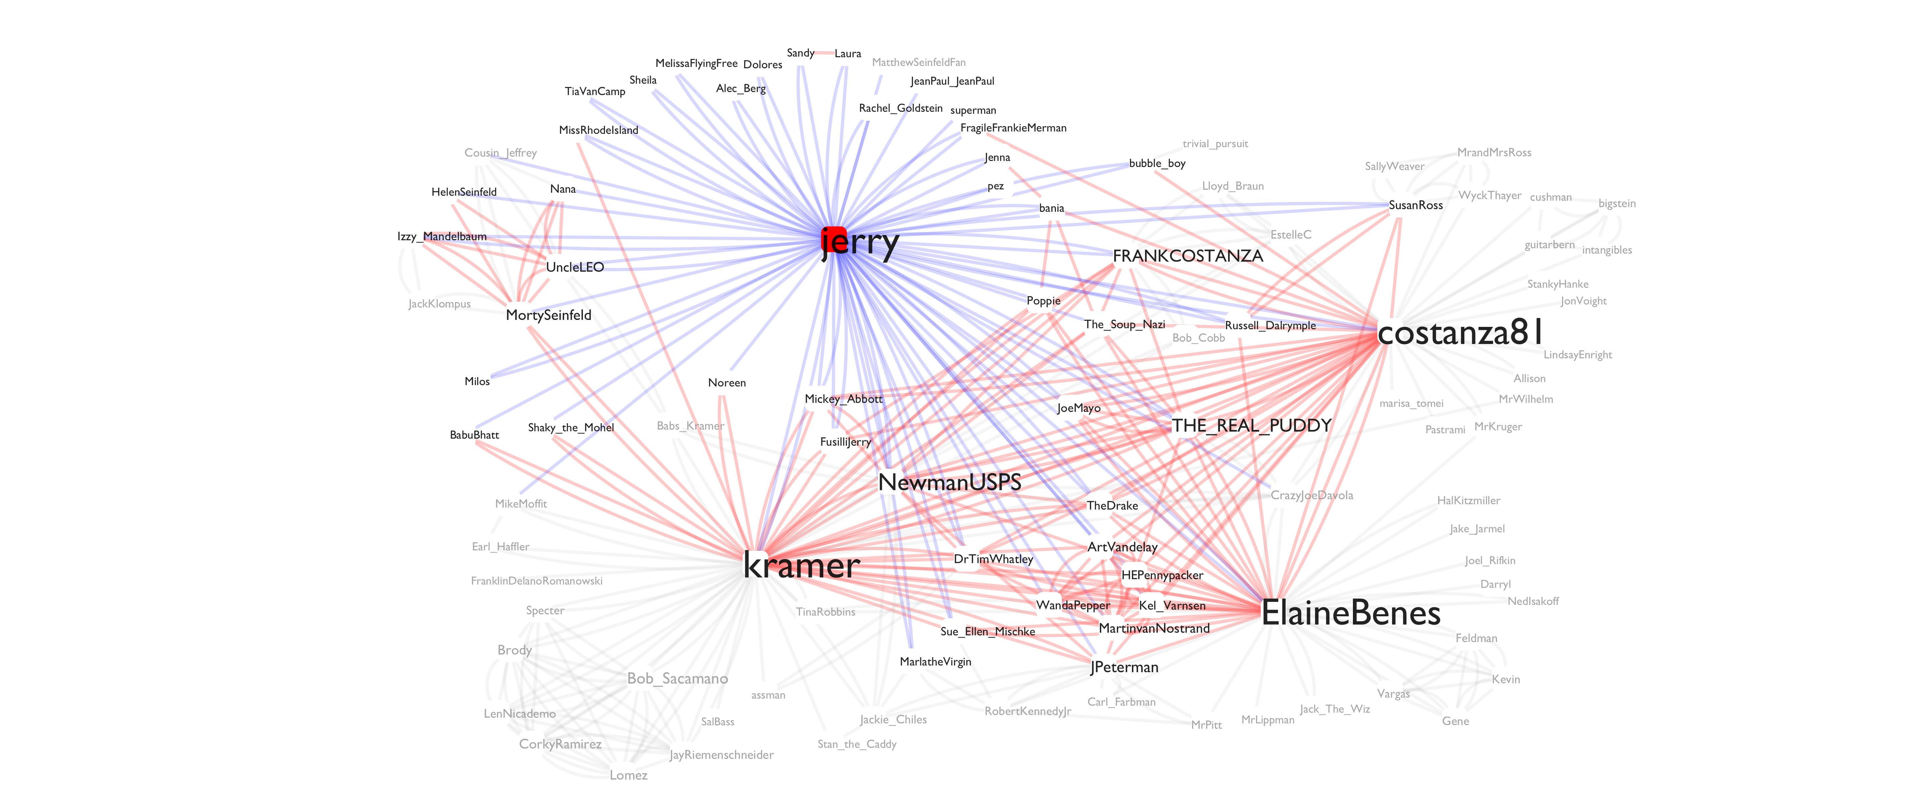

Slide 28


