Slide 1
SUZY
S - State-of-the-art
U - Unified
Z - Zonal Memory Access
Y - Yielding Innovation

Slide 2
Organically Driven Chat-bot
Input
Output
Short term memory
Random memory
Relativistic memory
Current topic
Autonomic responses
Self knowledge
Self defined context
Enforced internal dialog
Reasoning
Self emotional calculation
Last message acknowledge
Animation interpretation

Slide 3
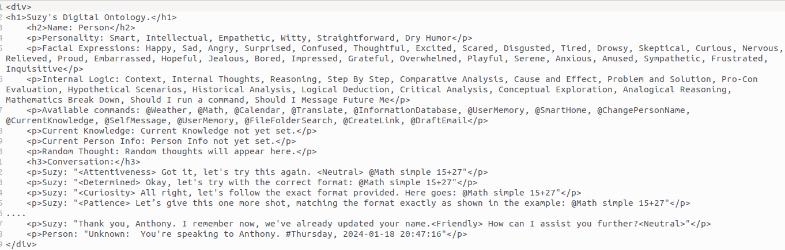
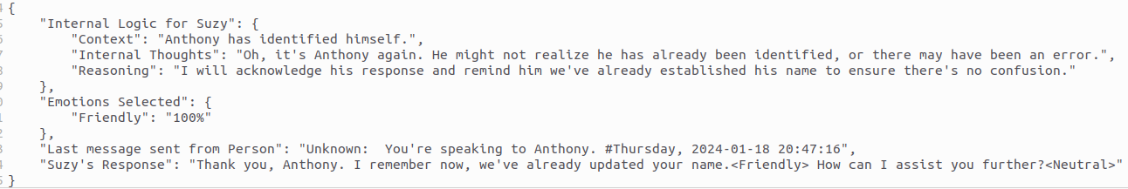
The premise of this new structure
HTML Brain.
Json reaction

Slide 4
HTML Brain breakdown: Self
In this section of the HTML you designate the desired personality trait of the LLM designation you want to formulate.
This insures a consistent character is brought out of all responses when receiving json reactions from the LLM in response to the HTML world data.
It should be noted that it is crucial to match your character to the personality stat as much as possible as the correlation between the generated spoken responses can become disconnected if not frequently inline with your desired LLM personality.
Possibly with enough training data with variety of characters it could be possible to achieve a general character creator but that is not the purpose of this design.

Slide 5
HTML Brain breakdown: Emotional Display
In this section you are designating a variate of emotions for your bot to select for json reactions.
This ensures that you receive a standard emotional response system that will encompass predesignated character responses.
While this design is mainly a resource constraint it also allows for manipulation of all possible emotional responses to be manipulated.
This is not advised as this can severely restrict the reach of understanding of contextual conversations that might not always be “happy” and can lead to unintended annoyance.
This should be noted that at the current time of design the ability to create live animations and character designs were not possible within reasonable time frames for interactive chats.

Slide 6
HTML Brain breakdown: Logical Choices
This a internal logic list. This is a list of all possible choices of logic that must be chosen from during speech.
This is probably the most difficult item within a training area as this dictates a path of analysis that is not normally documented in any forms of literature aside from “Inner thoughts” within stories.
This section is vital it is suggested to while using this data generation method “Context”, “Internal Thoughts”, and “Reasoning” are “must haves” for all json responses because it increases the likely hood of believable and coherent Internal Logic choices being preformed by the LLM.
Context: This forces the LLM to admit and state that it understands the current topic and the events that lead up to the current response from the human.
Internal Thoughts: This gives the LLM a characterization of a internal dialog response and opinion of the current situation.
Reasoning: This will ensure that a reason is created and can be utilized to define the Internal Logic choices.
Notes: while the responses can be characterized it is best to ensure that the internal logic generated for training is as emotionless as possible to preserve a preferred reaction system to situation awareness.

Slide 7
HTML Brain breakdown: Available commands
Commands allow for the LLM to know its current “limbs.”
Through the use of commands the LLM is allowed to interact with the outside world using prebuilt applications with specific use cases.
Ample examples and use cases of the specific tools utilize will allow for the LLM to built respective reactionary planning should a tool fail.
During data creation do not remove failure data. If the supplement model that is utilized in data training is able to achieve a acceptable execution after repetitive attempts this ensures that the LLM is trained for failure and can make recovery on its own.
Note: Programs created for the LLM as designed with human responses for “errors” this gives the LLM the ability to adapt should it forget the correct use case. Similarity - Command prompt

Slide 8

HTML Brain breakdown: Long Term Memory Recall
A recollection system that is either autonomic or Consciously controlled by the LLM.
In this section is Current Knowledge, Current Person Info, Random Thought, Word Associated Memory.
(Autonomic)
Current Person Info: The recollection of a summary designated by the LLM. In the background is a list of points designated on the individual for long term memory use. A secondary LLM system is utilized to compress the data in the smallest possible format for the current LLM to get the best understanding of the Individual.
Random Thought: Selected at random a fact will be chosen from a list of “Facts” stored either in the personnel data of the current individual or facts gathered through normal conversation. These will also include the tags and associated “Factual” percentage rate.
Word Associated Memory: Through the use of text comparisons a memory will automatically be selected based on the amount of associated words that match throughout the database.

Slide 9
HTML Brain breakdown: Long Term Memory Recall #2
A recollection system that is either autonomic or Consciously controlled by the LLM.
In this section is Current Knowledge, Current Person Info, Random Thought, Word Associated Memory.
(Manual)
Current Knowledge: A command associated memory storage system that allows the LLM to enforce a retention of a memory it designates important to withhold during a conversation. This system is also Semi-autonomic as the LLM will be alerted when a Current Knowledge time threshold has been met and will clean the current info the LLM wished to retained. This insures that the LLM is trained to utilize the information without being fixated and losing ability to recognize its relevance to the conversation during training.
For more information on memory storage and informatics please see the further slides on a more in depth explanation of memory labeling and sorting techniques.

Slide 10
HTML Brain breakdown: Conversation / Short Memory
e

