Slide 1
DEVOPS CAPSTONE
SST TERM 9 · FINAL PROJECT
Kairos
Incident
Response
on AWS EKS
An outage tracker taken from git push to a monitored Kubernetes cluster.
3
5/5
0
jobs
pods
CVEs
CI/CD PIPELINE
RUNNING ON EKS
FIXABLE HIGH/CRITICAL
PRABAL PATRA
OCT 2026
ALIENX5499/KAIROS
PYTHON · REACT

Slide 2
AGENDA
WHAT WE COVER
The
Journey
01
Why Kairos
THE PROBLEM
02
Tech Stack
THREE LAYERS
03
Pipeline
CI/CD ON PUSH
04
Containers
DOCKER COMPOSE
05
Kubernetes
EKS + HELM
06
Observability
TRIVY + GRAFANA
07
Alternatives
WHY THESE TOOLS

Slide 3
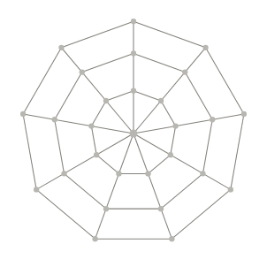
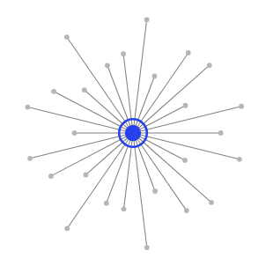
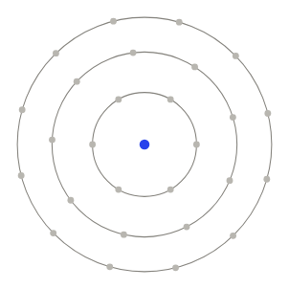
01 · WHY KAIROS
PROBLEM AND STACK
Outages need
A
B
C
a log
Application
Delivery
Platform
REACT · FASTAPI
DOCKER · ACTIONS
TERRAFORM · EKS
Teams lose track of who owns
an outage.
KAIROS KEEPS ONE RECORD.
Helm deploys to EKS;
Log P1-P4 incidents, track status,
Each push is tested, built,
Prometheus and Grafana watch
store in Postgres.
scanned and pushed to GHCR.
it.

Slide 4
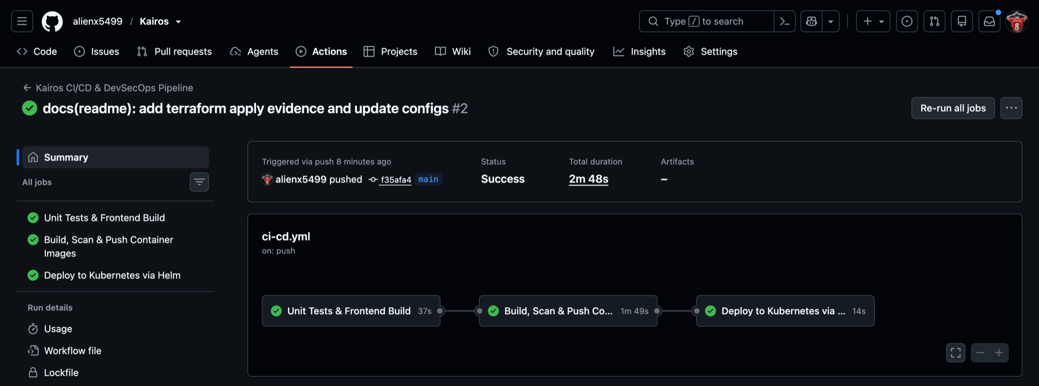

02 · PIPELINE
GITHUB ACTIONS ON PUSH
Commit to cluster
One push to main tests, builds, scans and deploys to EKS in
under 3 minutes.
37S
Test
pytest suite and frontend build
1M 41S
Build & Scan
Docker images, Trivy HIGH/CRITICAL
CI/CD PIPELINE PROOF
SHA TAG
Push
Images to GHCR tagged by commit
17S
Deploy
helm upgrade on EKS, pods roll
Green pipeline, zero manual deploy steps.
RUN #4 · 2M 43S

Slide 5
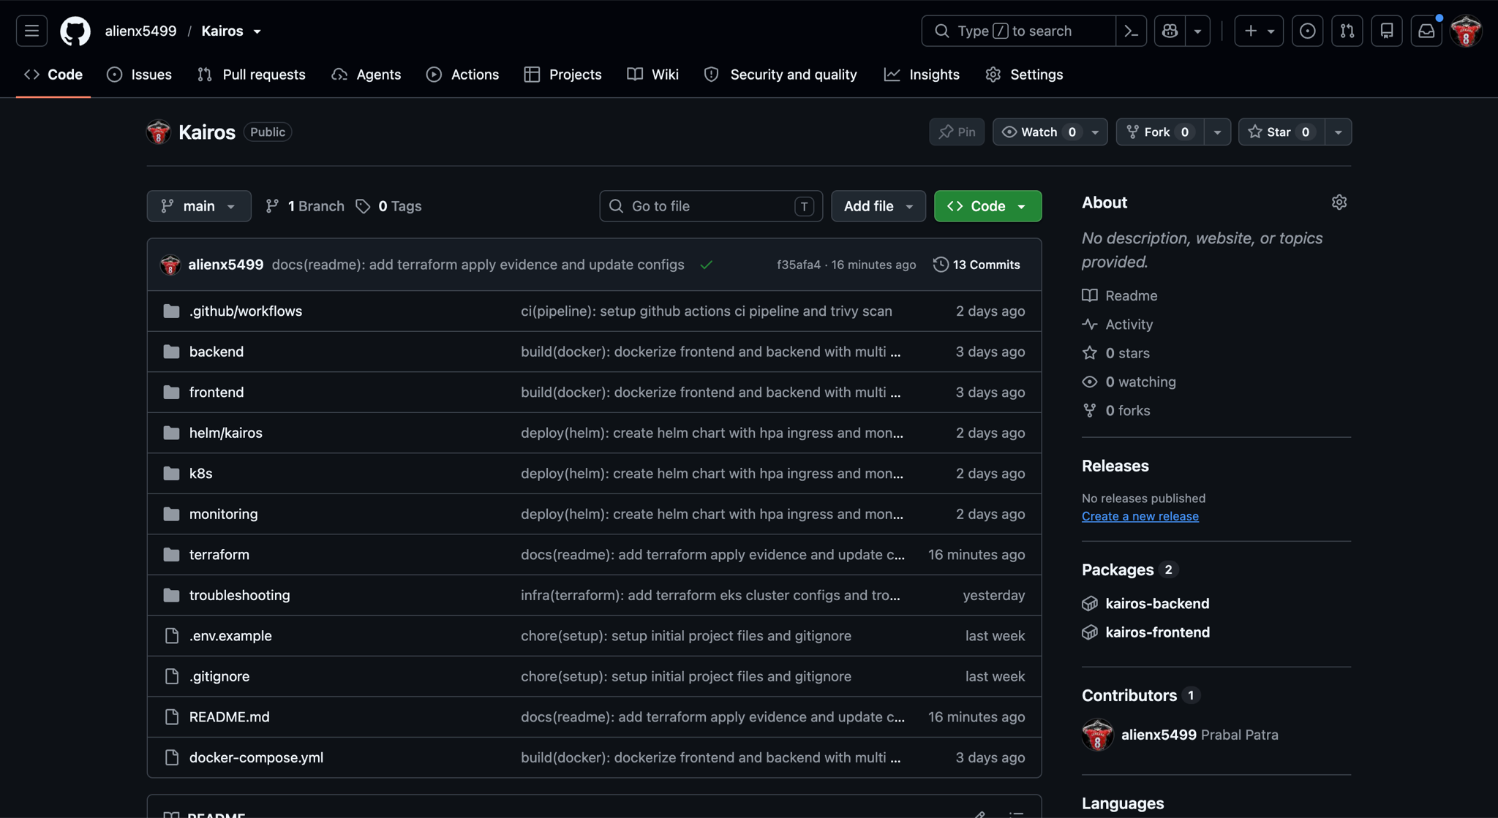
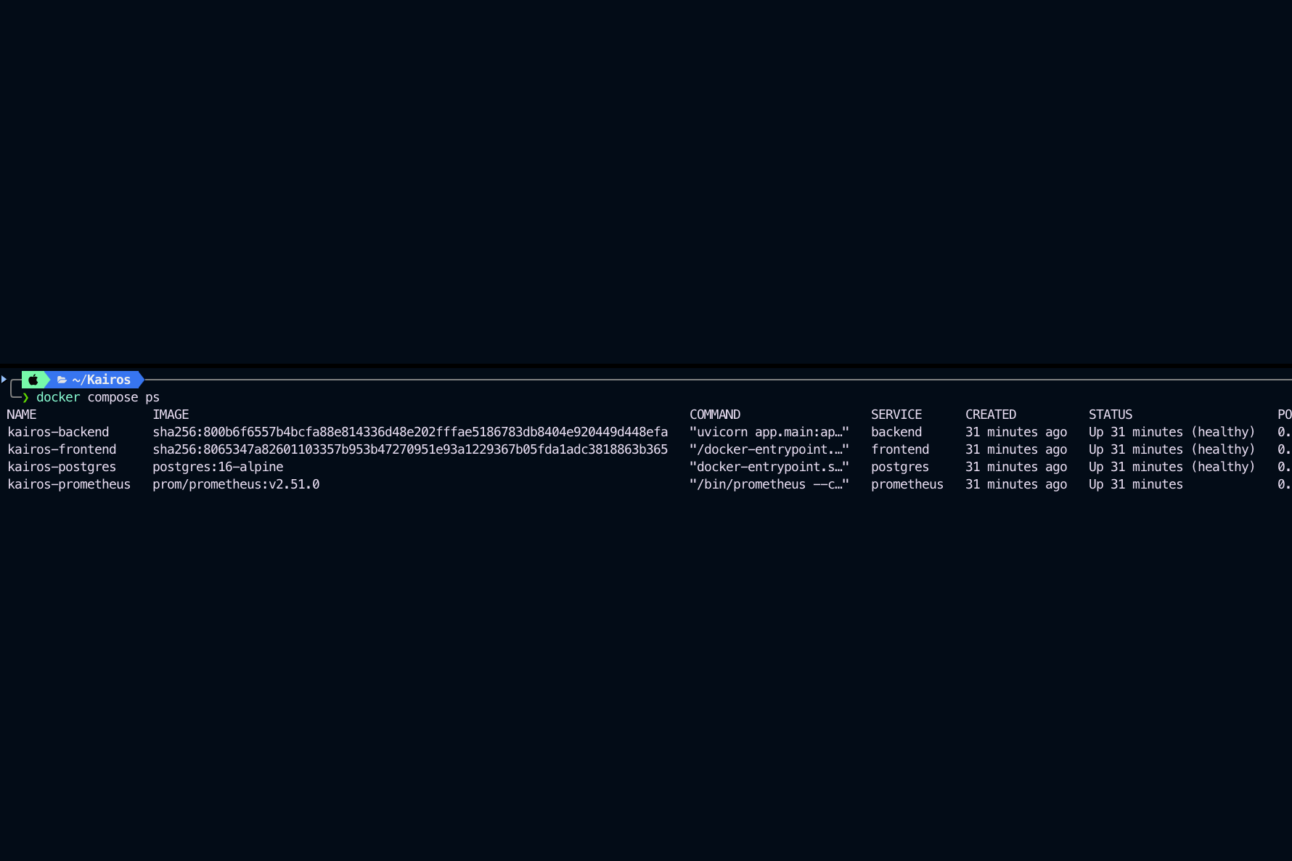
03 · CODE AND CONTAINERS
GITHUB REPO, DOCKER COMPOSE
REPO AND COMPOSE PROOF
Built
in Docker
first
Each service has its own Dockerfile; one compose command
runs all three locally.
3/3
SERVICES
Healthy in Compose
Multi-stage
Non-root
15 commits
GITHUB REPO · COMPOSE PS
WHY DOCKER
Same image runs on a laptop and on EKS.

Slide 6
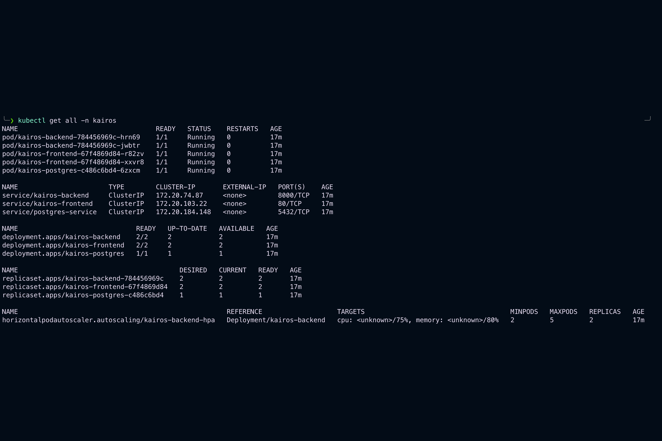
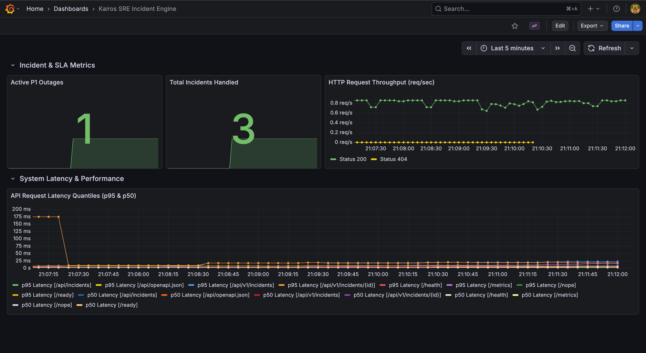
04 · KUBERNETES AND MONITORING
TERRAFORM EKS, HELM, PROMETHEUS
DEPLOYMENT PROOF
Running
on EKS
and
watched
Terraform builds VPC and EKS; Helm runs 2 replicas each;
Grafana shows it live.
5/5
PODS
Running, 0 restarts
2 AZs
HPA 2-5
2/2 targets UP
KUBECTL GET ALL · GRAFANA
WHY EKS
Managed control plane plus HPA scaling.

Slide 7
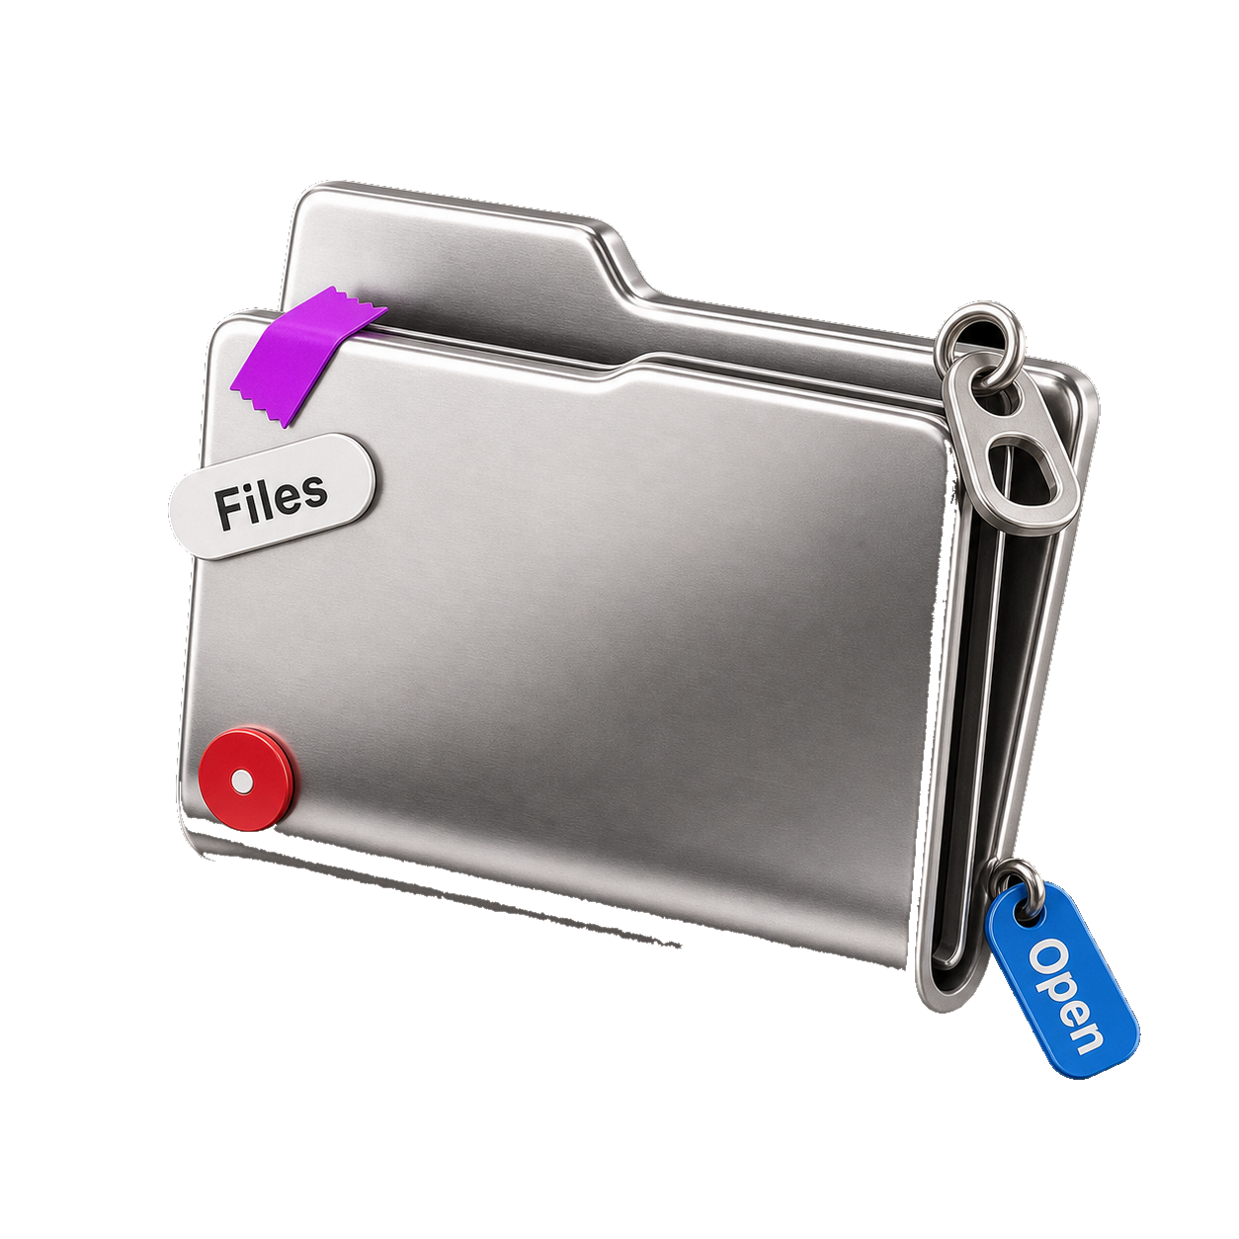
05 · ALTERNATIVES
WHY THESE TOOLS
Choice vs options
Chosen
Option A
Option B
LAYER
USED
SKIPPED
SKIPPED
Runtime
EKS + Helm
PORTABLE
ECS Fargate
PORTABLE
Docker Swarm
PORTABLE
ORCHESTRATION
CI/CD
GH Actions
REPO-NATIVE
Jenkins
REPO-NATIVE
GitLab CI
REPO-NATIVE
AUTOMATION
IaC
Terraform
MULTI-CLOUD
CloudFormation
MULTI-CLOUD
Pulumi
MULTI-CLOUD
INFRASTRUCTURE
Registry
GHCR
FREE WITH REPO
Docker Hub
FREE WITH REPO
ECR
FREE WITH REPO
IMAGES
Monitor
Prometheus
OPEN SOURCE
CloudWatch
OPEN SOURCE
Datadog
OPEN SOURCE
OBSERVABILITY
RULE
Pick managed, open and free for students.

Slide 8
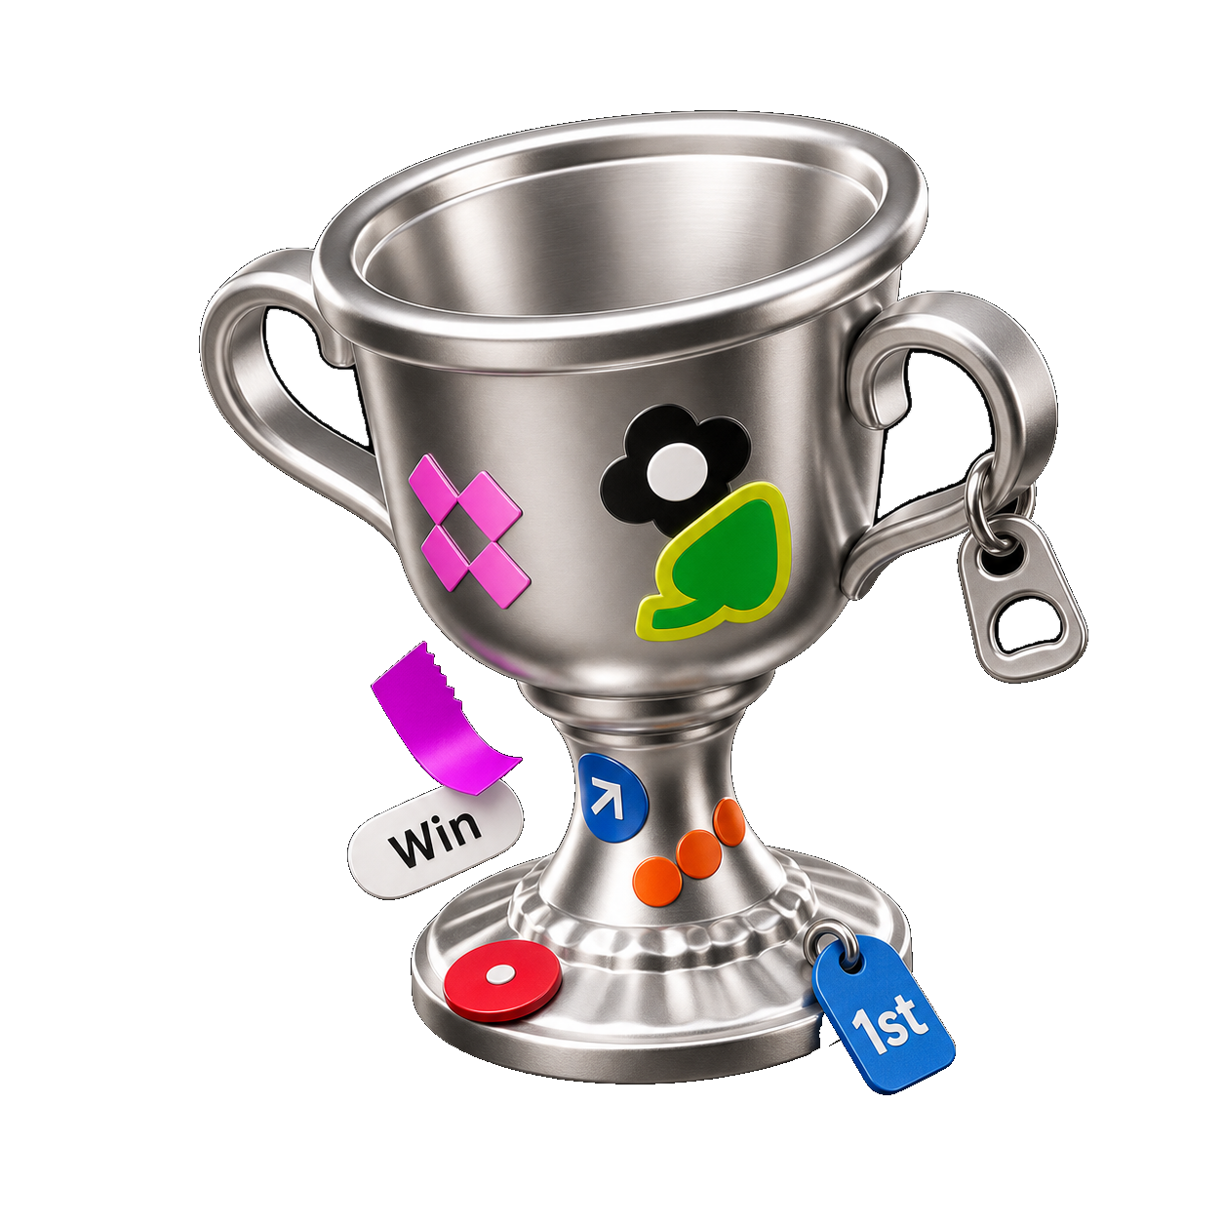
THANK YOU
KAIROS · DEVOPS
Push
your
code,
ship
LINKS
safely
.
REPO
github.com/alienx5499/Kairos
CI
GitHub Actions · ci-cd.yml
From git push to monitored pods on AWS.
IMAGES
ghcr.io/alienx5499/kairos-*
RESULTS
01
13 tests pass
02
0 fixable CVEs
03
Torn down after demo
PRABAL PATRA
OCT 2026
CAPSTONE

