Slide 1

Machine Learning and Imaging
Methods
Erik Dam and Raghavendra Selvan Data Science Lab
Faculty of SCIENCE

Slide 2
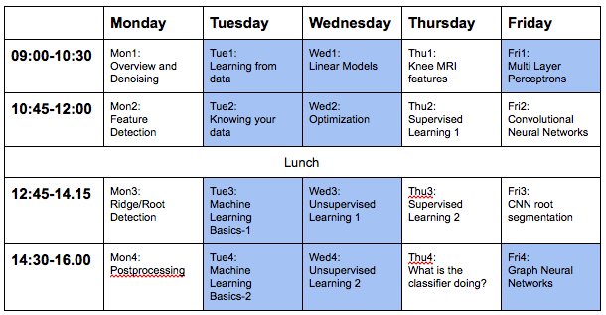
Program

Slide 3
Thursday
Why does your grandmother’s knees hurt?!
The UK Chingford study [Arden et al, A&R, 2010]:
Among 1000 women over 50, 63% have knee pain in a given year.
So: Most likely, yes! (but your Grandmother is no cry baby, so you may not know)
Osteoarthritis (OA, “slidgigt”):
OA costs around 2% of the GDP (“BNP”)
Direct Healthcare cost are around 10% of GDP (18% in US)
No cure: 1 million total knee replacement surgeries per year

Slide 4
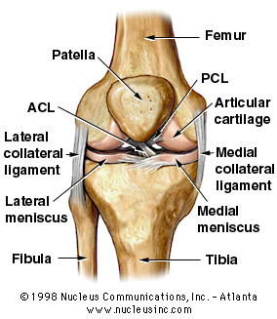
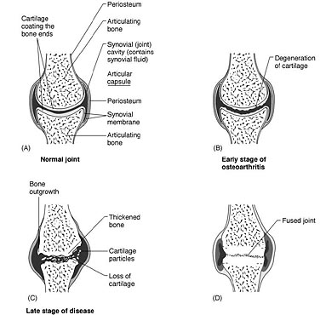
Knee OA

Slide 5
Why does the knee hurt?
Tissues:
Bones have blood and nerves
Cartilages don’t – you can’t feel it
Research papers:
“some of the pain is from the bones”
“some of the pain is from inflammation”
“some of the pain is in the central nervous system”
…
To make a treatment, we must understand the pain!
Epidemiology = Machine Learning: Let’s take thousands of scans, measure everything, and explain the pain.

Slide 6
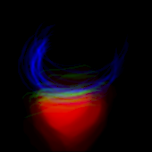

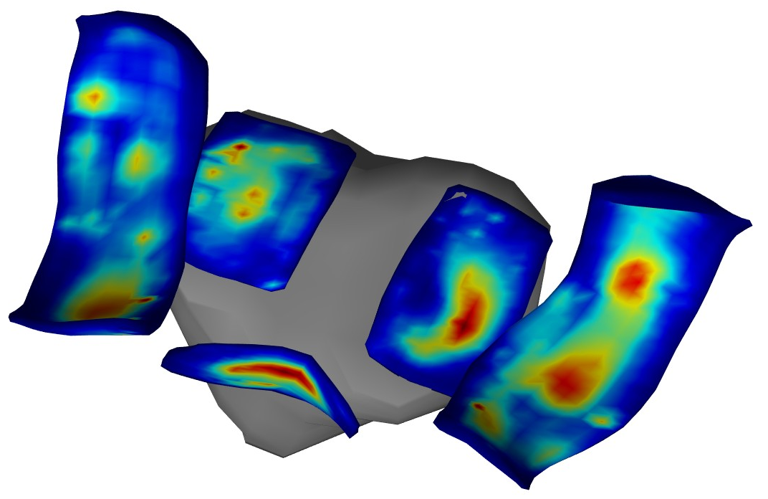
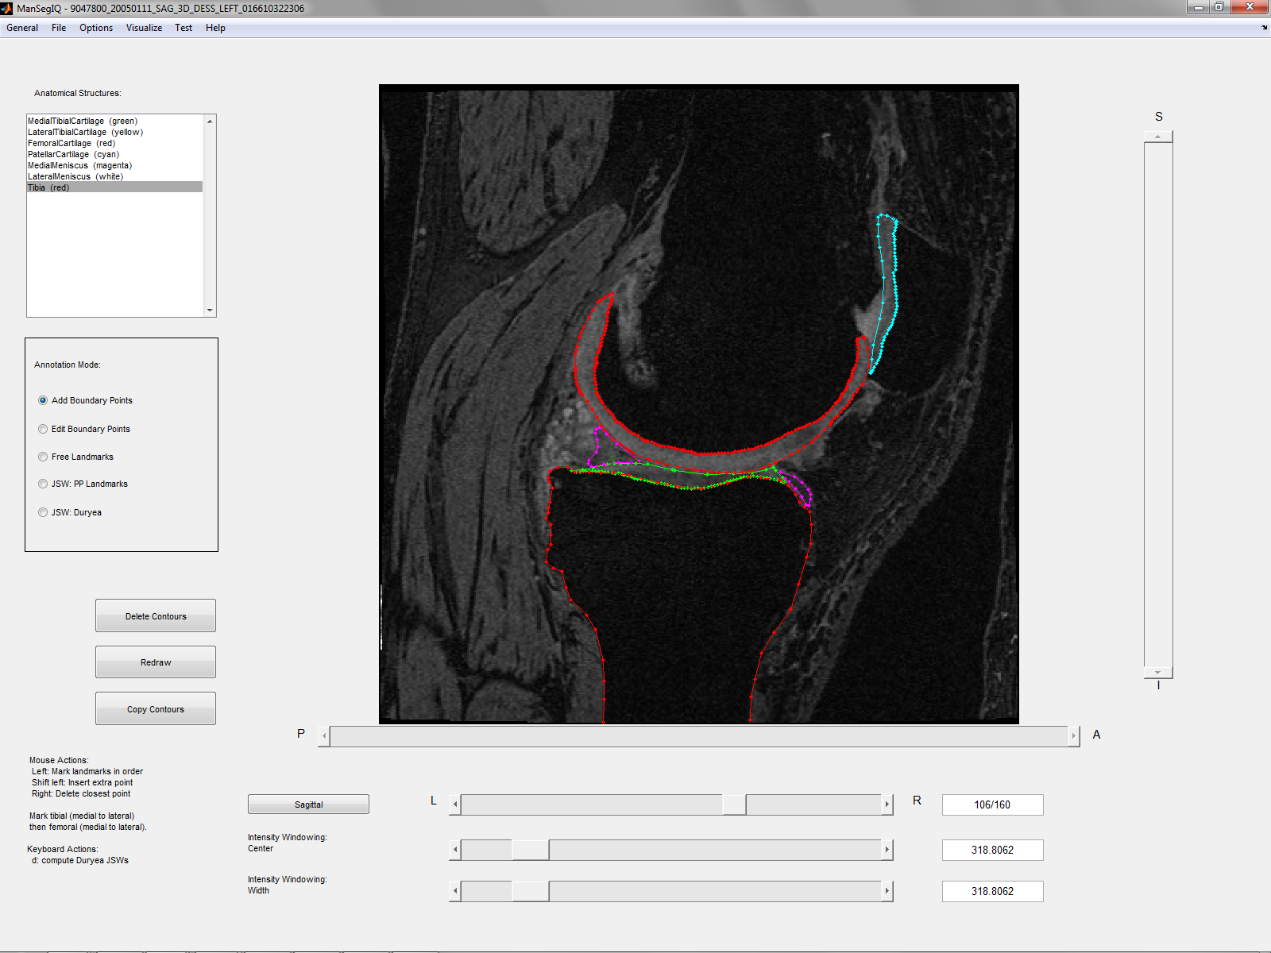
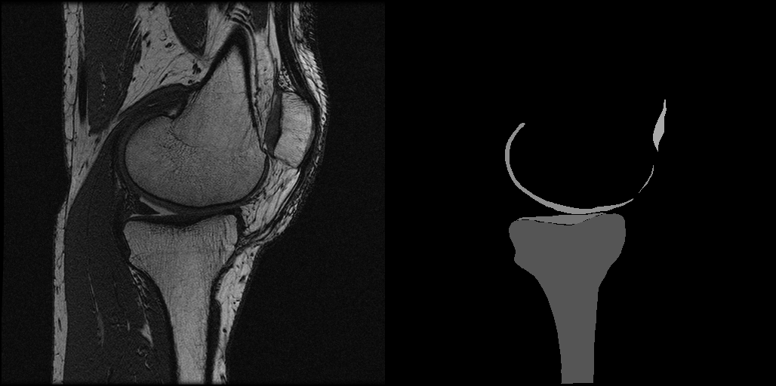
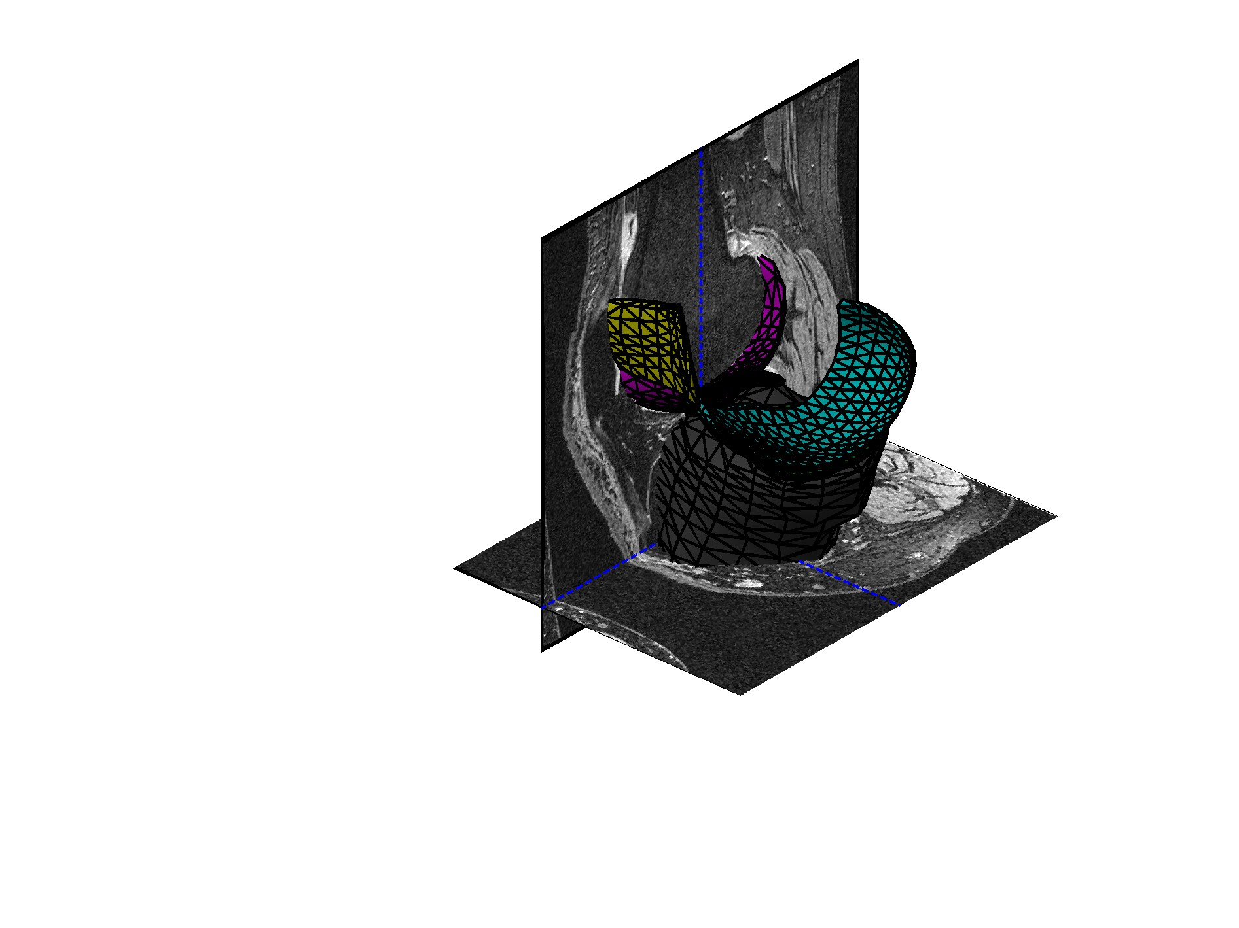
Measure Everything: Knee Imaging Quantification
Training Segmentation Biomarkers
Registration to training data
Expert annotation
Voxel classification (ML)
Measurements:
Thickness
Smoothness
Cavity
Homogeneity
Congruity
Contact Area
Shape
…
Shape Model

Slide 7
Theme of the day
Given:
The OA Inititative includes 5000 subjects with knee MRI as numerous demographic and clinical variables (including pain scores).
Previously, using KIQ, we computed 77 variables for each knee describing quantity/quality/shape of bones/cartilages/menisci.
Task:
How much of the pain can we explain from structural markers?
Which tissues contribute to this pain?
Method:
Try different Supervised Learning methods
Understand what they are doing
Investigate which markers they use
Warning: this is a hard problem!

