Slide 1
Performance Improvements for Unplanned High Density Wireless LANs
Mesut Ali Ergin
WINLAB, Rutgers University
Ph.D. Defense Presentation
Advisor: Prof. Marco Gruteser

Slide 2
Presentation Flow
I U SM SN C

Slide 3
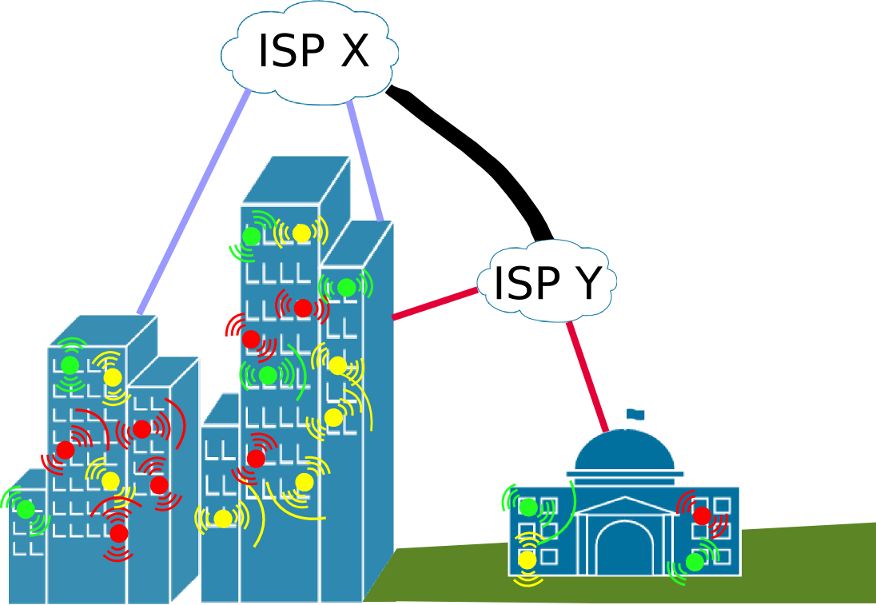
High-Density Wireless LANs
Collection of IEEE 802.11-based (CSMA/CA w/ DCF) WLANs
  Chaotic (vs. planned)
  Unmanaged (vs. engineered)
  High-density of APs (as well
  as STAs)
  Residential (vs. enterprise)
An interference-heaven

Slide 4
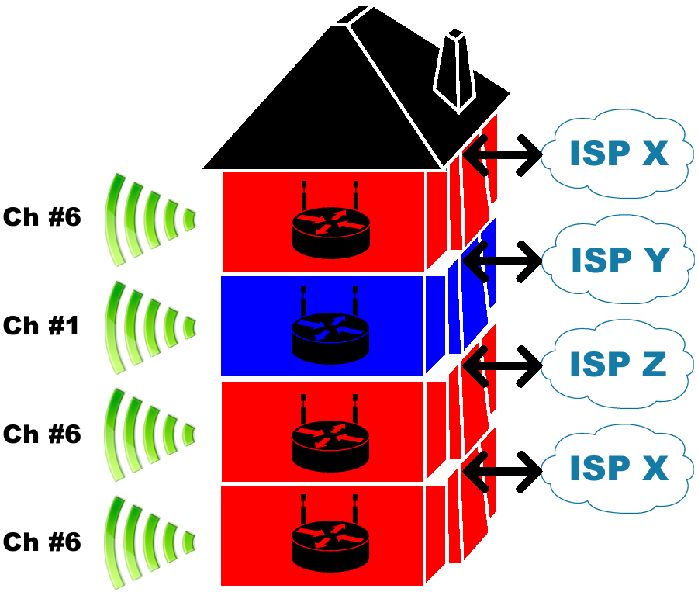
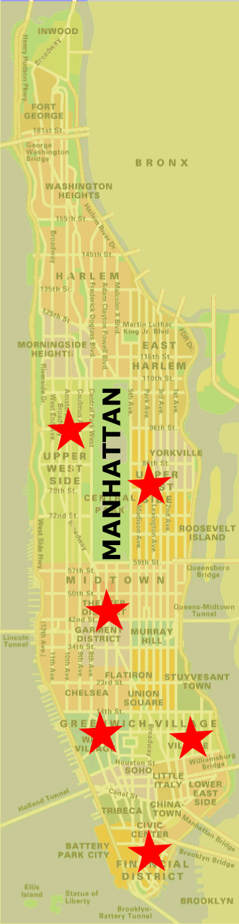
Are they for real?
from a single location upto 320 networks observed
221 of those on the same channel
potential strong interference from 44
of the access points
So, how would they perform?
Unplanned chaotic
deployments are a fact!

Slide 5
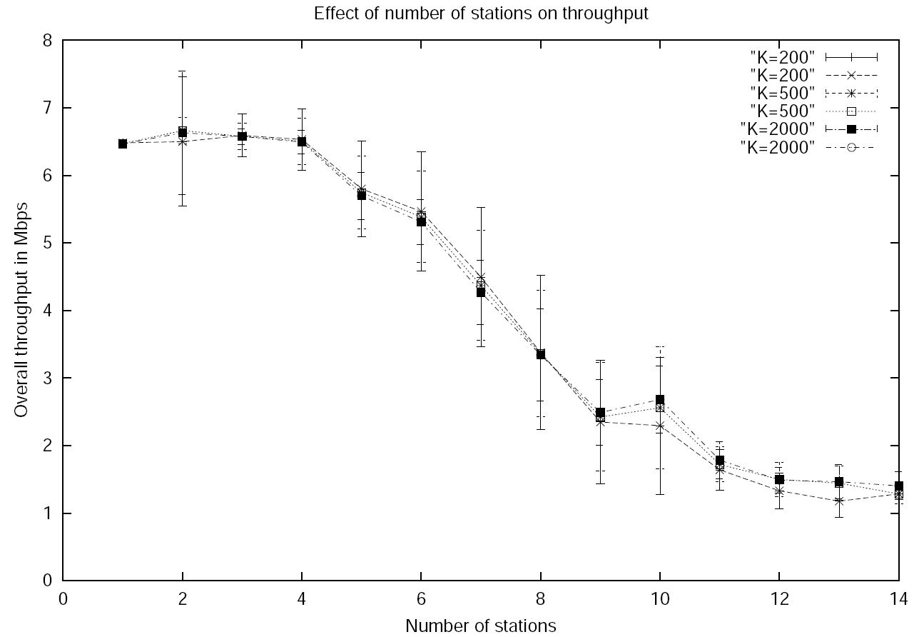
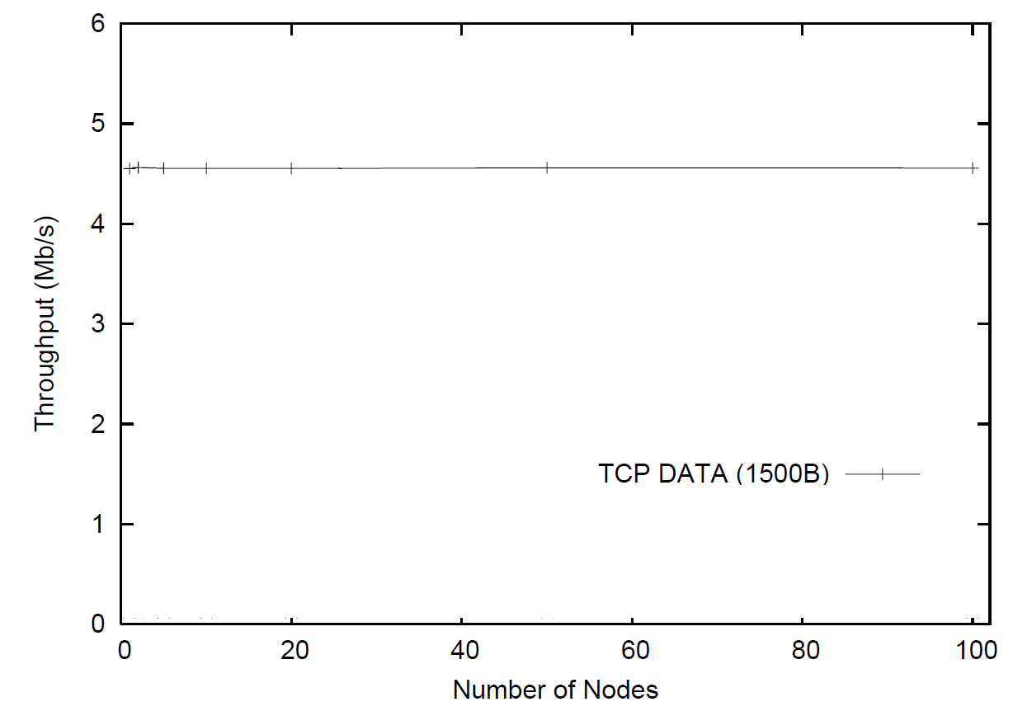
IEEE 802.11 Performance Models
[Bianchi'00], and several others [Wu et.al'02] [Chatzimisios et.al.'02'03] [Robinson et.al.'04] [Ergen et.al.'05] [Banchs et.al.'07] modeled 802.11 to investigate its performance
Common assumptions include backlogged nodes and flat hierarchy (nodes vs. sta/ap)
Cumulative throughput vs. per node throughout
( result courtesy of Vasan & Shankar '02)
( result courtesy of Choi et.al. '05)

Slide 6
Objective
Understand the inefficiencies due to interference in the high-density residential WLAN deployments, and improve the system capacity by addressing these inefficiencies, considering existing deployments, ease of adoption and available resources such as available channels, link bandwidths, etc.

Slide 7
Related Work
Understanding WLAN Performance
Where, How many, How Dense?
Enterprise
Single WLAN Case
Overhauled MAC
Managed WLANs
Prevent Interference
Recovering Lost Performance

Slide 8
Understanding HD WLANs
Where, How Many, How Dense
  Wardriving Databases [Wigle.Net '01] [WiFiMaps '02] [PlaceLab '03]
  Conference/Campus-type Scenarios [Henderson et.al. '04] [Balachandran et.al. '02] [Jardosh et.al. '05]
Enterprise Domain
  Automated Fault Analysis [Cheng et.al. '06,'07] ,[Sheth et.al. 06]
  Managed WLAN Architectures [Murthy et.al. '08] [Shrivastava et.al. '09] [Miu et.al. '05] [Cisco WCS '08]
Protocol Studies in Single WLAN Case
  MAC/client density [Choi et.al. '05] TCP/MAC Interaction [Gong et.al. '05] RF/HW Vulnerabilities with Interference [Gummadi et.al. '07]

Slide 9
Recovering Lost Performance
Prevent/Mitigate Interference
  Channel/frequency assignment [Georganas '78] [Kauffmann et.al. '07][Leung et.al. '03] [Leith et.al. '06]
  AP selection [Bejerano '04] [Guo '05] [Nicholson '06]
  Channel/frequency hopping [Pickholtz '82] [Bahl et.al. '04] [Mishra '06]
Centralized (Managed) WLANs
  Scheduling [Cisco/Aruba/Meru] [Kompella '05] [Shrivastava '09]
  Adapt CCA-threshold, receiver sensitivity and/or other transceiver parameters [Vasan et.al .'05] [Zhu et.al. '06] [Ma et.al. '08]
Overhauling 802.11 MAC
  Collision avoidance [Chen et.al. '06] [Choi et.al. '05]
  Interference-aware power control [Aein '73] [Kim '06] [Mhatre '07]

Slide 10
Objectives Calling for More Work
Consider Available Wireless Channels
  Channel/frequency assignment, AP selection, channel hopping are complementary and have limited benefit
Consider Available Wired Links
  Centralized (Managed) WLANs with scheduling and transceiver adaptation relies on high-bandwidth low delay links to Aps
Compatibility with Existing Deployments
  Overhauling MAC for introducing collision avoidance or interference-aware power control is prohibitively costly
Understand HD residential deployments
  Trace-based investigations for enterprise domains reflect a very different environment

Slide 11
Presentation Flow
I U SM SN C

Slide 12

The Principle Question
In an unplanned residential HD WLAN deployment
  with multiple-APs
  under typical workload
  using typical WLAN equipment
How does the system capacity
behave with increasing density?
?

Slide 13
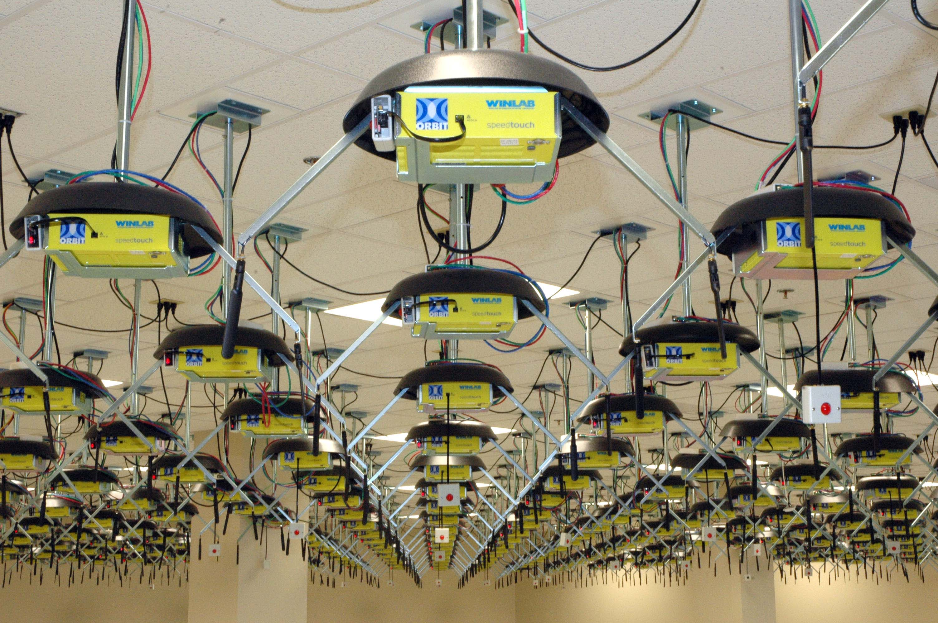

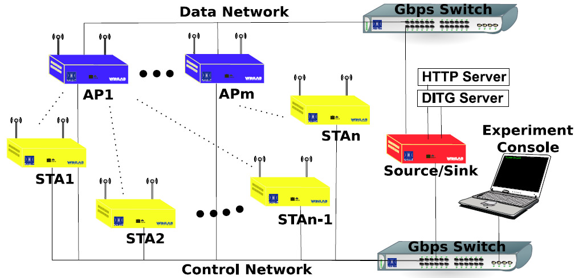
Evaluation Methodology
Experimental evaluation on ORBIT
  320 IEEE 802.11a/g clients
  12 interfering WLANs (via 12 bridging APs)
  12 wireless sniffers (one per AP – biased)
  A DHCP server, an HTTP server, a DITG traffic generator/sink
  One wired sniffer per server
  Multiple observer nodes for monitoring experiment status and sanity checks
One of the largest WLAN
experiments conducted
on ORBIT to date

Slide 14
Workload Distributions
Conducted a long-term WLAN observation study on WINLAB production network to obtain protocol and application usage distributions for typical users
Accordingly 75% of our stations use web browsing monkey to create HTTP traffic, 21% utilize DITG to offer background TCP traffic, and 3% offer VoIP traffic

Slide 15
Realistic Workload Design
Extracted user-arrival
patterns from 62nd IETF
Meeting WLAN with 150
APs and over 700 users
Modeled and implemented
standard compliant
web-browsing monkey
for each station.

Slide 16
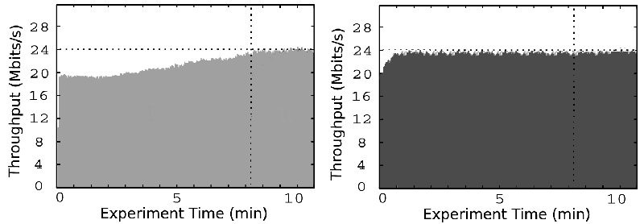
Single-AP Case
?
A single AP WLAN performs
remarkably robust with a TCP-dominated workload
irrespective of the number of stations it serves.
127 clients with bulk TCP file transfers (downlink) on a single AP
High throughput fairness among stations – Jain's Fairness Index values of 0.9620 for Test I, and 0.9434 for Test II
#1
#127
#1
#127
23.68 Mbps
23.56 Mbps
Test I
with realistic
client arrivals
Test II
with simultaneous
client arrivals

Slide 17
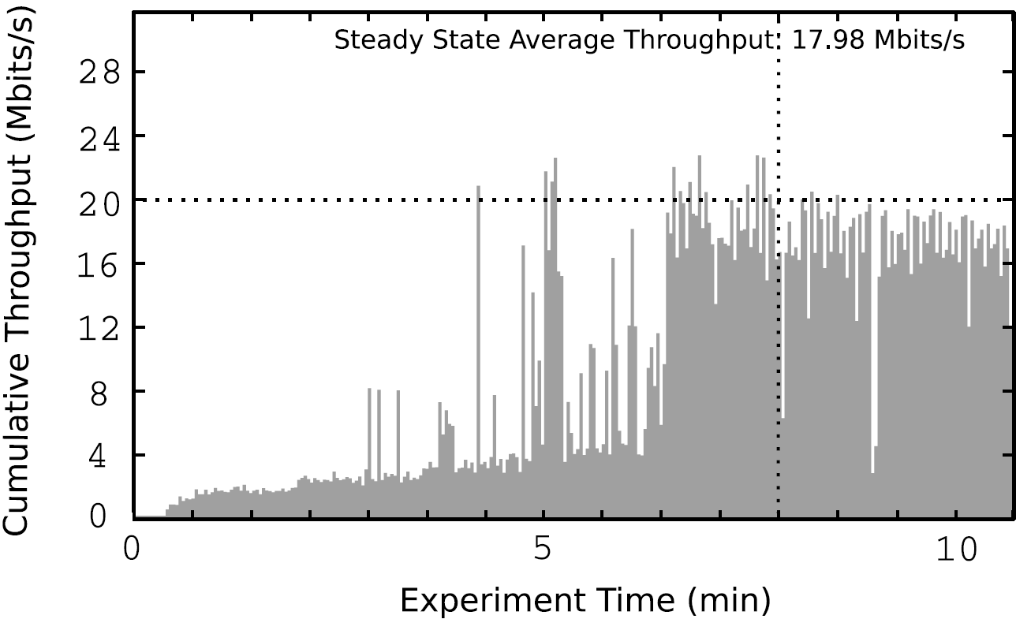
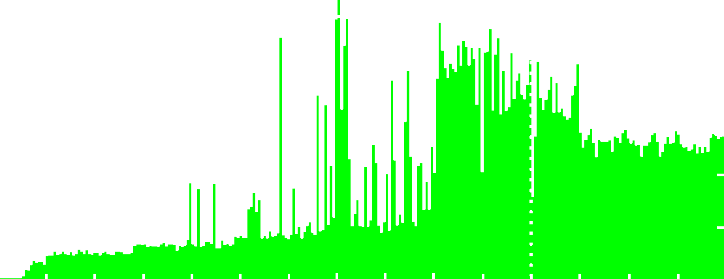
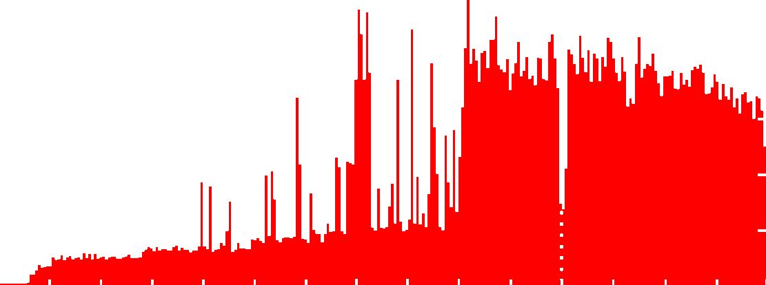
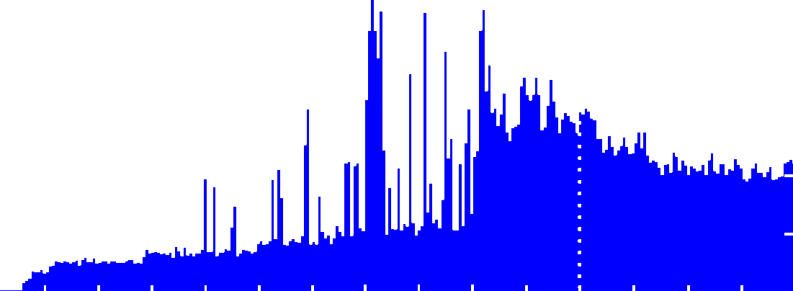
Multi-AP Case
Increased # of APs from one to four
kept # of clients and workload the same
system throughput degraded by about 50%
Same clients w/ 1,2,3 and 4 APs, using the realistic traffic mix
1AP: 17.98 Mbps
2AP: 15.59 Mbps
3AP: 10.91 Mbps
4AP: 8.71 Mbps

Slide 18
Why ? The collision-based PER behavior
PER due to collisions is
marginally affected by the # of clients
but significantly affected by the # of APs
Making sure that channel-induced errors are unlikely (very high SNR @ 36Mbps forced rate), we zoom into collision-based PER (packet error rate) performance
ORBIT
EXPERIMENTS
BIANCHI's
MODEL

Slide 19
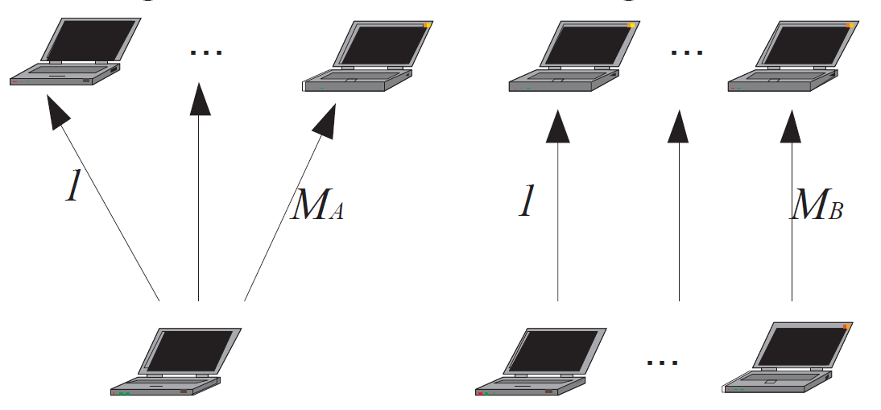
Backlogged nodes vs. # of APs
Each additional AP brings in
two more backlogged 802.11 nodes
The intuition?
CW, frame size,
# of backlogged nodes
Bianchi's Model
Throughput
# of APs
Gong and Marbach's [MobiHoc '06] TCP Reno model shows that
  At operating point for TCP Reno on IEEE 802.11 for a single source flows, E[backlogged] = 2,
  If n additional flows are added, then
  E[backlogged] = 2(1+n)
Trivial extension to i interfering WLANs
E[backlogged] = 2i

Slide 20
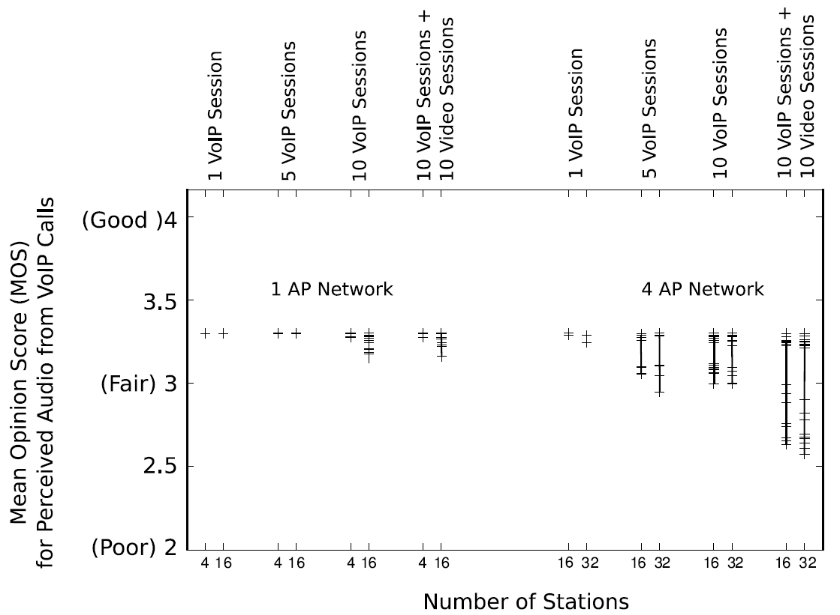
Multimedia Performance on HD WLANs
MOS tests with VoIP sessions (G.711/UDP) and 400K DivX video streaming
Targeting better than Fair (3+) MOS score
  Single AP: can support up to 10 video sessions together with 10 VoIP calls
  Four APs: only supports 2 VoIP calls
  Four APs with WMM: improves MOS for 2 VoIP call, but can not achieve beyond 5 VoIP calls

Slide 21
Summary: Understanding HD WLANs
Single-AP WLAN performs remarkably robust independent of the client density
Multi-AP network loses capacity as more cells are added to support the same workload
Number of backlogged stations equals twice the number of active access points
As low as three WLANs might cause deterioration of VoIP performance.
WME can improve multimedia performance, however degradation still noticeable beyond 10 interfering WLANs.

Slide 22
Presentation Flow
I U SM SN C

Slide 23



CW Adaptation for HD: WiPhi
Earlier adaptation techniques assumed backlogged stations [Cali '00] [Heusse '05] [Hu '06], thus based adaptation on the number of stations in the WLAN
Using our insights, we propose CW-adaptation based on the number of active APs
We build on the optimization in [Hu '06]
which reduces to for no priority queues, where is the number of backlogged stations

Slide 24


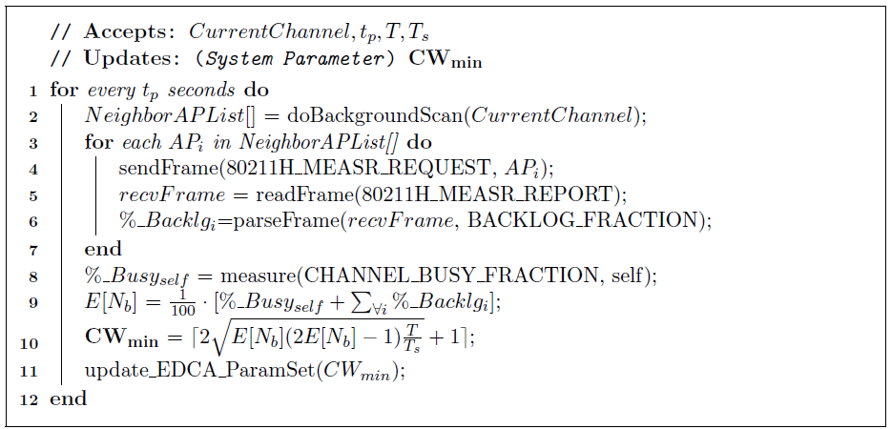
WiPhi Algorithm
Using where is the number of active APs, we have contention window adaptation as
IEEE 802.11h standard defines measurement-exchange mechanisms that can be used to implement WiPhi in a standard-compliant way.
[1]
Receive Neighbor AP Channel
Busy Measurement Reports
Measure Own Channel
Busy Fraction
Estimate E[Nb]
Update CWmin using [1]
Sleep for tp

Slide 25
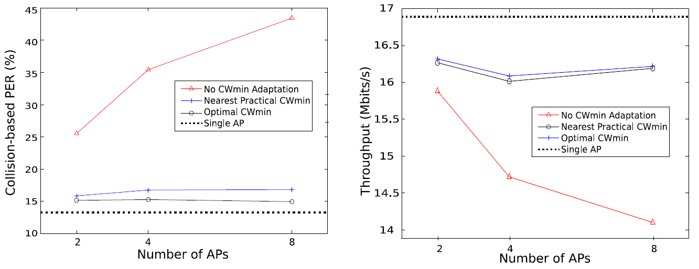
WiPhi Performance
Experiments with 32 stations and varying APs show that WiPhi can keep the HD WLAN around the optimal collision rate
Rounding to nearest power of 2 (practical limitation in WLAN HW) do no affect WiPhi performance significantly

Slide 26
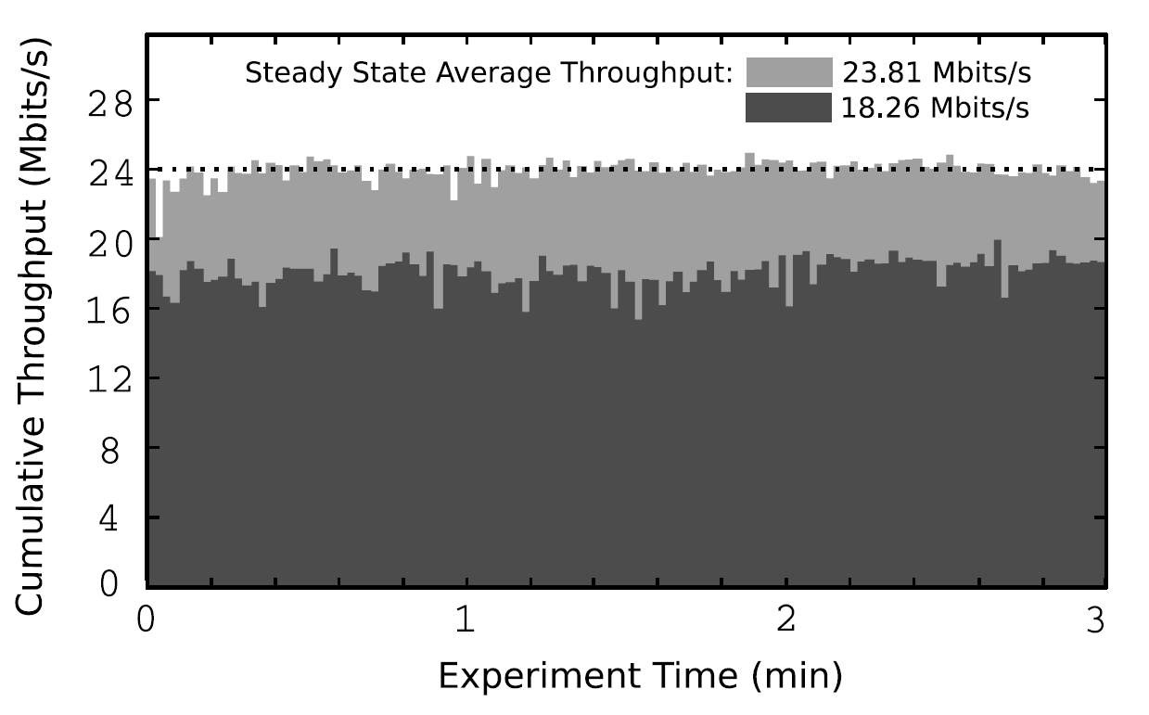
WiPhi Beneficial for Bit-rate Adaptation
WiPhi recovers an additional 23% system capacity, otherwise lost due to legacy bit-rate schemes (e.g. ARF) acting on collision-losses as bit-errors

Slide 27
Summary: WiPhi
CW adaptation proposed based on the new insight into the # of APs and the # of backlogged stations
WiPhi can reduce the collision rate very close to the levels of the single AP case (~10%) and recover up to 80% of lost system capacity
WiPhi also helps recovering the capacity loss due to misbehaving bit-rate algorithms

Slide 28
Presentation Flow
I U SM SN C

Slide 29
HeedNet: ISP Participation in HD WLANs
WiPhi implies a software upgrade for APs requiring an ISP to
  invest in firmware upgrades for APs (multiple vendors, many models)
  ship new APs to customers, or
  have customers upgrade the ISPs eclectic AP-base
Can we avoid this cost and still recover lost system capacity
Deployment of utility software on some clients is more feasible
ISP router can take role in interference management

Slide 30
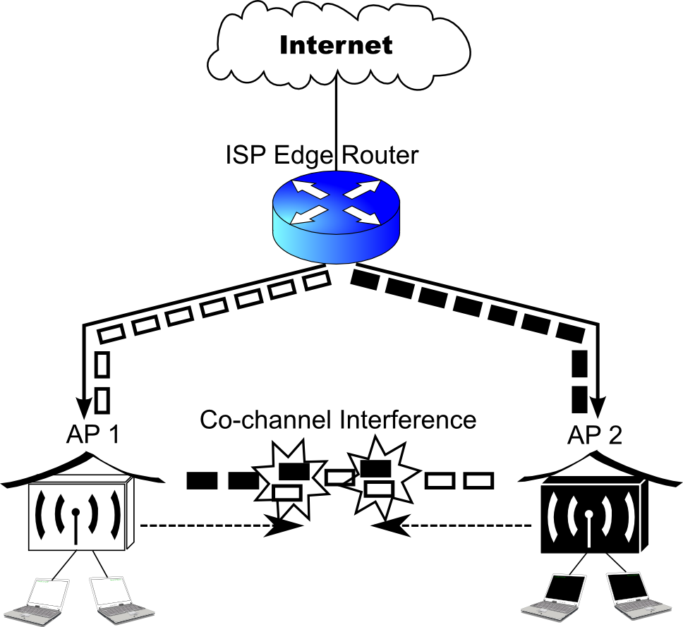
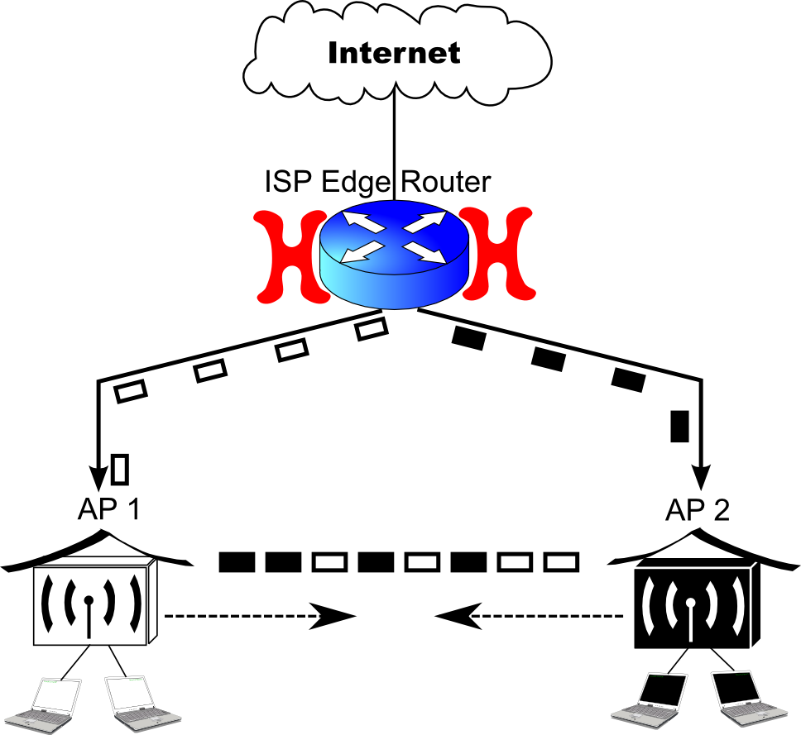
HeedNet: Overview
Aims lost system capacity recovery by scheduling IP packets at ISP edge router – reducing collisions
Controls IP packet flow (only bulk traffic) to interfering APs
  Exclusive routing to each WLAN for a given timeslot interval
Increases per WLAN capacity-share fairness

Slide 31
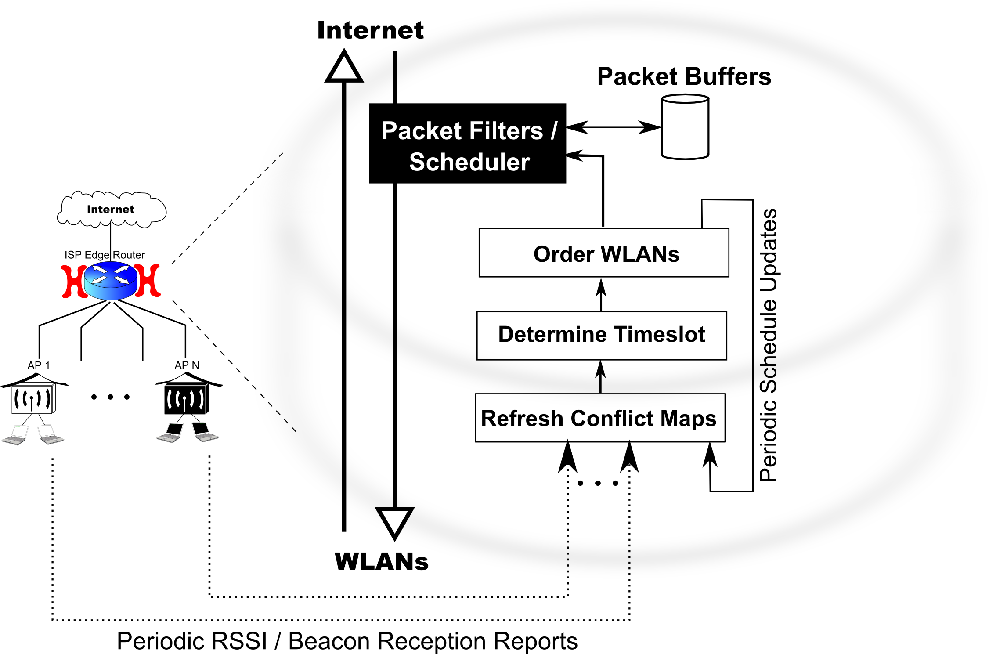
HeedNet: Operation

Slide 32
HeedNet: Challenges
Which WLANs to schedule?
  reduced spatial re-use vs. excluded interferers
  ALGORITHM1 map_conflicts()
What should be the scheduling interval?
  exciting more APs vs. causing too much delay
  ALGORITHM2 pick_interval()
How should we order WLANs in scheduling?
  managing imperfect serialization
  ALGORITHM3 order_APs()

Slide 33
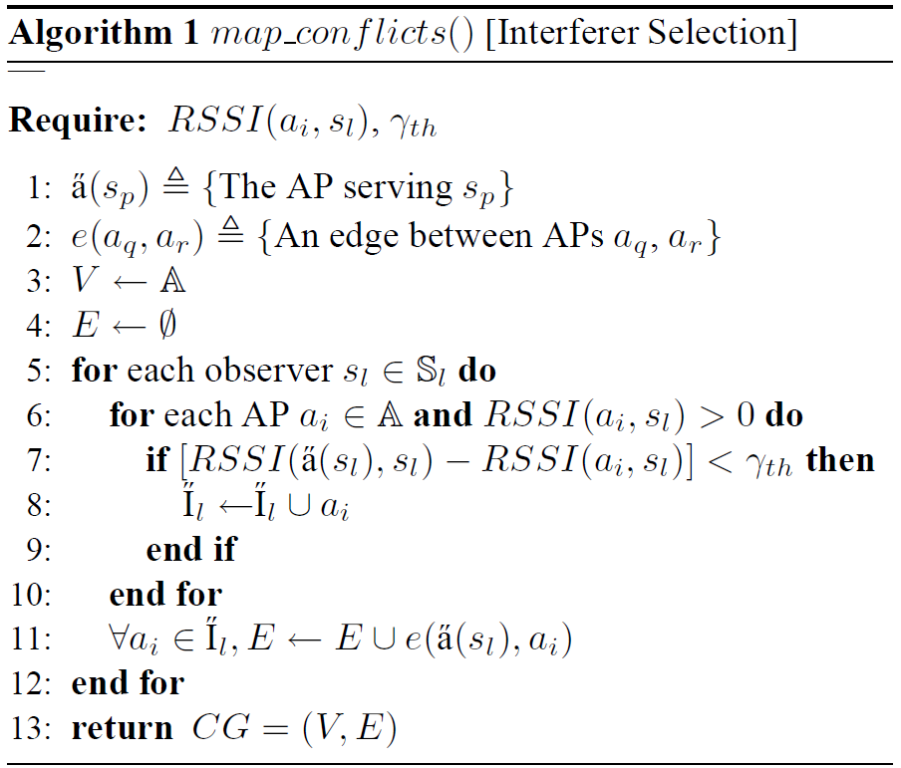
HeedNet: Interferer Selection
A variant of CMAP by [Vutukuru et.al 2008]
SNR-budget based per-observer conservative interference list construction
All interference lists are merged to construct a conflict map
Each connected component of the CMAP is scheduled independently
A3
c3
A1
A2
A4
A5
c1
c1
c4
c2
c4
c5
RSSI_c2={A1:-60, A2:-72, A3:-80, A4:-91}
RSSI_c4={A4:-59, A5:-68, A3:-89}
ITF_c1={A1(A2,A3)}
ITF_c4={A4(A5)}

Slide 34
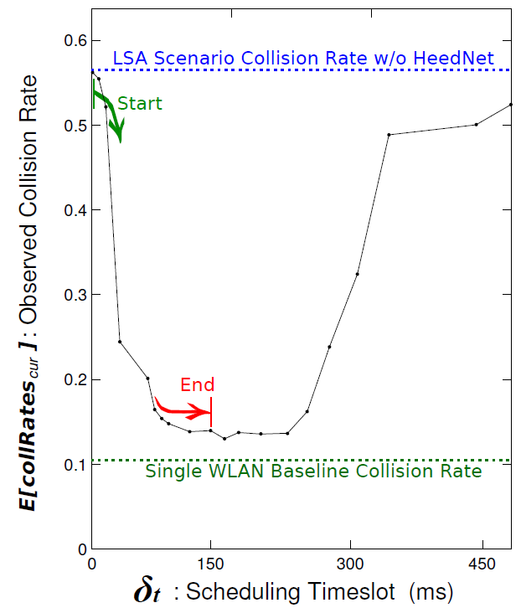
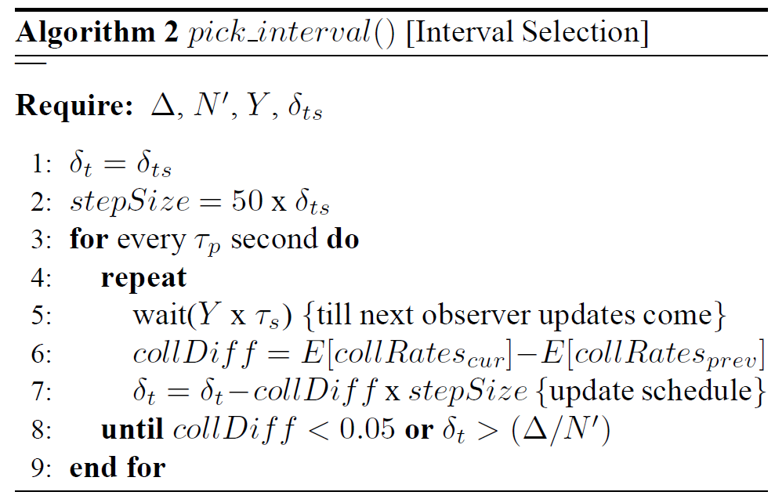
HeedNet: Determine Schedule Timeslot ()
Exclusive routing and total # of APs on CG bounds 
Too small or too large  weakens serialization
Discriminant is the average collision rate estimates
Beacon-based average collision observation drives  on a gradient-descent search algorithm

Slide 35
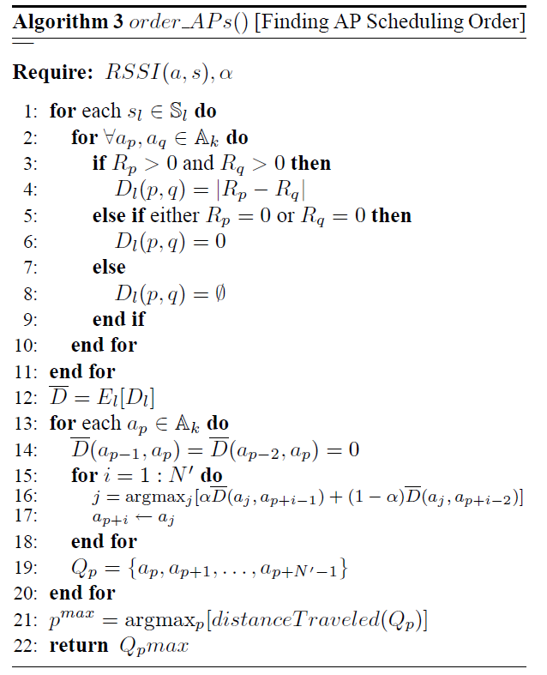
HeedNet: Find Scheduling Order
Delay jitter (wired+wireless) would cause unwanted collisions
Proper ordering reduces collisions due to overlapping transmissions from back-to-back APs
APs are ordered in signal space and most dissimilar ones are served one after the other
c1
c3
A1
A3
c2
c4
A2
c5
A4
A6
A5
c6
order1={A1,A2,A3,A4,A5,A6}
order2={A2,A6,A1,A4,A5,A3}

Slide 36
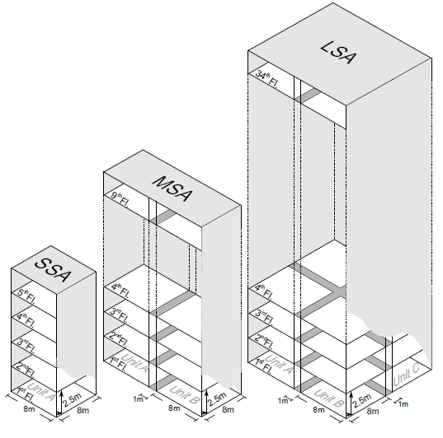
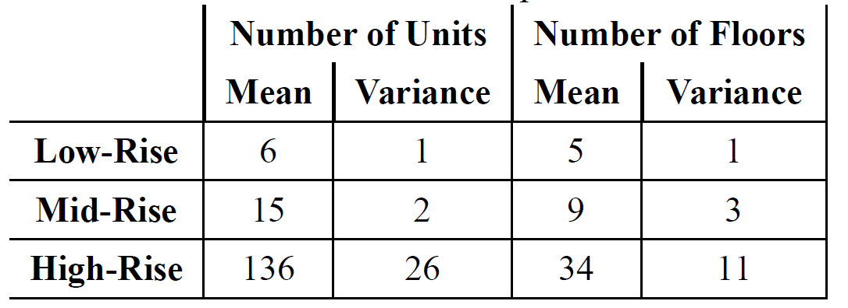
Simulation Scenario Setup
We have created three apartment classes out of an apartment dataset of 1379 buildings from NYC
Used 2.4GHz channel usage statistics from WiGLE.Net
(1B+ WLAN observations) → 35% of all AP population on interfering channels
Randomly placed one AP, two stations in
3D space of each apartment unit, and
randomly assigned 35% of them the
same channel

Slide 37
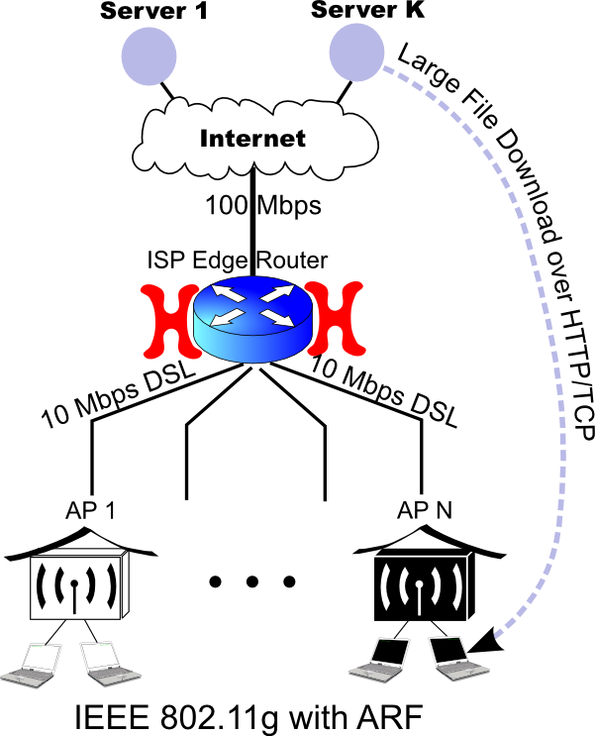
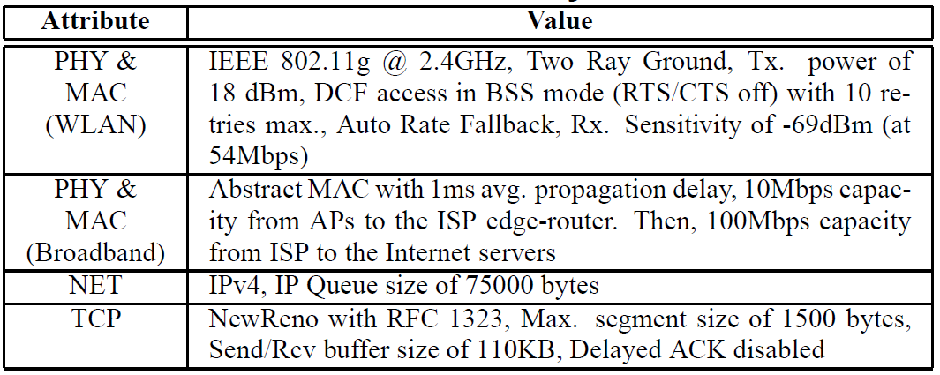
Topology and Simulation Parameters
Clients try to download a large file using HTTP/TCP from one of the ten Internet servers for the duration of simulation –
2 minutes
First second of the simulation is used as warm-up period for STA associations, DHCP, application initiation etc.
Averages (and 95%-iles) are reported from repeated runs

Slide 38
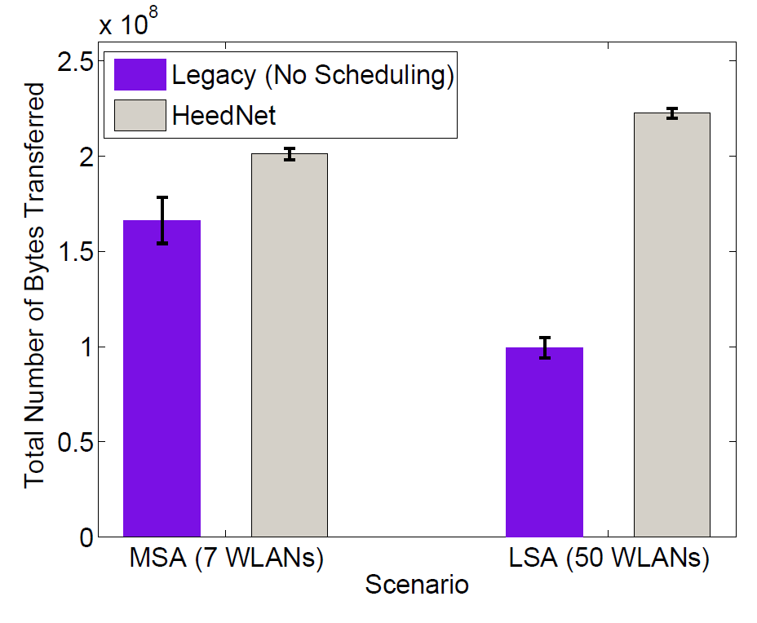
HeedNet: Recovers Lost System Capacity
Up to 2.2X improvement in capacity

Slide 39
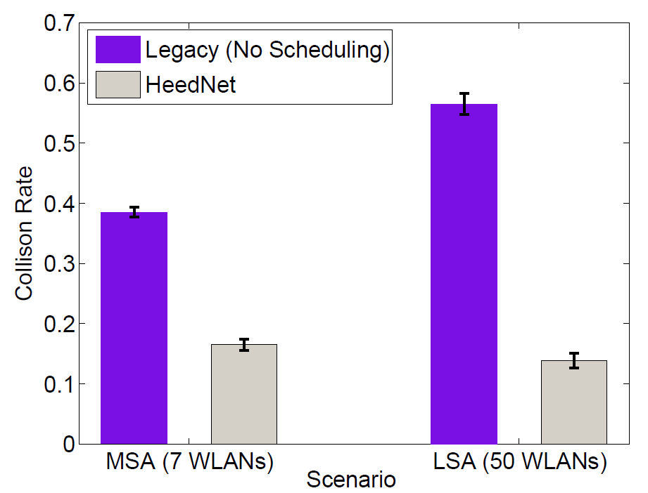
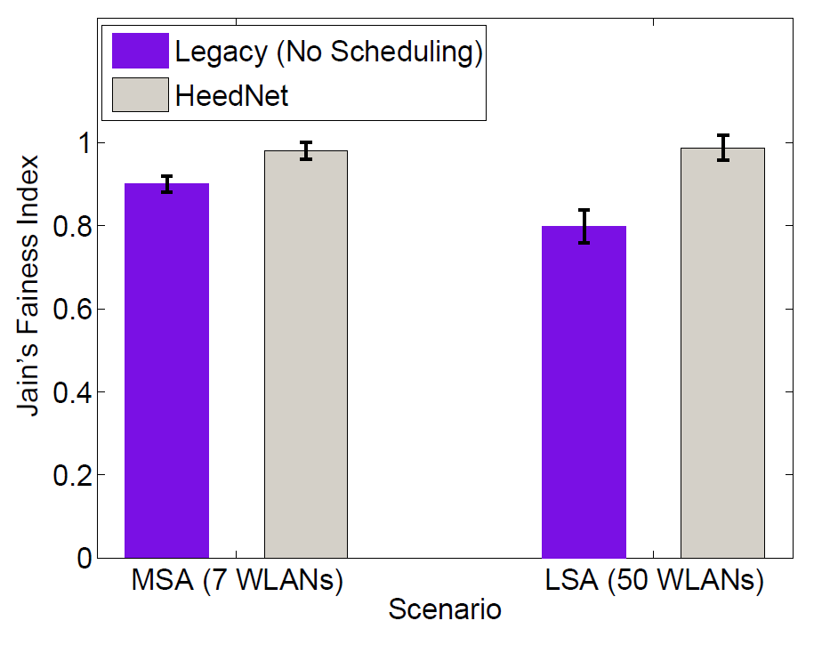
HeedNet: Collision Rate and Fairness
collision could
be driven back to
single WLAN levels
also improves
fairness slightly

Slide 40
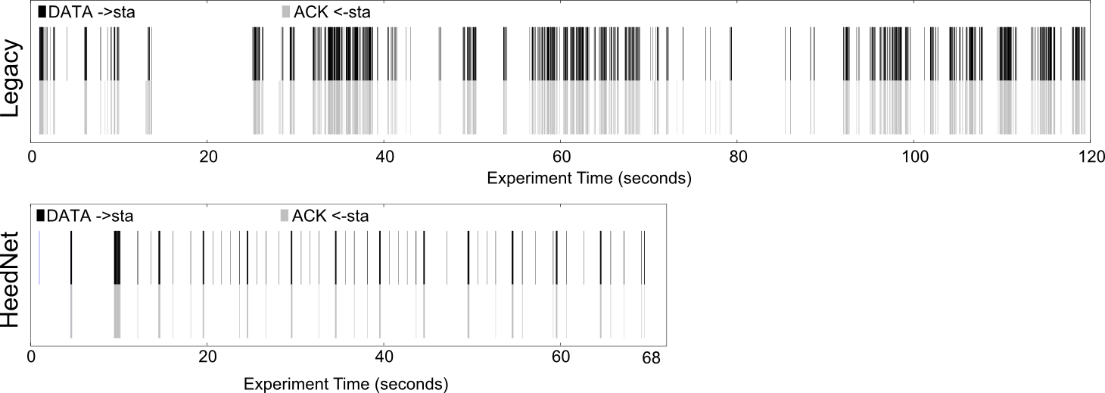
HeedNet: Delay Behavior
Does HeedNet affect TCP behavior negatively?
How does HeedNet affect my download time?

Slide 41
HeedNet: Implementation

Slide 42
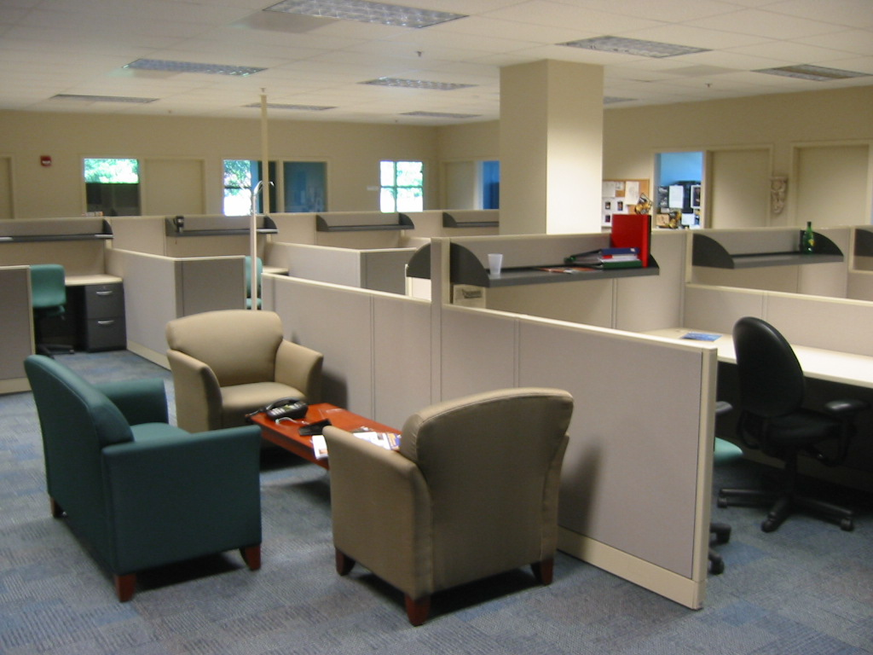

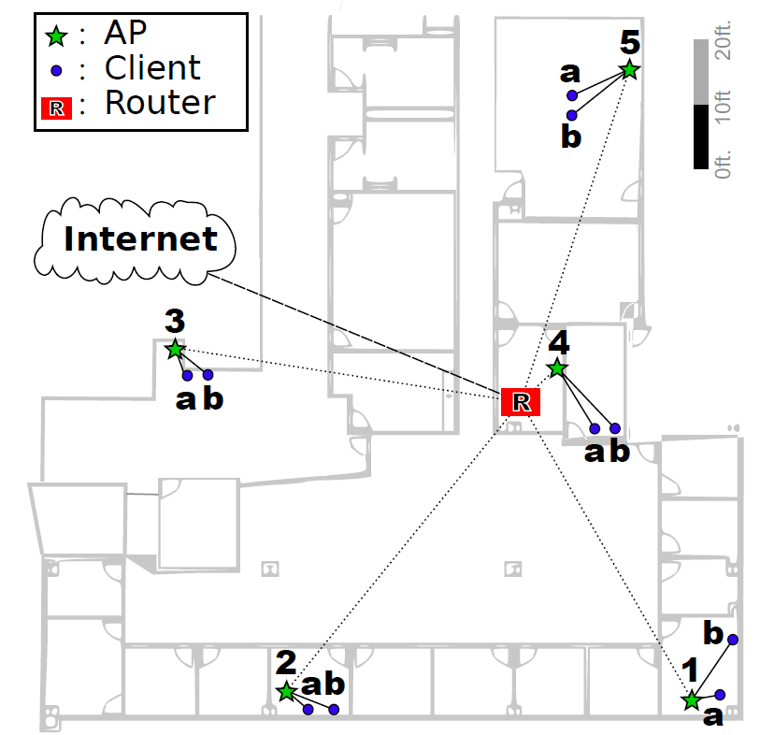
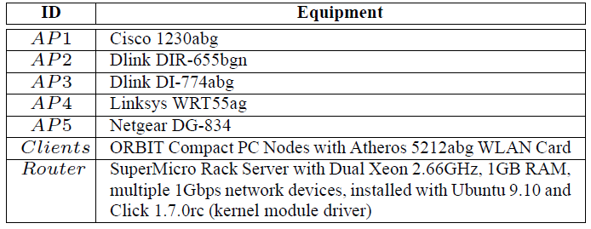
HeedNet: ORBIT Deployment
WINLAB
Five WLANs with 10 clients
YouTube 720p (~2Mbps) streaming workload on
all clients
Also, an unscheduled VoIP
session (G.711) is tested
for behavior under HeedNet

Slide 43
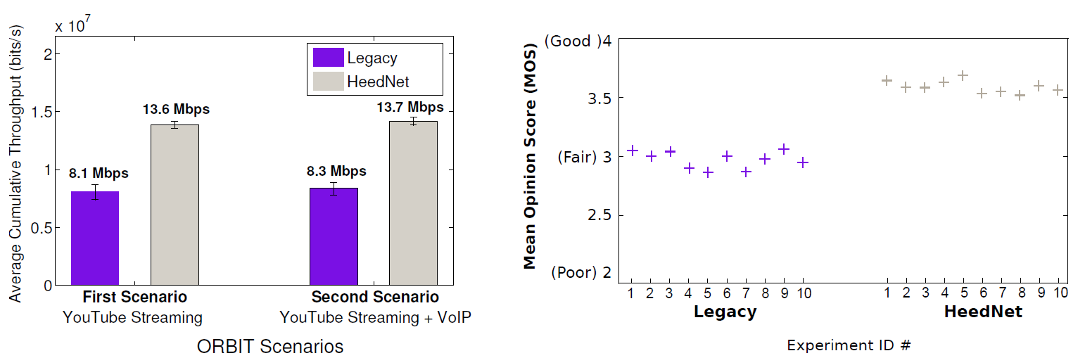
HeedNet: Summary Deployment Results
Capacity recovery proves practical
Unscheduled traffic also benefits from HeedNet i.e., delay sensitive applications (e.g. VoIP)

Slide 44
Summary: HeedNet
An ISP-based solution where WiPhi could not be adopted
Client observation based algorithms drive scheduling parameters at ISP router
Representative scenarios for residential settings are created using actual apartment and WLAN datasets
HeedNet could recover 73% of lost capacity, up to 2.2 X improvement
HeedNet scheduling delay has no negative effect on TCP and improves download completion time
Implemented and deployed on ORBIT demonstrating gains to be practical
Non-scheduled interactive traffic enjoys HeedNet

Slide 45
Presentation Flow
I U SM SN C

Slide 46
Conclusions
Workload assumptions are very important in understanding HD WLANs. For a TCP-dominated typical Internet-type workload:
Having more clients in a HD deployment has no effect on total system capacity. Serving them from multiple interfering APs affects capacity significantly – up to 2/3 capacity loss
Each AP brings in two backlogged stations to the deployment
WiPhi, as a CW adaptation technique exploiting the insight on number of APs, can recover up to 80% of the capacity loss
HeedNet is an alternative scheduling technique with ISP router participation. It can recover capacity losses up to 73%

Slide 47
End of Presentation

