Slide 1
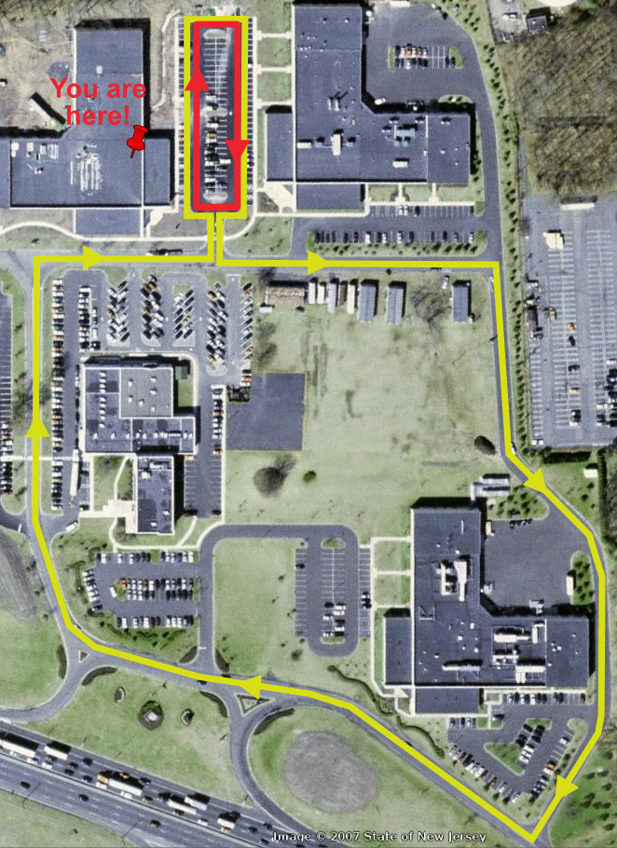
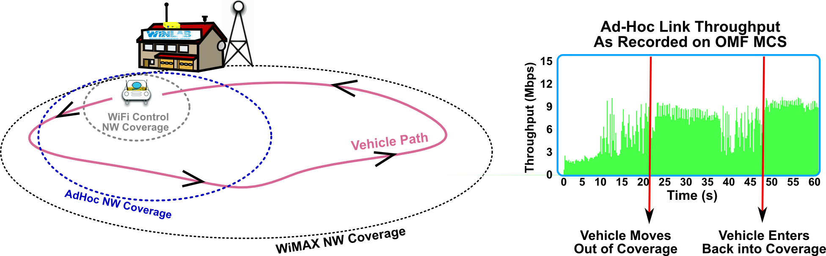
DEMO: Disconnected Operation
Showcases recent OMF support for disruption-free experiments under control network disconnections
Successfully demonstrated @ 4th GENI Engineering Conference on Apr. 2009
  Measures ad hoc network capacity between a fixed-node and a mobile vehicle
  Experiment flow and measurement results preserved beyond WiFi control network coverage, and sync'ed when coverage returns
  Vehicle mobility and experiment flow is monitored via WiMAX network real-time

Slide 2
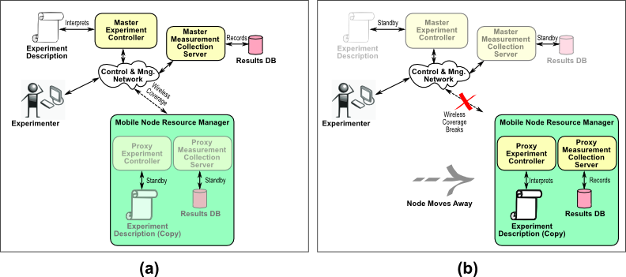
DEMO: Disconnected Operation – How It Works?
Experiment starts under connected-mode and managed by the Master Experiment Controller (and Master Collection Server).
The Proxy Experiment Controller stands by.
When, control network disruption is detected, Proxy Experiment Controller takes over the experiment, directing measurements to local Proxy Collection Server. Upon reconnection Master and Proxy are sync'ed.

Slide 3
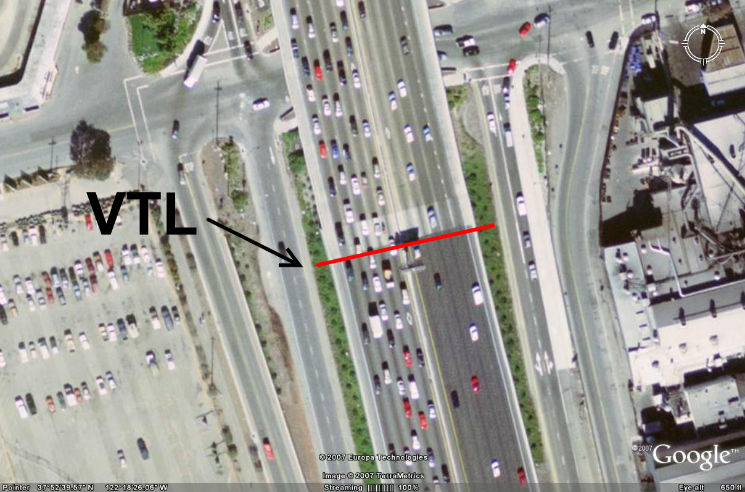
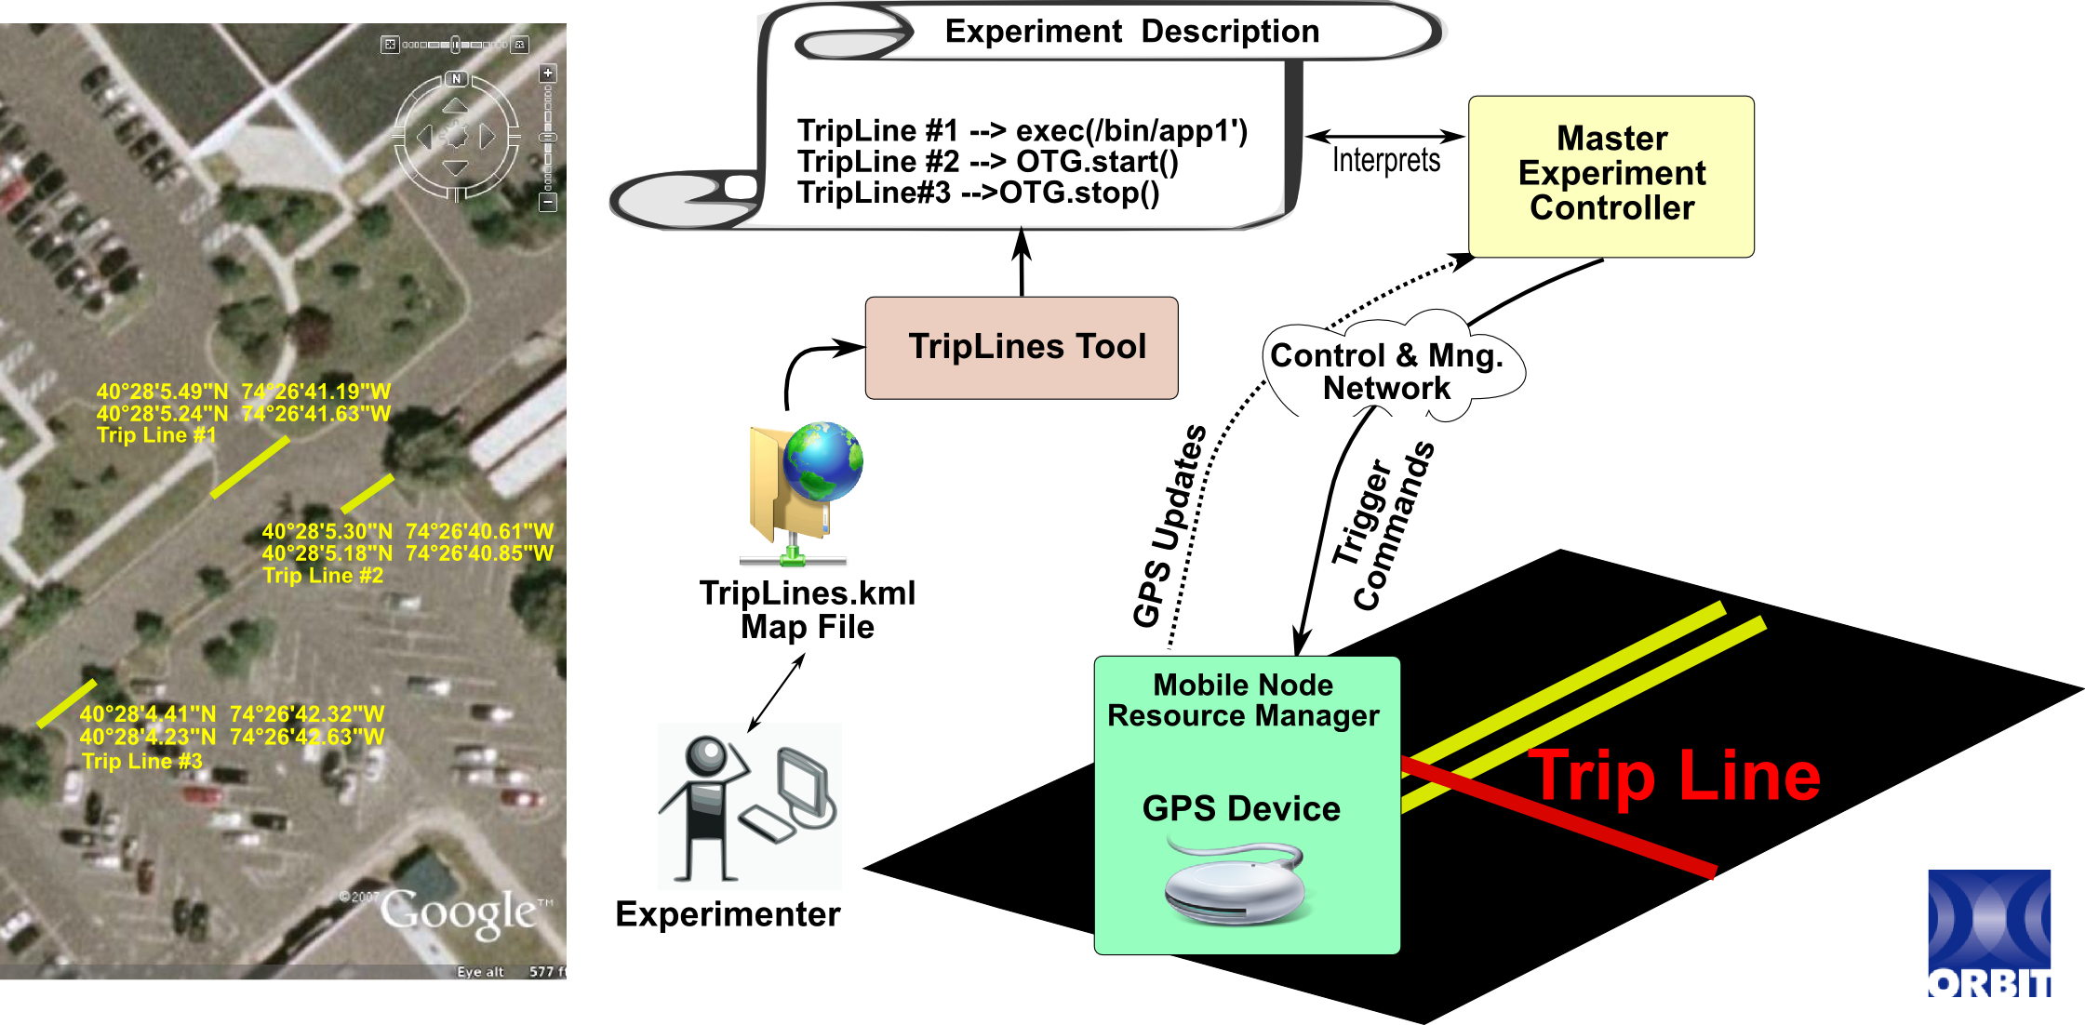
Controlling Mobile Experiments with Spatial and Temporal Triggers
Provides spatial and temporal control on the experiments
E.g., executes commands when
  Vehicle passes a certain region of the highway
  15s after vehicle enters into parking lot
  Five nodes are within ½ mile radius
Implemented through feedback loop using GPS on
mobile nodes
Current implementation allows specifying trip-lines on
Google Maps and creates trip-line
coordinates for experiment script
Experiment script binds
trip-lines to commands
GPS updates are matched
with these trigger commands
Spatial
Trigger

