Slide 1
HD-WLAN Work Summary
8/2/2006
Mesut Ali Ergin
mesut.a.ergin@intel.com

Slide 2
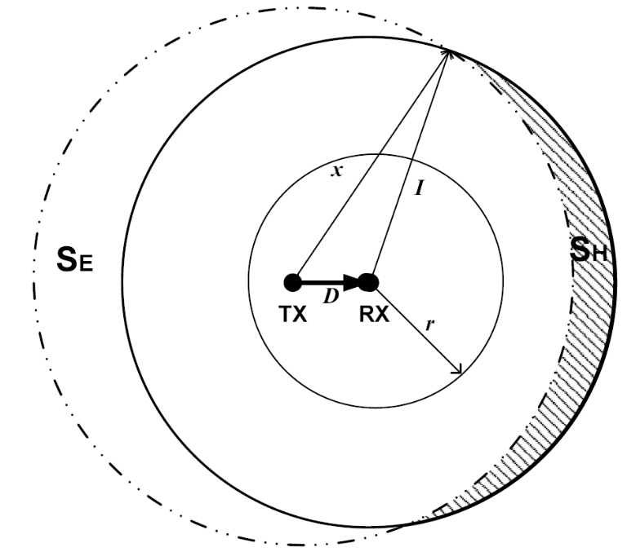
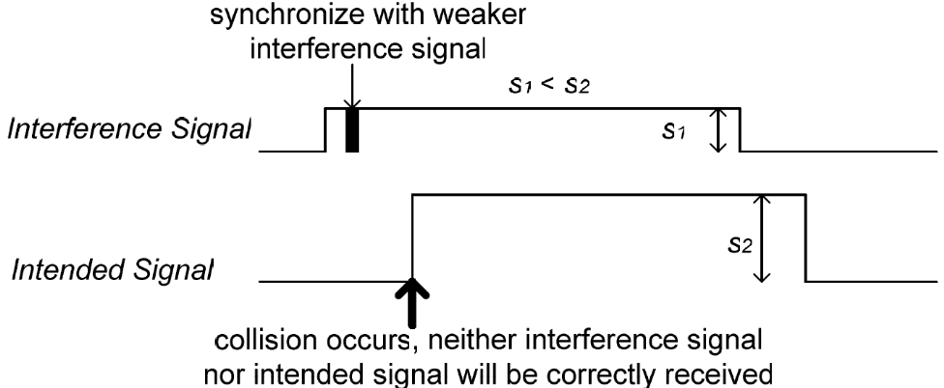
Problem Definitions
Determined by Clear Channel Assessment (CCA) Threshold
Determined by Receiver Sensitivity (RS) Threshold

Slide 3
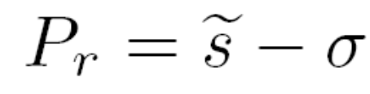




Proposed in [1]
Receiver Sensitivity (RS) Adjustment
  After association, clients set their RS threshold high enough so that receiver is activated only upon hearing their AP.
  An adaptation margin (σ) is used to account for variations in RSSI from AP.
[1] Adaptive CSMA for Scalable Network Capacity in High-Density WLAN: A Hardware Prototyping Approach, Jing Zhu, Benjamin Metzler, Xingang
Guo, and York Liu, In. Proc of Infocom 2006.

Slide 4
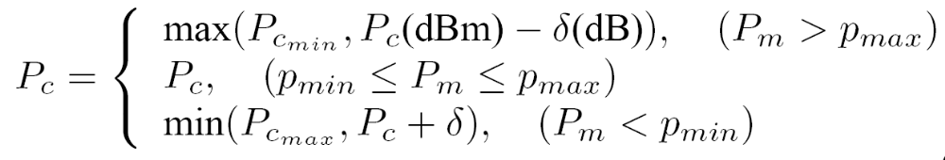
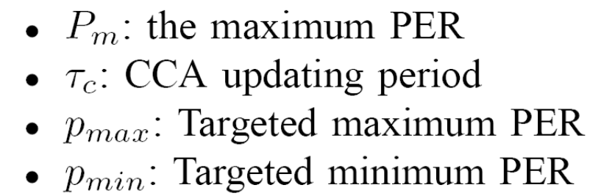
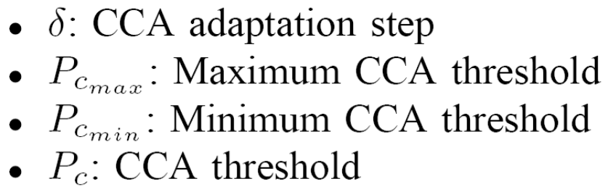
Proposed in [1] (cont’d)
Algorithm to update CCA-threshold is tied to packet error rates (PER)
All stations measure avg. PER per link over τ_{c} period and algorithm uses max of those measurements (P_{m}).
Decrease CCA-th when large PER observed
Increase CCA-th when small PER observed

Slide 5
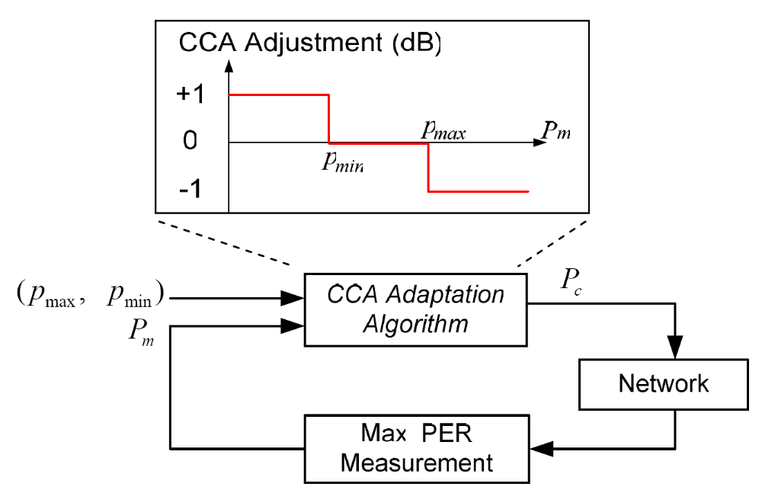
CCA Adaptation System Diagram

Slide 6
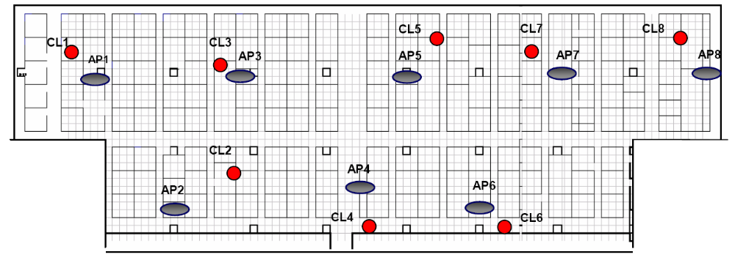
Evaluation setup in [1] (cont’d)
Each AP sends saturated UDP traffic of 1400-byte packets to clients.
Only one client per AP is tested
Only download direction (AP->CL) traffic is tested
75m
27m

Slide 7
Enhancements for RS adaptation
There is a need to restore RS to original (as small as possible) value
  when scanning other AP’s
  after handoff to another AP
Selection of adaptation margin (σ) is open
  AP probe counts could be used as an indication to stop decreasing σ
  Percentage of the receive-air-time used to decode other APs+their CLs packets could be used to start decreasing σ

Slide 8
Considerations for CCA adaptation
Method has an assumption that PER is mainly driven by the hidden nodes.
  This assumption is mostly true if number of clients per AP is small. How true is this for an HD-WLAN?
  Argument by Jing is that (Intel’s) definition of HD-WLAN is HD deployment of APs, not clients. So, they observed low (local) collisions among the clients of an AP.
  With this approach, a PER target range [p_{min} p_{max}] can not be fixed and has to be maintained w.r.t. local collision rate
  Otherwise, if collisions due to heavy local load increases, algorithm will erroneously lower CCA threshold, making PER situation worse.

Slide 9
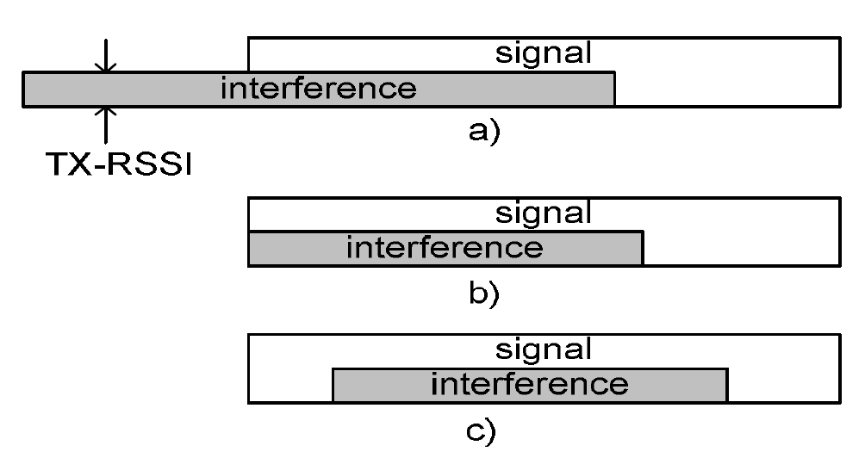
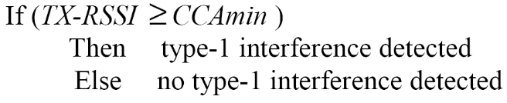
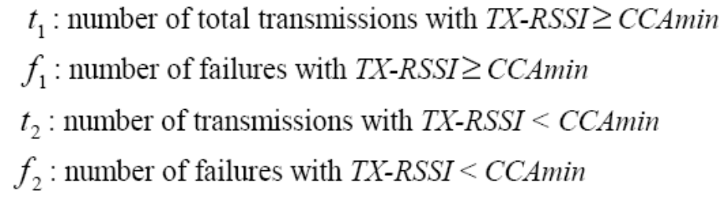
Proposed in [2]
Just before transmissions, read on-air
received energy (TX-RSSI)
and compare it with CCA_{min} to detect
Type I interference
Type I
Type II
Type III
Record the following for the transmissions
[2] Transmission Power and CCA Threshold Self-Adaptation for Effective Spatial Reuse in High Density WLAN, Jing Zhu, Xingang Guo, and Sumit
Roy, Submitted to Infocom 2007.

Slide 10
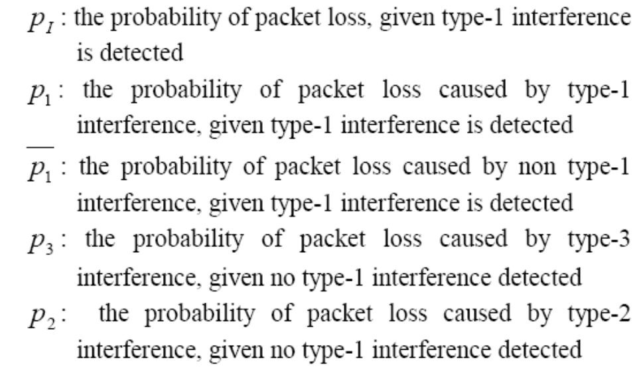

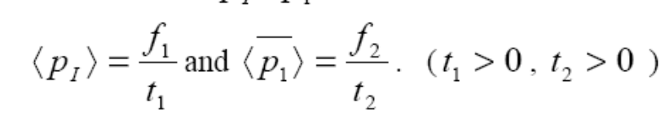
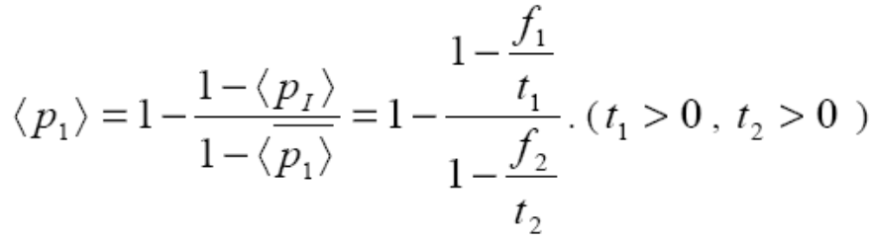
Proposed in [2] (cont’d)
(eq.1)
(eq.2)
(eq.3)
[2] Transmission Power and CCA Threshold Self-Adaptation for Effective Spatial Reuse in High Density WLAN, Jing Zhu, Xingang Guo, and Sumit
Roy, Submitted to Infocom 2007.

Slide 11
Considerations for CCA adaptation in [2]
Effects of local collisions are minimized in CCA adaptation algorithm.
This is due to the ideal condition that, p_{I} and p₁ changing proportionally when there is Type II interference. How do those estimates change in practice?
Adaptation is driven by the energy knowledge at the transmitter. However, our CCA selection objective is to prevent exposed terminals as long as receiver can tolerate the interference.

Slide 12
Considerations for CCA adaptation in [2] (cont’d)
Let’s consider the following proposal
  Let AP maintain per node interference information.
  AP and the client reads on-air energy during the SIFS period after AP send him a packet
  SIFS period ensures whatever is heard will be interference + noise
  Client feeds back this reading and packet RSSI in ACK packet to AP
  AP stores this <CL_{id}, AP_{reading}, CL_{reading},CL_{RSSI}> record. A history of max. N records are stored per client

Slide 13
Considerations for CCA adaptation in [2] (cont’d)
Let’s consider the following proposal
  When a packet is to be transmitted to a client, AP reads on-air energy, and estimates a CL_{reading} interval from that, using previous records (can be via averaging, regression or a similar method).
  Given the rate to send the packet, AP knows the required SIR at the receiver for that packet.
  Using the estimated CL_{reading} interval, and average of the earlier RSSI reports by client, AP probabilistically decide to transmit or defer the transmission.
  Removes the need to maintain a single CCA_{th} for all clients.

Slide 14
End of Slides

