Slide 1



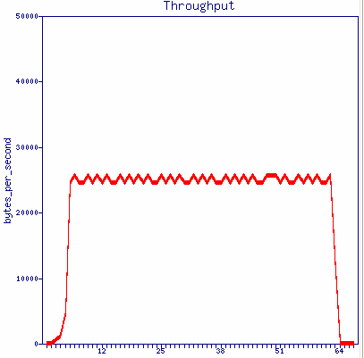





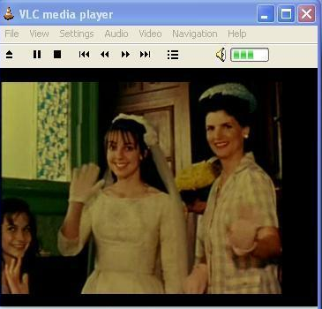
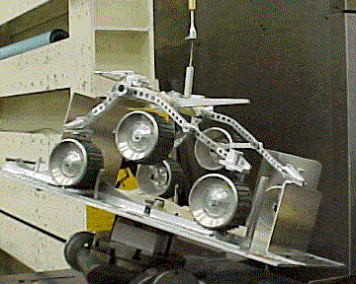
ORBIT – PLANETLAB Integrated Streaming Video Demo
END
START
Run-time measurement collection server
Media (Content) Servers
Run-time
statistics
Support
services
Central experiment control script
Hotspot AP
Control Messaging
Wireless user
Media Streaming

Slide 2
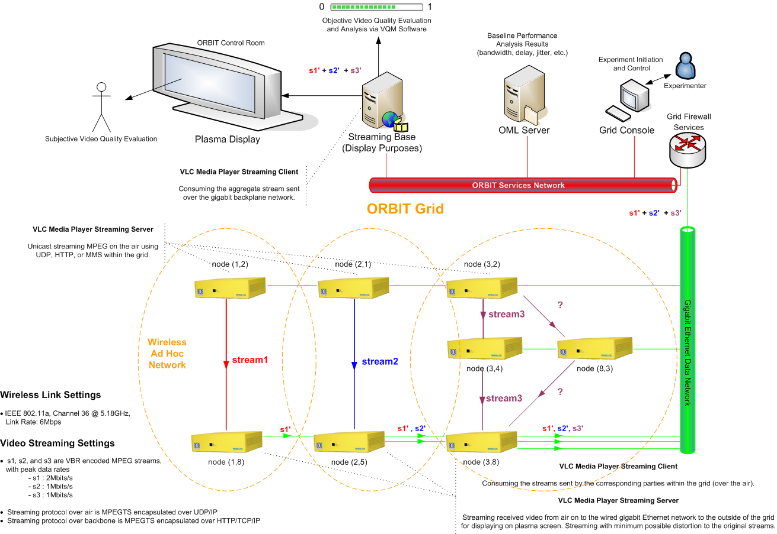

ORBIT – Streaming Video Admission Control Demo

