Slide 1
Simulation of Submarine’s ballast tank and its effect on buoyancy using the Archimedes’ Principle
By: Adam Lieu (100451790)

Slide 2
Background information:
What is the Archimedes’ principle?
It describes buoyancy, an upwards force that is applied to an object being partially or entirely submerged in a fluid, which acts opposite to gravity
How does this apply to submarines?
Submarines use ballast tanks to take in water which increases the overall density of the submarine, this allows them to sink or surface at will
The ballast tanks is flooded by water when diving and expels the water out using compressed air when surfacing.
When the submarine is submerging, the submarine has a negative buoyancy, when the submarine is surfacing, it has positive buoyancy
When the submarine is maintaining a certain depth, it has a neutral buoyancy

Slide 3
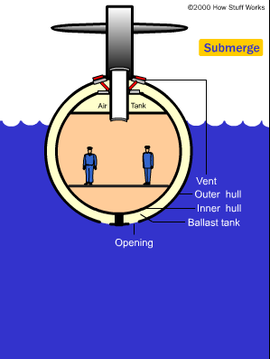
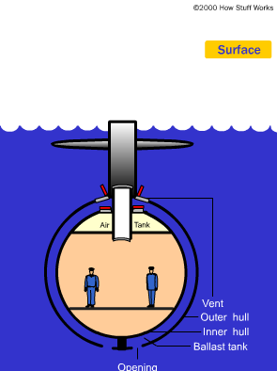
Background information
What are we trying to accomplish here?
A simulation that can visualize how a submarine submerges or surface in sea water or fresh water.
For the simulation, Open Source Physics was used to show this

Slide 4
Assumptions
For the simulation, assumptions were made for the sake of simplicity:
The fluid is assumed to be static, which pressure would not matter much for the simulation
Temperature is only assumed to be whatever the normal amount is, which means it would not be considered in the simulation
Space is not considered, when an object is submerged in water, it displaces a certain amount, and the simulation does not take this into consideration
Realistic values for the submarine itself are disregarded, this includes things such as the maximum depth a submarine can dive and the maximum water the ballast tanks can take in.

Slide 5
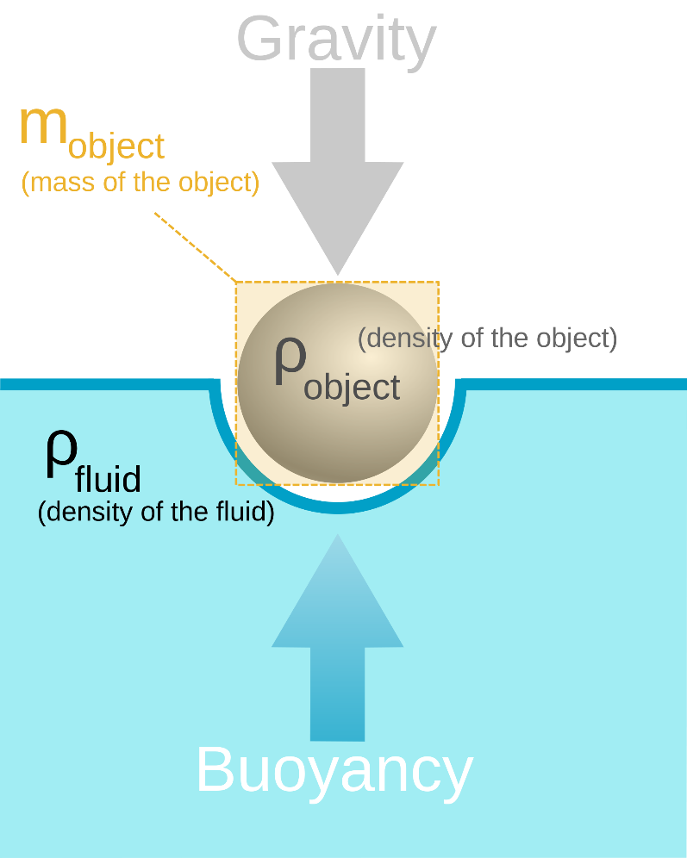
Variables:
The simulations takes in input for:
The measurements for the submarine
The mass of the submarine
The density of the fluid (default is 1033 kg/m³ for seawater)
The amount of water for the ballast tanks
State variables are:
Net Force (F_{net} = Buoyant force – m*g)
Buoyant force = ρ * V * g
Submarine density and volume
From all of this, we get:
Acceleration, velocity and displacement of the submarine

Slide 6
Demo:
Using OSP, takes inputs for the submarine’s measurements, mass, density of the fluid, amount of water in the ballast tanks
The simulation calculates the forces applied to it and visualizes the submarine submerging underwater and how fast.
If the net force is negative, the submarine sinks accordingly, if the net force is positive, the submarine surfaces.

Slide 7
Shortcomings:
OSP does not seem to allow you to change values while it is running without having to reset the simulation
As mentioned before, there are things such as pressure and temperature left out, so the simulation is not as realistic as it could be.
The simulation only shows 1-dimensional movement of a submarine, normally, they would move horizontally as they submerge or surface
Archimedes’ principle by itself doesn’t take certain things like temperature into consideration and is actually not that well suited for submarines

Slide 8
What more was needed?
If the simulation were to be further developed:
Visualizing 2-dimensional movement of the submarine
Include more variables such as pressure or temperature of the fluid so the simulation could be more realistic
Use something besides OSP that would allow for modifying values mid-simulation
Make the simulation more realistic by introducing things such as the maximum depth that a submarine can dive

Slide 9
Conclusion – What was found from this:
Found out the forces that are applied when an object is submerged in a liquid
How a submarine submerges or surfaces by
The drawbacks of using Archimedes’ principle for this type of simulation

