Slide 1
System Programming
Teachers: Nicolas Magaud, Konul Aliyeva

Slide 2
Synopsis
This course presents the main concepts of operating systems from a programming point of view. It aims at making the students use properly system calls provided in C for files and directories, drivers, processes, permissions, pipes and signals. It focuses on building portable applications by using the POSIX norm. Practical works consist in writing C programs in a Linux environment.

Slide 3
Objectives
use the main system calls properly, thus enabling communication between a program and the operating system;
write programs handling system objects such as processes, files, directories, pipes and signals;
optimize the use of system resources;
make programs interact with one another.

Slide 4
Requirements
write programs using C features (such as dynamic data structures, pointers, binary operators, etc.);
translate algorithms into actual C programs;
write simple assembly programs;
read and write shell script

Slide 5
Operating System
An Operating System (OS) is an interface between a computer user and computer hardware. An operating system is a software which performs all the basic tasks like file management, memory management, process management, handling input and output, and controlling peripheral devices such as disk drives and printers.

Slide 6
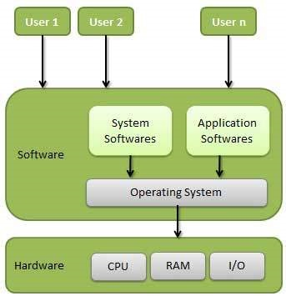

Slide 7
Important functions of an OS
Memory Management
Processor Management
Device Management
File Management
Security
Control over system performance
Job accounting
Error detecting aids
Coordination between other software and users

Slide 8
Operating System Services
Program execution
I/O operations
File System manipulation
Communication
Error Detection
Resource Allocation
Protection

Slide 9
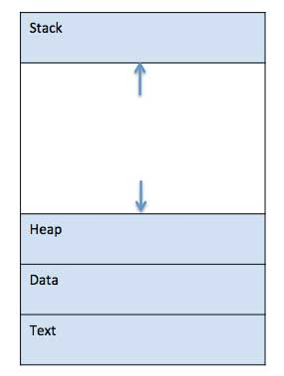
Operating System – Processes
A process is defined as an entity which represents the basic unit of work to be implemented in the system.

Slide 10
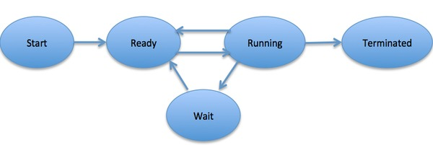
Process Life Cycle

Slide 11
Operating System Scheduling Algorithms
First-Come, First-Served (FCFS) Scheduling
Shortest-Job-Next (SJN) Scheduling
Priority Scheduling
Shortest Remaining Time
Round Robin(RR) Scheduling
Multiple-Level Queues Scheduling

Slide 12
Check your Linux I/O scheduling algorithm:
cat /sys /block /nvme01 / queue / scheduler

Slide 13
POSIX Standard-Portable Operating System Interface
POSIX is a set of standard operating system interfaces based on the Unix operating system.
Wait a sec… What?

Slide 14
Long time ago, UNIX had a lot of different implementations. This was leading to problems about portability. One application developed for one Unix variant like HUX did not work for other Unix variant like IBM.

Slide 15
POSIX versions
POSIX.1 or C API
This standard extend ANSI C standard and add some concepts, operations and libraries like mkdir , dirname , fork , kill , networking, regular expression and Linux system calls.
POSIX.2 or CLI Utilities
This standard defines commands like cd , ls , echo , …
POSIX.3 or Shell Language
This substandard defined some shell language and programming basics like a=b or echo $a etc.

Slide 16
POSIX.4 or Environment Variables
Environment variables provide a way to influence the behaviour of software on the system. Printenv prints the names and values of all currently defined env variables.
POSIX.5 or Program Exit Status
POSIX.6 or Regular Expression
POSIX.7 or Directory Structure
POSIX.8 or File Names
POSIX.9 or Command Line API Utility Conventions

Slide 17
System Calls and Library Functions
The functions which are a part of standard C library are known as Library functions. For example the standard string manipulation functions like strcmp(), strlen() etc are all library functions.

Slide 18
The functions which change the execution mode of the program from user mode to kernel mode are known as system calls. These calls are required in case some services are required by the program from kernel.

Slide 19
Types of Library Functions
Functions which do not call any system call.
Functions that make a system call.
For example, the string manipulation functions like strlen() etc fall under this category. Also, there are library functions that further make system calls, for example the fopen() function which a standard library function but internally uses the open() sytem call.

Slide 20
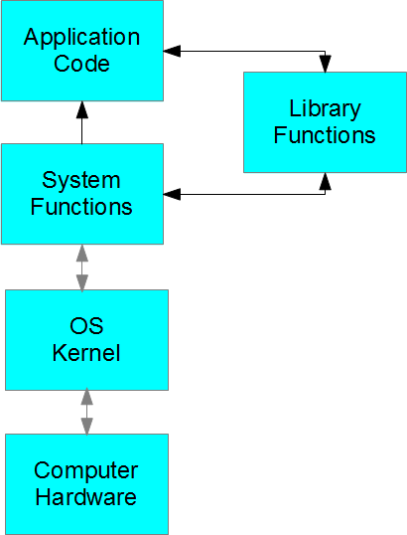
Interaction Between Components

Slide 21
fopen() vs open()
Why do we have two functions for the same operation i.e. opening a file?
fopen() is a library function which provides buffered I/O services for opening a file while open() is a system call that provides non-buffered I/O services.

Slide 22
Buffered I/O services refer to the technique of temporarily storing the results of an I/O operation in user-space before transmitting it to the kernel (in the case of writes) or before providing it to your process (in the case of reads).
By so buffering the data, you can minimize the number of system calls and can block-align I/O operations, which may improve the performance of your application.

Slide 23
If there are functions exist which do the same job (library functions and system calls), which one an user should use?

Slide 24
If a library function corresponding to a system call exists, then applications should use the library function because :

Slide 25
Library functions are portable which means an application using standard library functions will run on all systems. While on the other hand an application relying on the corresponding system call may not run on every system as system call interface may vary from system to system.

Slide 26
Sometimes the corresponding library function makes the load to system call lesser resulting in non-frequent switches from user mode to kernel mode. For example if there is an application that reads data from file very frequently, then using fread() instead of read() would provide buffered I/O which means that not every call to fread() would result in a call to system call read().

Slide 27
Some other differences
A library function is linked to the user program and executes in user space while a system call is not linked to a user program and executes in kernel space.
A library function execution time is counted in user level time while a system call execution time is counted as a part of system time.
Library functions can be debugged easily using a debugger while System calls cannot be debugged as they are executed by the kernel.

Slide 28
Command Line
Most applications can be launched using a command , e.g. firefox & instead of clicking on an icon.
Options, (as well as file names) can be added to the command line : gcc -o a.out my_file.c
These arguments can be retrieved inside a C program using argc/argv mechanism using the formal parameters argc and argv:

Slide 29
