Slide 1
FILES
Teachers: Nicolas Magaud
Konul Aliyeva

Slide 2
FILES
The file is the most basic and fundamental abstraction in Linux. Linux follows the everything-is-a-file philosophy

Slide 3
TYPES OF FILES
By default Unix have only 3 types of files. They are:
Regular files (-)
Directory files (d)
Special files

Slide 4
Special files have 5 sub types:
Block file(b)
Character device file(c)
Pipe file(p)
Symbolic link file(l)
Socket file(s)

Slide 5
Regular File types
1. Readable file or
2. A binary file or
3. Image files or
4. Compressed files etc.
Use touch command to create regular files.
To list regular files use ls -l | grep ^-

Slide 6
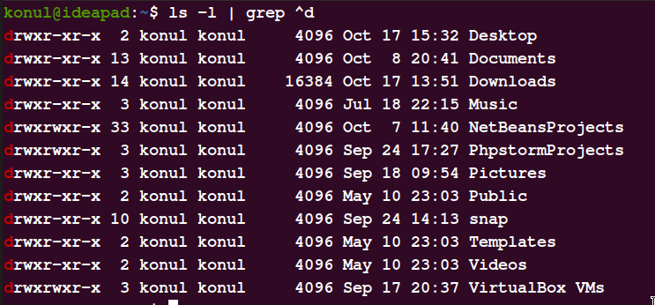
Directory files
To list directory files use ls -l | grep ^d
Use mkdir command to create them.

Slide 7
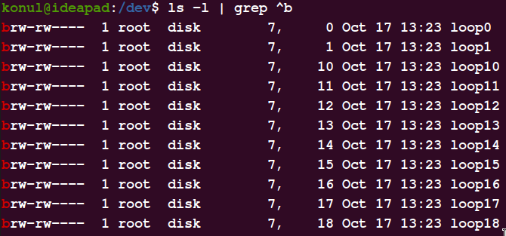
Block file type
These files are hardware files most of them are present in /dev.
To list them use ls -l | grep ^b

Slide 8
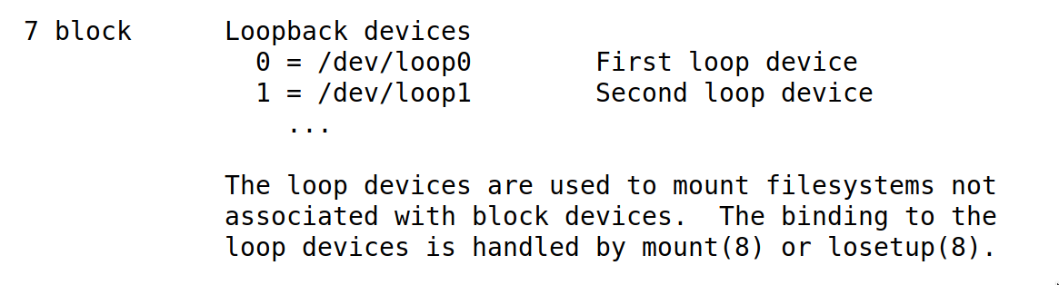

Slide 9
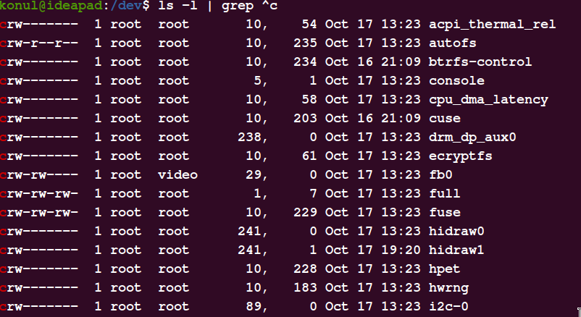
Character device files
To list them use ls -l | grep ^c

Slide 10
Unfortunately, device files can present a major security hazard when an attacker is able to access them in an unauthorized way.
For instance, if attackers can read or write to the /dev/kmem device, they may be able to alter their priority, or other attributes of their process. Similarly, access to disk devices, tape devices, network devices, and terminals being used by others all can lead to problems. Access to your screen buffer might allow an attacker to read what is displayed on your screen. Access to your audio devices might allow an attacker to eavesdrop on your office without your knowing about it.

Slide 11
Pipe files
The other name of pipe is a “named” pipe, which is sometimes called a FIFO. FIFO stands for “First In, First Out” and refers to the property that the order of bytes going in is the same coming out.
To list them use ls -l | grep ^p
To create them use mkfifo

Slide 12
Symbolic link files
These are linked files to other files. They are either Directory/Regular File. The inode number for this file and its parent files are same.

Slide 13
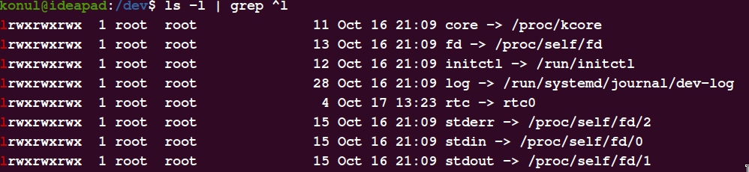
To list them use ls -l | grep ^l

Slide 14
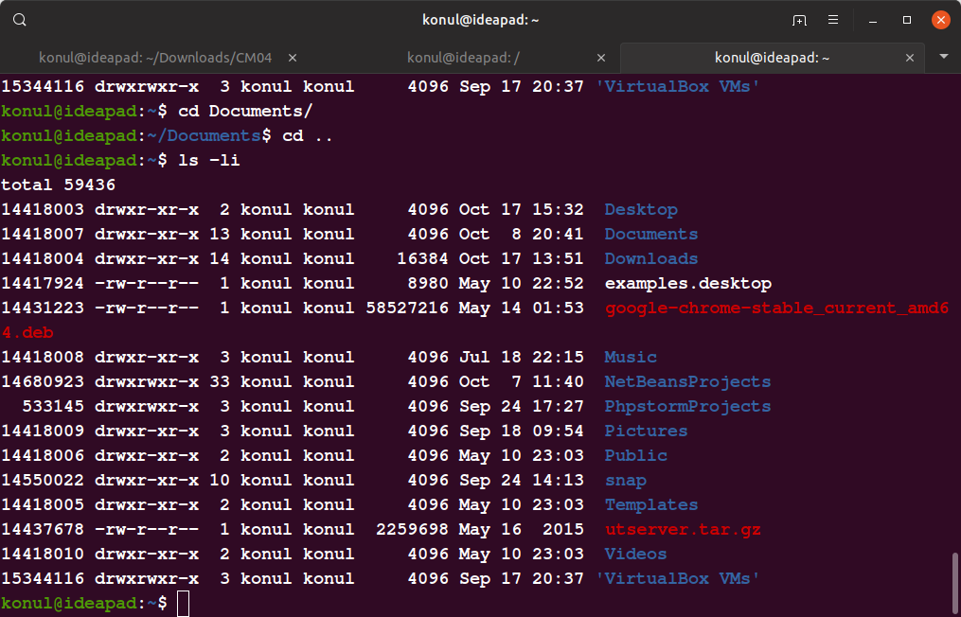

Slide 15
Socket files
A socket file is used to pass information between applications for communication purpose
To create them use socket() system call

Slide 16
References
https://igm.univ-mlv.fr/~yahya/progsys/linux.pdf
https://www.linux.com/tutorials/file-types-linuxunix-explained-detail/
https://www.kernel.org/doc/Documentation/admin-guide/devices.txt

