Slide 1
CSE181 Discrete Mathematics
Lecture: 1
Md. Asiful Islam Miah

Slide 2
Lecture Outline
1.1 Propositional Logic
Logic
Propositional Logic
Propositions
Propositional Variables
Compound Propositions
Logical Operators
Truth Value & Truth Table
Truth Tables of Compound Propositions (next class)
Conditional Statements (next class)
Logic and Bit Operations (next class)

Slide 3
Objectives and Outcomes
Objectives: To understand the importance of logic in mathematical reasoning, to understand proposition and propositional logic, symbol and usage of different types of logical operators.
Outcomes: Students are expected to be able to apply logical operators and analyze logical propositions via truth tables, be able to construct a truth table for a given compound proposition.

Slide 4
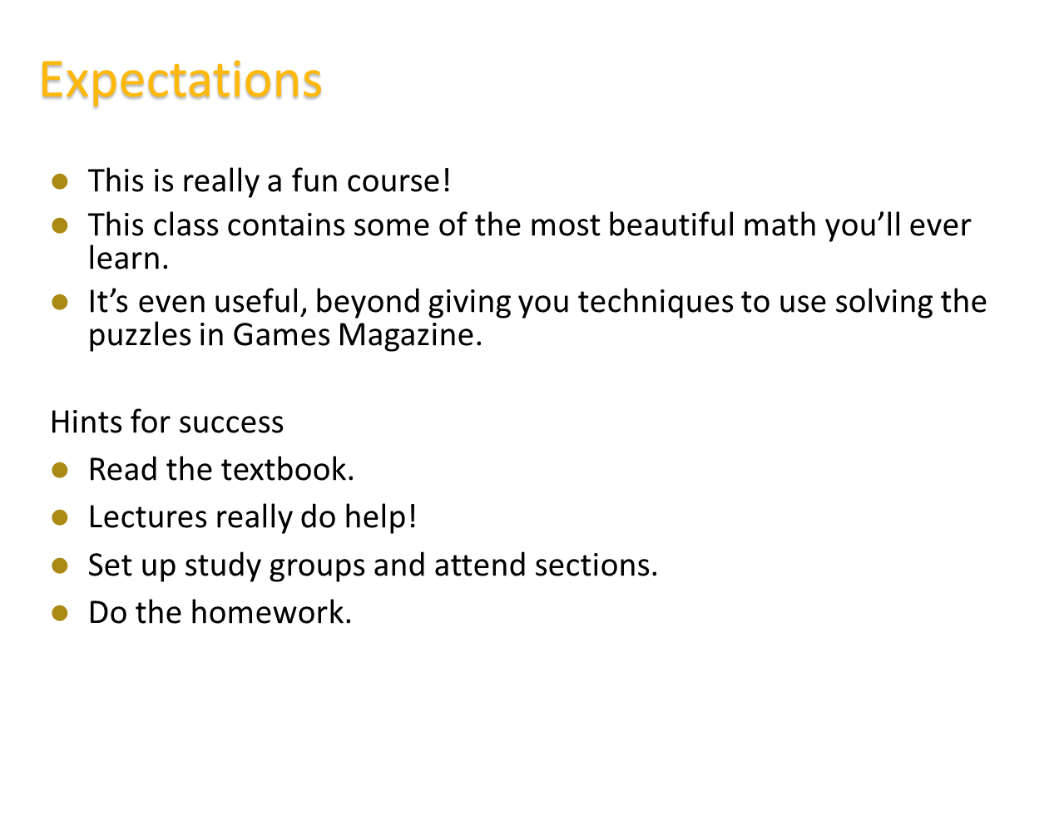

Slide 5
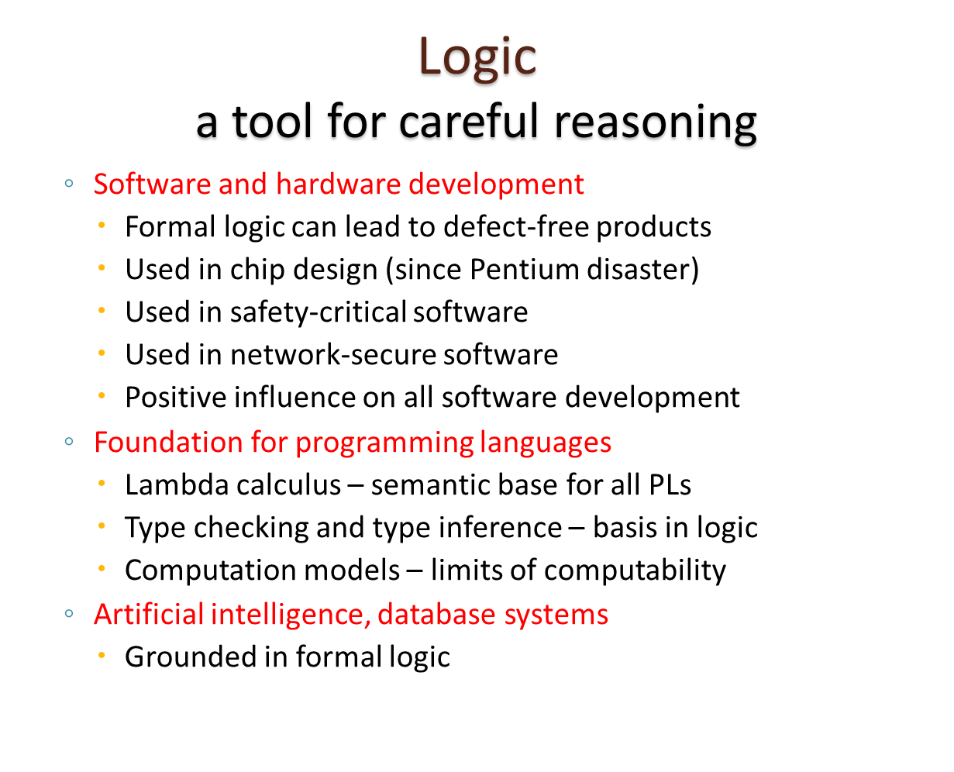

Slide 6
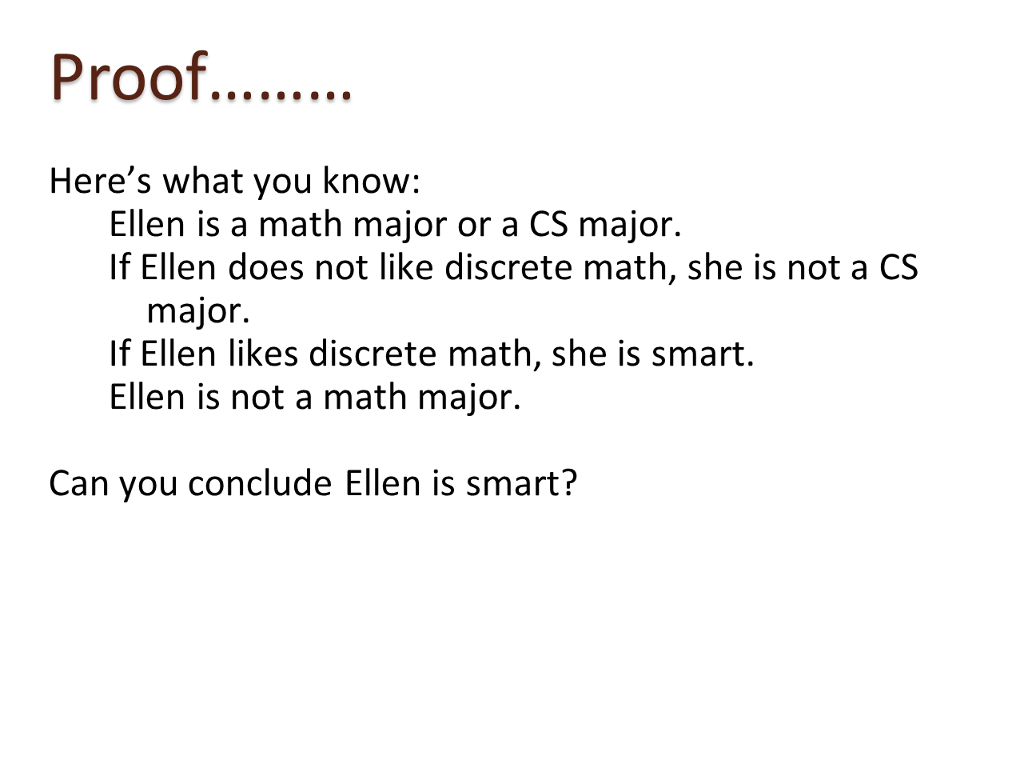

Slide 7
Key Terms
Logic: Logic is the discipline that deals with the methods of reasoning.
Logic is the basis of all mathematical reasoning
The rules of logic specify the meaning of mathematical statements
Propositional Logic: The area of logic that deals with propositions is called the propositional logic.

Slide 8
Key Terms
Proposition: A proposition is a declarative statement that’s either TRUE or FALSE, but not both.
Assigned one of the two distinct values, True and False or T and F.
Denoted by p, q, r.
Statements that are not propositions include
Questions
Commands

Slide 9
Key Terms
Propositional variable: A variable that represents a proposition. The conventional letters used for propositional variables are p, q, r, s, t,..
Compound proposition: A proposition constructed by combining two or more propositions using logical operators (AKA : logical connectives)
Logical Operators: Operators used to combine propositions
Truth Value: The truth value of a proposition is true, denoted by T, if it is a true statement and false, denoted by F, if it is a false statement. Truth Value ==> Either True or False
Truth Table: A table displaying the truth values of propositions.

Slide 10
Proposition: Examples
Propositions:
The integer 20 is a Prime.
Dhaka is the capital city of Bangladesh
Not Propositions:
What is your name ?
Solve the problem.
Is Karim a good boy?

Slide 11
Proposition: Examples
Proposition | Not Proposition
3 + 2 = 32 | Bring me coffee!
3 + 2 = 5 | 3 + 2
CSE 181 is Karim’s favorite class. | CSE 181 is his favorite class.
Every cow has four legs. | Do you like Cake?

Slide 12
Logical Operators
Logical Operators ==> unary, binary
Unary:
Negation
Binary
Conjunction
Disjunction
Exclusive OR
Conditional/Implication
Bi-conditional

Slide 13
Logical Operators: Symbols & Usage
Operator | Symbol | Usage
Negation | ¬ | NOT
Conjunction | ∧ | AND
Disjunction | ∨ | OR
Exclusive or | ⊕ | XOR
Conditional | → | if, then
Bi-conditional | ↔ | iff

Slide 14
Propositional Logic : Negation
Let p be a proposition. The negation of p, denoted by ¬p , is the statement “It is not the case that p.”
The proposition ¬p is read “not p”
The truth value of the negation of p, ¬p, is the opposite of the truth value of p.

Slide 15
Propositional Logic : Negation
Negation just turns a false proposition to true and the opposite for a true proposition.
Example1: p: I am going to town.
¬ p: I am not going to town. ; or,
It is not the case that I am going to town.
Example2: p : “23 = 15 +7”
p happens to be false, so ¬ p is true.
Example3: p: 9 is divisible by 3.
¬ p: 9 is not divisible by 3.; or,
It is not the case that 9 is divisible by 3.

Slide 16
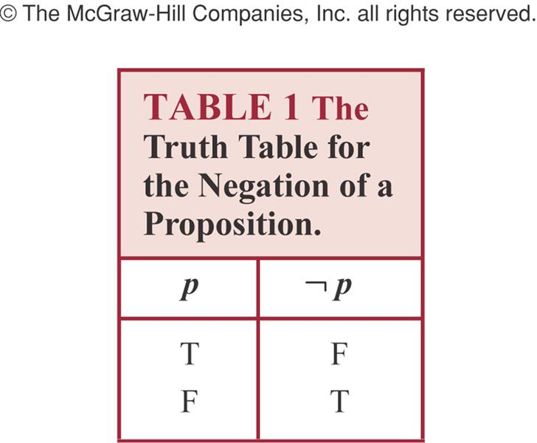
Truth table for Negation of a Proposition
¬ (¬ p) is logically equivalent to p .

Slide 17
Compound Proposition
A proposition constructed by combining two or more propositions using logical operators (AKA : logical connectives)
Conjunction
Disjunction
Exclusive Disjunction

Slide 18
Conjunction
Let p and q be propositions. The conjunction of p and q, denoted by p ∧ q, is the proposition “p and q.”
The conjunction p ∧ q is true when both p and q are true and is false otherwise.
Conjunction corresponds to English “AND”.
Example: p : The boy prepare his lessons regularly. q : The boy helps his parents everyday.
p ∧ q : The boy prepare his lessons regularly and helps his parents
everyday.
Another Example: Lina is brilliant and helpful.

Slide 19
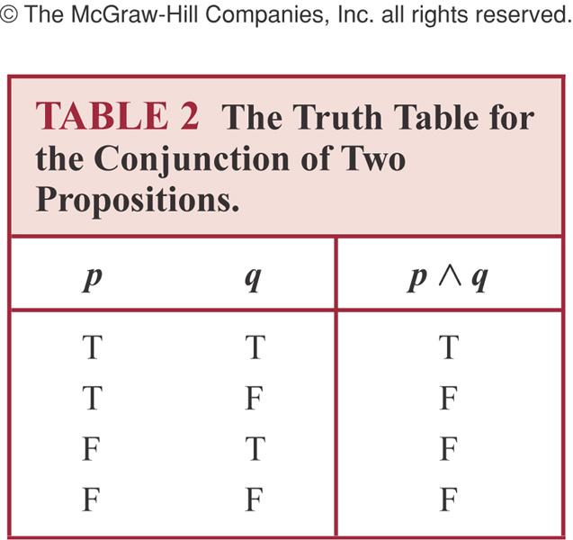
Truth Table for Conjunction

Slide 20
Conjunction: Another Example
Example: p : ‘I am going to town’
q : ‘It is going to rain’
p ∧ q : ‘I am going to town and it is going to rain.’
Note: Both p and q must be true to p ∧ q be true

Slide 21
Disjunction
Let p and q be propositions.
The disjunction of p and q, denoted by p ∨ q, is the proposition “p or q.”
The disjunction p ∨ q is false when both p and q are false and is true otherwise.
Disjunction is true when at least one of the components is true.
Disjunction corresponds to English “OR”.
Example: p : You can take physics this semester. q : You can take chemistry this semester.
p ∨ q : You can take physics or chemistry this semester.
Another Example: Abdullah is brave OR intelligent.

Slide 22
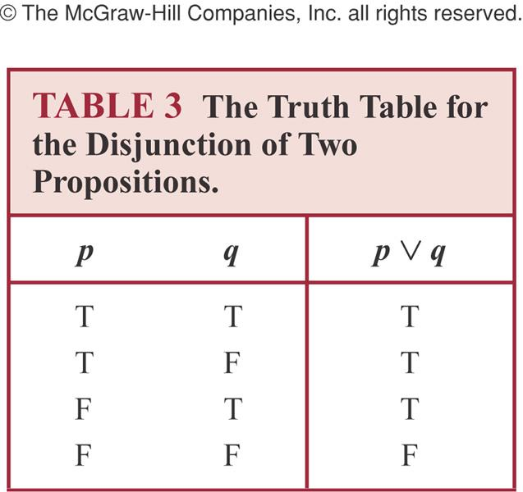
Truth Table for Disjunction

Slide 23
Examples of Conjunction & Disjunction
Let,
p : 5 < 9
q : 9 < 7.
Construct the propositions p ∧ q and p ∨ q.
Solution:
The conjunction of the propositions p and q is the proposition
p ∧ q : 5 < 9 and 9 < 7
The disjunction of the propositions p and q is the proposition
p ∨ q : 5 < 9 or 9 < 7
Question: What are the truth values of p ∧ q and p ∨ q?

Slide 24
Exclusive Disjunction
Let p and q be propositions.
The exclusive or of p and q, denoted by p ⊕ q, and read “p or exclusive q“ is the proposition that is true when exactly one of p and q is true and is false otherwise.

Slide 25
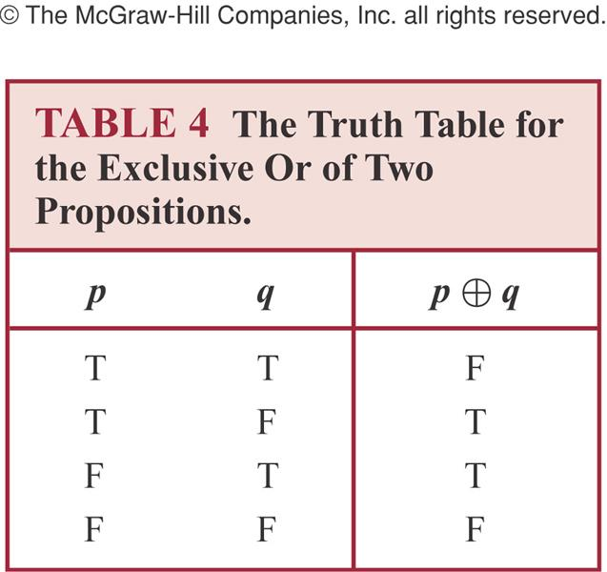
Truth Table of Exclusive Disjunction

Slide 26
Exclusive Disjunction: Example
Example: p : You can take tea.
q : You can take coffee. p ⊕ q : You can take tea or coffee, but not both.

Slide 27
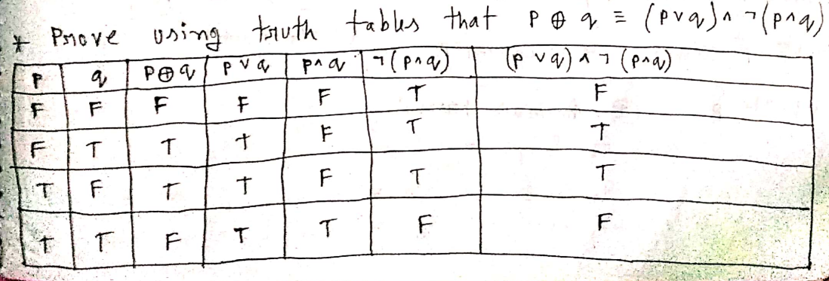

Slide 28
Thank You

