Slide 1
Computer Networks - Lab Socket Programming in C
1. Introduction

Slide 2



Network Programming = Socket Programming
Network Programming
Also known as Socket Programming because the network programming itself is based on Sockets.
A simple understanding of Socket
Provided by the Operating System within devices
Socket provides a high level of abstraction for programmers so that we don’t have to worry about underlying physical & software details of networking.

Slide 3
5 “must-know” fundamental details of Socket Programming in C

Slide 4






An Analogy with a Phone call
Phone number A
Phone number B
A
B

Slide 5
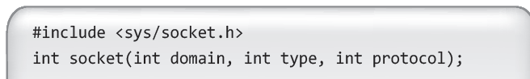
1. Socket
Creating a Socket (a Socket descriptor)
TCP Socket can be compared to a phone → we need a device to call someone or accept their phone calls, right?
To perform network I/O, the first thing a process must do is, call the socket function to create a specific type of socket by specifying the type of communication protocol desired, protocol family, etc.
Creating a socket descriptor

Slide 6
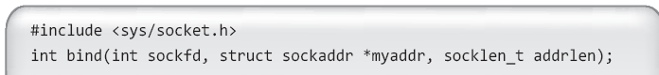
2. Bind
Binding the socket
It is like registering a phone number to the phone (to connect to other phones)
Sockets do not have a complete address in the beginning to start transferring data, so we bind a Socket to a port. → Phones do not have a phone number at the beginning to make phone calls, so we register a phone number.
The process of allocating a port number to a socket is called ‘binding’
Binding a request to TCP/IP indicating that it is ready to receive/send information

Slide 7
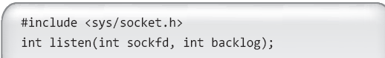
3. Listen
Listening for connection requests
Identifying a bound, unconnected socket → means “identify the connection request”
The process of converting an unconnected socket into a passive socket, indicating that the kernel should accept incoming connection requests directed to this socket
Listening for connection requests

Slide 8
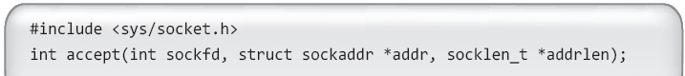
4. Accept
Accept a connection request
Transition of the connection request from listen() method to an actual Socket → means “accept the connection request”
After accepting the request (and automatic creation of the socket), the data can be finally transferred between the nodes.
Accepting an incoming connection request

Slide 9
Make the logical steps from the 4 previous parts
Sequence
Step 1. Creating the socket (socket function call)
Step 2. Bind the socket to a port (bind function call)
Step 1. Listen for incoming connection requests & identify ones (listen function call)
Step 4. Accept the identified connection request and open the socket (accept function call)
See & feel the sequence with an existing Server-Client code
download from the course materials in learn.inha.ac.kr

Slide 10
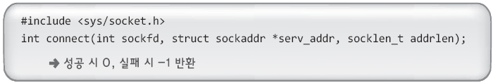
5. Connect
Attempting to establish a connection (requesting to connect)
It’s like dialing to a specific phone number
The implementation of requesting to connect is very simple, unlike listening & accepting a socket.
To make a connection request, just specify the address to connect to and the socket descriptor to attach the socket to.
Making a connection request

Slide 11
“gcc” compiler installation and comlining / running codes in C

Slide 12


Method of running Linux-based
Compile and run
How to compile
How to Run

Slide 13
Install a gcc compiler
Download from the link: https://drive.google.com/a/nsl.inha.ac.kr/file/d/1_mDQpP0lZcn7FCDOoqkra5yByZc3UBVu/view?usp=sharing
2. Unarchive in a desired location
3. Set the bin folder containing gcc file in the Environment (follow my instructions)
4. Launch the CodeBlocks application

Slide 14
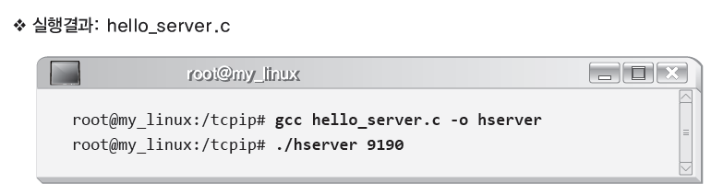
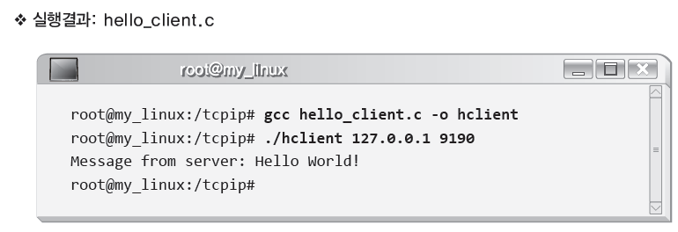
Compile, Launch & Test
The results of the sample
127.0.0.1 is the local computer’s address

Slide 15
Opening / closing, and writing into files

Slide 16
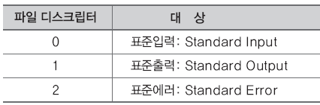
Low-level file input and output file descriptors
Low-level file IO
There is no compatibility with the operating system because it is not a standard.
Linux is based on a low-level file input and output functions can be based on data transmitted and received in the socket, because the socket is also to be considered as a file.
File Descriptor (fd)
Operating system files are created (and sockets) simply as numbers (to be able to easily distinguish them)
Low-level file input and output function requires a file descriptor for the purpose of input and output.
Both socket & file have Input/Output streams (socket being more advanced than file), socket descriptor can be used simply as a file descriptor as well.

Slide 17
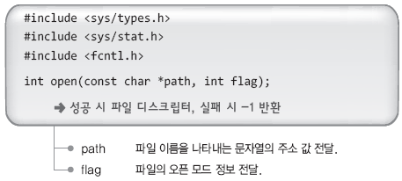
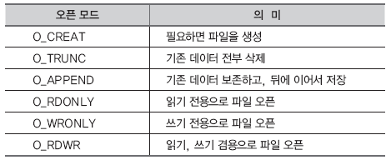
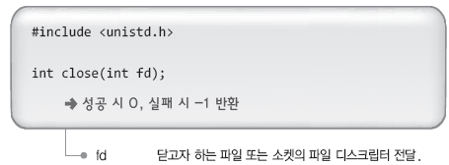
File Open and Close
open To proceed to the output file using the file descriptor returned by a function call,.

Slide 18
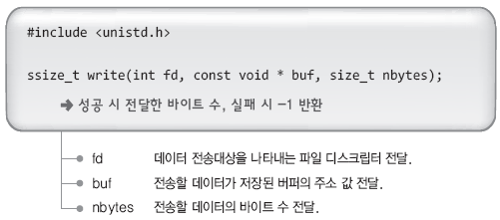
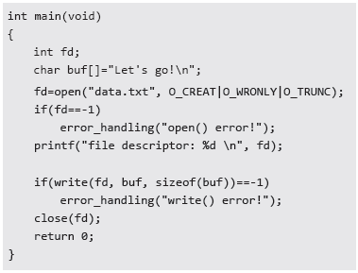
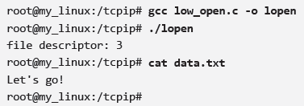
Writing data to a file

Slide 19
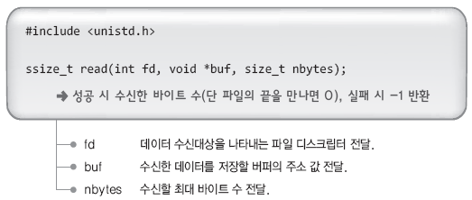
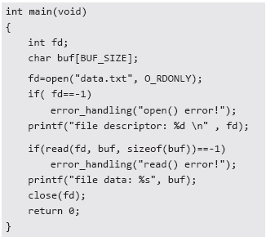
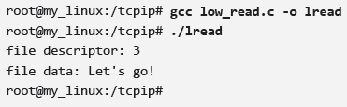
Read data stored in the file
The results

Slide 20
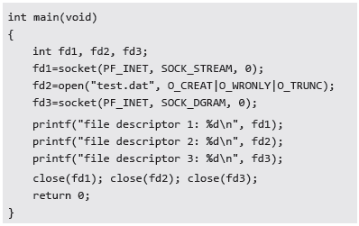
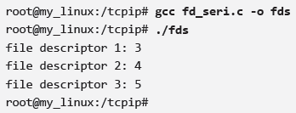
File descriptors and socket
The results
Both socket and file descriptors are in the same number sequence.
This confirms that Linux I/O considers the socket and files the same.

