Slide 1


Module 2
Train the Trainer Certification

Slide 2

Module 2: Icebreaking Techniques
Objectives:
In this module you will:
Discuss why icebreaking techniques are necessary
Determine how icebreaking activities be conducted
Examine icebreaking activities that work well
Train the Trainer Certification
Notes:
You can safely remove this slide. This slide design was provided by SlideModel.com – You can download more templates, shapes and elements for PowerPoint from http://slidemodel.com/

Slide 3

Module 2: Icebreaking Techniques
Why Are Icebreaking Activities Necessary?
Up to this point you have completed your pre-class preparation. You are ready to meet your class, but is your class ready to meet you?
Icebreaking includes everything that you should do to establish a relaxed atmosphere in the class. It is designed to get the students to begin participating actively in the class. It is an opportunity to get the students to know you and for you to get to know them. In some classes, it is a great way for the students to get to know each other.
Train the Trainer Certification
Notes:
You can safely remove this slide. This slide design was provided by SlideModel.com – You can download more templates, shapes and elements for PowerPoint from http://slidemodel.com/

Slide 4

Module 2: Icebreaking Techniques
How to Conduct Icebreaking Activities
Icebreaking should occur very early in class, certainly within the first fifteen minutes. Activities should be chosen to achieve the objectives described above, but also to have fun. It goes without saying, icebreaking should never embarrass students. If a student is very reticent about participating, excuse them from the activity. Whenever possible, you should participate in the activity also. This helps to build rapport with your students.
Train the Trainer Certification
Notes:
You can safely remove this slide. This slide design was provided by SlideModel.com – You can download more templates, shapes and elements for PowerPoint from http://slidemodel.com/

Slide 5
Module 2: Icebreaking Techniques
Suggested Icebreaking Activities
There are entire books written on icebreaking. Do not hesitate to design your own. A few simple activities are listed on the next pages.
Student interviews
Have the students’ pair off. If there is an odd number, you should pair off with one of the students. Have the student’s interview each other collecting the following information:
Name
Department (if applicable)
Past work experience
Why they are taking the course
Something unique about themselves: favourite hobby, sport, food, etc.
Give them about five minutes to do this. Then have each student introduce his/her partner.
Train the Trainer Certification
Notes:
You can safely remove this slide. This slide design was provided by SlideModel.com – You can download more templates, shapes and elements for PowerPoint from http://slidemodel.com/

Slide 6
Module 2: Icebreaking Techniques
Suggested Icebreaking Activities
Draw a Picture
Have each student write his/her name on a name tent. On the other side, have students draw a picture either describing himself or herself or a hobby they enjoy, then have the rest of the class try to guess what the picture represents.
What’s Your Colour?
Have each student write his/her name on a name tent. On the other side have each student write a colour that describes his or her personality, One at a time, the students introduce themselves by stating their name, how long they have been with their department, what their experience is, their colour, and why they chose that colour.
Train the Trainer Certification
Notes:
You can safely remove this slide. This slide design was provided by SlideModel.com – You can download more templates, shapes and elements for PowerPoint from http://slidemodel.com/

Slide 7


Module 2: Icebreaking Techniques
Suggested Icebreaking Activities Contd.
Completed Thought
This icebreaker can be used during the introductions. The object is to give the students an incomplete statement and, using their own words, have them complete the thought. A few examples are:
“Today I wish I could be…”
“If I won the lottery, I would…”
“Customer service to me means…”
“If I could live anywhere, I would live…”
Writing with Opposite Hand
This is another good icebreaker for introduction classes. Have the students write their names on a piece of paper with their opposite hand. Explain to them that this may not feel comfortable at first but if they practiced writing with this hand, it would start to feel more natural. It is the same with any new skill; it may feel uncomfortable at first but when they practice, it will start to feel more natural.
Train the Trainer Certification
Notes:
You can safely remove this slide. This slide design was provided by SlideModel.com – You can download more templates, shapes and elements for PowerPoint from http://slidemodel.com/

Slide 8


Module 2: Icebreaking Techniques
Suggested Icebreaking Activities Contd.
Action Words
Liven up potentially dull material by analysing it for a key word and then assigning an action to it. Every time that word is mentioned during the session, the group must perform an action, such as clapping their hands. The actions also help burn those concepts into trainees’ memories. The aim is to keep concentration and interest high, and to get the group to focus on key words, ideas, and attitudes.
Coloured Slickers
Coloured stick-on dots, such as those used to code file folders, can be used to mark places in workbooks and identify meaningful material. Provide strips of dots at each table so that as participants come across key points, they can place a coloured dot in the margin. It makes it easy for participants to later scan the workbook and pick out ideas they can use for action planning!
Train the Trainer Certification
Notes:
You can safely remove this slide. This slide design was provided by SlideModel.com – You can download more templates, shapes and elements for PowerPoint from http://slidemodel.com/

Slide 9
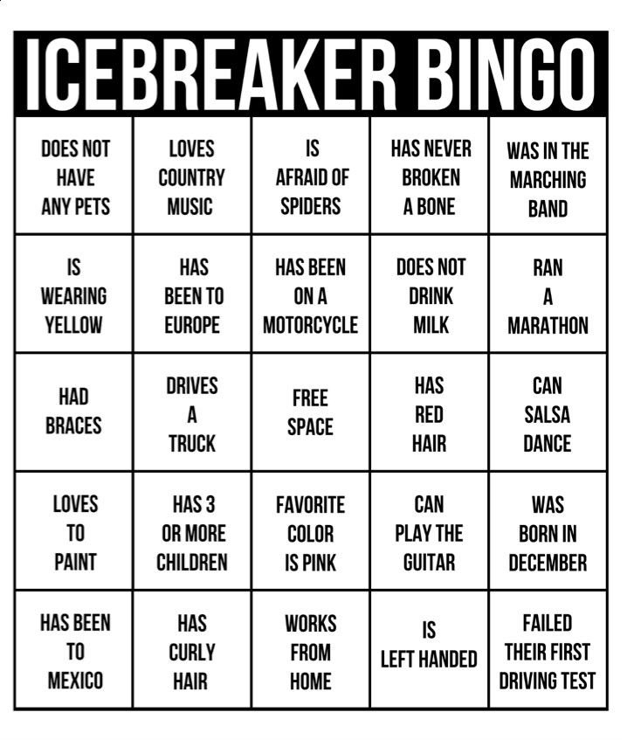
Module 2: Icebreaking Techniques
Suggested Icebreaking Activities Contd.
Bingo Icebreaker
Objective: Use this game to facilitate introductions. Print and copy a bingo card for each player. Players circulate to find others who match descriptions in the bingo squares and write the name of that person in the individual square. When a player has filled the entire card, s/he yells ‘Bingo!”
Train the Trainer Certification
Notes:
You can safely remove this slide. This slide design was provided by SlideModel.com – You can download more templates, shapes and elements for PowerPoint from http://slidemodel.com/

