Slide 1


Train the Trainer Certification

Slide 2
Course Outline
Module 1: Pre-Class Planning
Module 2: Icebreaking Techniques
Module 3: The Instructor’s Behavior
Module 4: Checklist
Module 5: Balanced Instruction
Module 6: Questing Techniques
Module 7: Classroom Dynamics and Motivational Theories
Module 8: Adult Learning

Slide 3
Module 1: Pre-Class Planning
Module 1: Pre-Class Planning
Module 2: Icebreaking Techniques
Module 3: The Instructor’s Behavior
Module 4: Checklist
Module 5: Balanced Instruction
Module 6: Questing Techniques
Module 7: Classroom Dynamics and Motivational Theories
Module 8: Adult Learning

Slide 4
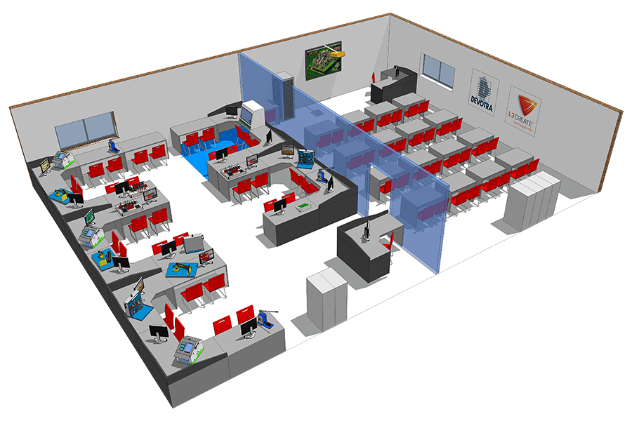
Module 1: Pre-Class Planning
Objectives:
In this module you will:
Define pre-class planning
Discuss the importance of pre-class planning
Define pre-class planning activities
Review a checklist for pre-class planning
Discuss preparing to teach a class
Train the Trainer Certification
Notes:
You can safely remove this slide. This slide design was provided by SlideModel.com – You can download more templates, shapes and elements for PowerPoint from http://slidemodel.com/

Slide 5
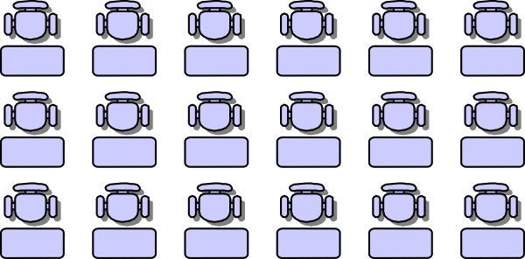

Module 1: Pre-Class Planning
What is Pre-Class Planning
Pre-class planning is everything that you do before class starts to ensure its success. These are the activities that all professional instructors do and there is no excuse for not doing them. The first few times you teach pre-class planning will consume more of your time. As you become comfortable with the subject matter and the classroom environment, pre-class planning is less time-consuming. Still, some pre-class planning is always required.
Pre-Class Planning Activities
When students arrive for a new class, they are usually there because they want to be, they are looking forward to learning the material. They have not yet formed an opinion of the course of the instructor. They are probably neutral or slightly positive toward that class. They have expectations. The professional instructor will try to meet these expectations.
Train the Trainer Certification
Notes:
You can safely remove this slide. This slide design was provided by SlideModel.com – You can download more templates, shapes and elements for PowerPoint from http://slidemodel.com/

Slide 6
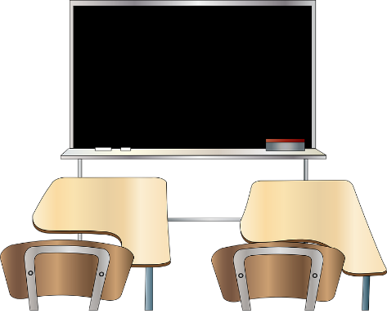
Module 1: Pre-Class Planning
Subject Matter Preparation
The most important pre-class activity is reviewing the subject matter material. We cannot stress the importance of this enough. It is imperative that you enter the class as a subject matter expert. You should not only be conversant with the skills and knowledge, but also with the course material. It is a good idea to review all exercises that will be used. It is easy to forget solutions to complicated exercises.
Classroom Preparation
If possible, prepare and check the classroom 30-45 minutes before the class begins. Check that all materials are complete and sufficient. This includes the Student Manuals, Student Exercises, tent cards, pens/pencils, etc. Is the correct software installed? Are the printers working? If you are teaching off-site, it’s a good idea to have extra copies of student materials with you.
If possible, arrange the room to be most conducive to teaching and learning. This simply means arranging the desks and chairs so that the students are as close to you as possible. Also, make sure they will be able to see the instructional media that you will be presenting. Aisle spacing should allow you to walk to each student’s desk. You will not always have control over the size of the room or the location of the student desks. Often you will have to make do with a less then desirable learning environment. An experienced instructor can overcome these obstacles. Remember the classroom will reflect on you and Stefanini. The most important thing is not to complain about the room as it sets a negative tone.
Train the Trainer Certification
Notes:
You can safely remove this slide. This slide design was provided by SlideModel.com – You can download more templates, shapes and elements for PowerPoint from http://slidemodel.com/

Slide 7
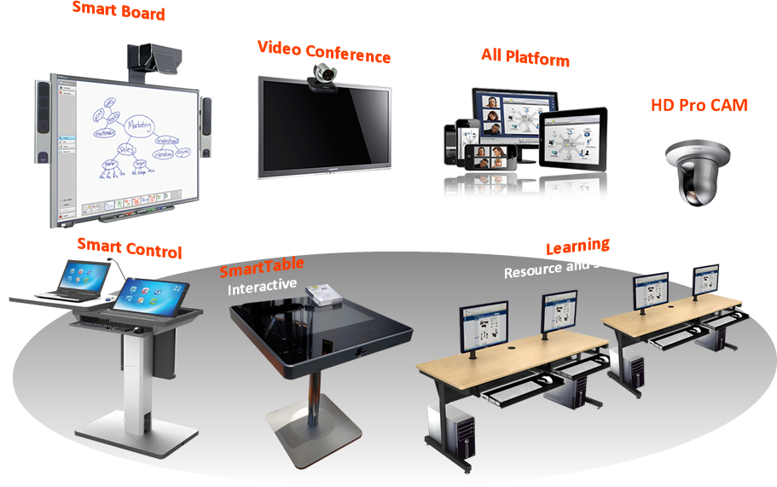

Module 1: Pre-Class Planning
Presentation Equipment
Check that all electrical equipment is working and that you have spare bulbs for project equipment. Do you know how to use the equipment? Check that you have markers, flipchart paper, etc. Check that you know how to turn equipment on and off, check that you know how to dim lights in the room. Check that all students will be able to see and hear the material that you are presenting.
Plan Opening Remarks
The first hour of your class is the most critical. This is when your students will form an impression (probably lasting) of you. Plan how you will begin the class. Icebreaking activities and student introductions will be discussed later.
Train the Trainer Certification
Notes:
You can safely remove this slide. This slide design was provided by SlideModel.com – You can download more templates, shapes and elements for PowerPoint from http://slidemodel.com/

Slide 8
Module 1: Pre-Class Planning
Develop a Positive Mental Set
Teaching is one of the most rewarding professions one can be in. Your attitude has more influence on the trainee than any other of your personal traits or actions. You must have an attitude of service toward those you teach. You must be confident about your abilities without being pompous. There may be many problems in your outside life. Do not carry them into the classroom , leave them outside the door.
Also, after having taught a course many times, there is a tendency to become jaded with the material and teaching. A professional trainer can prevent this with self-motivational techniques. View each class as a experience for you to learn something and to meet new people.
Train the Trainer Certification
Notes:
You can safely remove this slide. This slide design was provided by SlideModel.com – You can download more templates, shapes and elements for PowerPoint from http://slidemodel.com/

Slide 9
Module 1: Pre-Class Planning
Pre-Class Planning Checklist
Pre-Class Planning Checklist
Materials | Equipment | Facilities
The checklist on the right will help ensure that you have covered the items necessary during pre-class planning. Modify this checklist as needed to reflect individual courses.
A post-class checklist is also a helpful tool that can be used to maintain consistency in the classroom.
Train the Trainer Certification
Notes:
You can safely remove this slide. This slide design was provided by SlideModel.com – You can download more templates, shapes and elements for PowerPoint from http://slidemodel.com/

Slide 10
Module 1: Pre-Class Planning
Item List
1.When observing the class, jot down the questions students ask and, if necessary, the trainer’s reply .Also write down any tips, interesting suggestions, or practical examples that the trainer provides.
Steps in Preparing for a Class
Over time each trainer develops an individual style in preparing to teach a course for the first time. On the right is a list of items, by category, to consider in preparing for a class that is to be taught for the first time.
2.During your sit-in, not how far you should be in the material at each break and at lunchtime.
3.Identify the appropriate points for demonstrations and exercises to take place. Complete each of the demonstrations and exercises with the students if possible. This provides you with needed practice.
Learning the Courseware
4.On the next available prep day walk through the entire course as if you were back in class. Read through the manual, complete each demonstration as indicated, and work through each exercise.
In addition to having sufficient prep time, observing the course as it is being taught serves as a terrific tool for learning the courseware for a particular product level. On the right are some ways to use prep time and “sit-ins” productively.
Train the Trainer Certification
Notes:
You can safely remove this slide. This slide design was provided by SlideModel.com – You can download more templates, shapes and elements for PowerPoint from http://slidemodel.com/

Slide 11
Module 1: Pre-Class Planning
Item List
5.Go through each of the exercises again. In doing so, make some notes on each of them, such as:
When do students complete this exercise?
What skills are covered?
Which exercises can be modified if time is running short?
Is the exercise done individually or as a group?
Steps in Preparing for a Class Contd.
Over time each trainer develops an individual style in preparing to teach a course for the first time. Below is a list of items, by category, to consider in preparing for a class that is to be taught for the first time.
6.Plan the following items for each topic in the course and as you do note them in your Instructor Guide.
Define
How will you define the benefits of how and why this feature/topic is used?
Do you have practical business examples for each topic?
Can you relate this topic to your own experiences or the experiences of a co-worker?
Show
How will you demonstrate this feature (on the board, at the student’s computer, using an overhead projection system, etc.)?
Test each of you demonstrations before going into class.
When dealing with a difficult topic, be sure to have numerous examples available. It is a good idea to idea to have extra demonstrations and exercises available for those types of topics.
Do
What exercise will the student use to practice this?
Note any areas where students may have difficulty in completing the exercise steps. Be ready clarify the steps for them.
Learning the Courseware
In addition to having sufficient prep time, observing the course as it is being taught serves as a terrific tool for learning the courseware for a particular product level. On the right are some ways to use prep time and “sit-ins” productively.
Train the Trainer Certification
Notes:
You can safely remove this slide. This slide design was provided by SlideModel.com – You can download more templates, shapes and elements for PowerPoint from http://slidemodel.com/

Slide 12
Module 1: Pre-Class Planning
Item List
6.Plan the following items for each topic in the course and as you do note them in your Instructor Guide.
Review
What summary exercises will the student use to reinforce that they can complete the skill steps on their own.
What questions will you ask to check for understanding?
When will you ask each question?
What summary questions will you ask at the end of each chapter, before lunch, at the end of the day?
Is appropriate, study the next level course for the application if available. This will help you to field questions in class that pertain to advanced topics. You will also know whether the topic is covered in the next level.
Schedule a work session with an experienced trainer or your training manager to discuss style/presentation or software issues.
Schedule Presentation Certification.
Schedule a Product Certification.
Steps in Preparing for a Class Contd.
Over time each trainer develops an individual style in preparing to teach a course for the first time. Below is a list of items, by category, to consider in preparing for a class that is to be taught for the first time.
Learning the Courseware
In addition to having sufficient prep time, observing the course as it is being taught serves as a terrific tool for learning the courseware for a particular product level. On the right are some ways to use prep time and “sit-ins” productively.
Train the Trainer Certification
Notes:
You can safely remove this slide. This slide design was provided by SlideModel.com – You can download more templates, shapes and elements for PowerPoint from http://slidemodel.com/

