Slide 1



DHCP: Dynamic Host Configuration Protocol
Course Title: Data Communication | Course Code: ICT-3101
Submitted By
Supervised By
Alif Ahmed Joy
ID: IT24015
Session: 2023-2024
Department of ICT, MBSTU
Dr. Nazrul Islam
Associate Professor
Department of ICT, MBSTU
Department of Information and Communication Technology
Mawlana Bhashani Science and Technology University
Santosh, Tangail-1902, Bangladesh

Slide 2
Presentation Outline
01
Introduction to DHCP
02
DHCP components and network diagram
03
DHCP workflow (DORA process)
04
Lease renewal and relay agent
05
Advantages, disadvantages and conclusion
DHCP – Dynamic Host Configuration Protocol
Course Code: ICT-3101
02

Slide 3
Introduction to DHCP
DHCP automatically assigns IP addresses and network settings to devices on a network.
01
Why it matters: manual IP setup is slow and error-prone, and can cause duplicate-address conflicts.
02
How it works: a client–server protocol over UDP (server port 67, client port 68), defined in RFC 2131.
03
What it provides: IP address, subnet mask, default gateway and DNS server, with reusable leases.
DHCP – Dynamic Host Configuration Protocol
Course Code: ICT-3101
03

Slide 4
DHCP Components
Component | Role | Key detail
DHCP server | Holds the IP pool and hands out leases | Listens on UDP port 67
DHCP client | Any device that requests configuration | Uses UDP port 68
Relay agent | Forwards DHCP messages between subnets | Converts broadcast to unicast
Key terms
IP pool (scope): the range of addresses available. Lease: how long a client may use its IP.
DHCP – Dynamic Host Configuration Protocol
Course Code: ICT-3101
04

Slide 5
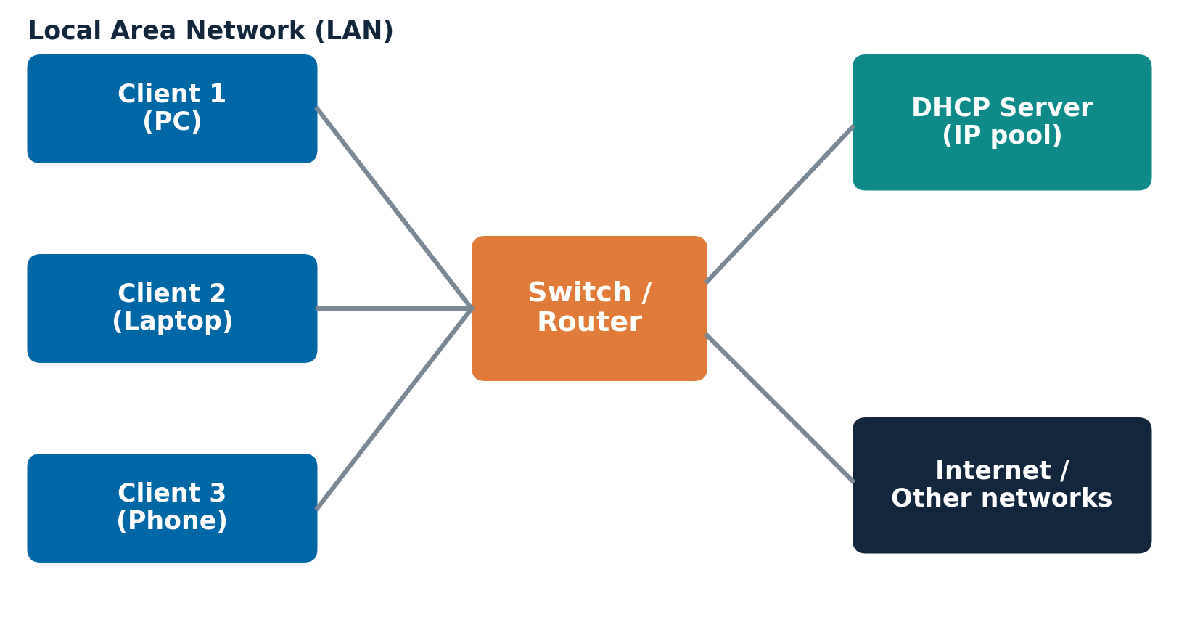
Network Diagram
Clients obtain their settings from a central DHCP server
01
Clients
Request configuration
02
Switch / router
Carries DHCP broadcasts
03
DHCP server
Allocates IPs from its pool
DHCP – Dynamic Host Configuration Protocol
Course Code: ICT-3101
05

Slide 6
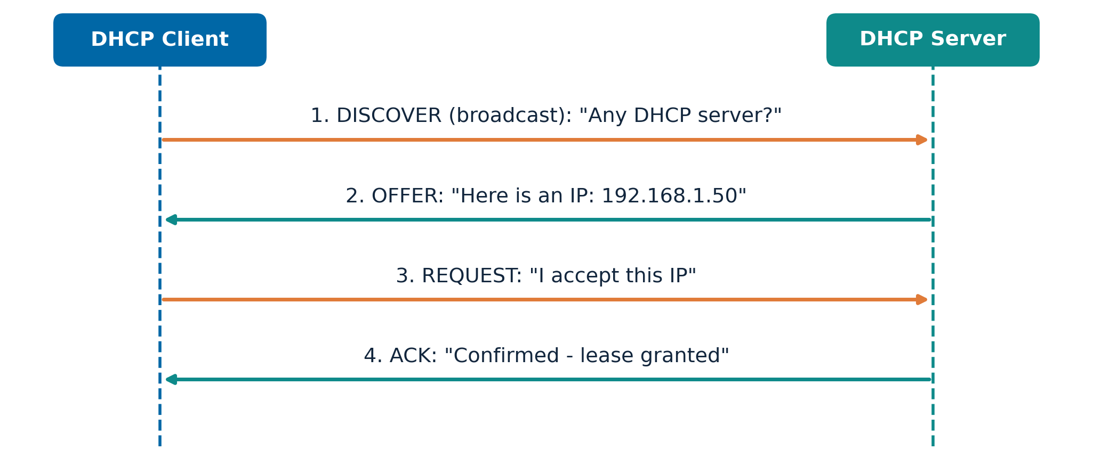
DHCP Workflow (DORA)
Key point
DORA = Discover, Offer, Request, Acknowledge.
Four messages give a client a leased IP.
Figure: DORA message exchange between a DHCP client and server.
DHCP – Dynamic Host Configuration Protocol
Course Code: ICT-3101
06

Slide 7
DORA Steps Explained
Discover
Client broadcasts to find any DHCP server.
Offer
Server offers an IP, mask, gateway, DNS and lease.
Request
Client accepts one offer; other servers withdraw.
Acknowledge
Server confirms the lease; client can use the IP.
DHCP – Dynamic Host Configuration Protocol
Course Code: ICT-3101
07

Slide 8
Lease Renewal and Release
Stage | Lease time | Client action | Result
Renewal (T1) | 50% | Unicast request to same server | Lease extended
Rebinding (T2) | 87.5% | Broadcast request to any server | Lease extended
Expiry | 100% | Stop using IP, restart DORA | New lease obtained
A client may send DHCPRELEASE to return its IP address to the pool before the lease ends.
DHCP – Dynamic Host Configuration Protocol
Course Code: ICT-3101
08

Slide 9
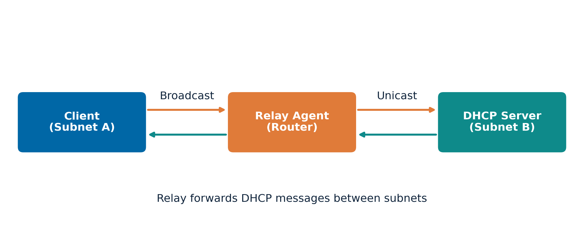
DHCP Relay Agent
Why needed
Broadcasts do not cross routers.
A relay agent forwards them as unicast to a remote DHCP server.
Figure: relay agent between a client subnet and a DHCP server subnet.
DHCP – Dynamic Host Configuration Protocol
Course Code: ICT-3101
09

Slide 10
Advantages and Disadvantages
Aspect | Advantages | Disadvantages
Management | Automatic, central and fast setup | Extra load on the server in large networks
Reliability | Fewer errors and IP conflicts | Single point of failure if the server is down
Security | Supports reservations and DHCP snooping | Rogue server and starvation attacks
Summary
DHCP trades some server dependency for fast, automatic, conflict-free configuration.
DHCP – Dynamic Host Configuration Protocol
Course Code: ICT-3101
10

Slide 11
Conclusion
DHCP automates IP configuration, making networks easier to build and manage.
01
The DORA process (Discover, Offer, Request, Acknowledge) is the core of its workflow.
02
Leases allow efficient reuse of limited IP addresses, and relay agents extend DHCP across subnets.
03
With DHCP snooping and server redundancy, DHCP remains reliable and secure.
DHCP – Dynamic Host Configuration Protocol
Course Code: ICT-3101
11

Slide 12
Selected References
[1] R. Droms, “Dynamic Host Configuration Protocol,” RFC 2131, IETF, 1997.
[2] B. A. Forouzan, Data Communications and Networking, McGraw-Hill.
[3] J. F. Kurose and K. W. Ross, Computer Networking: A Top-Down Approach, Pearson.
[4] A. S. Tanenbaum and D. J. Wetherall, Computer Networks, Pearson.
DHCP – Dynamic Host Configuration Protocol
Course Code: ICT-3101
12

Slide 13
Thank you
Questions and Discussion
Alif Ahmed Joy
Department of ICT, MBSTU
Supervised By:
Dr. Nazrul Islam
Associate Professor
Department of ICT, MBSTU
DHCP – Dynamic Host Configuration Protocol
Course Code: ICT-3101
13

