Slide 1


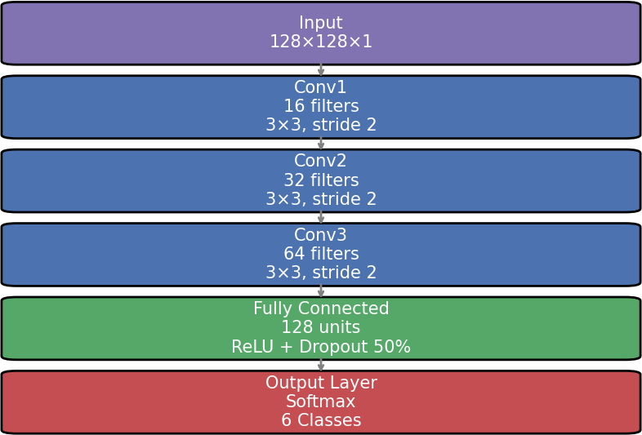
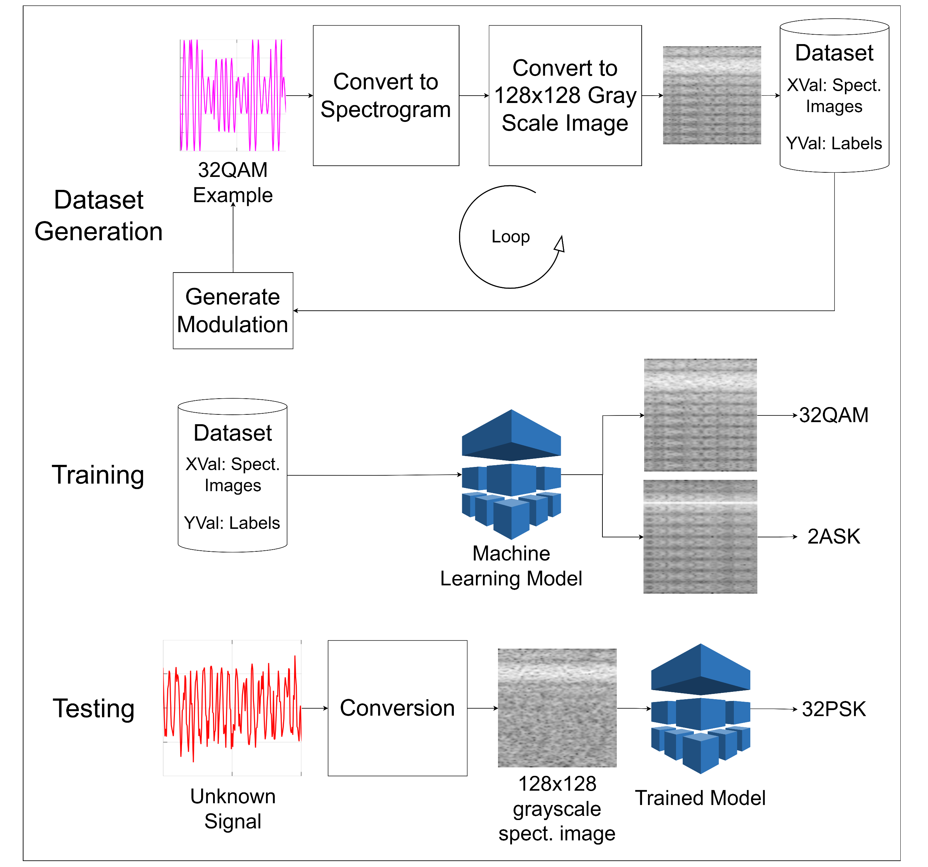
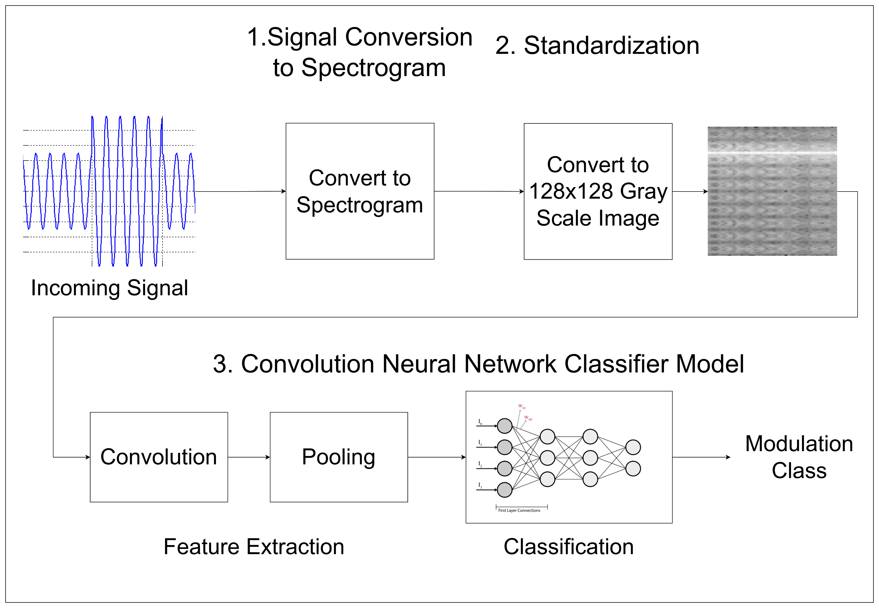
Classification Of Digital Modulation Types Using AI
Ali Faisal Ghazi, Information & Communication Engineering
Dr. Asmaa Hameed Majeed
Introduction
Neural Network Design
Result
The objective of this work is to design a digital modulation classification system based on NN, and specifies the type of processes and methods required to implement it.
The network used in this project is a Convolutional Neural Network (CNN), which is well-suited for processing images like spectrograms. The network is designed to classify different digital modulation types from these spectrogram images. The architecture follows a simple and effective structure with multiple convolutional layers, batch normalization, activation functions, pooling, and fully connected layers.
The model shows strong performance across different SNR levels, with a slight decrease in accuracy as noise increases:
Noiseless (∞ dB): 90%
10 dB SNR: 89%
8 dB SNR: 88%
5 dB SNR: 84%
Despite noise degradation, the model maintains robustness, particularly due to training on a multi-SNR dataset. Misclassifications primarily occur between PSK, QAM, and DPSK, as their spectrograms share similar features, especially at higher modulation orders.
Even in noisy conditions, the model shows high confidence, with softmax outputs indicating meaningful ambiguity. This highlights the advantage of spectrogram-based CNNs, where prediction probabilities can support secondary decision systems.
Aim of The Project
To develop a machine learning model that can automatically recognize different digital modulation types by converting time-domain signals into spectrograms and classifying them using AI.
Methodology
Block Diagram of CNN Design
Signal Simulation: Generate synthetic signals for different modulation types using MATLAB.
Spectrogram Generation: Convert time-domain signals into time-frequency images (spectrograms).
Use a loop to generate a large dataset for training.
Model Training: Use a supervised learning algorithm to classify spectrograms based on modulation type.
Validation and Testing: Evaluate model performance using accuracy metrics and test cases.
Conclusion
This project successfully developed an Automatic Modulation Classification (AMC) system using spectrogram-based deep learning. The system was able to classify various modulation schemes (ASK, FSK, PSK, QAM, DPSK, and Chirp) under different conditions, achieving 90% accuracy on clean signals and 84% accuracy at 5 dB SNR.
The model demonstrated robustness in noisy environments and showed strong real-world inference performance. Although challenges like memory usage and model confusion between similar modulation types were encountered, the use of spectrograms proved effective for distinguishing modulation schemes.
Block Diagram of digital modulation classification system
Block Diagram Showing how the System Works
Future Work
Several areas can be explored to improve and expand this work:
Use a larger and more varied dataset for better model performance.
Explore more complex modulation types like OFDM.
Implement the AI model in real-world applications.
Develop a demodulation process to recover the original binary data.
Improve noise handling by including more SNR levels and real-world channel effects.
Combine spectrograms with other features (e.g., IQ plots or raw signals) to enhance model training.
References
Stuart J. Russell and Peter Norvig, “Artificial Intelligence A Modern Approach”
Pearson Education, pp. 670-671, 2022
John G. Proakis and Masoud Salehi, “Digital Communications” McGraw-Hill, pp. 3,2008

