Slide 1
Classification of Digital Modulation Signals Based on AI
How we can utilize AI to classify incoming modulation types
Ali Faisal Ghazi, Information & Communication Engineering
Dr. Asmaa Hameed Majeed

Slide 2
Introduction
What is “Classification of Digital Modulation Signals Based on AI”
It’s to use a trained AI model to classify an incoming modulated signal.
Why is it important?
Optimizes Bandwidth in satellite communication by dynamically allocating bandwidth based on signal type.
Reduce errors in environments where multiple modulation types are used to carry signals.
Improves signal detection for military applications.

Slide 3
Research Objectives
Create a trained AI Model that is able to reach high level of accuracy in modulation classification.
Adding noise to the modulated signals, and examine how the AI model accuracy will be affected.

Slide 4
Proposed Structure
The structure we propose contains the following components:
Functions to generate different modulations which are: ASK, PSK, FSK, and QPSK.
A “Feature Extraction” function that will extract the signal features out of an incoming modulated signal.
Data Generator that will use the earlier components to data.
A Database used to store the data.
A Function that converts the Data into scalers.
A Function that will create a Neural Network to be trained and tested on the data.

Slide 5
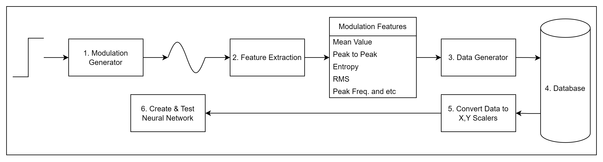
Cont. Proposed Structure
Figure 1, Shows how the different components work together

Slide 6
Modulation Generator
A Function that will generate different Modulation types based on:
Input Bits
Sampling Frequency
Carrier Frequency
Duration of the signal
Based on these parameters, four modulation types will be generated: PSK, QPSK, FSK & ASK.

Slide 7
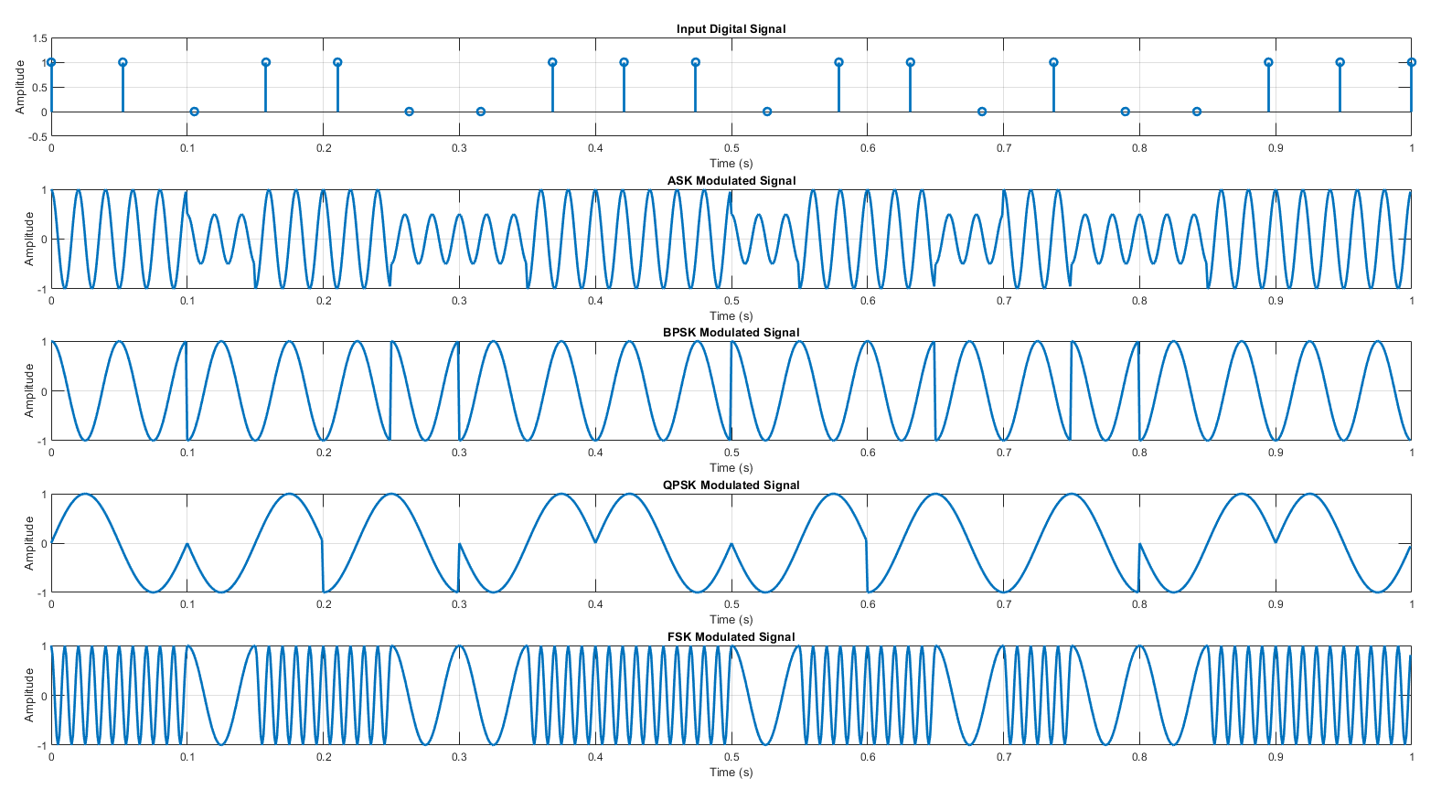
Cont. Modulation Generator
Figure 2, Shows different ASK, BPSK, QPSK and FSK generated by Modulation Generator

Slide 8
Feature Extraction
A Function that will analyze and extracts important features out of the modulated signals, that will be helpful to determine the differences between different kinds of modulation.
These features include, but not limited to:
Duration
Mean Value
RMS
Peak to Peak
Power Spectral Density
Peak Frequency and etc.

Slide 9
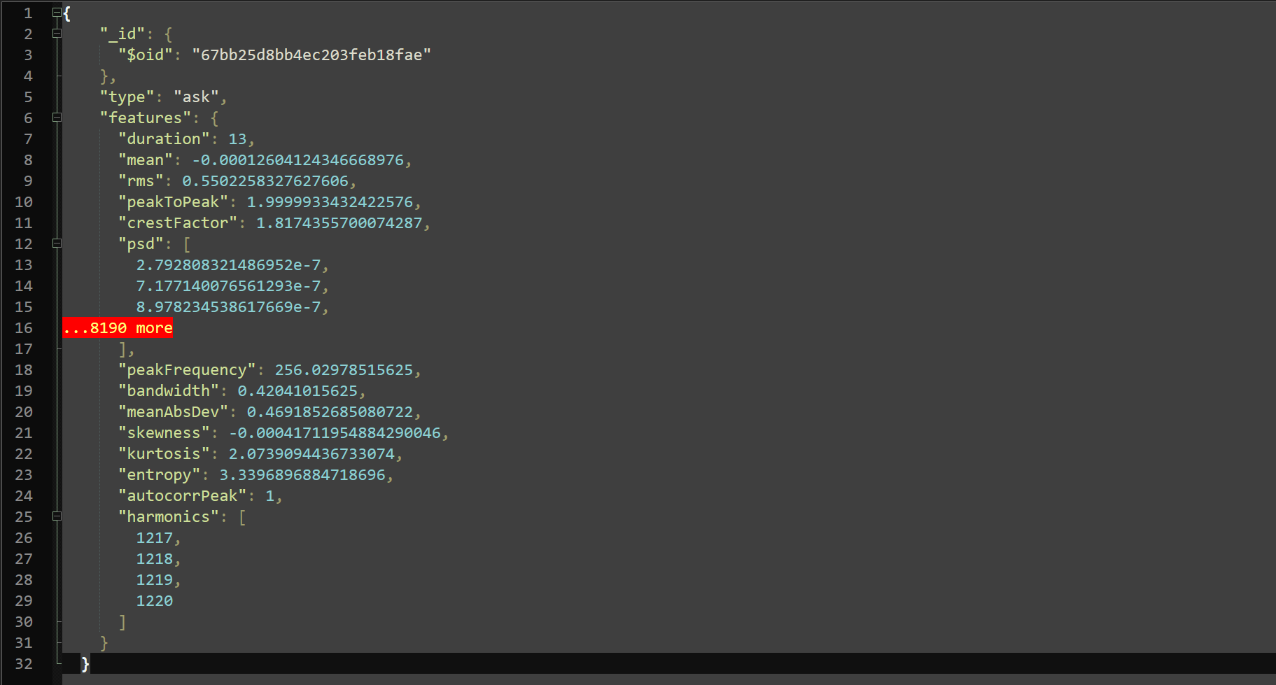
Cont. Feature Extraction
Figure 3, Shows an signal features sample extracted from an ASK signal

Slide 10
Data Generator
A function responsible to generate large amount of data samples for training purposes.
Data Generator uses a simple for-loop and MATLAB's randi function to generate many modulations with random parameters.
After the loop is done generating data, it will be passed on to a Python script that will handle storing it in the DB.

Slide 11
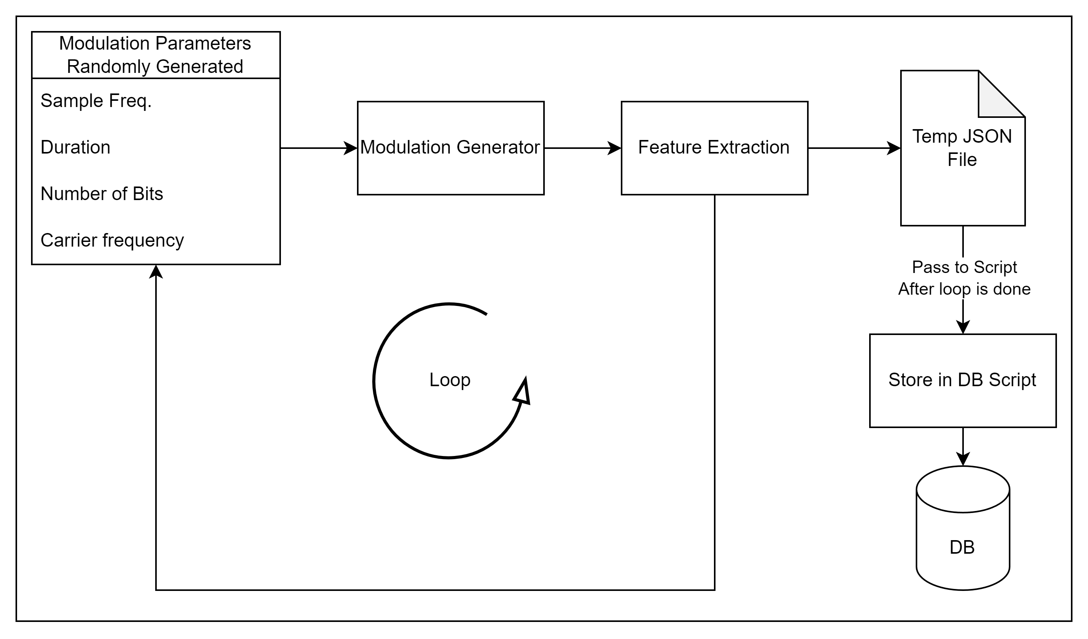
Cont. Data Generator
Figure 4, Shows how data generation works using a loop

Slide 12
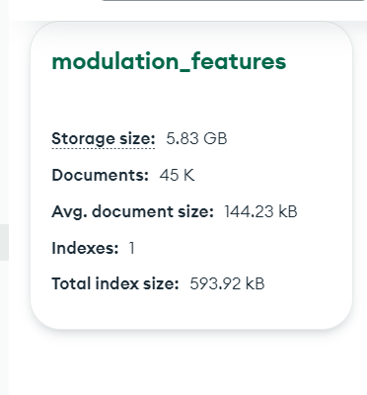
Cont. Data Generator
Figure 5, Shows data stored in a MongoDB database

Slide 13
Database
Many database solutions could be utilized for this project, we chose MongoDB for the following reasons:
Scalability: Easily handles large volumes of data.
Flexible Schema: which will allow us to easily add or remove properties later on.
Fast Read/Write Operations.

Slide 14
Convert Data into Scalers
A Python script that will extracts the Data from the Database, and uses StandardScaler from scikit-learn to normalize and standardize the data.
This will improve the over all performance during training.
We end up with two scaler files:
X_data_scaled: Which holds the features data.
Y_labels: Which hold the labels (PSK, QPSK, FSK & ASK)

Slide 15
Create & Test Neural Network
The script builds, trains, and evaluates a neural network model to classify modulation types (ASK, BPSK, QPSK, FSK) based on processed feature data.
This will create a machine learning model that can classify modulation types.
To achieve this we use Keras to build the neural network, and scikit-learn to split the data into 80% training data, and 20% testing data.
scikit-learn also splits data into categories and it computes the accuracy of our model.
The model is trained using categorical cross-entropy loss to examine how accurate are the model’s predictions and the Adam optimizer to minimize the error by adjusting parameters during training.
The model was able to achieve an accuracy level of 90.62% on the test data.

Slide 16
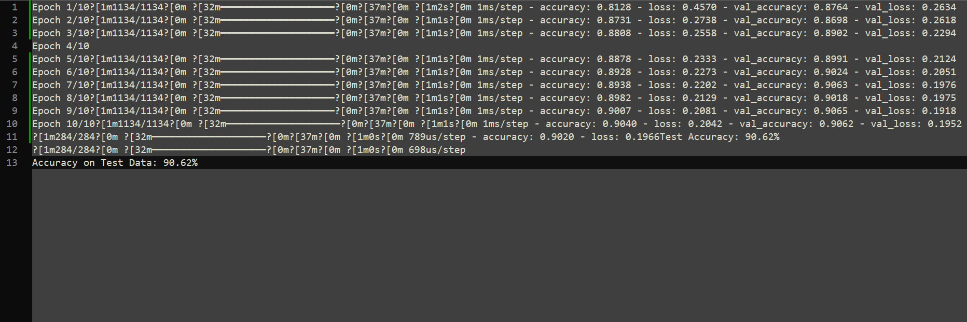
Cont. Create & Test Neural Network
Figure 6, Shows test results

Slide 17
What’s Next?
What we want to examine further is:
Use the same Model but with test data for signals that have noise added to them.
Build a new model, trained on signal data with noise, and test on both data with noise and without noise.

Slide 18
Conclusion
The model improved its performance over 10 epochs, with training accuracy rising from 81.28% to 90.40%, and validation accuracy stabilizing around 90.62%.
The final test accuracy shows the model performs well on unseen data, achieving 90.62%.
Examining how the model will accuracy will hold up against data with noise will be the next step.
All code for this project can be found at: github.com/alifaisal101/signal-mod-classifier

Slide 19
Thank you for listening.

