Slide 1

Final Project Title: Classification of real-estate property listings
By:
Ali Faisal Raza

Slide 2
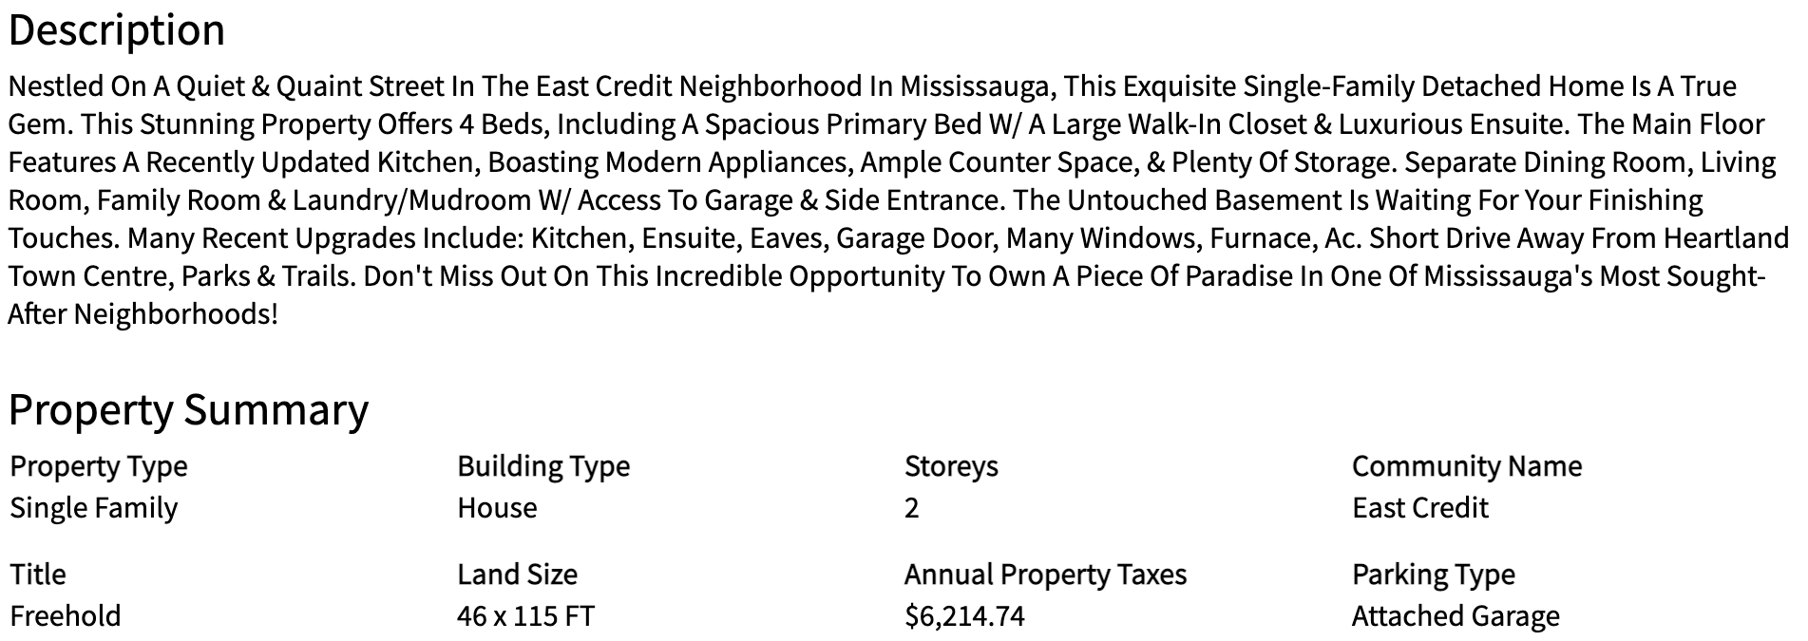
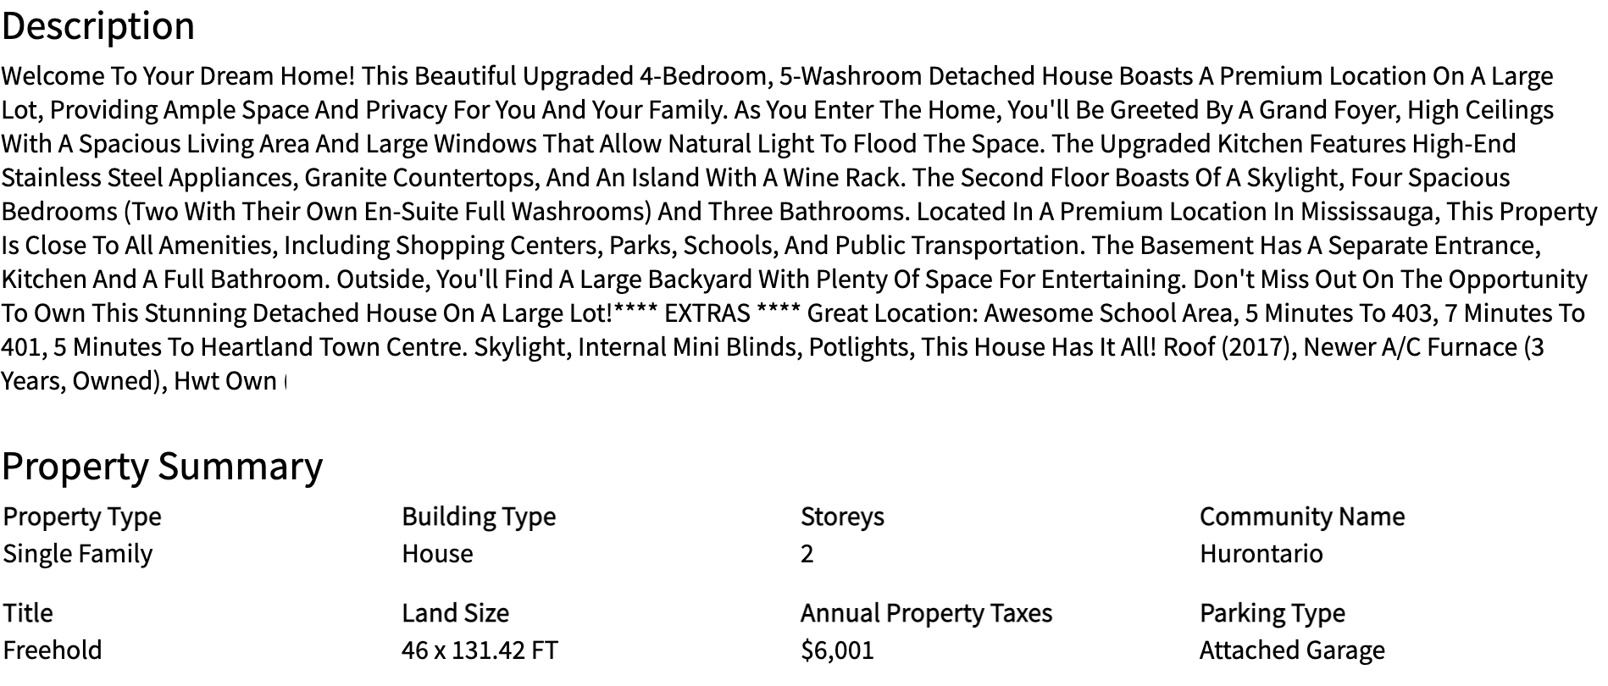
Real Estate Listing A
Are these real estate listings unique or duplicates?
Real Estate Listing B

Slide 3

About Myself
10+ years of experience in IT and Project Management.
MBA, Bachelors in Engineering, PMP, CBAP.
Joined Data Science bootcamp to explore new path and challenges.

Slide 4

Location
Type
Price
Bedrooms
Bathrooms
Total Area
Living Area
Plot Area
Terrace Area
Title
Description
Features
Latitude
Longitude
Categories
Dataset Size: 82k
Numeric
Real Estate Listing Attributes
Text

Slide 5
Real Estate Categories
Property Location
City
Province
Country
Region
Property Type
House
Plot
Other
Apartment
{Apartment/House/Plot/Other}

Slide 6
Problem Statement:
Predict if any two real estate listings are unique or duplicates?
Predict if a given property listing is a ‘house’ or an ‘apartment’?
Verify if property listings could be separated into clusters based on attributes.

Slide 7
EDA Findings
Property locations were not consistently identified.
Numeric data were missing.
Latitude and Longitude information were missing in majority of listings.
Imputation of mean/median values will change property characteristics.

Slide 8
Feature Generation Approach
Location identification was normalized across all location types.
Modeling algorithms known to handle missing values were employed.
Natural Language Processing (NLP) was employed.

Slide 9
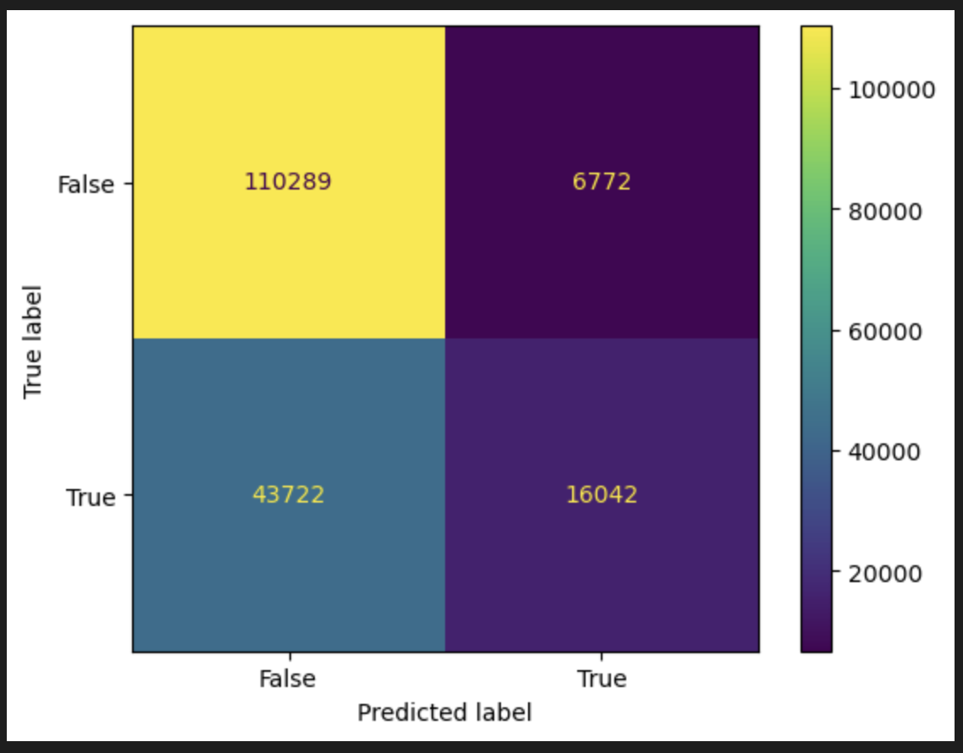

Scenario A - (Predict Property Similarity)
With Listing’s Text Descriptions only:
Accuracy:
71.1%
Training Strategy:
High percentage of common words between listings infer high similarity.
Training Set: 707k Test Set: 177k

Slide 10
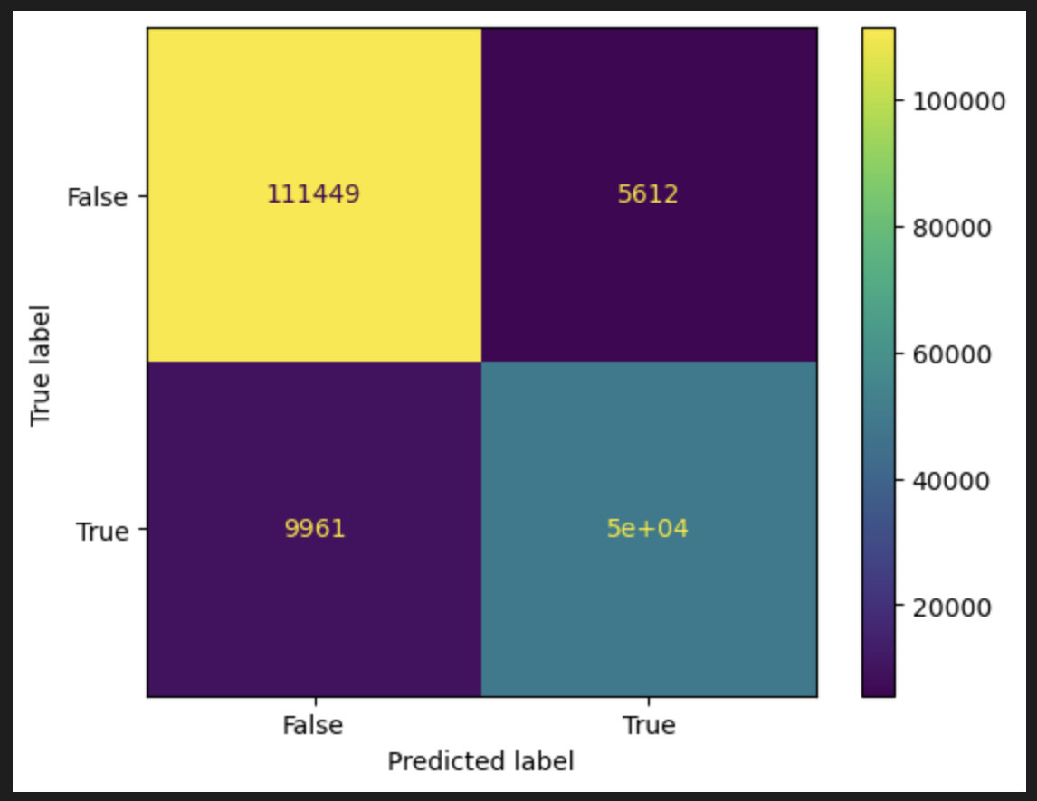
Scenario A - (Predict Property Similarity)
With Numeric and Text Descriptions Together:
Accuracy:
91.2%
Training Strategy:
High percentage of common words between listings infer high similarity.
Low differences between numeric attributes infer higher similarity.
Training Set: 707k Test Set: 177k

Slide 11
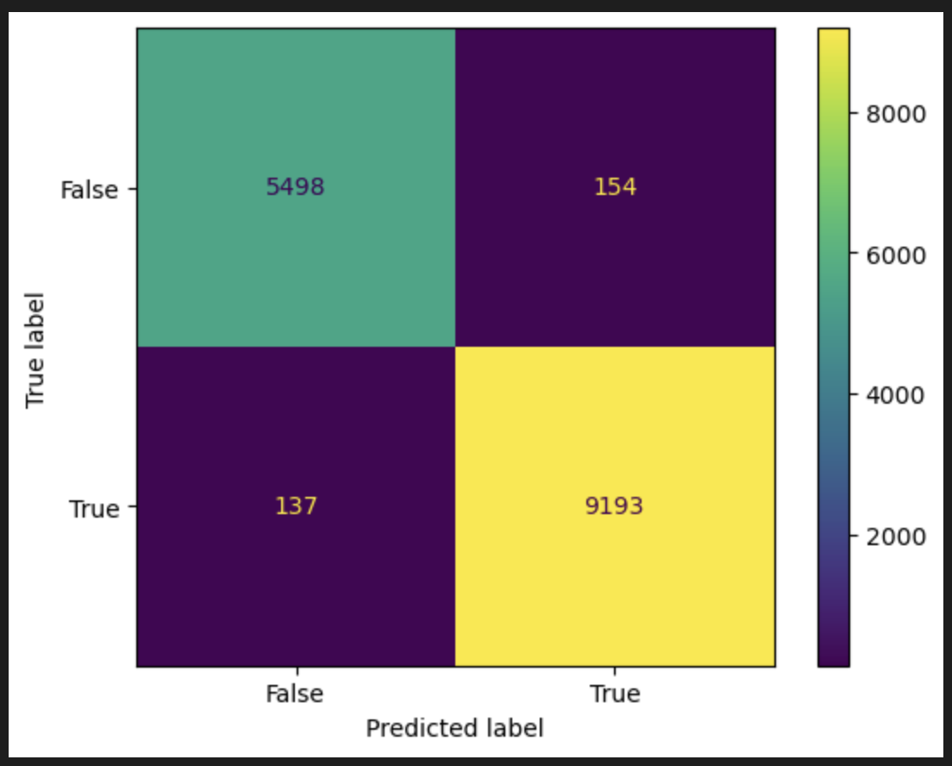
Scenario B - (Predict Property Type: House or Apartment?)
With Listing’s Text Descriptions only:
Accuracy:
98.1%
Training Strategy:
High weights of words related in meaning infer a category.
Training Set: 60k Test Set: 15k

Slide 12
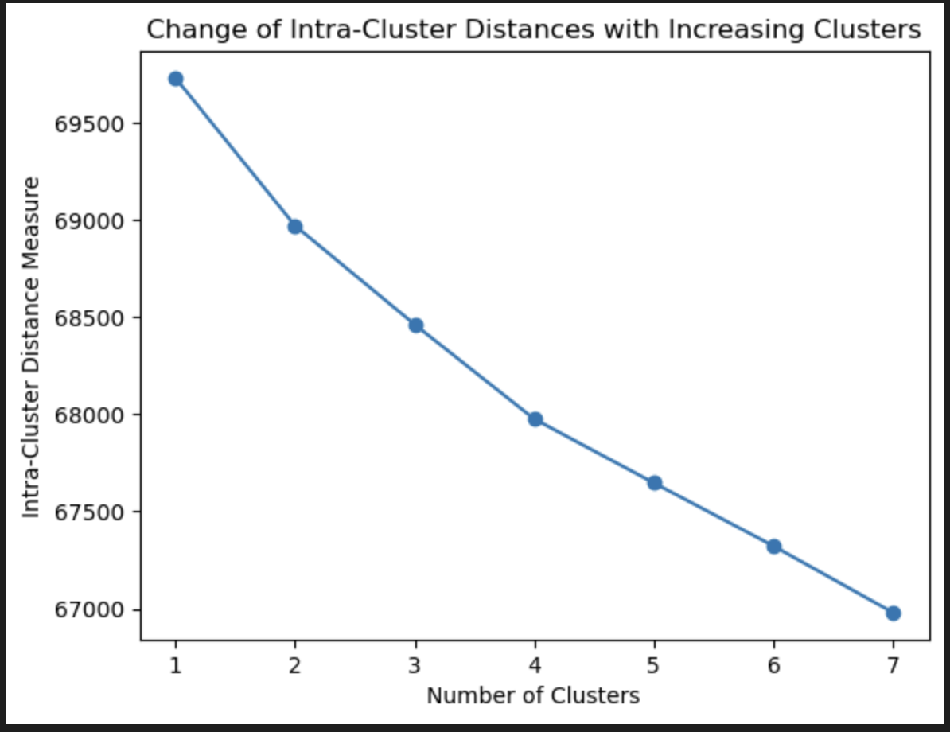
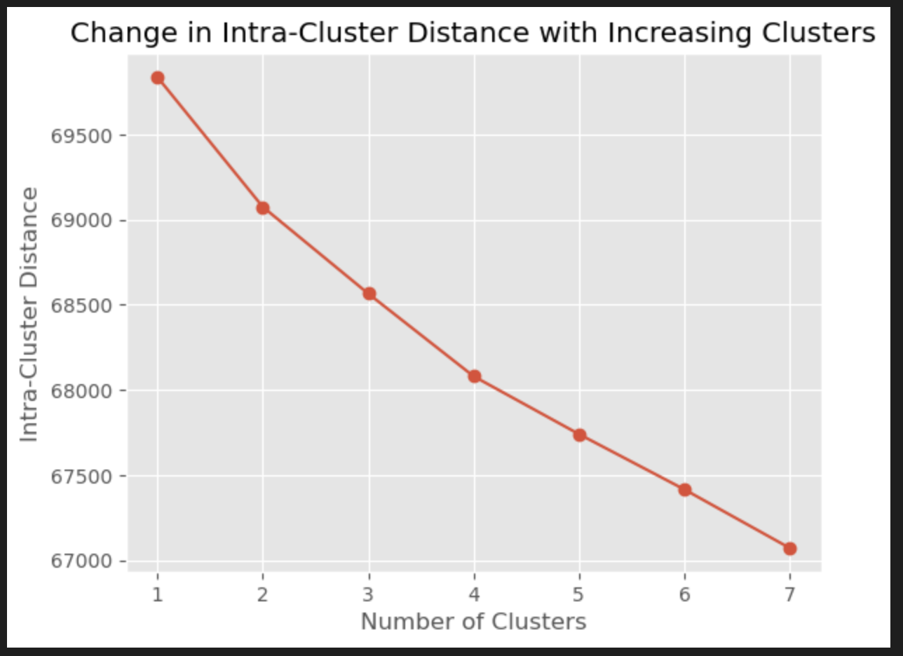
Scenario C - (Unsupervised Clustering - KMEANS)
With Listing’s Text Descriptions only:
With Numeric and Text Descriptions Together:
No clustering tendency revealed
No clustering tendency revealed
Total Set: 75k
Total Set: 75k

Slide 13
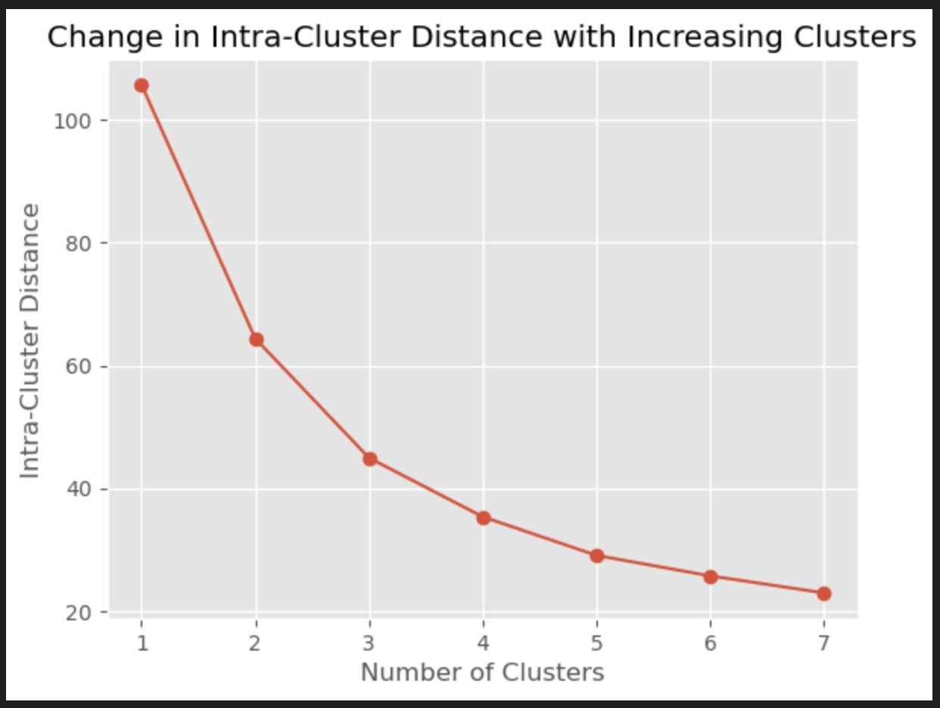


Scenario C - (Unsupervised Clustering - KMEANS)
With Numeric Attributes only:
Grouping towards 2 clusters
Total Set: 75k

Slide 14
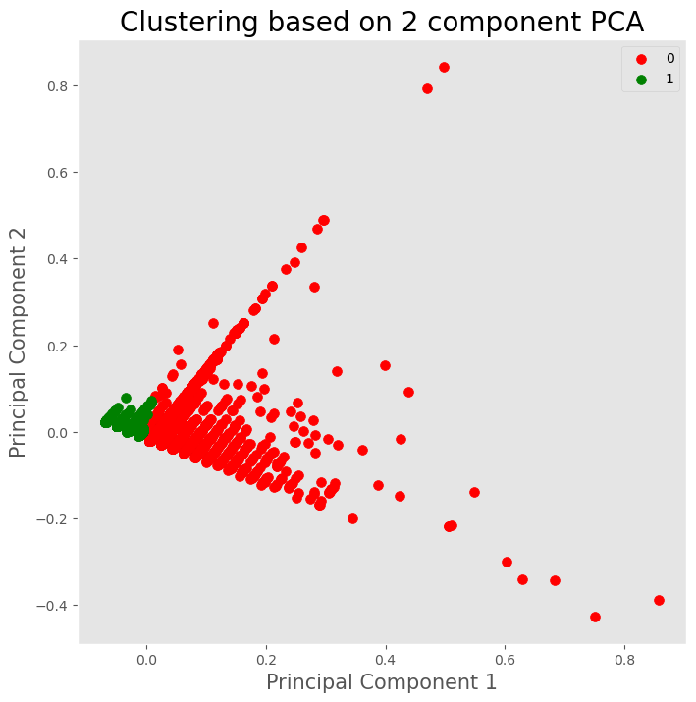
Scenario C - (Unsupervised Clustering - KMEANS)
Green Cluster represents ’Apartments’ and accounts for 94.8% of apartment listings.
Red Cluster represents ’Houses’ and account for 98.7% of house listings.
Total Set: 75k

Slide 15
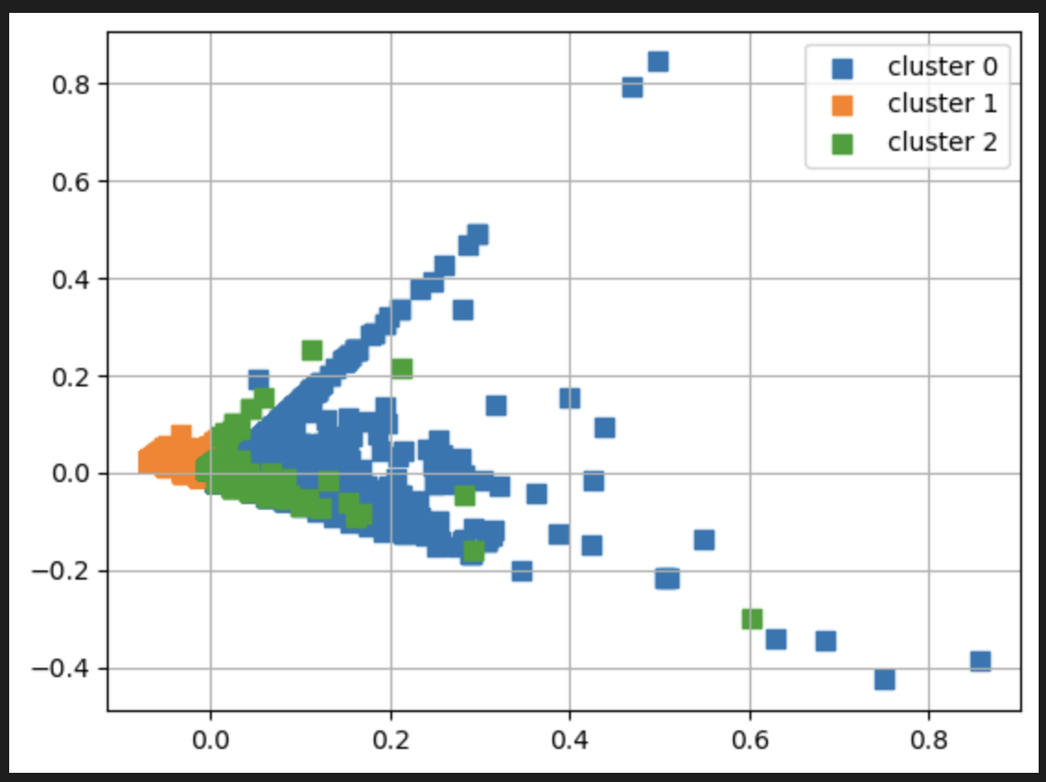
Scenario C - (Unsupervised Clustering - DBSCAN)
Orange Clusters represent ’Apartments’ and account for 100% of apartment listings.
Blue Clusters represent ’Houses’ and account for 98.7% of house listings.
Green Clusters represent ‘Intermediate’ properties and account for 0.1% of all real estate listings.
Total Set: 75k

Slide 16
Conclusions
Supervised Learning:
Models successfully predicted real estate similarity and property types based on natural language processing.
Numeric and categorical attributes improve odds of prediction.
Un-supervised Learning:
Natural language processing adds noise and hinders clustering.
Numeric attributes successfully identify ‘Houses’ and ‘Apartments’; and recognize a new cluster of ‘intermediate’ properties.

Slide 17
Q&A

