Slide 2
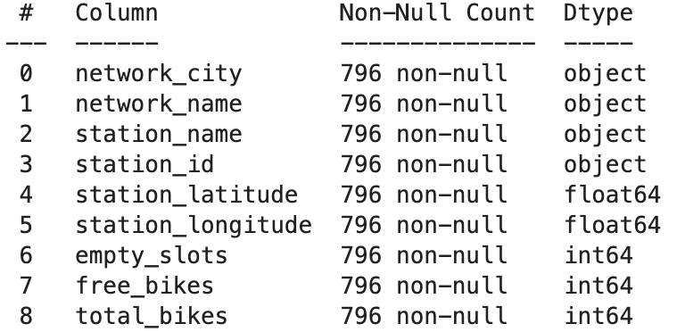
Part 1: Connecting to CityBikes API
City selected: London
Find the network managing bike stands in the city of London.
Network discovered: ‘Santander-cycles’.
Get all the bike stations belonging to the city of London.
Total number of bike stations discovered: 796
Gather bike stations details and collate them into a csv file.
CSV file name: ’london_city_bikes_stns.csv’
Network details collected:

Slide 3
Part 2: Connecting to Foursquare and Yelp APIs
aa

Slide 4
Part 3: Joining Data
aa

Slide 5
Part 4: Building a Model
aa

