Slide 1
Mini Project 5
By
Ali Faisal Raza

Slide 2
Agenda
EDA
Data Cleaning
Feature Engineering
Way forward
Questions?

Slide 3
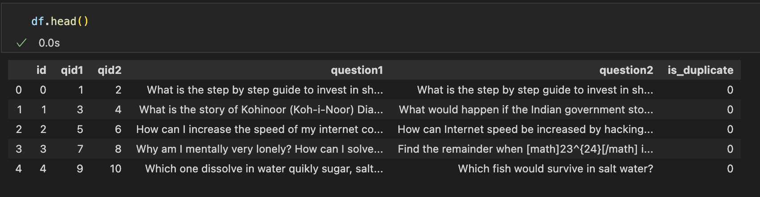
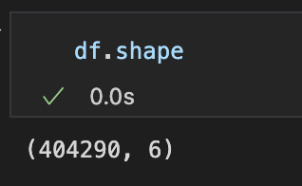
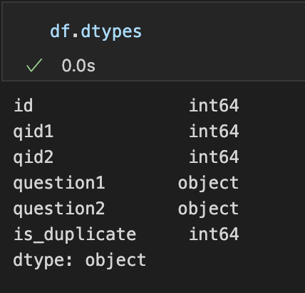
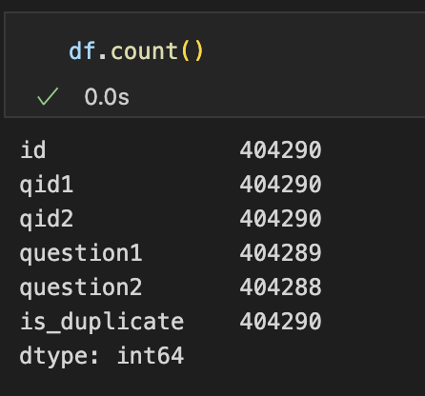
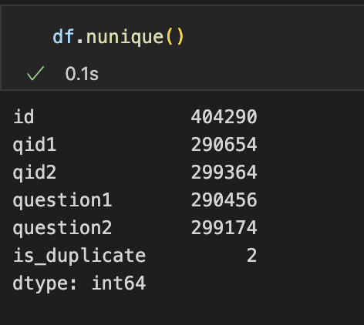
Input Dataset

Slide 4
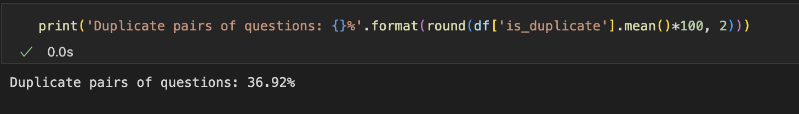
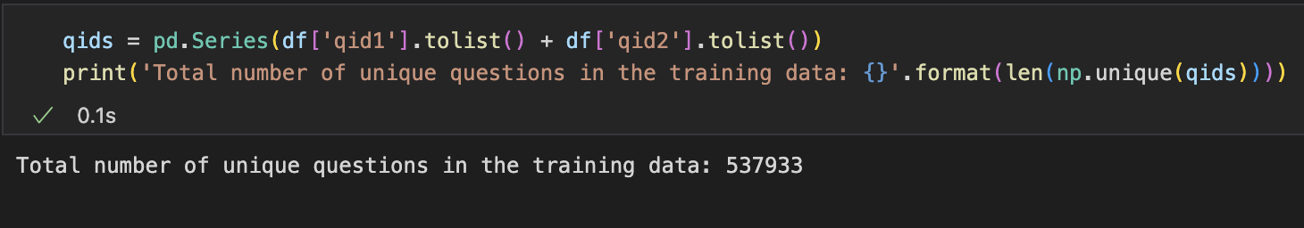
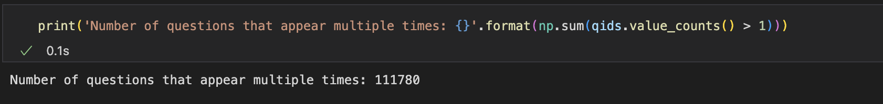
Questions Distribution

Slide 5
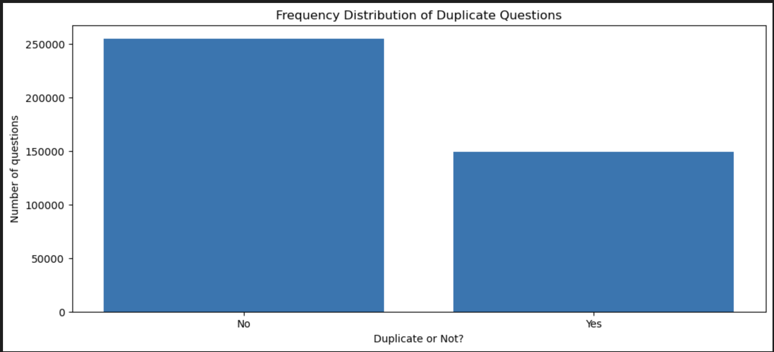
Duplicate vs Non-Duplicate Questions Distribution

Slide 6
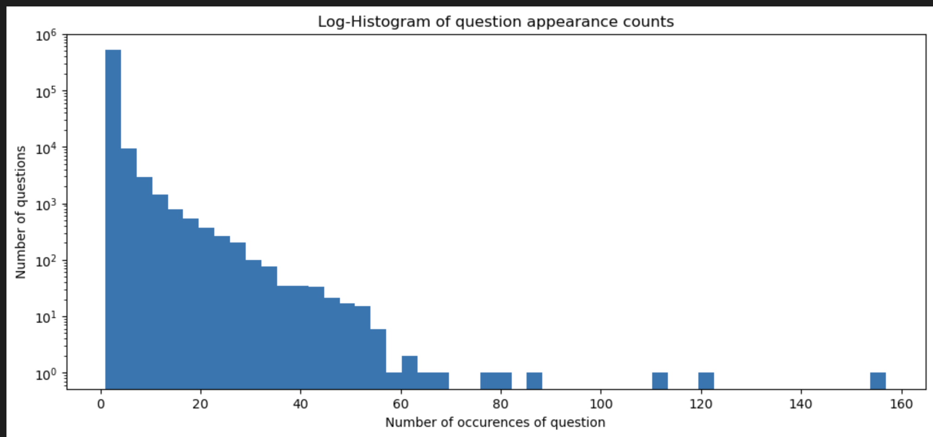
How many times is the same question being asked?

Slide 7
Data Cleaning and Feature Engineering
Null values were removed.
First fifty thousand rows extracted owing to limitation of processing power and memory.
All questions from the 50000 thousand rows were tokenized to create a central corpus of questions.
The corpus was cleaned for punctuation marks, special characters and stop words.
The corpus was vectorized using TF-IDF vectorizer and a limited vocabulary set of 500 words was created (owing to processing power limitation).
Each question was vectorized for input to future classification model. Both the questions from each row were taken through vector addition to enhance the weightage of duplicate words in those questions.

Slide 8
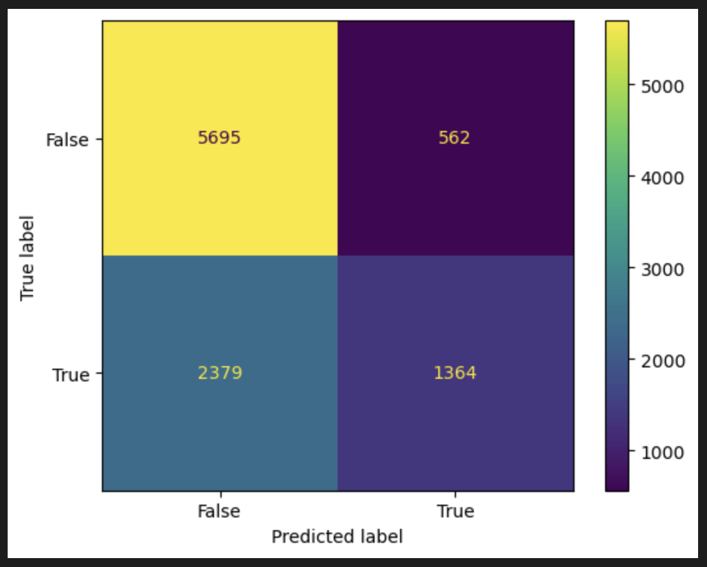
XGBoost classification
Accuracy Score: 70.59%

Slide 9
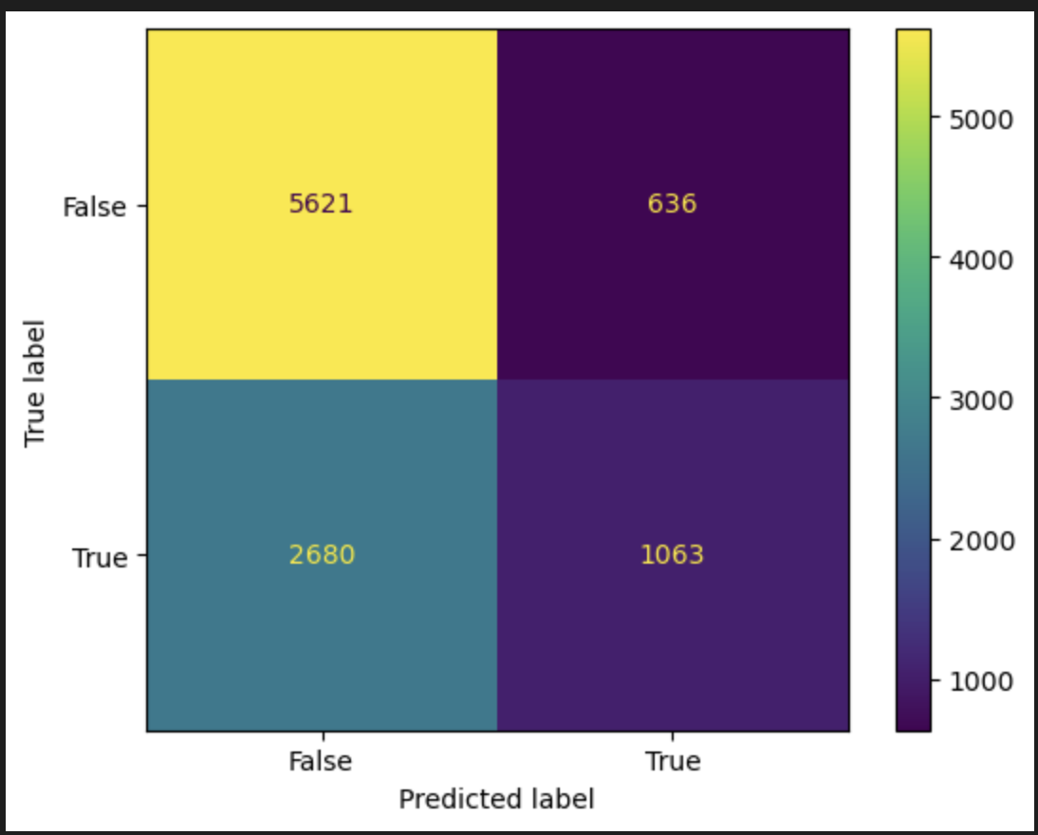
AdaBoost classification
Accuracy Score: 66.84%

Slide 10
Observations
It was noted the model performed well on identifying non-duplicate cases but performed poorly on identifying duplicate cases.
One reason for above behavior may be the slightly unbalanced nature of the dataset which has only 37% of duplicate cases. Improving the balance of dataset might improve the performance on this criteria.
Other limiting factor may have been the small size of the vector dimension of 500 words which may also have affected the performance of the dataset. This needs the problem to be studied on more powerful computing environment to improve the performance of the model.

Slide 11
?

