Slide 1
Mini Project 4
By
Ali Faisal Raza

Slide 2
Agenda
Problem Formulation - Hypothesis
Data Cleaning
Final Feature Set
Pipelining and Modeling – In progress
Deployment of Model on Flask - upcoming
Questions?

Slide 3
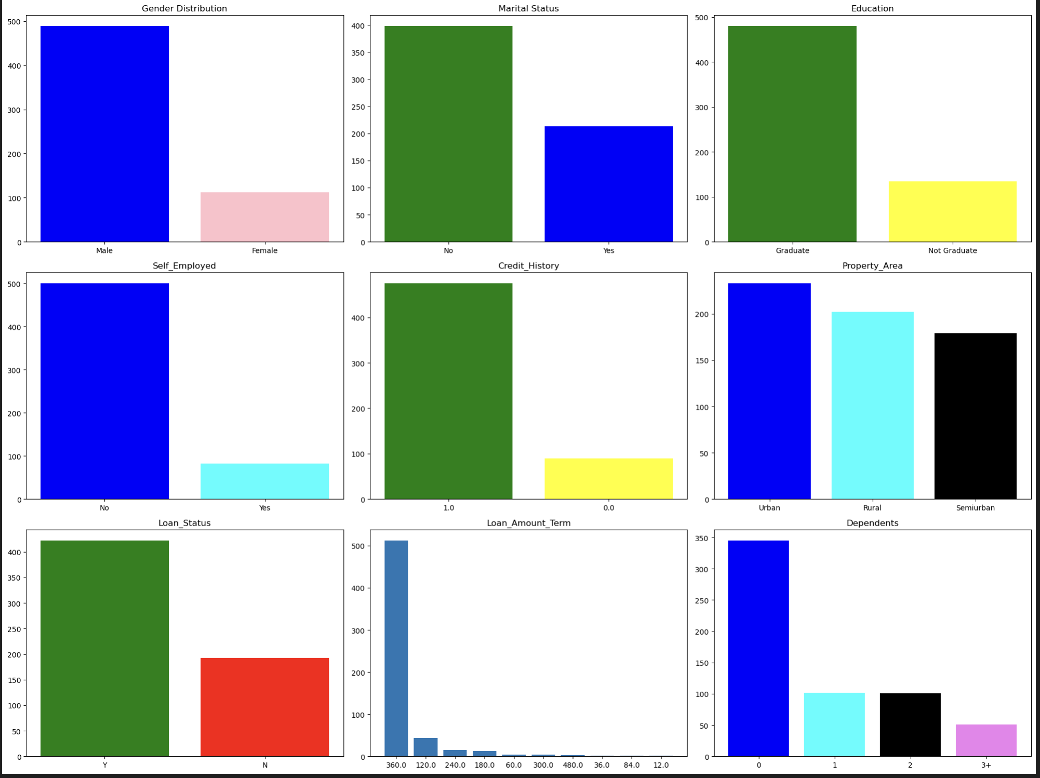
Notable Frequency Distributions
Predominantly more males applicants than females.
Majority are educated.
Majority are salaried employees.
Majority have no dependents.
Majority possess credit history.
The preference for property areas is evenly distributed.
Majority loan terms are for 30 years.

Slide 4
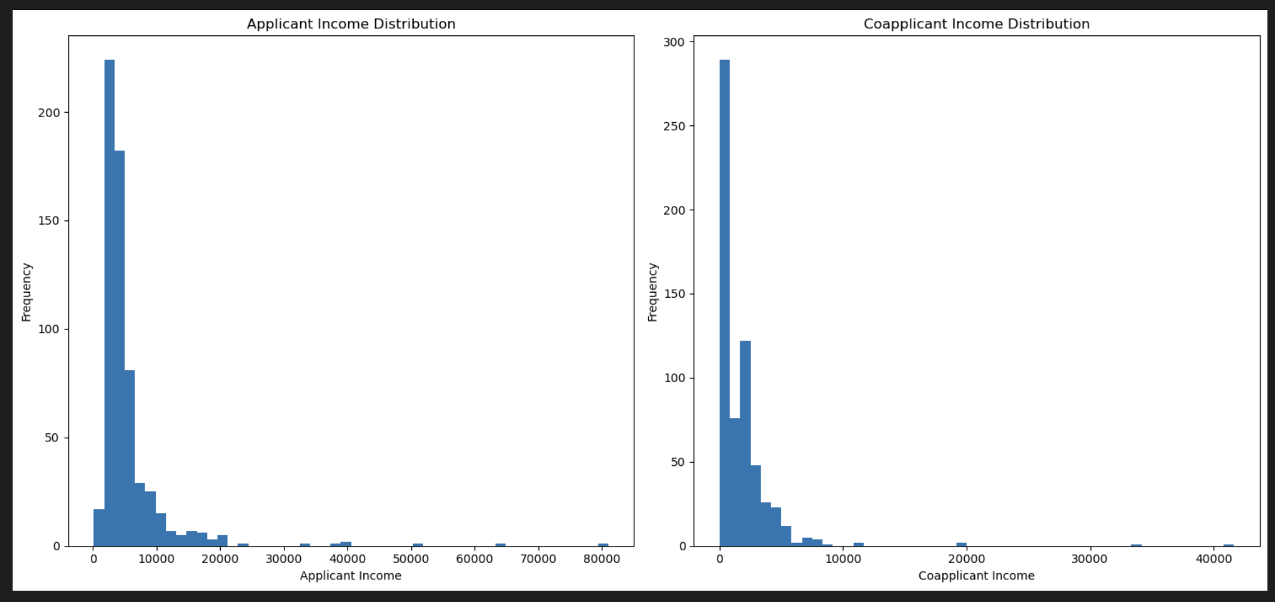
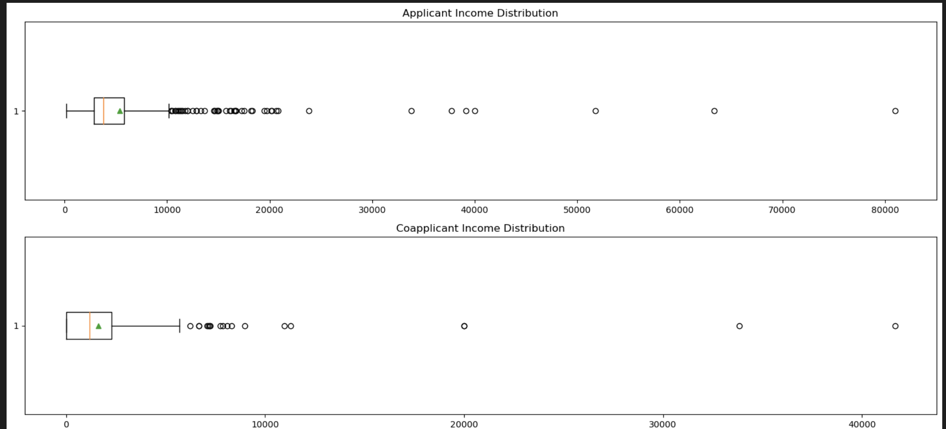
Nature of Income Distribution
Skewed on left side.
Too many outliers.

Slide 5
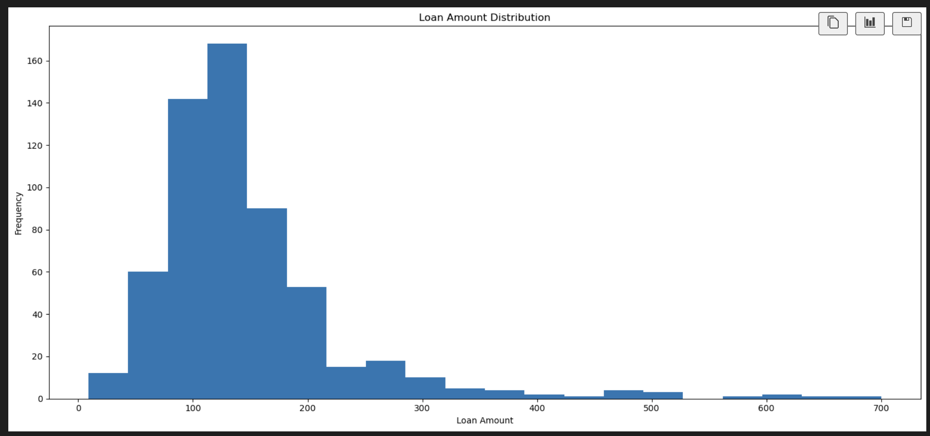
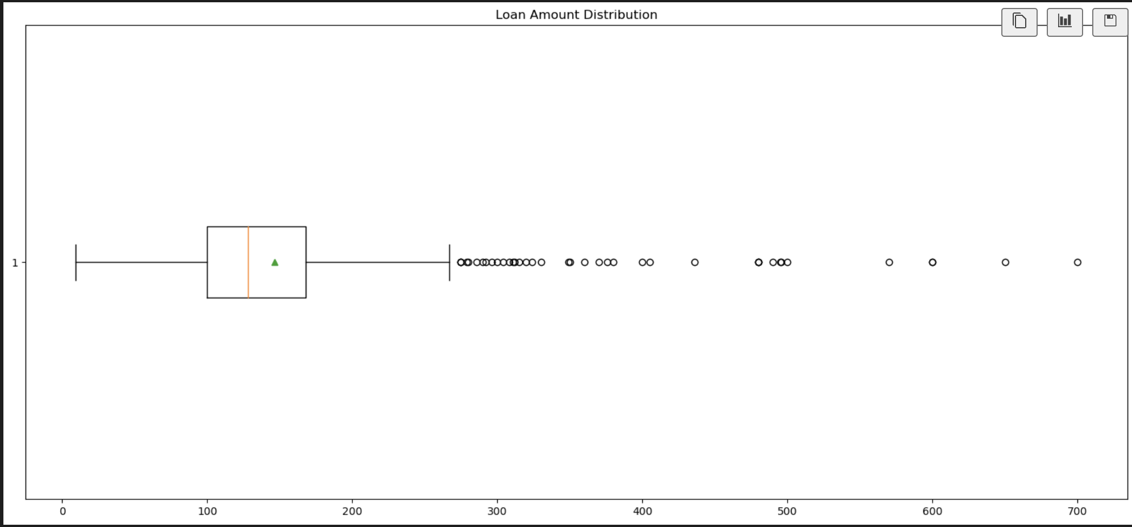
Loan Amount Distribution
Skewed on left side.
Too many outliers.

Slide 6
Problem Formulation and Hypothesis
To predict whether a customer is eligible for loan given his profile and requested loan amount and term.
Hypothesis:
Persons with high income have higher probability for loan approval.
Person with existing credit history have higher probability for loan approval.

Slide 7
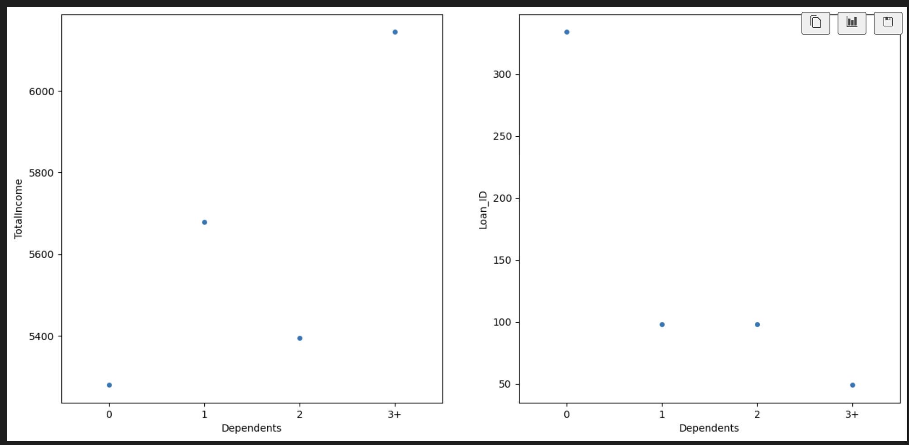
Data Cleaning – Imputing Missing Values
Technique:
Correlate each affected category variable against income and infer pattern, if any.
Impute most common value as default in case of no discernible trend.
Imputing missing ‘Dependents’ values
Assign all cases with total income higher than 6000 with 3+ dependents and rest with 0.

Slide 8
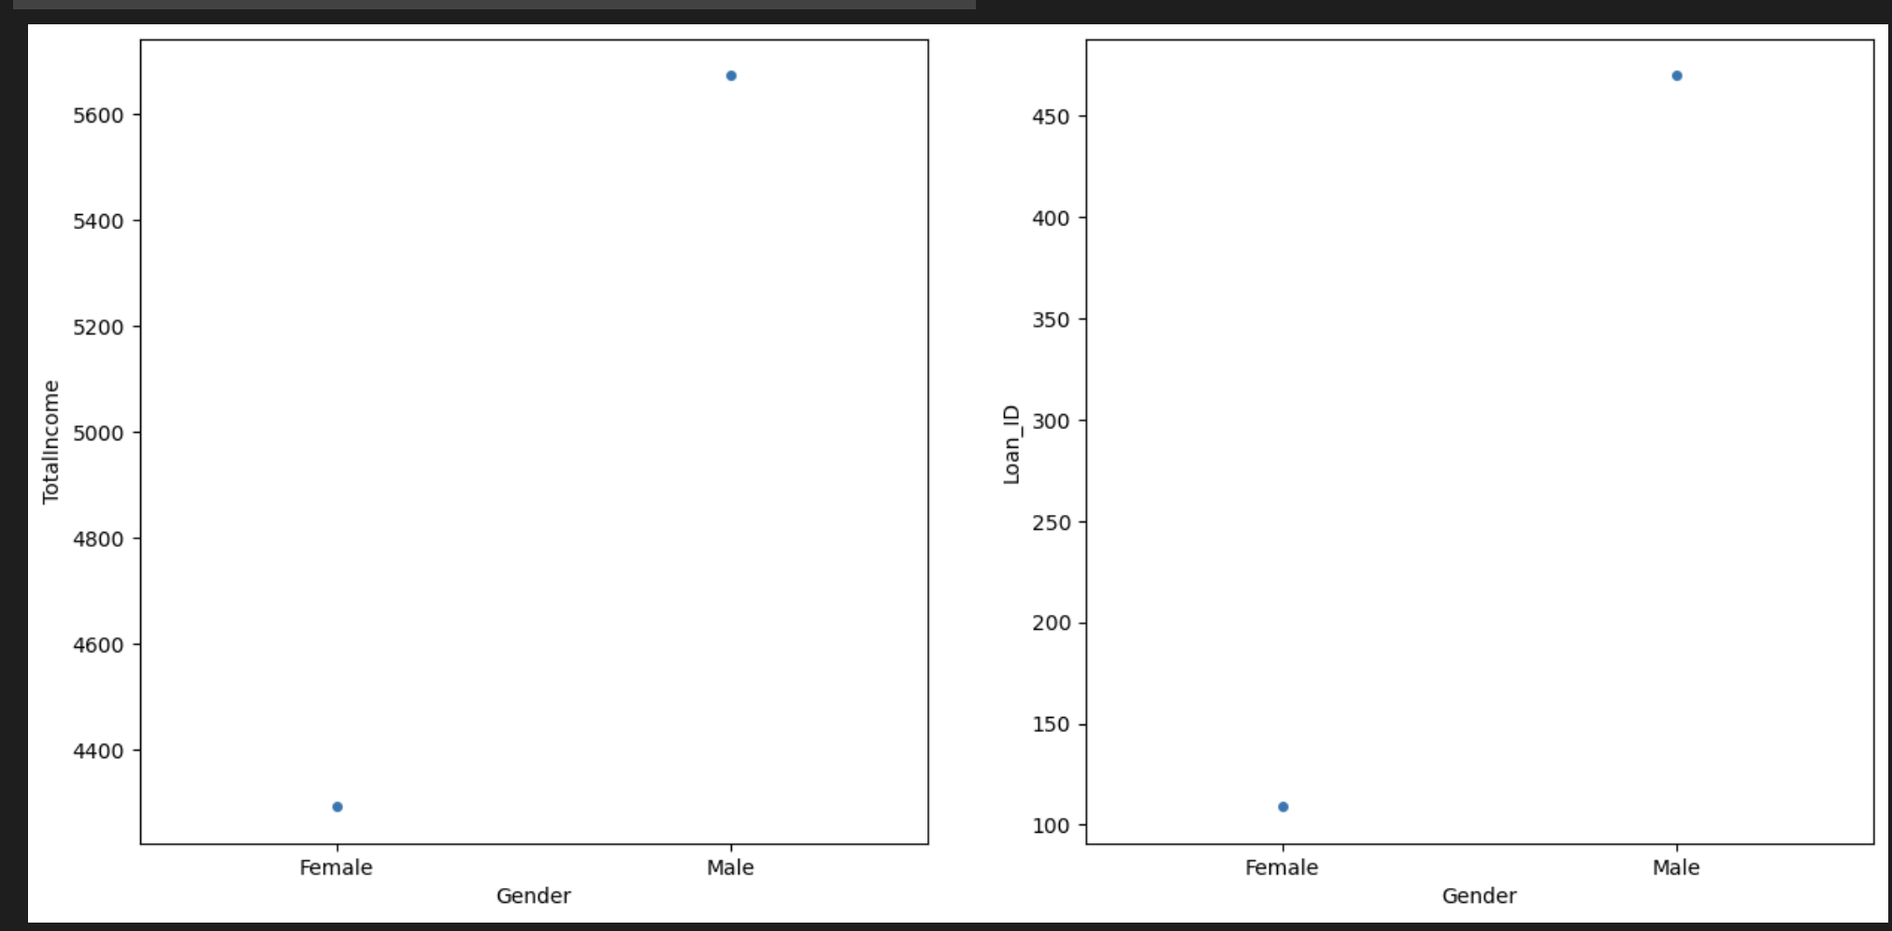
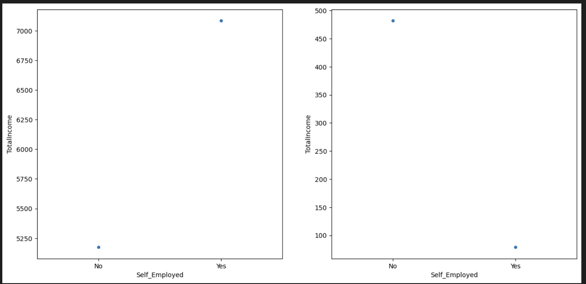
Data Cleaning – Imputing Missing Values
Imputing ‘Gender’
Assign all cases with total income higher than 4600 under ‘Male’ bucket and rest under ‘Female’ bucket.
Imputing ‘Self Employment’ factor
Assign all cases with total income higher than 6750 under ‘self-employed’ bucket and rest under ‘non self-employed’ bucket.

Slide 9
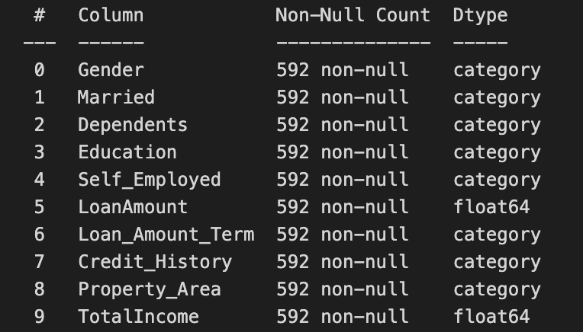

Final Feature Set
Input Features
Target Variable

Slide 10
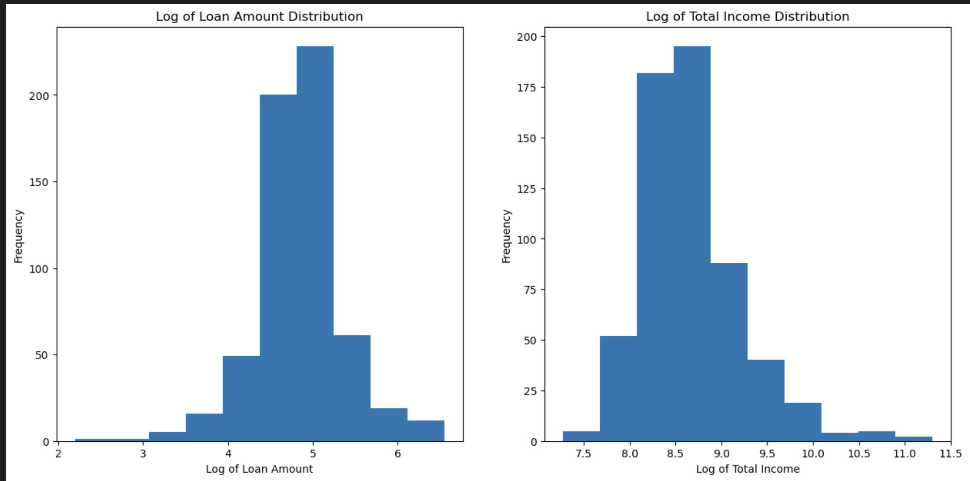
Applying Log Transformation on Income and Loan to approximate to normal distribution.

Slide 11
Applying Grid Search for Hyperparameter Tuning and Checking Model Accuracy
Model | Model Accuracy
Ridge Classifier | 75.63%
Random Forest Classifier | 78.15%
XGBoost Classifier | 77.31%

Slide 12
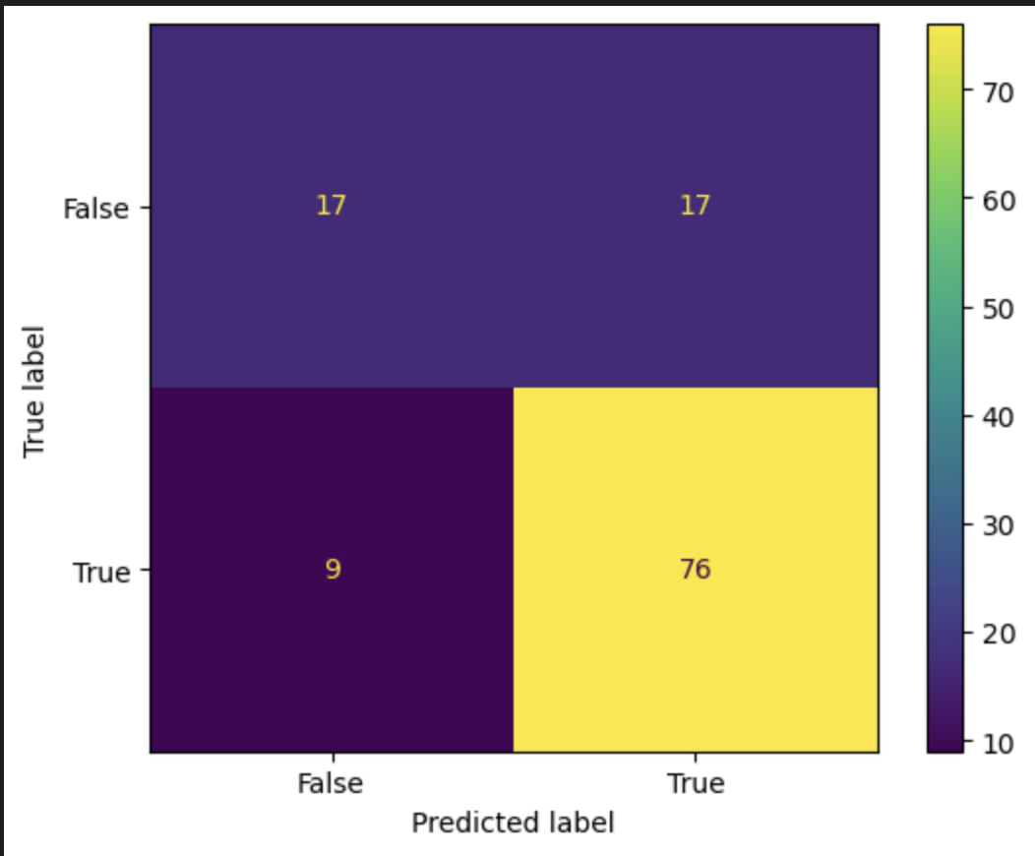
Confusion Matrix – Ridge Classifier

Slide 13
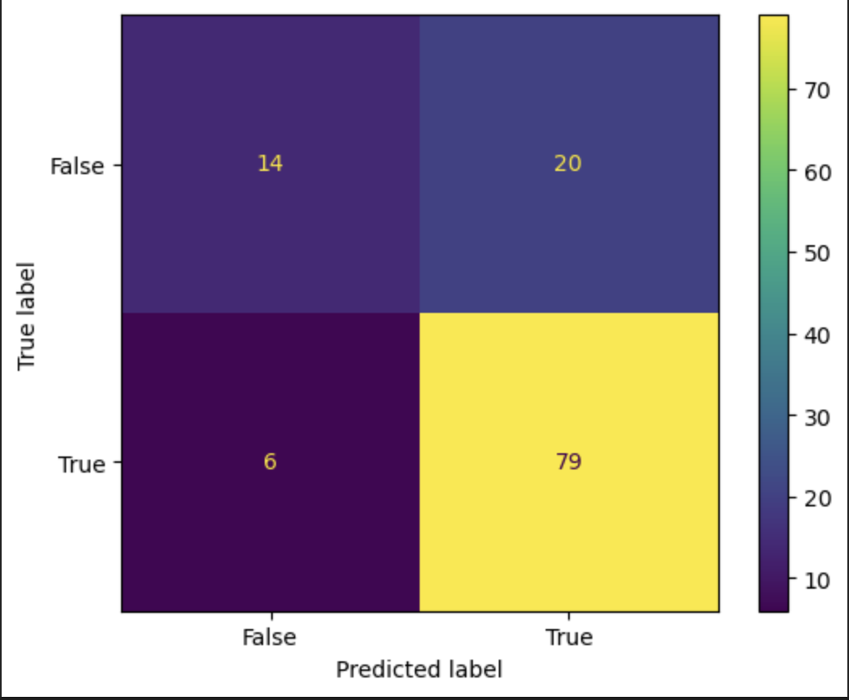
Confusion Matrix – Random Forest Classifier

Slide 14
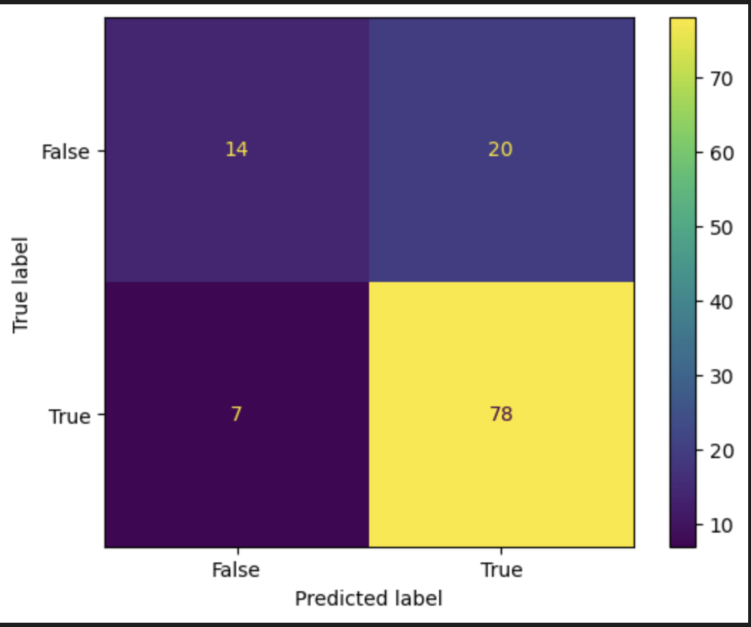
Confusion Matrix – XGBoost Classifier

Slide 15
?

