Slide 1



MaileX
Communication Bridge Between Generations

Slide 2

Elevator
Pitch
It has been ages since the last time email have been revolutionized. The generation that is entering the work force is not very comfortable with using email. They believe, it is boring and frankly I do too.
The generation I am referring to likes to scroll, big social media companies have taken advantage of that and creating all social media's with a key feature "endless scrolling".
And it is also phsycologically proven that scrolling model, have the least bounce rate.
Now imagine you wake up in the morning and check your email, but rather than clicking and open each of them. What is you had all you email in a scrollable feed with each email shown as a post.

Slide 3
Description
MaileX is a innovative Application making a effort to build bridges between Generations and making emailing a bit more fun
Motivation
I hate emailing, but it is a industry standard. There are applications being developed everyday like Slack & Discord, but they are not recognized as industry standard ways of communications
User Story
- As a person entering the work industry
- I want to be able to view my emails all together
- So that I am following the industry standard

Slide 4
Technologies
- React js (Front-End Framework)
- MUI ( React Component Library )
- Graphql ( Database Manipulation Language )
- MongoDB ( Database )
- Express/Node js
Challenges
MaileX
Memorizing the spelling of Recipient, there were too many e's and i's and they kept changing places every time I try to spell it.
Implementing Rich Text Editor
Tasks
- Front-End (Faizan Ali)
- Back-End (Faizan Ali)
- Coffee (Keurig)

Slide 5

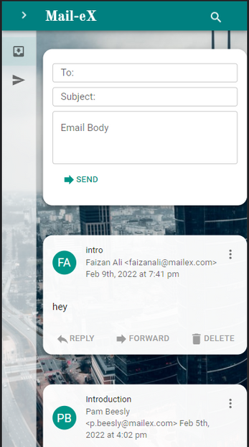

MaileX
Demonstration

Slide 6
Future
Development
Adding SMTP
Attachment
So user can send/receive emails from other email provider Gmail, Outlook, Yahoo(if someone still uses it)
So users are able to attach files to their emails
HTML/CSS Emails
So Marketers can easily embed HTML/CSS without using a 3rd party and pay alot of money
yes, I am refering to mailChimp

Slide 7

MVP
1
Feb, 16th 2022
MaileX
Alpha/Beta User
2
April, 1st 2022
- During our MVP phase I tried to figure out if the idea is viable by presenting it infront a audience
- Alpha/Beta User, 100 users will be selected and given access to work out the bugs
- Launch for anyone and every who wishes to revolutionise their Inbox
3
Launch
June, 1st 2022

Slide 8
MaileX
Questions?

