Slide 1

SimpleSqlEngine
DSIA-5101C
Created By :
Ankit Nagar
Farina Ali Kurabarwala

Slide 2
SimpleSqlEngine Objective
Integrate simple SQL queries.
Provide simple UI to be able to access the database.
Use as many scala and Java features as possible.
Create a light sql engine with limited features.

Slide 3

IDE
Java Version : 13
Scala Version : 2.13.3
2020.2

Slide 4
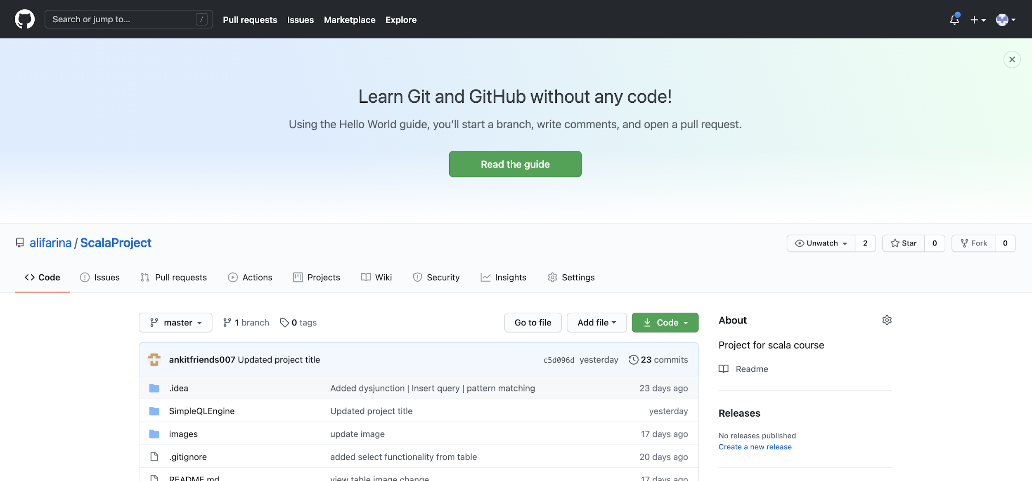
Version control

Slide 5
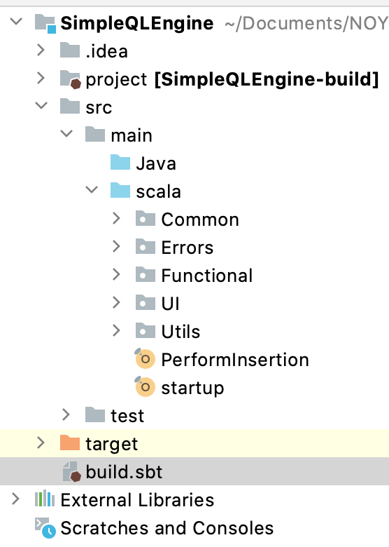
Project Structure
Common :
Project constants and global variables
singleton objects.
Errors :
Error class to be thrown as exception
Functional :
Classes of main usage, combines java and scala
code together
UI :
Contains User Interface elements
Utils :
Common usability functions.
startup : It is the primary file to be executed.(Startup file)

Slide 6
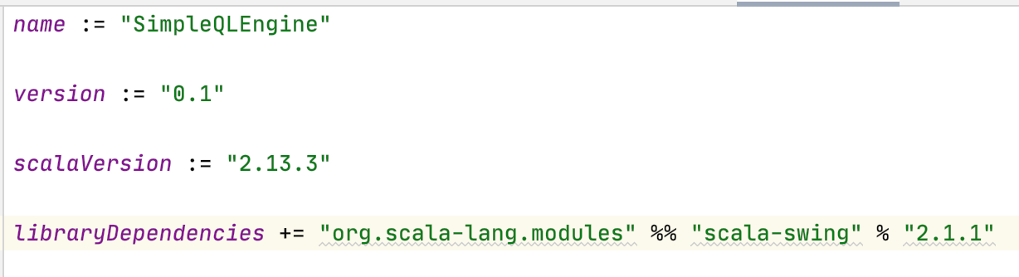
What is sbt?
Scala Build Tool : open-source build tool for Scala and Java projects, similar to Apache's Maven and Ant.

Slide 7
Scala Features

Slide 8
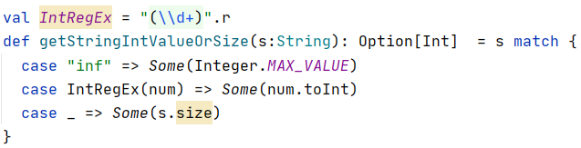
It is a technique for checking a value against a pattern. It is similar to the switch statement of Java and C.
Pattern Matching
Either - Dysjunction
Singleton Object class
Swing library
Abstract classes
Collections : List, Arrays and Hashmaps

Slide 9
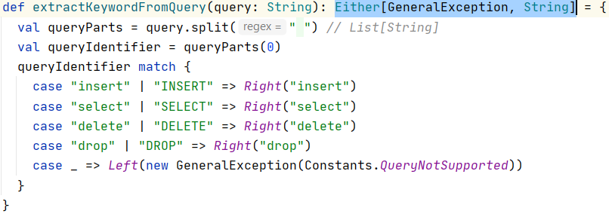
Represents a value of one of two possible types (a disjoint union.)
Instances of Either are either an instance of Left or Right.
Pattern Matching
Either - Dysjunction
Singleton Object class
Swing library
Abstract classes
Collections : List, Arrays and Hashmaps

Slide 10
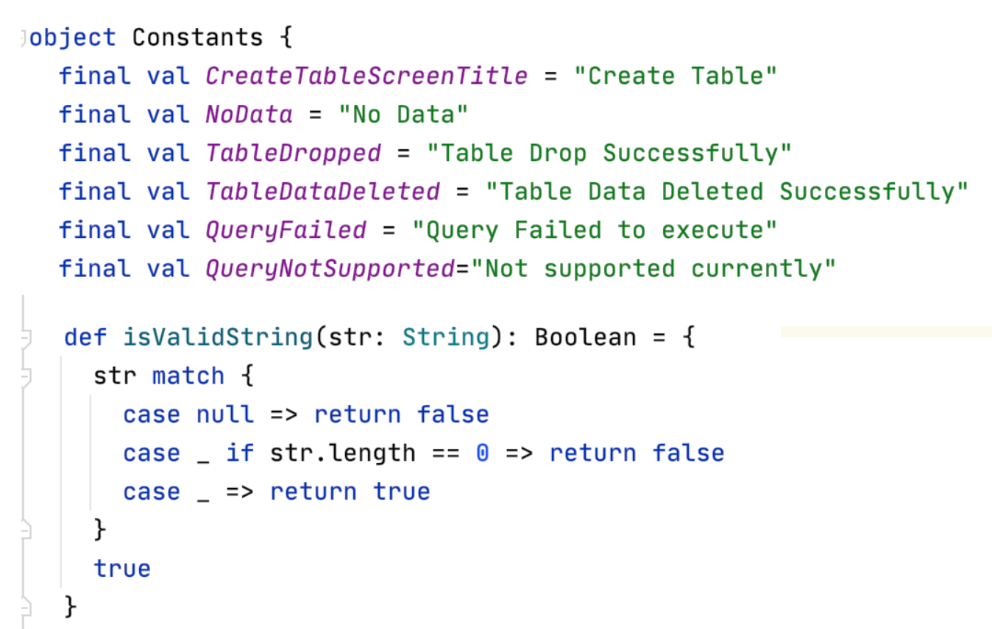
No concept of static class or methods in scala.
Object class as singleton class
Variables and functions can be accessed without creating object of the class.
Pattern Matching
Either - Dysjunction
Singleton Object class
Swing library
Abstract classes
Collections : List, Arrays and Hashmaps

Slide 11
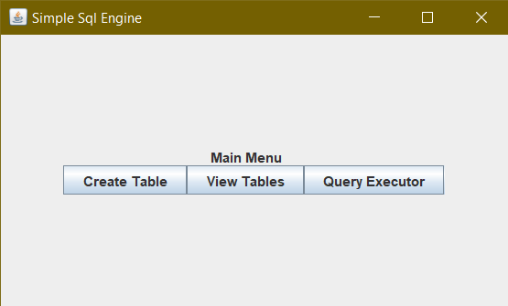
External Library
Added to build.sbt as dependency
Creating User Interface
Pattern Matching
Either - Dysjunction
Singleton Object class
Swing library
Abstract classes
Collections : List, Arrays and Hashmaps
This is a UI library that wraps most of Java Swing for Scala in a straightforward manner.

Slide 12
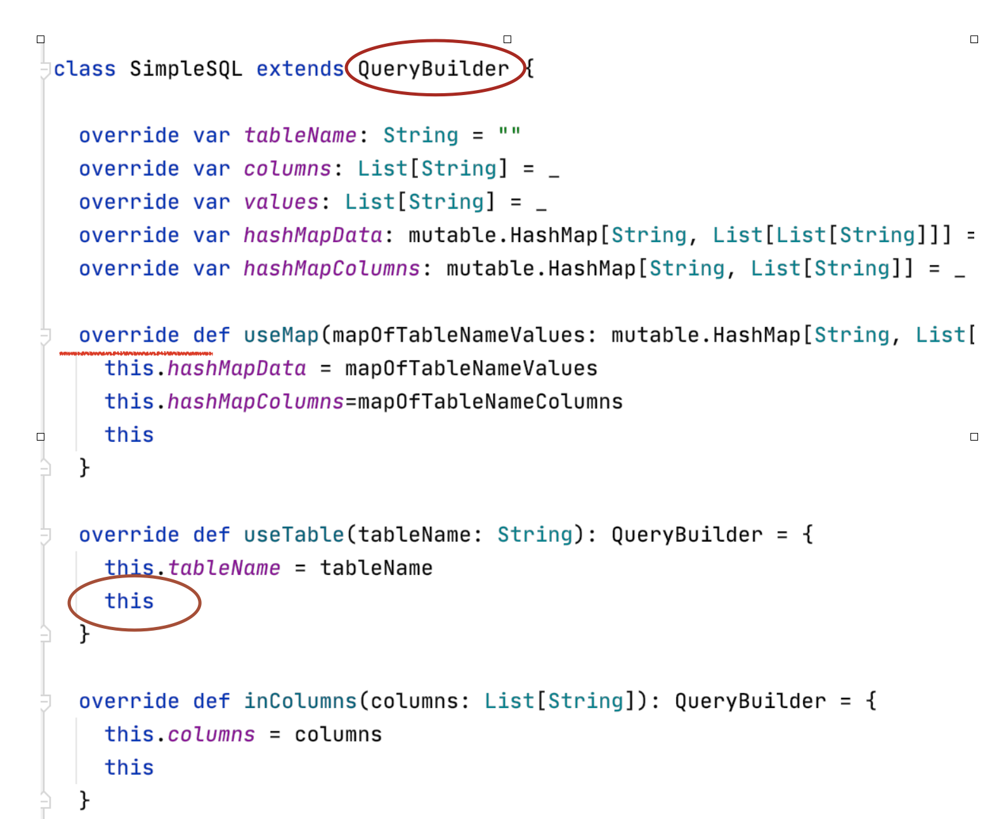
Use of Abstract class to declare the methods.
Extended this class to use the builder pattern and make query writing easy.
Pattern Matching
Either - Dysjunction
Singleton Object class
Swing library
Abstract classes
Collections : List, Arrays and Hashmaps

Slide 13
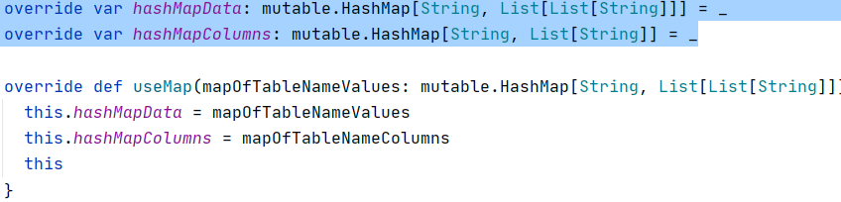
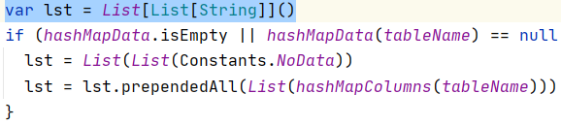
Pattern Matching
Either - Dysjunction
Singleton Object class
Swing library
Abstract classes
Collections : List, Arrays and Hashmaps
HashMaps
Lists

Slide 14
Here is the github link with detailed description in the ReadMe.
https://github.com/alifarina/ScalaProject
Références :
https://en.wikipedia.org/
https://docs.scala-lang.org/
https://www.geeksforgeeks.org/
https://stackoverflow.com/
Thank You

Slide 15
Demo

