Slide 1

HCS12-based power meter and fan speed controlled by Temperature using PWM technique
The supervisor:
Dr.Belal Sababha
14-6- 2023

Slide 2

Outline
Introduction
2. System Design
Results
Conclusion

Slide 3

Introduction
The HCS12 microcontroller-based power meter and fan speed control system, incorporating temperature regulation using the PWM technique and serial communication to a PC, provides a robust and efficient energy monitoring, control, and optimization solution. The project successfully demonstrates the capabilities of the HCS12 microcontroller in accurately measuring power consumption, dynamically adjusting fan speed based on temperature, and enabling data transfer to a PC for further analysis and management.

Slide 4
Introduction
The proposed HCS12 microcontroller-based power meter and fan speed control system, with temperature regulation using PWM technique and serial communication to a PC, offers a comprehensive energy monitoring and management solution. By combining power measurement, fan speed control, and data transfer capabilities, the system enables users to monitor their power consumption, optimize energy usage, and create a comfortable environment. This system can find applications in various settings, such as residential buildings, offices, industrial facilities, and more, contributing to energy efficiency and sustainability goals.

Slide 5
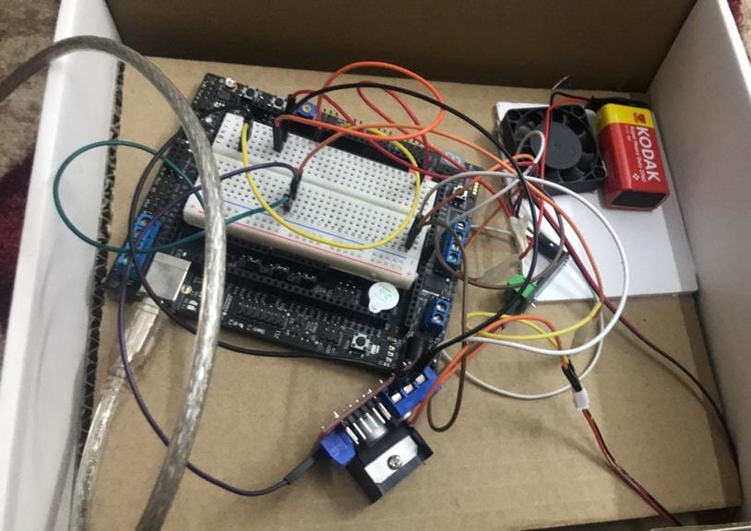
2.System Design

Slide 6
System Design
Components: -
Microcontroller: HCS12
temperature sensor) build in HCS12)
Current sensor ACS712
Serial Cable
Battery DC
Load (fan)
Wires
H-Bridge

Slide 7
System Design
Implementation Process: -
Making sure that the HCS12 can measure the voltage of the system.
Measuring current from a system.
Build a code that computes the power and energy consumed.
Applying the dynamic pricing concept and bill calculation. .
Display the information on PC screen.
Develop the loads
Calibrate the system and compare it to other products.
The expected work in the future regarding the prototype is adding more than one load. We can see in the video that we have only one load which is fan but our plan to have more than one and put them in a designed box to make it look organized.

Slide 8
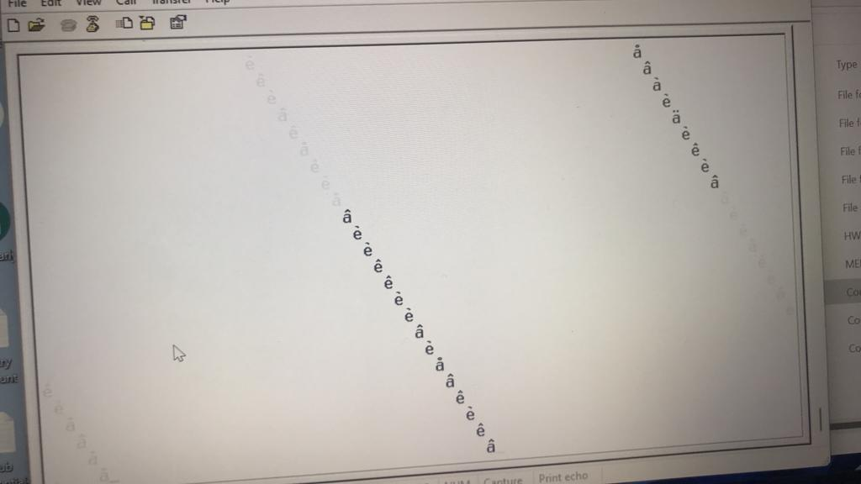
Results

Slide 9
Conclusion
The HCS12 microcontroller-based power meter and fan speed control system, incorporating temperature regulation using the PWM technique and serial communication to a PC, provides a robust and efficient energy monitoring, control, and optimization solution. The project successfully demonstrates the capabilities of the HCS12 microcontroller in accurately measuring power consumption, dynamically adjusting fan speed based on temperature, and enabling data transfer to a PC for further analysis and management.
The HCS12 microcontroller-based power meter and fan speed control system with temperature regulation using PWM technique and serial communication to a PC offers a comprehensive solution for energy management. Its accuracy, responsiveness, and versatility make it suitable for a wide range of applications in residential, commercial, and industrial settings. By providing real-time power monitoring, intelligent fan speed control, and data transfer capabilities, the system contributes to energy efficiency goals and enables users to make informed decisions for sustainable energy consumption

