Slide 1

Intelligent Robot
Ali Fele Paranj

Slide 2

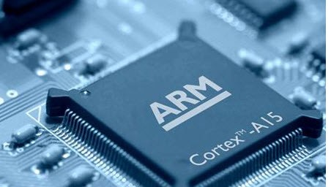
Electronics and Hardware
The Brain
Microprocessor based on ARM- Cortex A
Raspberry pi version3 b+

Slide 3



Software
Linux – Raspbian
Linux - Armbian
Python

Slide 4
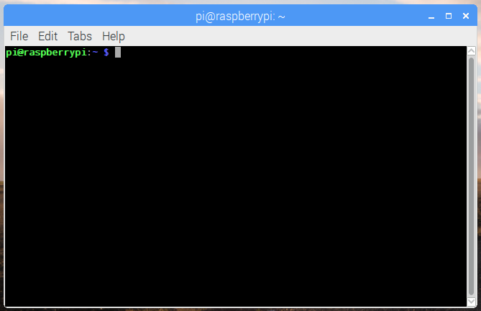
Command Line Interface

Slide 5
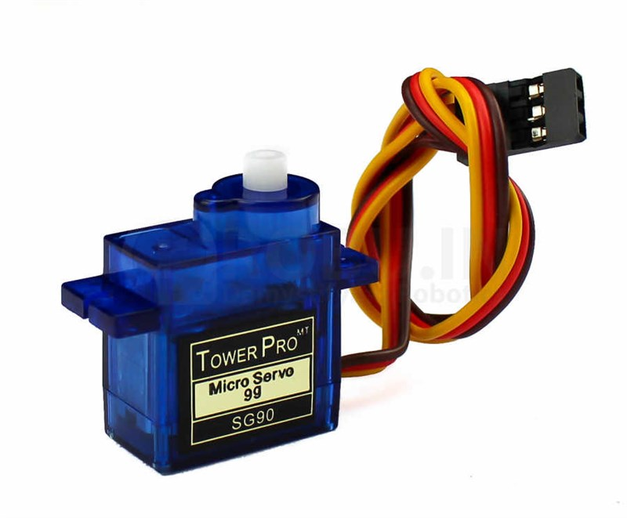
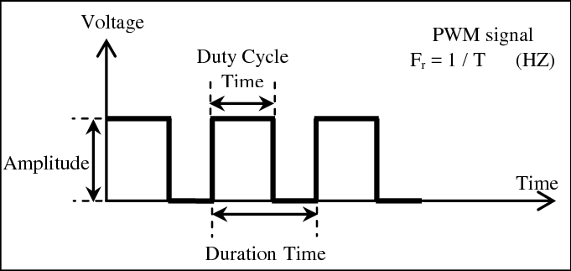
Electronic Devices
Servo motors as leg
Controlled with PWM (Pulse Width Modulation)

Slide 6
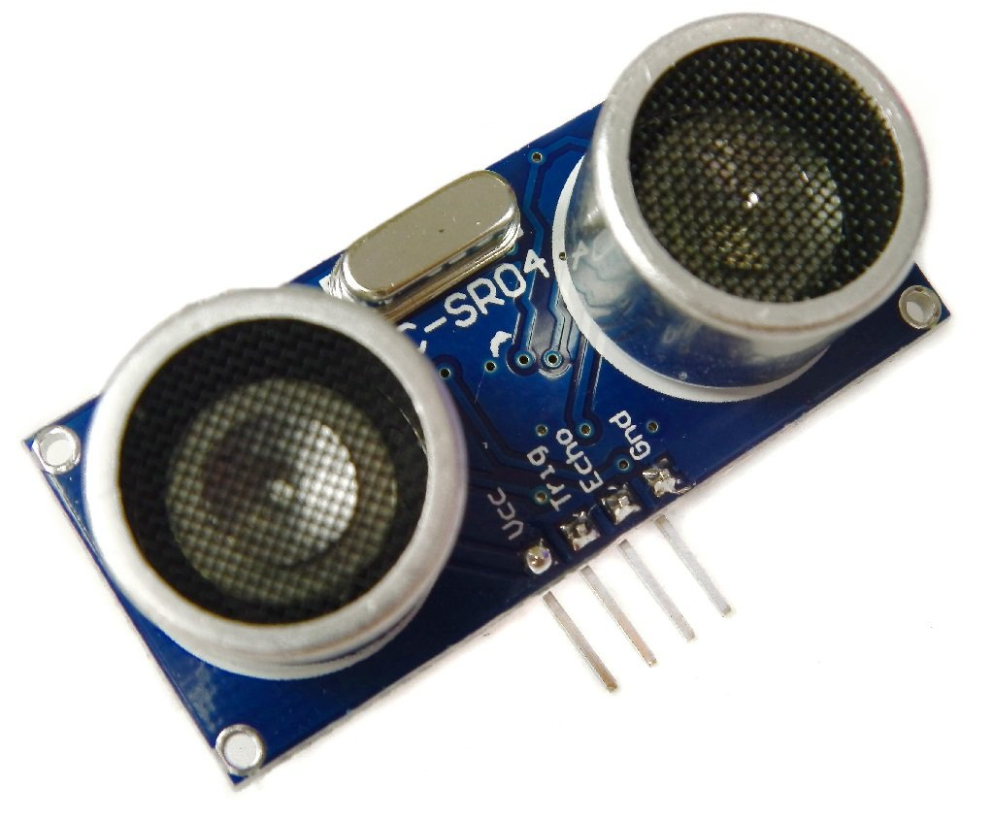
Electronic Devices
Ultrasound Sensors as Eyes
Data logging with interrupt
Raised by wave trigger

Slide 7
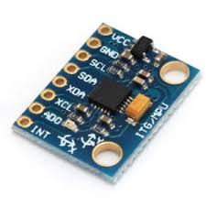
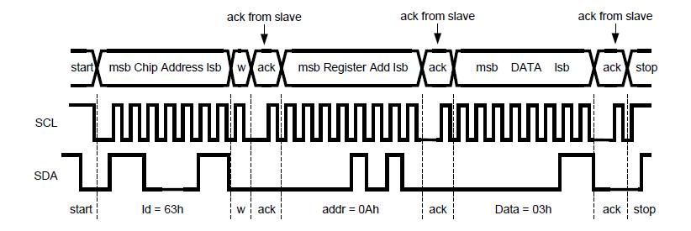
Electronic Devices
Gyroscope Sensor for the balance control
I2C interface with master

Slide 8
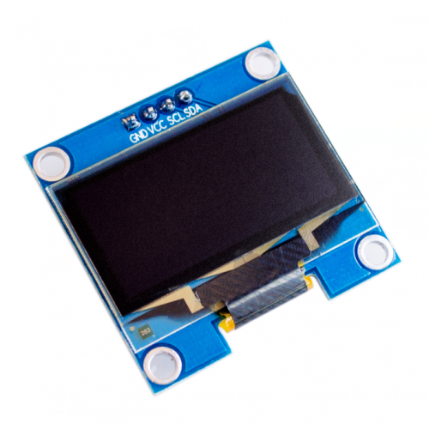
Electronic Devices
OLED, just a visual option
I2C interface with master

Slide 9
The assembly
Picture of robot

Slide 10

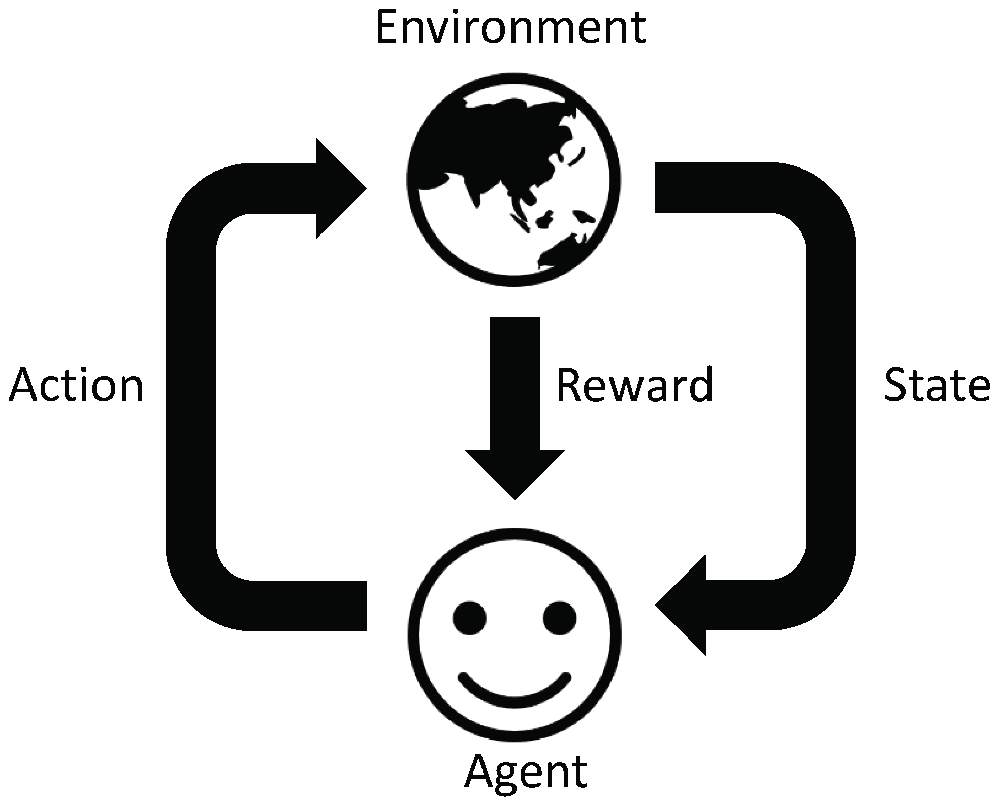

Algorithms
Genetic Algorithm
Reinforcement learning
Neural Network

Slide 11
Version I
Genetic Algorithm
Coding:
An individual in the population
Angles
Priority of steps
Angle of the balancer
Priority of the Balancer move

Slide 12
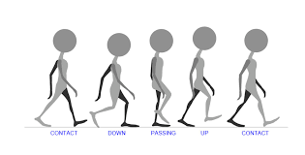
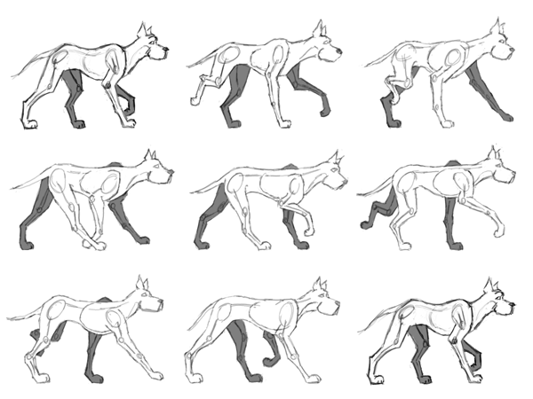
Fitness Function?!
What exactly is the walking ?
Walking Cycle for Human
Walking Cycle for animal

Slide 13
Fitness Function
For Cyclic motion detection
For Positive Move Detection

Slide 14
Fitness Function
Out put data
Out put data
DegX, DegY, DegZ
The values of these three angles must be Identical with their values in the beginning of the motion
Out put data
Out put data
Distance from the goal
I good cycle is the one which is not idle.

Slide 15

Thank you

