Slide 1
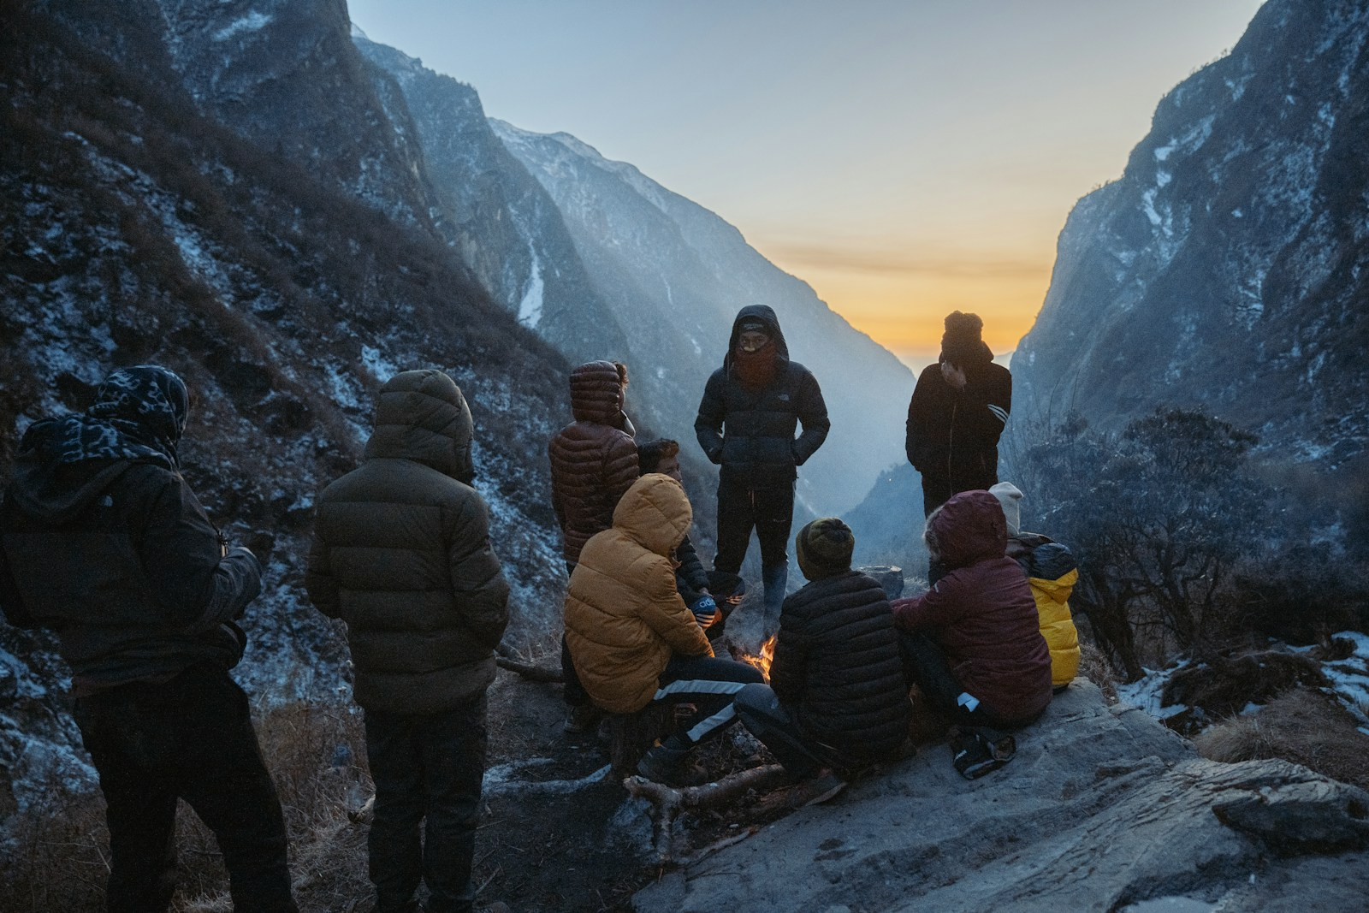

PRODUCT PRESENTATION / 2026
Real journeys.
Your way.
Discover real trips, plan together, and work with
travel agencies — all in one shared journey.
DISCOVER
PLAN
CONNECT

Slide 2
01 / THE PRODUCT
Travel planning is fragmented
The tools are separate. The journey isn’t.
BEFORE WAYTOWALK
WITH WAYTOWALK
“Which version
is latest?”
One shared trip
12 open tabs
Discovery, planning and proposals stay connected.
Where do we start?
Budget_v7.xlsx
AGENCY EMAIL
Estimated ≠ actual
Discover
Shape
Collaborate
Connect
A separate thread.
Another waiting game.
Who paid for what?
Everyone works from the same itinerary,
conversations, decisions and proposal.
Plans drift apart when every decision
lives somewhere else.
waytowalk
02 / 11

Slide 3
02 / THE SHARED LOOP
One platform. Two audiences. One shared trip.
Different starting points. A common place to make the journey real.
2
THE SHARED LOOP
01
02
03
04
Discover
Shape
Collaborate
Connect
audiences
1
Real trips, finished
plans and agency
profiles.
Join, clone, create
or generate a day-
by-day itinerary.
Invite people, decide
together and keep
one version of truth.
Share the plan, ask
for a proposal or
accept the right one.
shared trip
TRAVELLERS
AGENCIES
Explore • join • clone • create
Publish • respond • propose
One itinerary.
Many ways to begin.
waytowalk
03 / 11

Slide 4
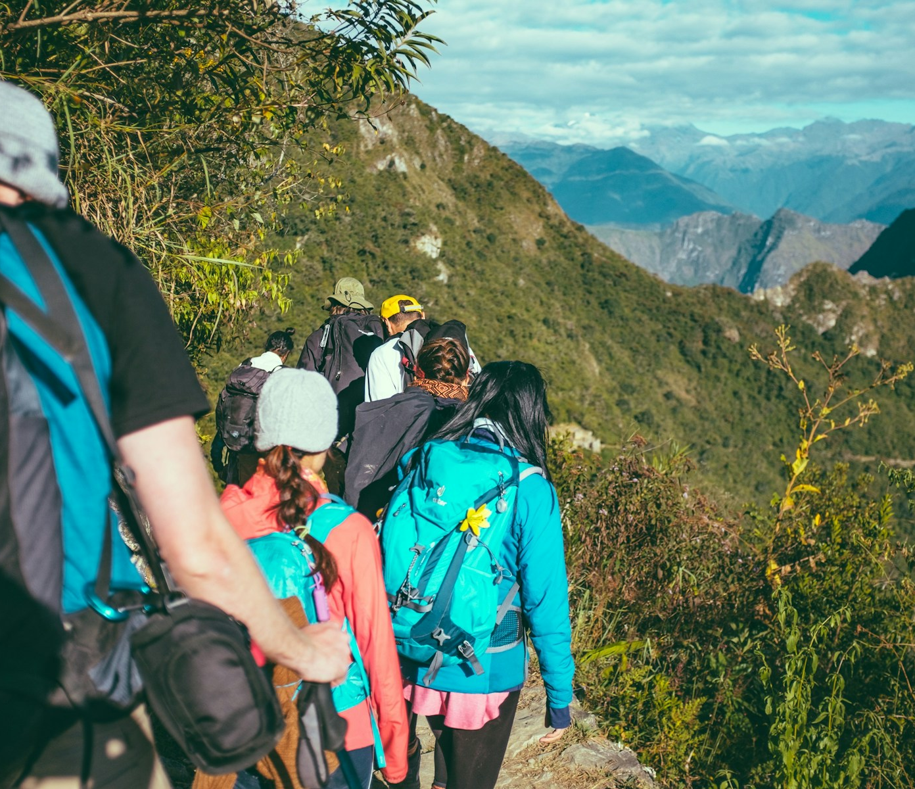
03 / FOR INDIVIDUALS
For individuals: start with possibility
Five ways in. One trip that becomes yours.
01 Join a live trip
See the plan, then send a request to join.
02 Find a travel agency
Discover profiles and packages; start an enquiry.
03 Create a trip for company
Travelling alone? Publish your trip so others can view it and ask to join.
04 Clone a published trip
Start with an existing itinerary, then make it your own.
05 Let AI remove the blank page
Find a trip. Find your people.
Use the six-step planner, then edit every day.
Join as a participant, or shape the journey as an owner.
waytowalk
04 / 11

Slide 5
04 / THE TRAVELLER WORKSPACE
A practical plan, not just an AI answer
The generated itinerary is a starting point. The workspace makes it usable.
Build and adapt
Plan together
Money and share
An itinerary you can keep changing.
Decisions stay with the trip.
From estimated cost to settled.
OWNER
EDITOR
VIEWER
BUDGET
ACTUAL
SETTLE
DAY 1
DAY 2
DAY 3
ONE SHARED TRIP
LINK
PDF
JSON
Day-by-day editing and drag-and-drop
Maps, distances and travel times
Custom routes and nearby places
Weather-aware alternatives
Invites, roles and comments
Polls and shared decisions
Encrypted group chat
Shared version history
Budgets and actual expenses
Group splitting and settlement
Receipts and currency conversion
Read-only links, PDF / print and JSON
waytowalk
05 / 11

Slide 6
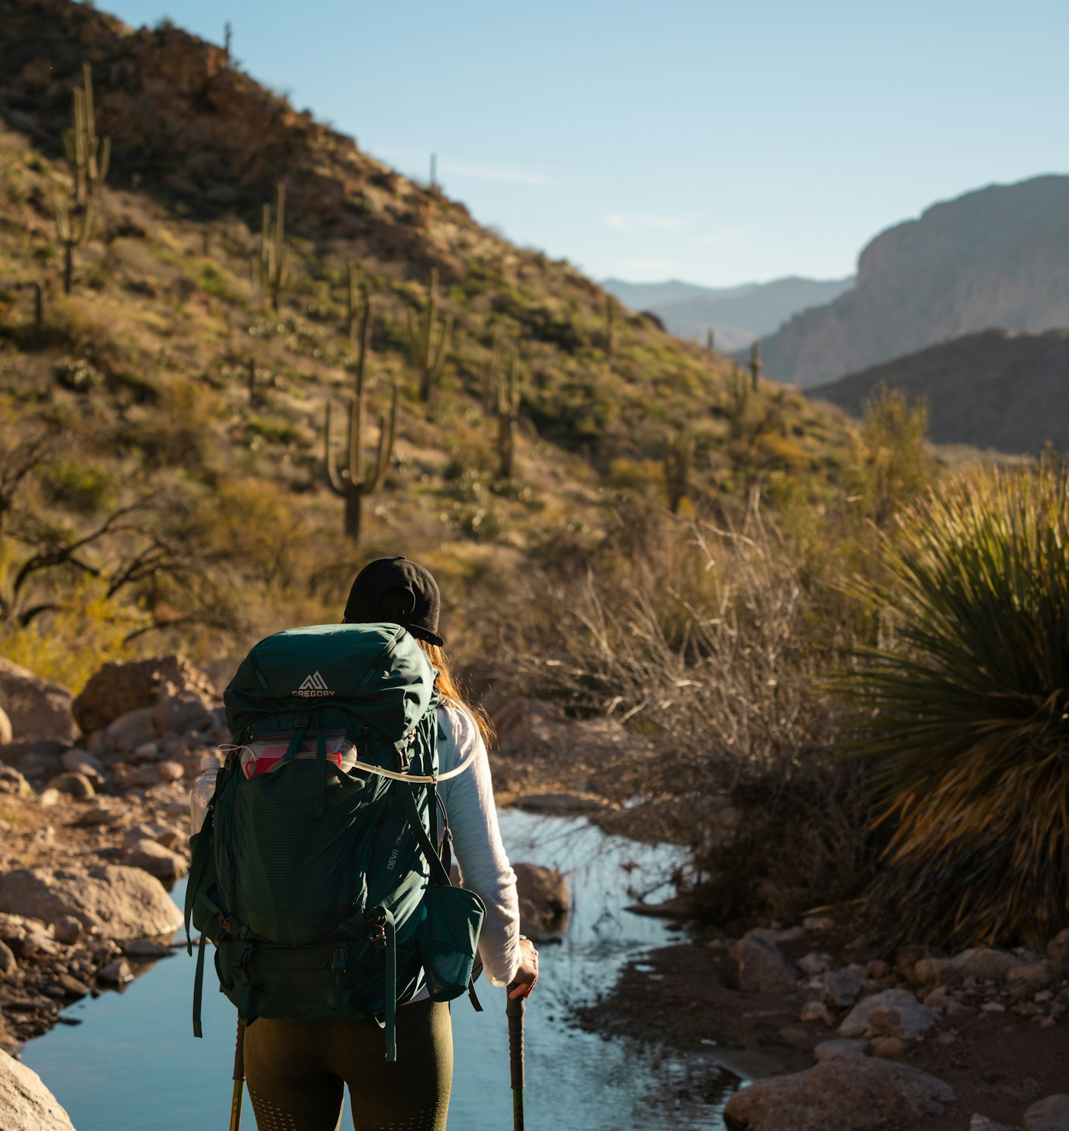
05 / THE INDIVIDUAL JOURNEY
Your way from
solo idea to
shared journey
Begin alone. Build the journey together.
01 Explore
Live trips, finished plans and agencies.
02 Join / clone / create
Choose the starting point that fits.
03 Personalise
Edit days, routes and details.
04 Invite / decide
Alone at the start.
Together by design.
Share roles, polls and expenses.
05 Share or go
Export the plan or accept the right proposal.
Publish a trip, invite companions, or bring in an agency.
waytowalk
06 / 11

Slide 7

06 / FOR AGENCIES
For agencies: one workspace from visibility to yes
Be discoverable. Respond with context. Send work that looks like your brand.
FROM FIRST SEARCH TO ACCEPTED PROPOSAL
Branded itineraries
Directory + packages
AI-assisted drafts, reusable assets and HTML / PDF templates.
A public profile and package cards that help travellers find you.
Leads + clients
Quotes + proposals
1
Enquiries, assignment, two-way threads and client records.
Versioned quotes, branded sharing and proposal acceptance.
workspace
Events + rosters
Team + oversight
Create, share and manage the work
without rebuilding it across tools.
Publish group trips and camps; collect interest and manage rosters.
Roles, export history, usage reporting and audit trails.
waytowalk
07 / 11

Slide 8
07 / THE AGENCY WORKFLOW
From enquiry to accepted proposal
A simple handoff, with the context kept intact.
01 / PUBLISH
02 / RECEIVE
03 / BUILD
04 / PROPOSE
05 / ACCEPT
Be discoverable
Assign the enquiry
Shape itinerary + quote
Send the branded proposal
Compare and say yes
List the agency and
publish package cards
that travellers can find.
Receive the enquiry
with its trip context;
assign a clear owner.
Use AI, reusable assets
and team input to build
the itinerary and quote.
Share a versioned,
branded proposal
through a signed link.
The traveller compares
options and accepts
the right proposal.
BUILT INTO THE HANDOFF
A confident yes
Two-way threads
Versioned quotes
Client-safe totals
Export history
Compare proposals without losing the
itinerary, conversation or version history.
waytowalk
08 / 11

Slide 9
08 / LIVE EVENTS
Publish more than packages
Turn group trips, camps and retreats into discoverable public events.
01 Create the event
Publish the route, dates, details and what
participants can expect.
Group trip
Camp
Retreat
GROUP TRIPS • CAMPS • RETREATS
02 Collect interest
03 Manage the roster
A public interest form brings potential
participants into one place.
Track capacity, prevent duplicate sign-ups
and organise the participant roster.
PUBLIC EVENT PAGE
INTEREST FORM
CAPACITY
DUPLICATES
ROSTER
waytowalk
09 / 11

Slide 10
09 / THE BENEFITS
Why it works for both sides
Less coordination for travellers. A clearer path to yes for agencies.
LESS
MORE
ONE
Less juggling
More clarity
One shared record
One place to discover, plan, decide,
track costs and share the journey.
One workspace for visibility, leads,
itineraries, proposals and events.
The itinerary, conversation, decisions
and versions stay connected.
FOR INDIVIDUALS
FOR AGENCIES
FOR EVERYONE
TRUST, WITH A CLEAR BOUNDARY
Roles, client-safe sharing and encrypted chat protect the work. waytowalk supports planning and proposals —
not booking inventory, payments, deposits or checkout.
waytowalk
10 / 11

Slide 11
Find your people.
Shape your route.
Share the journey.
Real journeys. Your way.
FOR TRAVELLERS
FOR AGENCIES
Explore. Join. Clone. Create.
Publish. Respond. Propose.
Start with possibility and shape a trip that fits.
Turn your expertise into a journey someone can say yes to.
DISCOVER • PLAN • CONNECT
11 / 11

