Slide 1
Inspection of the macroeconomic impact on firms’ healthcare

Slide 2
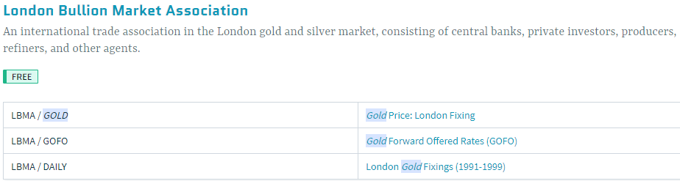
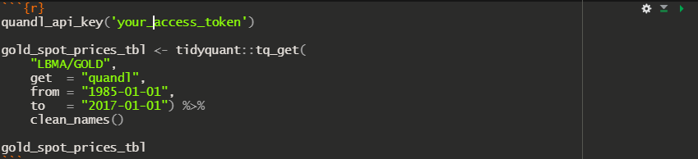
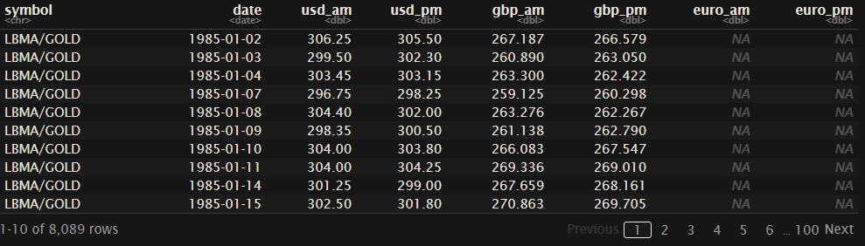
Quandl as source of data retrieval
Quandl
it!
Select timeseries
to retrieve
Dig up gold from
your client

Slide 3
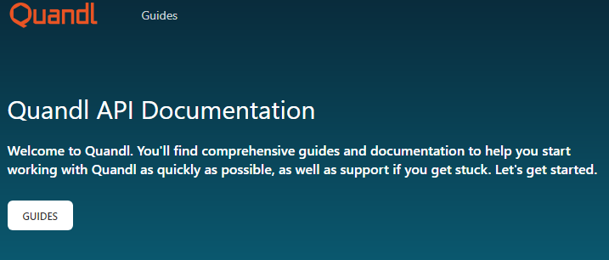
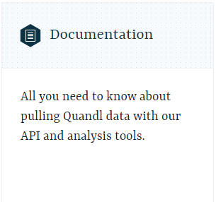
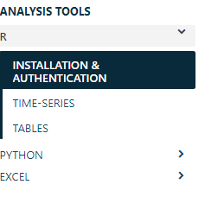
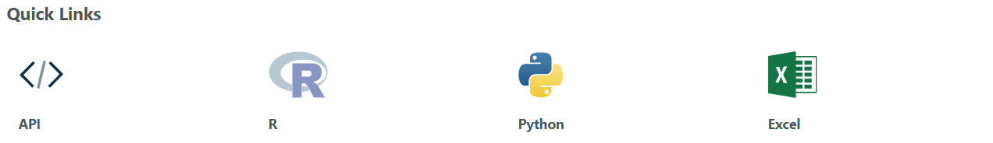

Set up R/python client
Check this hyper-link: Quandl docs
Data and calls limits for free subscribers! Check authentication window

Slide 4
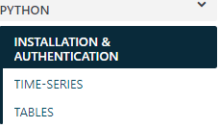


Set up R/python client
Check this hyper-link: Quandl docs
Data and calls limits for free subscribers! Check authentication window
quandl.ApiConfig.api_key = "YOURAPIKEY "
data = quandl.get(
“LBMA/GOLD",
start_date="2001-12-31",
end_date="2005-12-31“
)

Slide 5
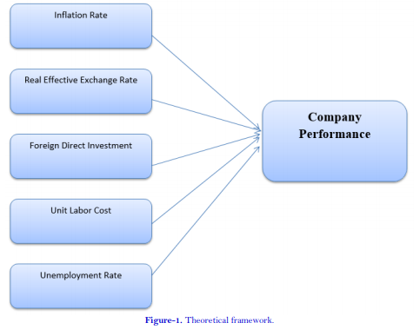
What features to start with?
Selection methods
In respect to a target? Which target? Do we need to engineer it from existing features?
Stepwise, best-subset selection, Lasso and Ridge regressions, tree based ML (most important are on the top) which best?
Selection votes?
keep in mind the target can be used to select features but can be dropped in later analysis
Consider some visualization to explore data
What defines a time series? (drift, volatility, band…)
Source: Effect of Macroeconomic Factors on Firms ROA: A Comparative Sectorial Analysis from Pakistan

Slide 6
Scope of the project
Define features to analyze (retrieve, engineer, and select)
Cluster analysis of current data
Predict future evolution (ARMA, LSTM, TBATS, NNAR, STL…)
Define window of prediction and how many models to vote for future evolution (probably if more than a model is used)
Interpret obtained clusters of evolution
A data visualization worth 1000 words: summary of interpretations into KPIs

Slide 7
Unleash the data scientist inside of you
Step on CRISP-DM footprint !
Strat investing time on business understanding
You don’t have to lose time on data cleaning as 80% of time, data is only collected from different eventual sources
Base your search on articles of impact (you can have web of science accounts via University of El Manar wireless network)
Report your work on chunks of commented codes in Markdowns ( use Rmarkdowns they’re super sweet how they communicate R and python)

Slide 8
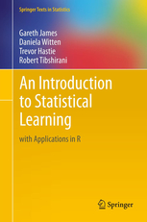
What references to consult?
Machine learning bible!
Don’t go deep into details as it may seem difficult
There are some R Labs that are associated to this book with video further explanations and they are free on GitHub

