Slide 1
Attention is all you need

Slide 2
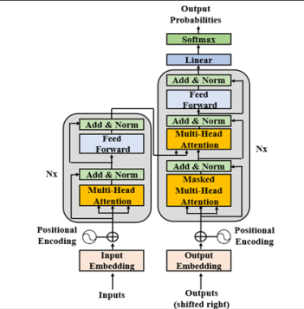
Architecture
Sub-
Layer 1
Sub-
Layer 2
Encoder
Decoder
Sub-
Layer 3
Sub-
Layer 4
Sub-
Layer 5
Sub-
Layer 6

Slide 3

Architecture

Slide 4
Input embedding
The black cat sat on the couch and the brown dog slept on the rug.
Input
The, black, cat, sat, on, the, couch, and, the, brown, dog, slept, on, the, rug, .
Tokenizer
Constraint dimension d=512
X =
The | black |  |  |  |  |  |  |  |  |  |  |  | rug | .
 | E1,2
 | E512, 2
Embed words

Slide 5

Architecture

Slide 6
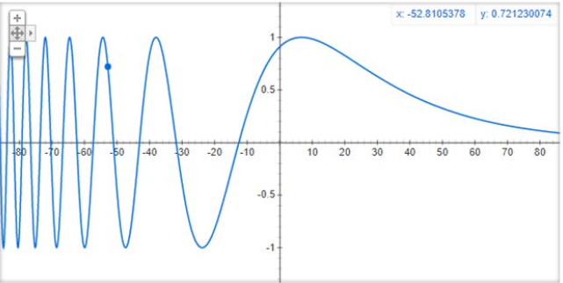
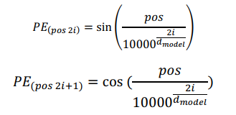
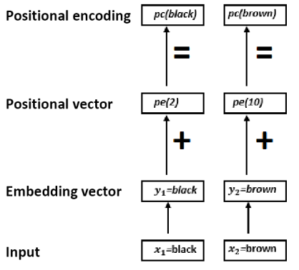
Embed position: unit sphere
black | brown
PE1,2
PE512,2
Embed position
PE =

Slide 7

Embed position
PE drops semantic embedding value → up weight semantic embeddings (* root(dimension of embeds))
Trust embeds for as compact information observed on embed’s vector dimensions… unless you fine tune it let’s see how further you can go in that!
Resultant embeds = Position embeds + Semantic embeds are vectors of 512 dimension (still under constraint)

Slide 8
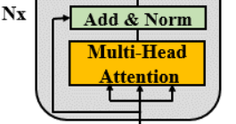
Architecture
8 attention heads
residual connection surrounds each main sub-layer to transport unprocessed information
512 dimensions learned on 8 segments
Parallelize computation
8 embeds’ heads

Slide 9
Attention mechanism
X = (X1, X2,…, Xn) where Xk of dim(512, 1)
Initialize Qw, Kw, Vw of dim(512, n)
Q = X.Qw
K = X.Kw
V = X.Vw
attention_scores = Q.tr(K)/root(512) # square matrix of dim(n, n)
attention_scores = softmax(attention_scores by row)
For each input k
attention_scores_kj = attention_scores[k, ]*V # square matrix of n by n
attention_scores_k = sum(attention_scores_kj[ , j] # vector 1 by n
attention_scores = concatinate(attention_scores_k)*W #trained W

Slide 10

Architecture
Post- layer normalization

Slide 11




Post-layer normalization
feedforward network : only forward propagation and no cylces within nodes
make sure critical information is not lost

Slide 12

Architecture

Slide 13
feedforward network
• The FFNs in the encoder and decoder are fully connected. • The FFN is a position-wise network. Each position is processed separately and in an identical way. • The FFN contains two layers and applies a ReLU activation function. • The input and output of the FFN layers is dmodel = 512, but the inner layer is larger with dff = 2048 • The FFN can be viewed as performing two kernel size 1 convolutions

Slide 14
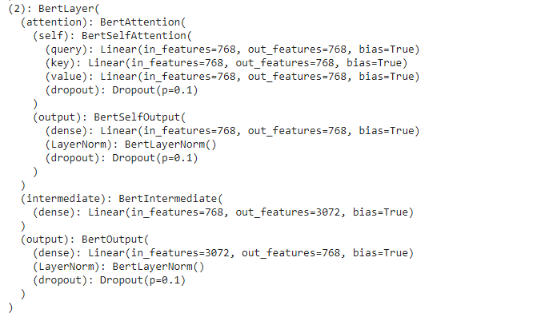
BERT architecture

Slide 15
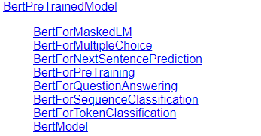
BERT pre-trained models

