Slide 1
Hitting the Wall
-
Writing your first 3 Selenium Tests

Slide 2




Ali Göktaş
– Software Test Engineer
: alig96
: alig06
: aligoktas

Slide 3

Why do we write test ?

Slide 4


Slide 5
Attention Please
Don’t repeat yourself
To stick to the scripts.
Should be idempotent

Slide 6
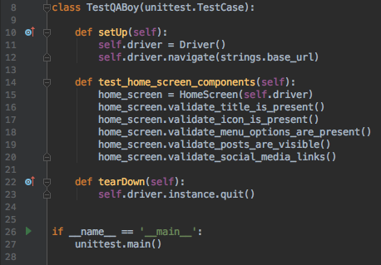
OOP

Slide 7
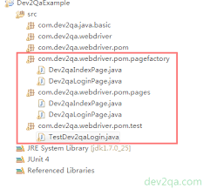
POM (Page Object Model)

Slide 8
For installation : https://selenium-python.readthedocs.io/installation.html
For learning :
https://selenium-python.readthedocs.io/getting-started.html
Source code :
https://github.com/alig06/pythonSaati86

Slide 9
LET’S WRITE TEST

