Slide 1

Lexical Analyzer

Slide 2
INTRODUCTION
Lexical analysis:
The first phase of a compiler.
It takes the modified source code from language preprocessors that are written in the form of sentences.
The lexical analyzer breaks these syntaxes into a series of tokens, by removing any whitespace or comments in the source code.

Slide 3
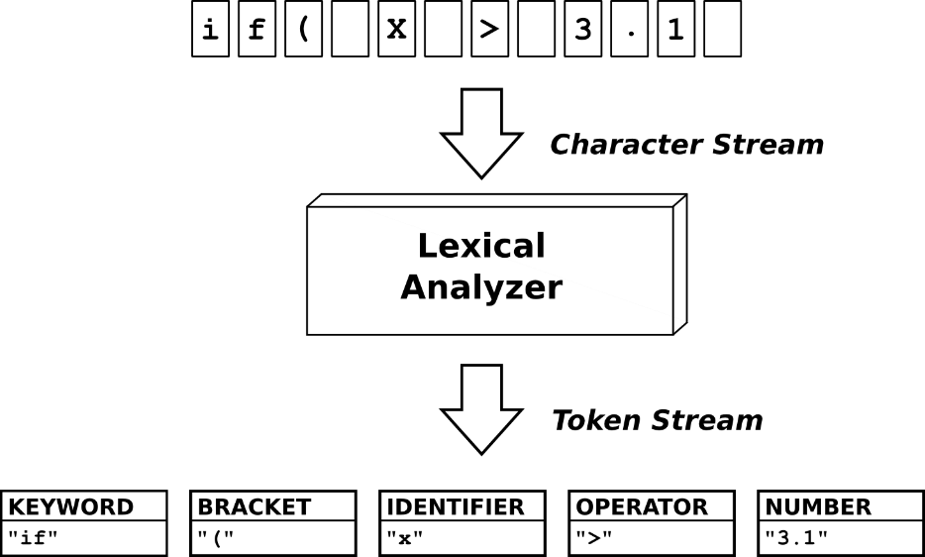
INTRODUCTION

Slide 4
INTRODUCTION
Token: A token is a group of characters having collective meaning: typically a word or punctuation mark, separated by a lexical analyzer and passed to a parser.
Example: “This is a dog”
Tokens: [“ “ “, “this”, “is”, “a”, ”dog”, “ “ “]
Types of tokens:
Keywords: Examples -> for, while, if etc.
Identifier: Examples -> Variable name, function name, etc.
Operators: Examples -> '+', '++', '-' etc.
Separators: Examples -> ',' ';' etc.

Slide 5


Construction
First we will read the input file.
We will import nltk library and re library which will help us in building the lexical analyzer.

Slide 6
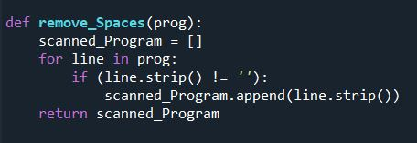
Construction
Then we will need to remove the white spaces in each line so we will make a remove_Spaces function.

Slide 7
Construction
After removing the white spaces we will need to remove two types of comments:
- Single comments -> //
- Multi comments -> /* */
For that we will make our remove_Comments function.
First we will use our imported re library which will make a regular expression to remove all the occurrences of the multi comments.

Slide 8
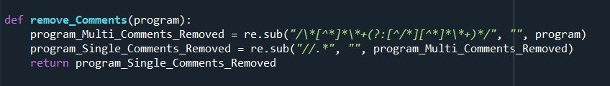
Construction
Second we will use our imported re library which will make a regular expression to remove all the occurrences of the single comments.
Remove_Comments function:

Slide 9
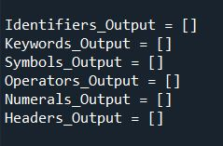
Construction
After that we are ready to store the tokens.
We will store six types of tokens:
- Identifiers
- Keywords
- Symbols
- Operators
- Numerals
- Headers
So we will create some lists to store them.

Slide 10


Construction
In order to check for them we must define them first as follows:
- RE_Keywords: contains all the occurrences of the keywords
- RE_Operators: contains all the occurrences of the operators
- RE_Numerals: contains all the occurrences of the numbers

Slide 11


Construction
- RE_Special_Characters: contains all the occurrences of the special characters
- RE_Identifiers: contains all the occurrences of the identifiers
- RE_Headers: contains all the occurrences of the headers

Slide 12
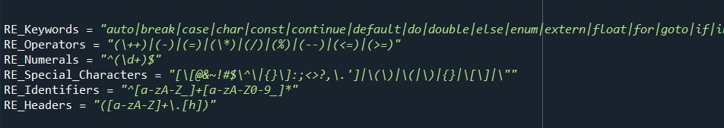
Construction

Slide 13
Construction
We will iterate our program and asks if the line starts with #include -> “header file”
so we will use word_tokenize otherwise we will use wordpunct_tokenize
So what is the difference between word_tokenize and wordpunct_tokenize ?
The answer is that word_tokenize is less accurate than wordpunct_tokenize so we will use it to detect the header files as it will not be able to detect “#” as a token.
After storing our program in tokens we will iterate it to check if it contains keyword or operators or identifiers or numerals or special symbols or headers.
After that we will print our tokens after classifying them and by that we succeeded in constructing the Lexical Analyzer

Slide 14
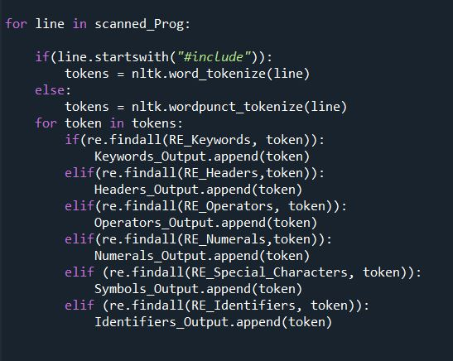
Construction

Slide 15
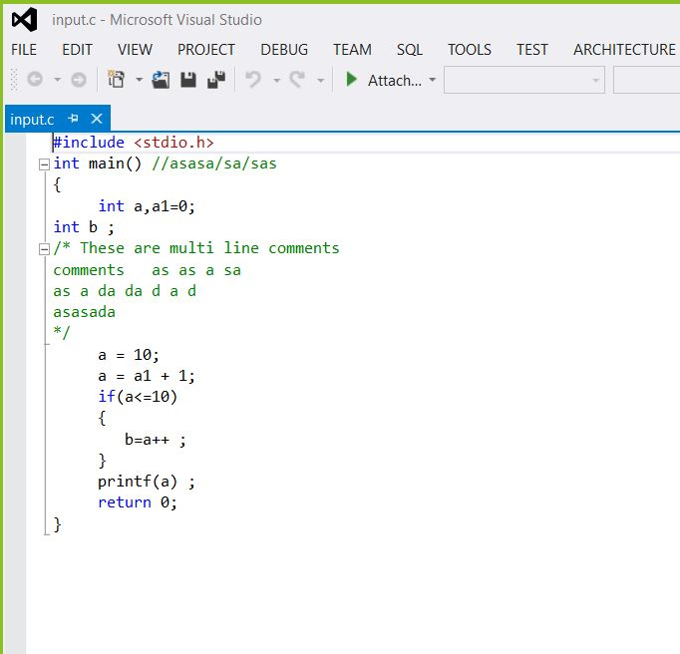
input

Slide 16
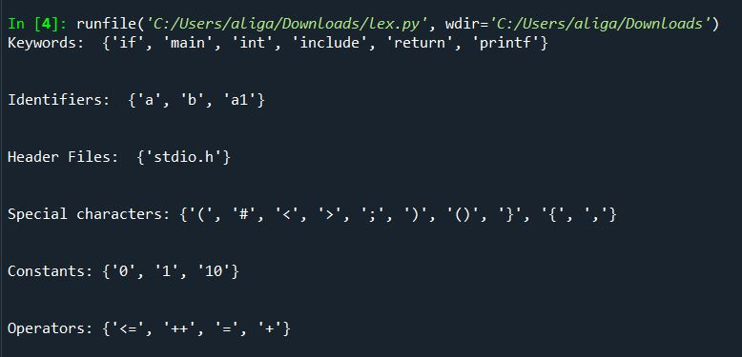
output

Slide 17
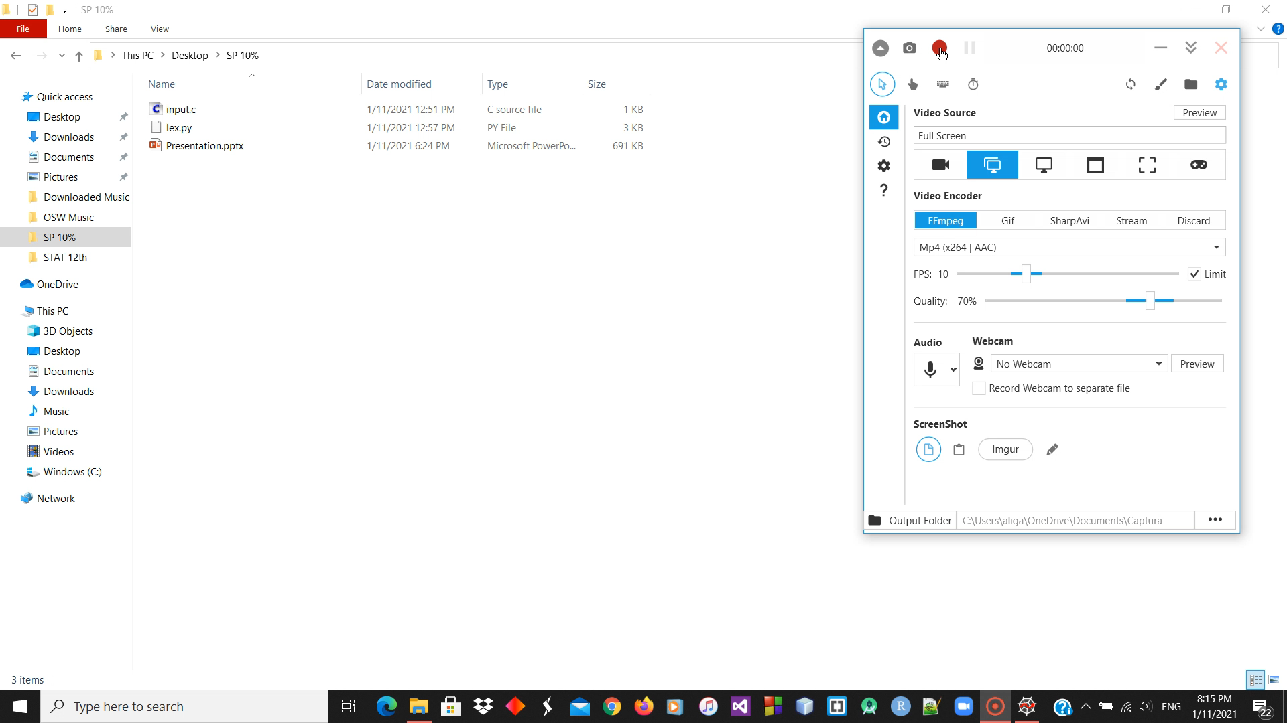
Livedemo

