Slide 1

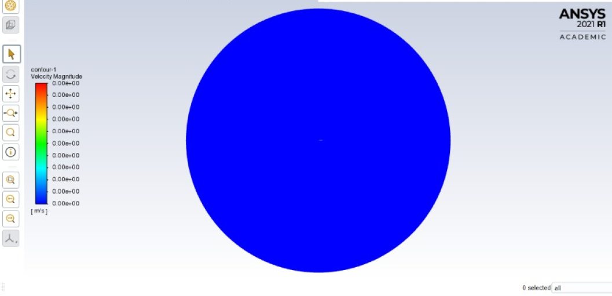
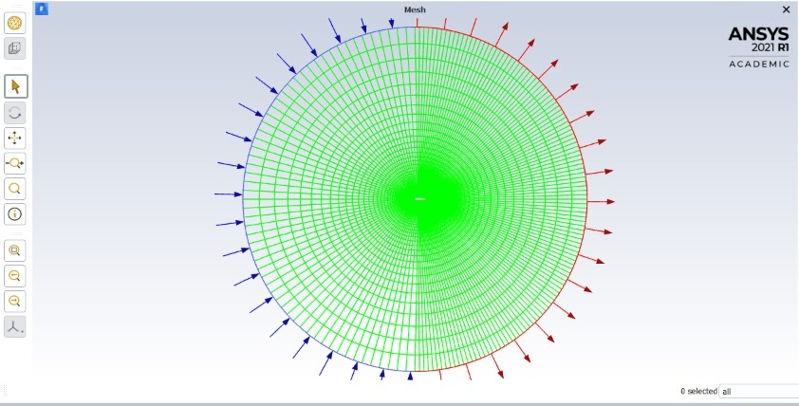
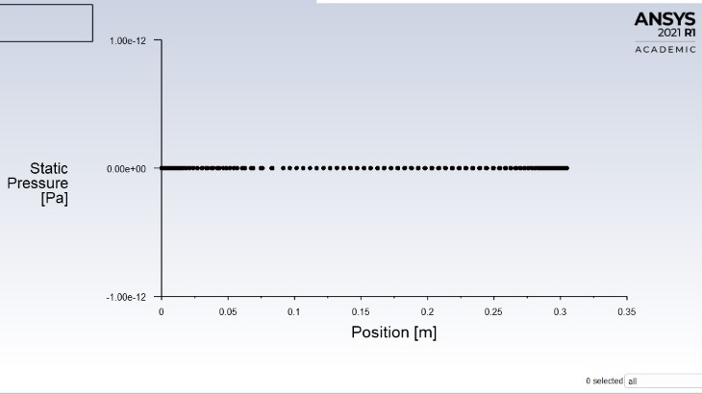
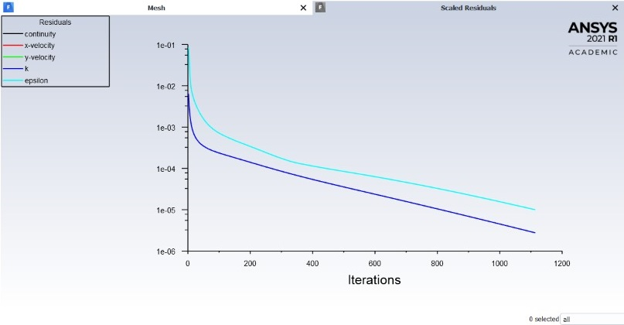
Fluid Mechanics
Project based Learning
Topic: Simulation of Turbulent Flow around an Airfoil
Introduction
Results
The Purpose of CFD Lab is to conduct parametric studies for turbulent flow around Clark-Y
airfoil following the “CFD process” by an interactive step-by-step approach. Students will have
“hands-on” experiences using ANSYS to investigate the effect of angle of attack and effect of
different turbulence models on the simulations results. These effects will be studied by
comparing simulation results with EFD data.
Objective
Results
In EFD lab you have conducted experimental study for turbulent airfoil
flow around a Clark-Y airfoil (Re»300,000). The data you have
measured were used for CFD PreLab 2. In CFD Lab 2, simulation will
be conducted under the same conditions of EFD Lab 3, except angle of
attack and turbulent models that will be changed in this lab.
The problem to be solved is turbulent flow around the Clark-Y airfoil with
angle of attack
Physics set up
Results
Select Double Precision and click OK.
Solution Setup > Models > Viscous –Laminar > Edit… Change the parameters as per below
and click OK.
3.Solution Setup > Boundary Conditions > inlet > Edit… Change parameters as per
experimental data (blue box) and default values (red boxes) and click OK. The experimental
value can be found from the EFD Lab 3 data reduction sheet case, you will select k-omega (2
eqn)).
4. Solution Setup > Boundary Conditions > Outlet > Edit… Change the parameters as
per below and click OK. (Use outlet B.C. for both k-ε and k-ω models)
5. Solution Setup > Reference Values. Change parameters as per below. The Velocity,
Temperature, Density, and Viscosity should be entered from EFD data.
6. Change parameters as per below for both k-ε and k-ω models.
Numerical solution
Results
Analysis of the air flow around the car without the spoilers and vortex generators
Analysis of the air flow around the car with a concept spoiler designs.
Effect of the aerodynamics on the car
Analysis with the variation of the aerodynamic components on the down force, drag and the stability of the car.
Estimating the CD (Coefficient of Drift) & CL (Coefficient of Lift) on a high speed run of the car.
Comparison of the CD and CL values with (variations in component designs) and without aerodynamic components.
Analysis of all the models on the CFD software ANSYS Fluent.
Drawing out the possible outcomes comparing the results & establishing the relation of using aerodynamic components(spoilers and vortex gen.) for better performance, reduced lift and drag.
Dept. Of Mechanical Eng., Galgotias University
Team Member Instructor
1.SAURAV KUMAR 3. Shuvam Chowdhury 5.Sandip prasad Yadav Mr. Faisal Shameem
2 .SHAGUN MISHRA 4. HARIDWAR NARAYAN PRATAP SINGH

