Slide 1

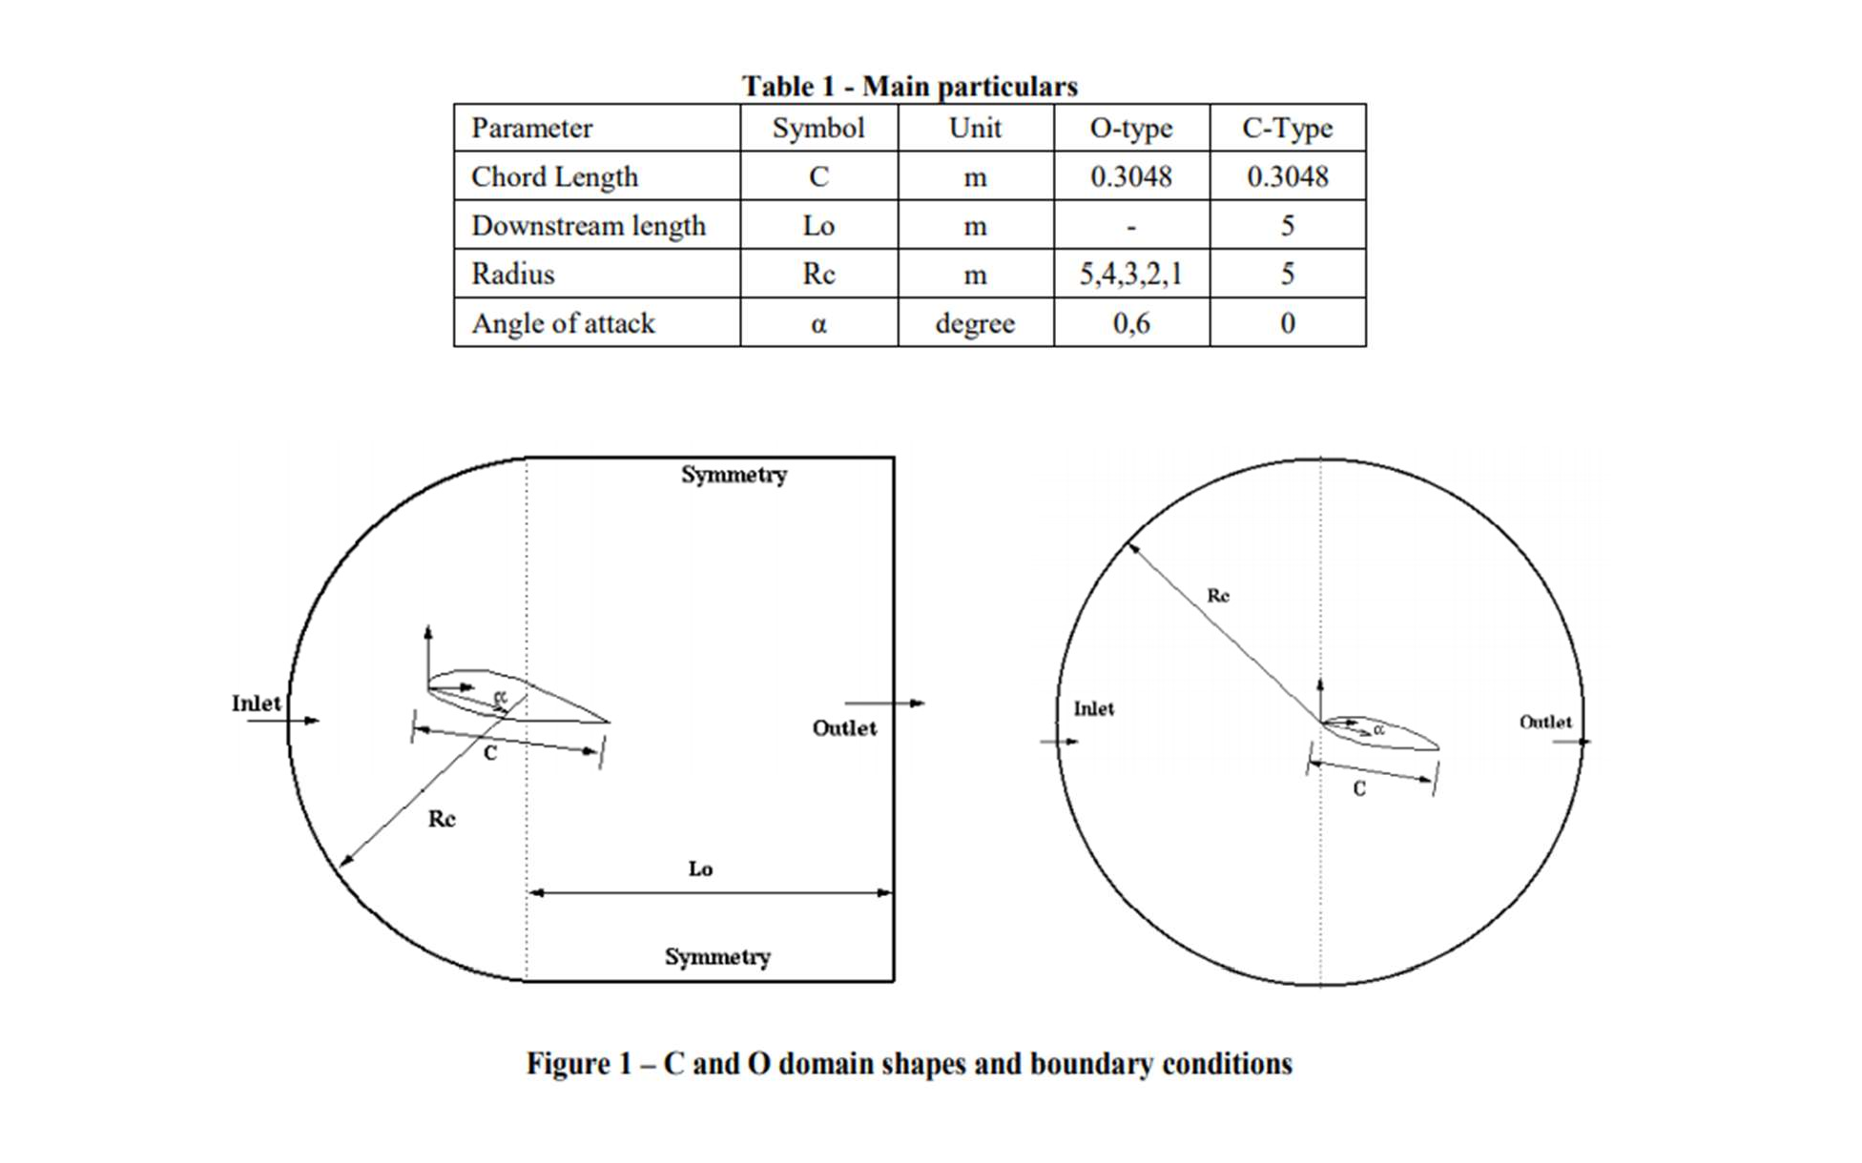
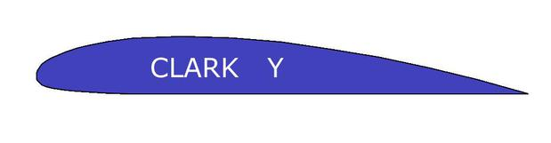
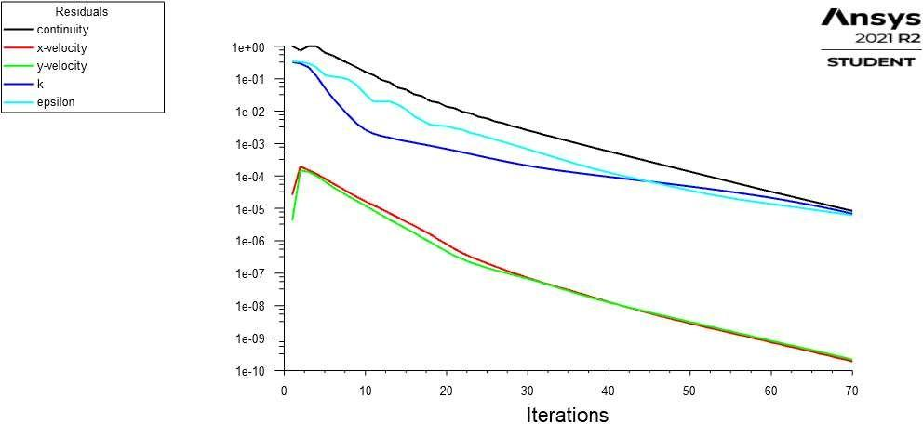
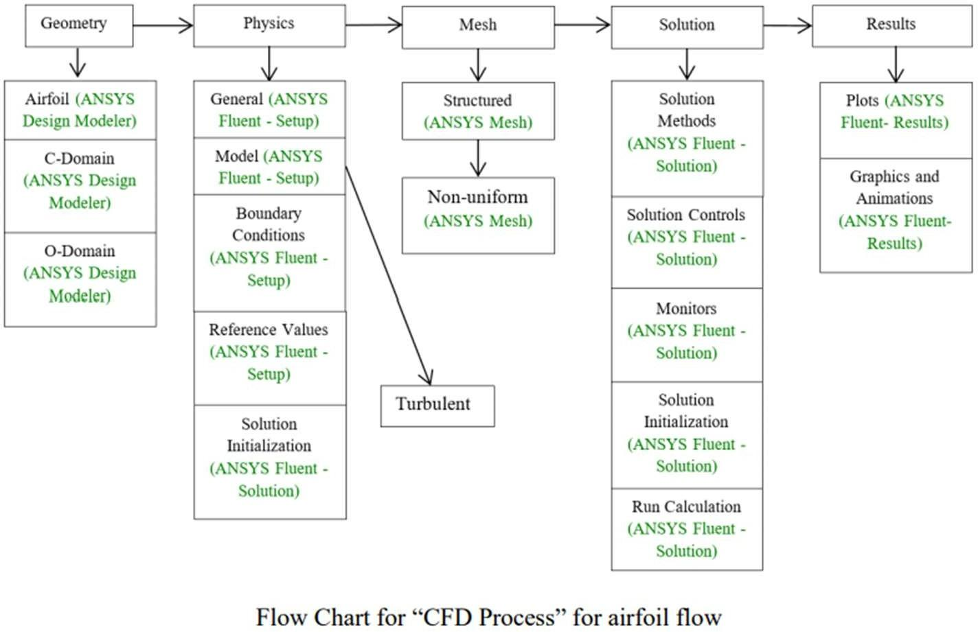
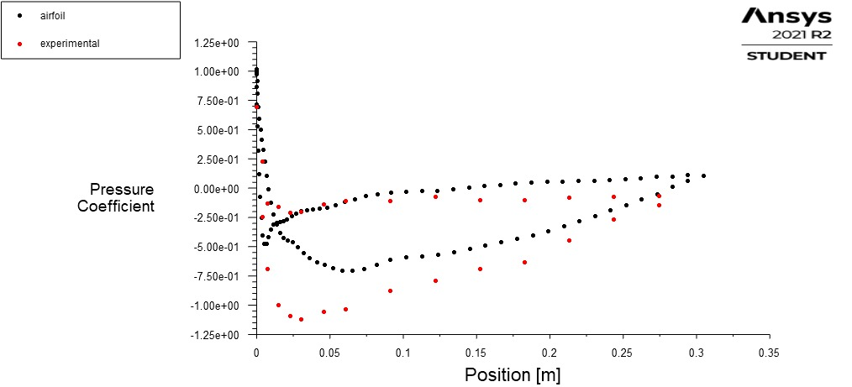
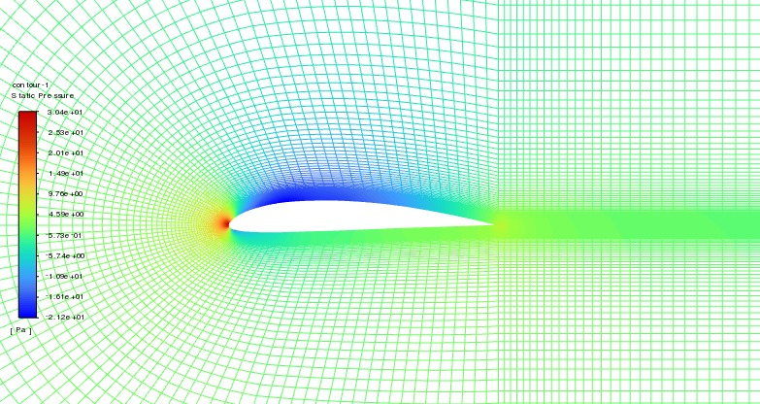
Computational Fluid Dynamics
Project based Learning
Topic: Verification and Validation of Turbulent Flow around a Clark-Y Airfoil
Introduction
Results
Clark Y is the name of a particular airfoil profile, widely used in general purpose aircraft designs, and much studied in aerodynamics over the years. The profile was designed in 1922 by Virginius E. Clark.
For many applications the Clark Y has been an adequate airfoil section, it gives reasonable overall performance in respect of its lift-to-drag ratio. The Clark Y has found favour for the construction of model aircraft, The Clark Y is appealing for its near-flat lower surface, which aids in the construction of wings on plans mounted on a flat construction board.
Fig. Clark Y Airfoil
Fig. Final Setup of car with Rear Spoiler and Vg
Objective
Results
The Purpose of this project is to simulate turbulent airfoil flows following “CFD process” by an interactive step-by-step approach and to conduct verifications. using ANSYS to conduct verification for lift coefficient and pressure coefficient distributions, and validation for pressure coefficient distribution, including effect of numerical scheme.
Fig. Residual Plots for an Airfoil
Results
Fig. Pressure Coefficient on Airfoil Surface
Simulation Design
The problem to be solved is that of turbulent flows around a Clark-Y airfoil. Reynolds number is 143,000 based on the inlet velocity and airfoil chord length. The figure 1 show the illustrations for C type and O type domains (Note: the figures are not in the exact scale as the true size of the domain and airfoil).
Boundary conditions for C type of mesh will be “inlet”, “outlet”, “symmetry” and “airfoil”, as described later. Boundary conditions for O type of meshes will be “inlet”, “outlet”, and “airfoil”. Uniform flow was specified at inlet. For outlet, zero gradients are fixed for all velocities and pressure is constant. No- slip boundary condition will be used on the “airfoil”. Symmetric boundary condition will be applied on the “symmetry”.
Results
Fig. Pressure contour across Airfoil
Dept. of Mechanical Engg., Galgotias University
Submitted by- Instructor
Mohd. Umar Mr. Faisal Shameem

