Slide 1


Nest.JS
Winter - 2022
Mostafavi
06 – Other building blocks

Slide 2
Course Structure
Binding Techniques
Catch Exception with Filters
Protect Routes with Guards
Using Metadata to Build Generic Guards or Interceptors
Add Pointcuts with Interceptors
Handling Timeouts with Interceptors
Creating Custom Pipes

Slide 3
Nest the GREAT
Nest has many building blocks that help us to maintain our application easily.
In nest.js we have more building blocks:
Exception filters
Responsible for handling and processing unhandled exceptions that might occur in our application.
Pipes
Transformation: transform input data to the desired output
Validation: evaluating input data and if valid, let it pass through pip unchanged, but if not valid throw and exception

Slide 4
Nest the GREAT
Guards
Determine that a given request meets a certain condition like authentication, authorization, role, … and if the conditions are met the request allowed to access the route.
Interceptors
Bind extra logic before or after method execution
Transform the results returned from a method
Extend basic method behavior
Completely override a method depending on specific condition
For example, Handling caching responses
Notes:
For interceptors, take a look at the https://en.wikipedia.org/wiki/Aspect-oriented_programming

Slide 5
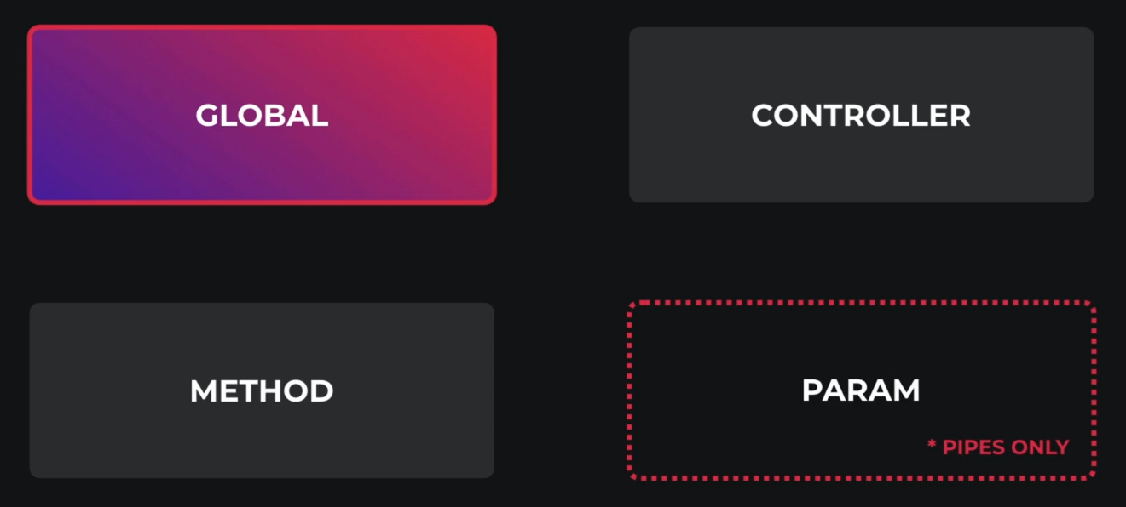
Binding techniques
You can add earlier building blocks on top of these scopes:

Slide 6
Binding techniques
Remember, each one does not override another
For example:
If you have a globally scoped pipe, it will apply as well as many other you might add on another scopes, whether: controller, methos, …

Slide 7
How to define each one?
Globally scoped:
Inside main.ts through:
app.useGlobalPipes
app.useGlobalFilters
app.useGlobalGuards
app.useGlobalInterceptors
Limitation: We can’t inject dependencies in main.ts
Directly inside the nest Module:
Then DI container will handle instantiation
Using global provider tokens (exported from nest core package) inside AppModule:
APP_PIPE, APP_GUARD, APP_FILTER, APP_INTERCEPTOR
It’s up to you where to provide them, but no matter, they are global for all modules
https://docs.nestjs.com/pipes#global-scoped-pipes

Slide 8
How to define each one?
Controller scoped:
Using decorator for controller, they accepts single class, or comma separated list of classes:
@UsePipes, @UseGuards, @UseInterceptors, @UseFilters
Method scoped:
Use previous decorators for your controller methods
Param scoped:
One specific parameter:
Pass the class to the Body

Slide 9
New requirement
Log every exception in database and return inserted id

Slide 10
Demo
Catch exception filters:
Built-in exception handler layer to process and handles all unhandled exceptions
When an exception not handled by our application, it automatically caught by this layer
Suppose we want to return exception message schema in different way
nest g filter <path-to-your-class>
@Catch decorator binds required metadata to the exception filter
We can pass all the exception types we want to handle to this decorator (in comma separated format)

Slide 11
Demo
Catch exception filters:
How to get response object?
Through host argument
host.switchToHttp()
This will give us the context, and then getResponse
You can implements error monitoring easily with this filter (like using sentry.io)

Slide 12
New requirement
We have to monetize our application
For public APIs, Accepts requests, otherwise only accept requests that has some specific api-key
API-keys are stored inside database

Slide 13
Demo
Protect routes with guards
If request meets some condition like authorization, authentication, acls, … it will be allowed to access the route, otherwise denied and error will be thrown
Authentication:
Extract some token from request and check access
There are many strategies
We will discuss it more in depth in Internship sessions
Create guard:
nest g guard <path-to-your-class>
canActivate: allowed or not? As simple as you see ☺
What is the status? It’s obvious ☺ 403 (forbidden resource)

Slide 14
Demo
How to specify whether a route is public or not?
There it comes metadata
@SetMetadata(key, value)
How to reuse code
Thanks to decorators we can specify custom decorator for ourselves
Anonymous functions is our solution to achieve custom decorators
Hot to access metadata in our guard?
There the helper class, named reflector, comes
This class are provided by the nest core package
Remember, if you use other dependency like reflector, then you have to use providers (APP_GUARD) to follow injection rules

Slide 15
New requirement
Wrap all responses inside an object with a filed called data.
Also add a timeout for all requests (make it configurable for me)

Slide 16
Demo
Benefits of interceptors:
Bind extra logics before or after method execution
Transform the result returned from a method
Transform the exceptions throwed from a method
Extend basic method behavior
Completely override a method depending on specific condition (caching)
How to create interceptor
nest g interceptor <path-to-your-class>
You should implement intercept method

Slide 17
Demo
We say that we can access before and after request, where are them?
Before: previous to return
After: You can pipe to the observable returned from the nest.handle() function
How to add multiple interceptor
Arrays are your friend man ☺

Slide 18
New requirement
Remove all commas from prices and then pass it to the service

Slide 19
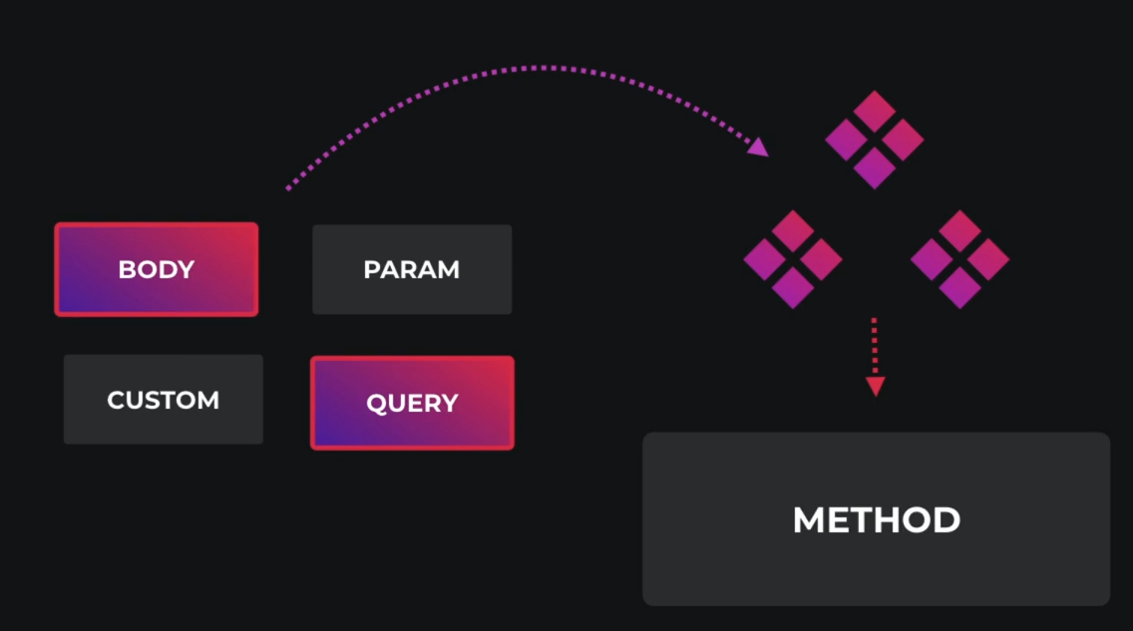
Demo
Benefit of pipes:
They have two typical use cases:
Transformation: transform input data to the desired output,
Validation: evaluate input data, if valid pass it, otherwise throw an exception

Slide 20
Demo
How to create a pipe:
nest g pipe <path-to-your-class>
You should implement transform method
Input1: value
Input2: metadata, is the metadata of the currently processed argument
What you return is override the value ☺ as simple as you see

Slide 21
Exercise
Required:
Exercise all we speak
Notes:
Hint: loggerService better to be transient
☺ For you (The seeker is the finder):
https://www.brunnerliv.io/articles/advanced-nestjs-dymaic-providers

