Slide 1


Nest.JS
Winter - 2022
Mostafavi
09 – Authentication

Slide 2
Course Structure
Authentication
How to save our use credentials in db?
Introduce passport
Session vs Token?
Local strategy
Auth Guard

Slide 3
User Entity
Username
Password
Passwords are stored in database in a way that no one can find them
There it comes hash functions
Md5
Sha256
Bcrypt

Slide 4
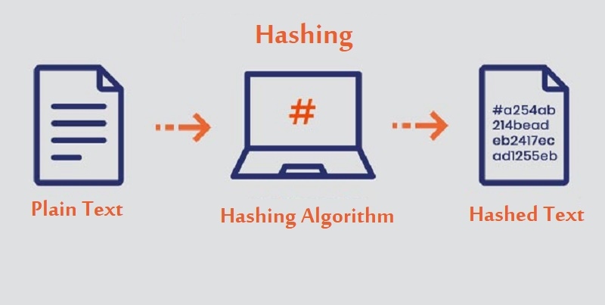
What is a hash function?

Slide 5
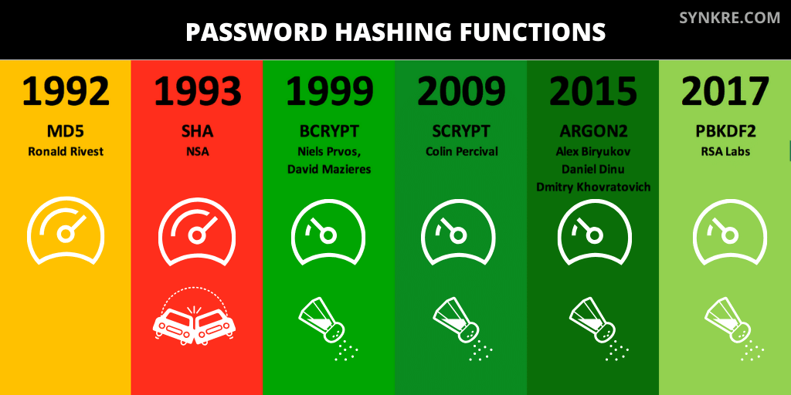
Algorithms

Slide 6
bcrypt
npm install bcrypt
import { hashSync, compare } from 'bcrypt';
export function hashPassword(password: string) {
const hashSaltRounds = 10;
return hashSync(password, hashSaltRounds);
}
export function comparePassword(password: string, hashPassword: string) {
return compare(password, hashPassword)
}
Notes:
https://virgool.io/Software/bcrypt-sjj46uhqjx88

Slide 7
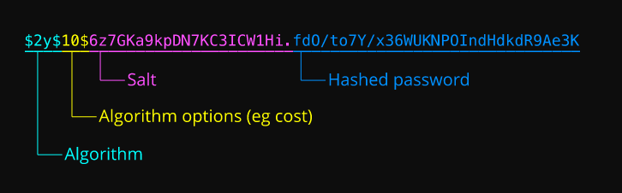
bcrypt
Notes:
https://en.wikipedia.org/wiki/Bcrypt

Slide 8
What is passport?
https://Passportjs.org
Passport gives you the basic layer, and you can implement your own strategy
Nest.js creates its own authentication strategy that wraps this packages

Slide 9
Demo
Install it:
npm install @nestjs/passport passport
Strategies:
Very simple strategy
npm install passport-local
npm install --save-dev @types/passport-local

Slide 10
Demo
Create an auth module for our authentication purposes
Auth service:
It will inject User Service
validateUser()
If user exists and password correct?
Find use by username
Check if the given password matches the real one in db (don’t forget to hash it)
If user validated return it
DON’T FORGET to remove password field!
@exclude() is your friend in these situations

Slide 11
Demo
Next step, create our first strategy, local strategy
Extends PassportStrategy(Strategy)
The one that exists in passport-local package (you installed it before)
Each strategy has two main thing:
Configuration (through super method in constructor)
Validate (if user validated or not, using our authService which has been injected)
This method should return user
Remember to throw UnauthorizedException if user does not exist
This validate method will map to the Verify callback in passport
Remember: this function input data may vary from strategy to another strategy, for local strategy, inputs are: username and password
NOTE: It is important to PassportModule and provide LocalStrategy

Slide 12
Demo
How to use this newly created guard?
@UseGuard(AuthGuard(‘local’))
Like old times ☺ passport.authenticate(‘local’)
Once the use validated, then the request object has a new object called: user
return req.user;
Don’t forget to pass the { username, password } body

Slide 13
Exercise
Required:
Exercise all we speak
Notes:
Hint: loggerService better to be transient
☺ For you (The seeker is the finder):
https://www.brunnerliv.io/articles/advanced-nestjs-dymaic-providers

