Slide 1


Nodejs Basics
Autumn – 2021
Mostafavi
06 – Express advanced topics

Slide 2
Course Structure
What is Node.js?
Node.js built-in modules
NPM
Asynchronous js
Built RESTFUL API using Node.js, Express & Javascript
Typescript
Build a RESTful API with Node.js, Express & TypeScript
Express – advanced topics:
Middlewares, Environments, Configuration, Debugging, Template engines, Structuring folders,

Slide 3
Demo – missing from last session
Type assertions:
let message = ‘abc’;
message.{we receive all the related functions}
Sometimes typescript is confused about type of a variable:
let message;
message = ‘abc’
In this case we have to explicitly tell the typescript that my type is:
(<string>message).{we receive all the related functions}
(message as string).{we receive all the related functions}
Remember, type assertion does not convert your type ☺

Slide 4
Using other user packages with ts
Some packages has type definitions inside their package
Like got
And some don’t
Like express
npm install @types/express
So don’t forget to bring packages types.
Question:
How to publish our types?
Set the "declaration": true inside tsconfig.json
tsc --declaration index.ts

Slide 5
Bootstrap express typescript
npm init --yes
tsc –init
rootDir
outDir
Install dependencies
npm install express joi
npm install -D @types/express

Slide 6
Demo
Convert last express to typescript

Slide 7
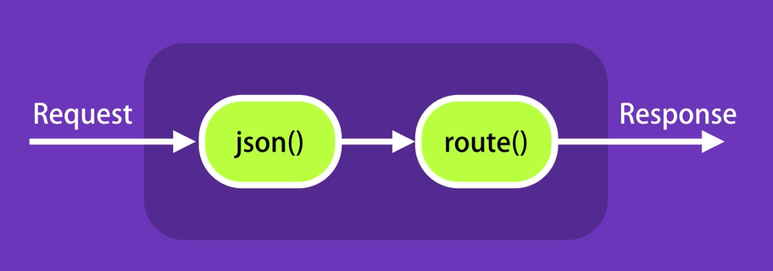
Demo
Middlewares
A function that takes a request object and return a response object to client, or passes the control to another middleware function.
Route handler is a function too
app.use(express.json())

Slide 8
Demo
Custom middleware
Do some logging, …
function(req, res, next) { console.log(‘Logging …’); next(); }
What happened if we don’t call next()?
Oh, we have modules, so make Middlewares in separate modules.
app.use(logger());

Slide 9
Demo
Built-in middleware
app.use(express.json());
app.use(express.urlencoded());
It parses url with url encoded, key=value&key=value,
We don’t use this approach, we use body as form-data
app.use(express.static(‘public’));
Don’t forget to create public folder

Slide 10
Demo
Third-party middlewares
Note: every middleware impact your program. Use in case you really need it.
helmet for security
morgan for logging html requests
Formats, we use tiny.
npm install -D @types/morgan
Notes:
https://www.securecoding.com/blog/using-helmetjs/

Slide 11
Demo
Environments
Development
Like when We want to log only in development environment
Production
Standard: NODE_ENV
process.env.NODE_ENV // It return undefined by default
app.get(‘env’) // It return development by default

Slide 12
Demo
Debugging
console.log is our friend
But not all the time, it is tedious
Debug package
Level of debugging
npm install debug
const startupDebugger = require(‘debug’)(‘app:statup’)
Don’t forget to assign env
export DEBUG=app:startup
export DEBUG=app:startup,app:db
Export DEBUG=app:*

Slide 13
Demo
Configuration
npm install dotenv
For reading .env file
Create a config folder
.env.sample

Slide 14
Demo
Template engines
Json is not all the world ☺
Popular:
pug
mustache
EJS
app.set(‘view engine’, ‘pug’);
app.set(‘views’, ‘./views’); //default is ./views
Create a new folder: views
res.render(‘index’, { //parameters });

Slide 15
Demo
Structure folders, make it more maintainable
For every logical endpoints create a separate file inside routes folder
When you separate routes, you have to use Router
export router;
Require it and then:
app.use(‘/api/books’, books);
Don’t forget to remove all the /api/books from your file.
Use middleware folder also for your custom middlewares

Slide 16
Exercise
Required:
Convert you express js project to a typescript project
Use Middlewares, Environments, Configuration, Debugging, Template engines, Structuring folders.
Optional:
Convert your recent Divar project to typescript ☺
And structure your folder to make it more maintainable.

